Slide 1
Distributed File System – Traditional File System
B. Ramamurthy

Slide 2
Our Plan
Traditional File System
Distributed File System
Decentralized File System

Slide 3
Traditional File System
This is the one you use everyday on your.
Usually file systems are operating systems dependent. We will use Unix file system as our example.
Lets begin our discussion with this.

Slide 4
Introduction
File system is the most visible aspect of an operating system. It provides the mechanism for on-line storage of and access to programs and data. It provides the persistent storage capability to a system.
File systems consists of a collection of files, a directory structure, access methods, secondary storage management and partitions (which separate logical and physical collection of directories.)

Slide 5
Topics for Discussion
File Attributes
File operations and structures
File Management
File Organization
File Directories
Directory Structure
Unix file system

Slide 6
File Attributes
Name: Symbolic reference for identifying the file object.
Type: Information that indicates the contents of the file.
Location: This information is a pointer a device and to the location of the file on that device.
Size : The current size of the file (in bytes, words, or blocks).
Protection: Access control information (RWX)
Time, date and user identification: This information may be kept for (1) creation, (2) last modification and (3) last use. Useful for protection, security and usage monitoring.

Slide 7
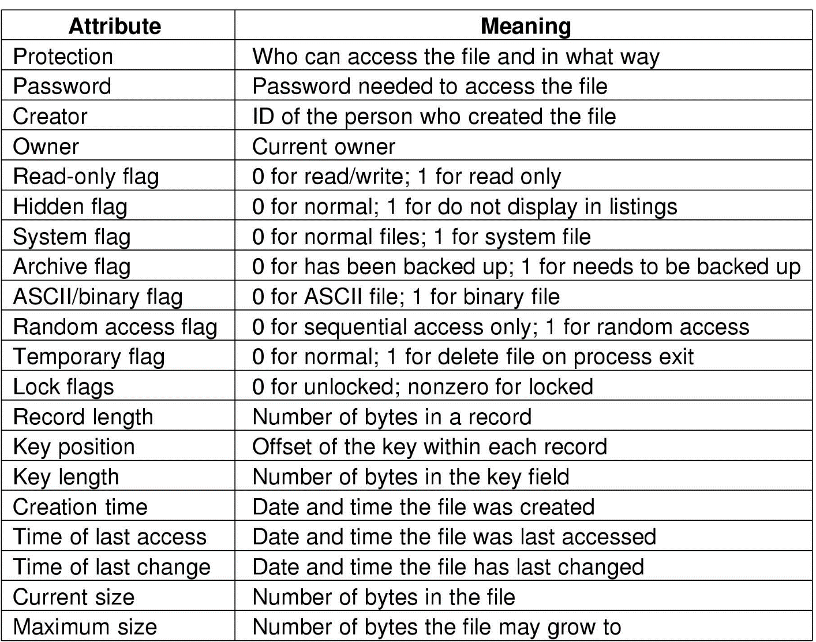
File Attributes
Possible file attributes

Slide 8
File Operations and structures
A file is an abstract data type.
Operations: open, close, create, destroy, copy, rename, list, read, write, update, insert item, delete item, size,...
Open file table: Table containing information about open files. When a file operation is requested, an index into this table is used for locating the file. When a file is closed the entry is removed from the table.
Current file pointer: Last read/write location is kept as a current-file-position pointer. Each process using the file has a unique pointer. Where is it kept?
File open count: Number of opens done on a given file. To allow deletion from Open file table, once the count reaches 0.

Slide 9
File Operations
Create
Delete
Open
Close
Read
Write
Append
Seek
Get attributes
Set Attributes
Rename

Slide 10
An Example Program Using File System Calls (1/2)

Slide 11
An Example Program Using File System Calls (2/2)

Slide 12
File management
Users and application programs interact with file system by means of commands for performing operations on files.
These commands are translated into specific file manipulation commands, after ensuring that the kind of access requested is allowed.
User view may be that of records or few bytes, but the actual IO is done in blocks. Data conversion to block “packing” is done. Optimized where applicable.
Now IO subsystems takes over by translating the file sub commands into IO subsystem (disk IO) commands.

Slide 13
Elements of File Management
User &
Prgm
Commands
Dir
Mgt.
File
Structure
File
API
Blocks
File management
Disk
OS Disk
Scheduling etc.

Slide 14
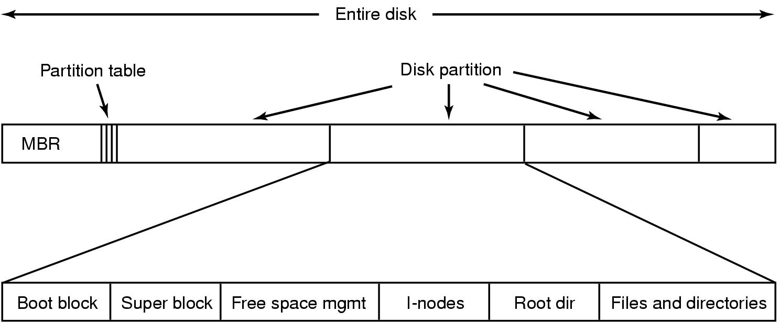
File System Implementation
A possible file system layout

Slide 15
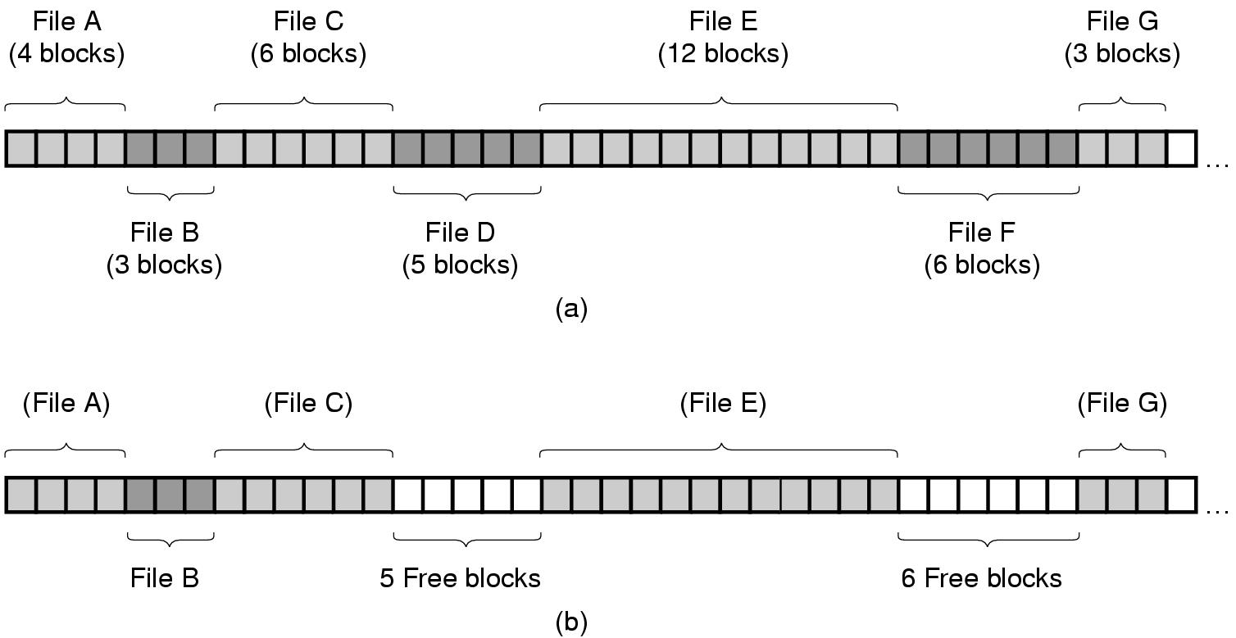
Implementing Files (1)
(a) Contiguous allocation of disk space for 7 files
(b) State of the disk after files D and F have been removed

Slide 16
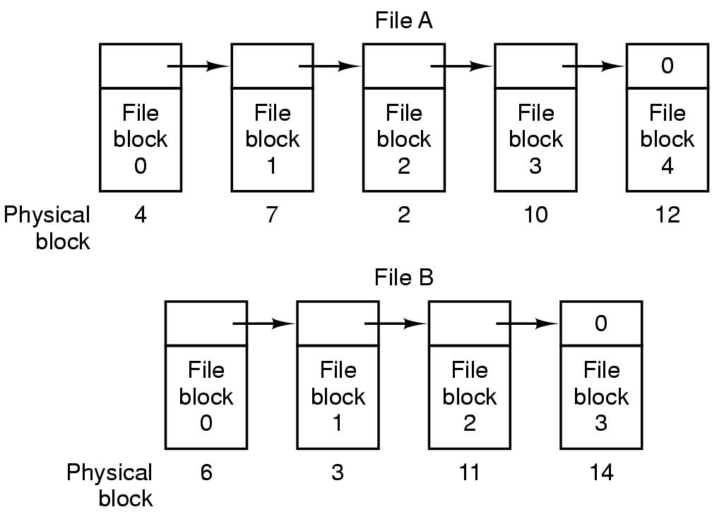
Implementing Files (2)
Storing a file as a linked list of disk blocks

Slide 17
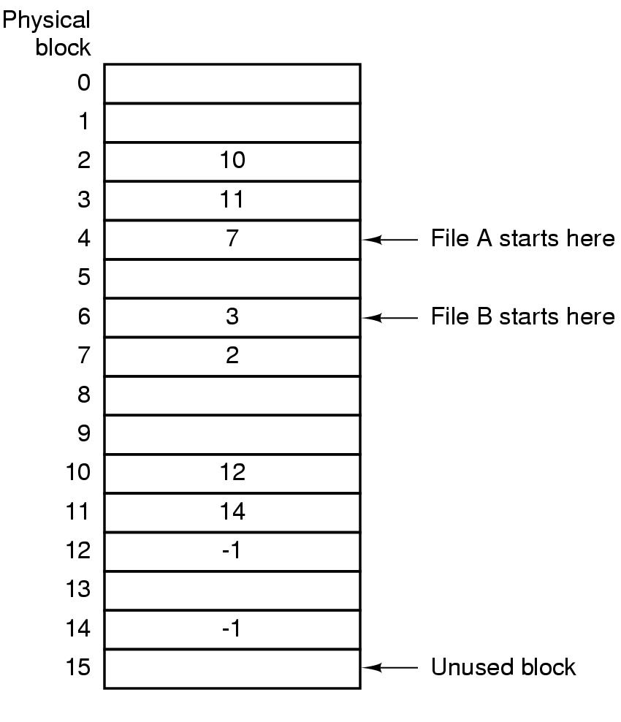
Implementing Files (3)
Linked list allocation using a file allocation table in RAM

Slide 18
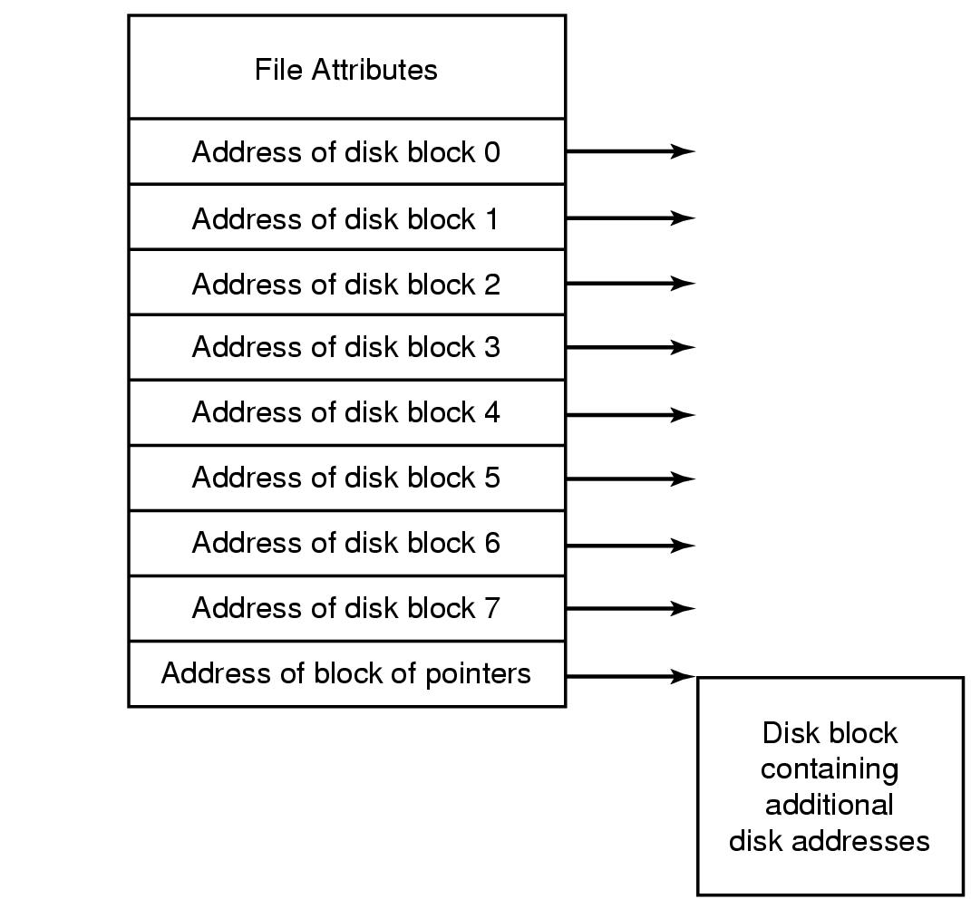
Implementing Files : Inode or Index node
An example i-node

Slide 19
Disk Space Management
(a) Storing the free list on a linked list
(b) A bit map

Slide 20
Unix File Management
Unix kernel views all files as streams of bytes.
Four types of files are distinguished:
Ordinary : regular files with data from user, or an application.
Directory : Contains list of file names + pointers to associated inodes.
Special : Terminals and other peripherals are abstracted as files.
Named : named pipes.

Slide 21
Operations
pathname searching : lookup
name creation : creat, mknod, link, symlink, mkdir
name change/deletion: rename, remove, rmdir
attribute manipulation: access, getattr, setattr
object interpretation: open, readir,readlink,mmap,close
process control : advlock,ioctl,select
object management : lock, unlock,inactive,reclaim,abortop

Slide 22
Inodes
Inode (information node) is a structure that contains the key information needed for managing a file.
Several files names may be associated with an inode.
But each file contains exactly one file.

Slide 23
Information in an inode
File mode (access and execution permissions)
Link count ( how many references)
Owner ID
Group ID
File Size
File Address : 39 bytes of address information as explained in the next slide
Last accessed time, last modified time, late inode modification time

Slide 24
File address
13 3-byte addresses (39 bytes)
Direct :10 : direct pointer 10 1K chunks of memory
Single indirect: 1 : indirect block of 256 points each of which points to a 1K : 256 K
Double indirect: 1: 256 X 256 : 65M
Triple Indirect : 1: 256X 256 X 256 : 16G

Slide 25
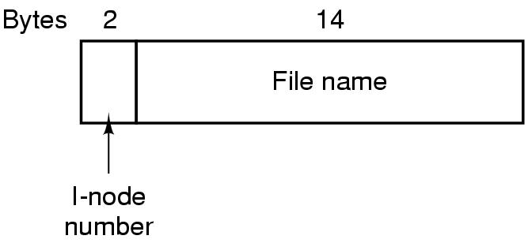
The UNIX V7 File System (1)
A UNIX V7 directory entry

Slide 26
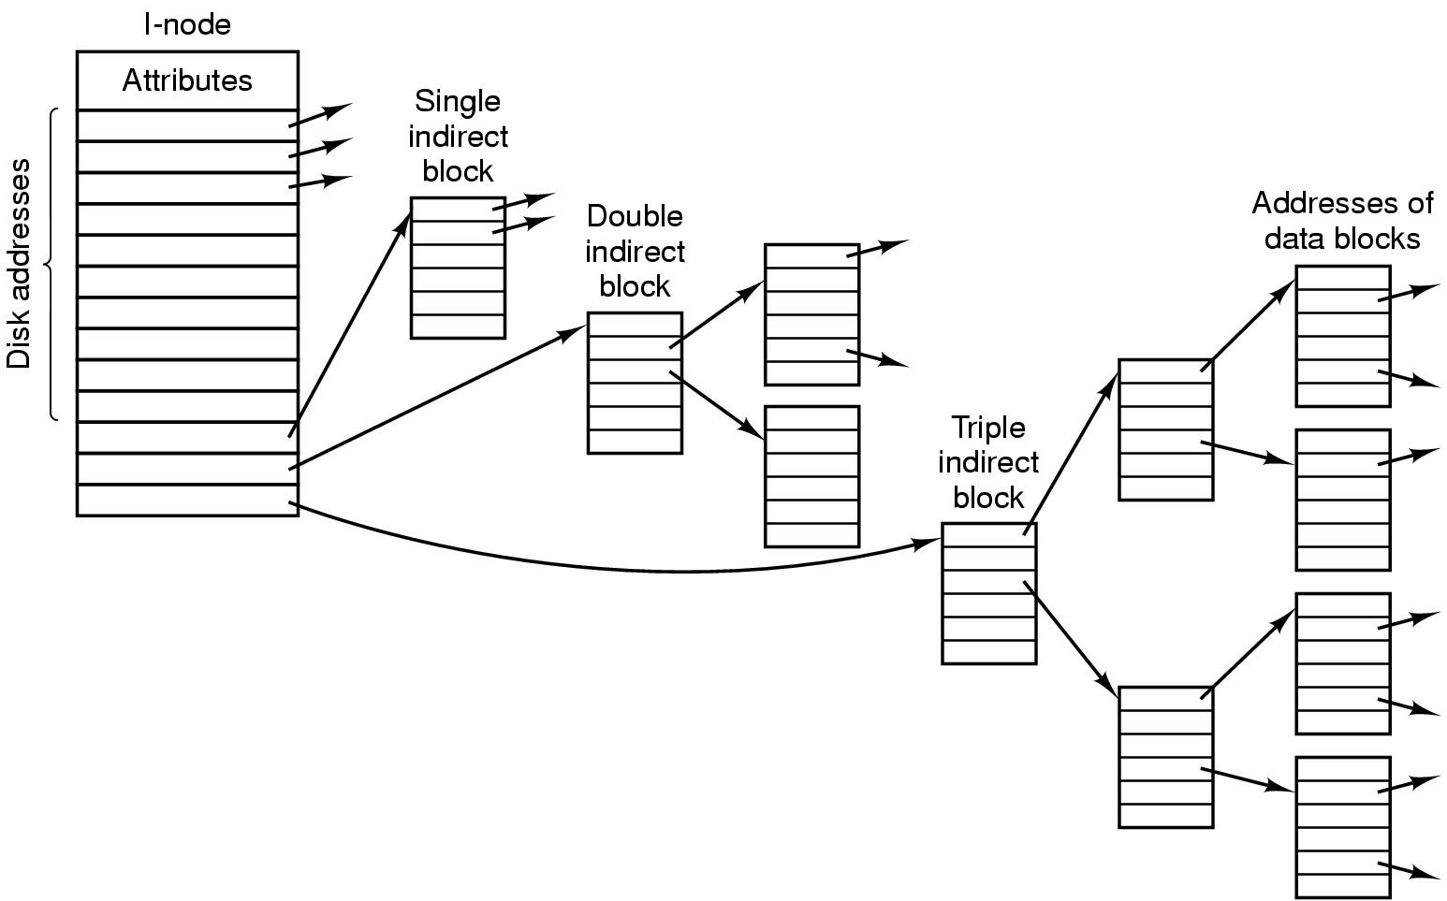
The UNIX V7 File System (2)
A UNIX i-node

Slide 27
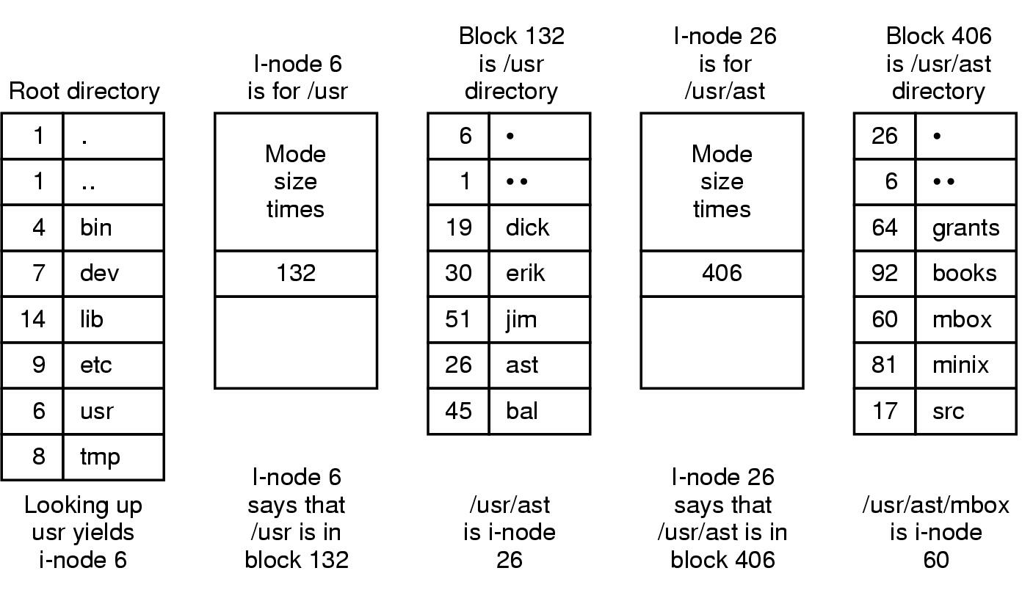
The UNIX V7 File System (3)
The steps in looking up /usr/ast/mbox

Slide 28
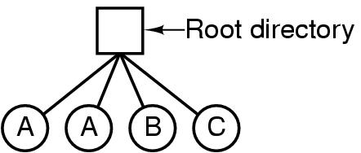
Directories Single-Level Directory Systems
A single level directory system
contains 4 files
owned by 3 different people, A, B, and C

Slide 29
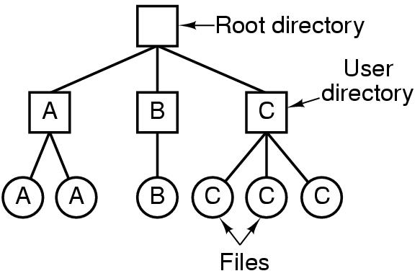
Two-level Directory Systems
Letters indicate owners of the directories and files

Slide 30
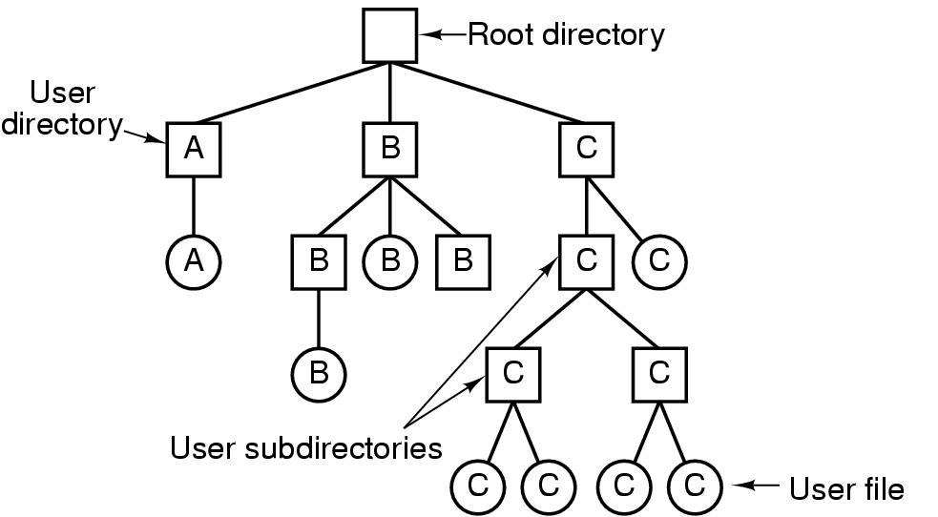
Hierarchical Directory Systems
A hierarchical directory system

Slide 31
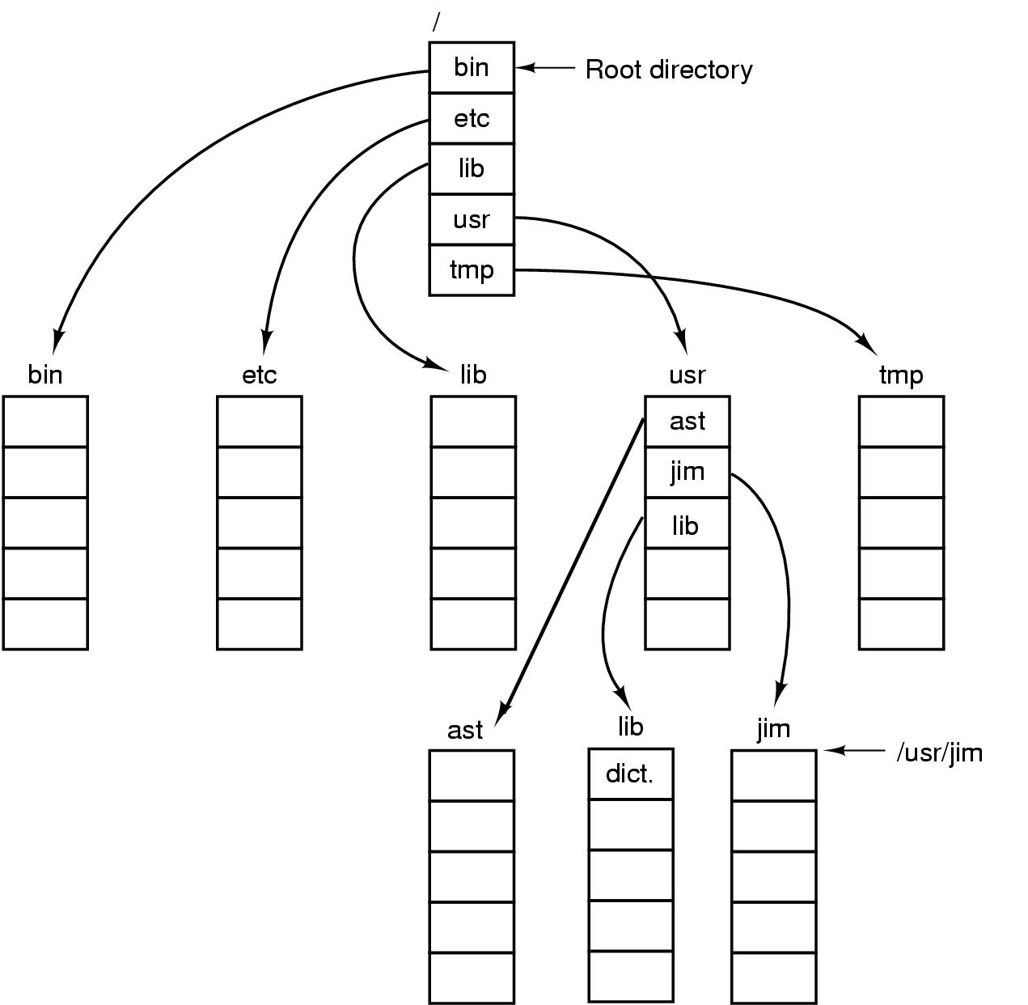
Path Names
A UNIX directory tree

Slide 32
Directory Operations
Create
Delete
Opendir
Closedir
Readdir
Rename
Link
Unlink

Slide 33
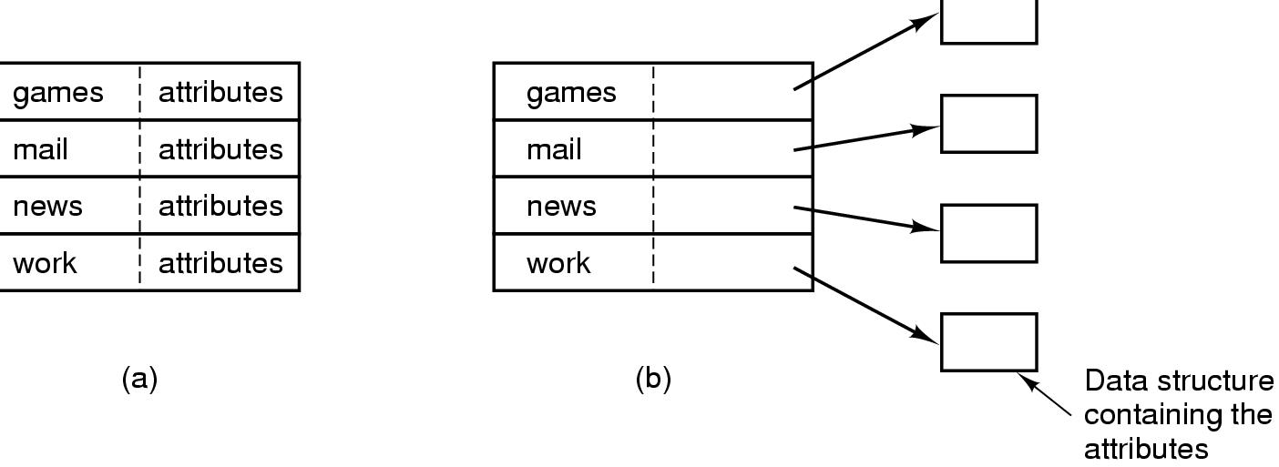
Implementing Directories (1)
(a) A simple directory
fixed size entries
disk addresses and attributes in directory entry
(b) Directory in which each entry just refers to an i-node

Slide 34
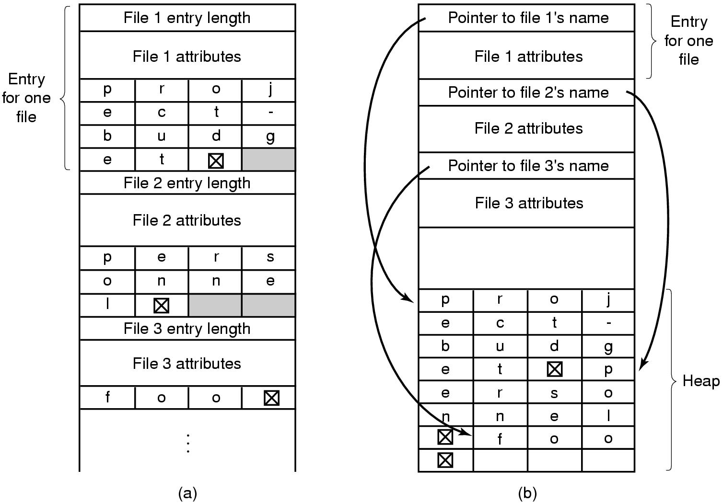
Implementing Directories (2)
Two ways of handling long file names in directory
(a) In-line
(b) In a heap

Slide 35
Unix Directories
Directories are allocated in units called chunks.
Chunks are broken up into variable-length directory entries.
A directory entry contains: index to inode structures, the size of entry in bytes, type of entry, length of filename, pointer to next entry.

Slide 36
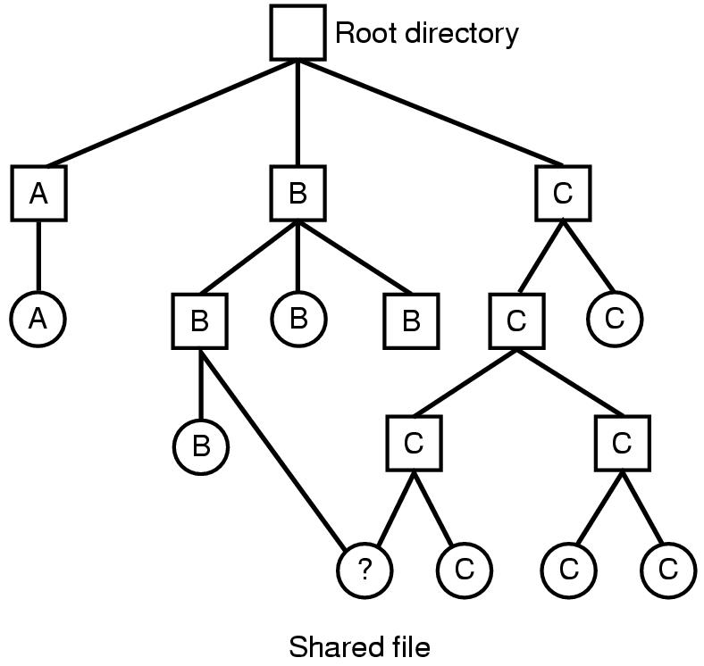
Shared Files (1)
File system containing a shared file

Slide 37
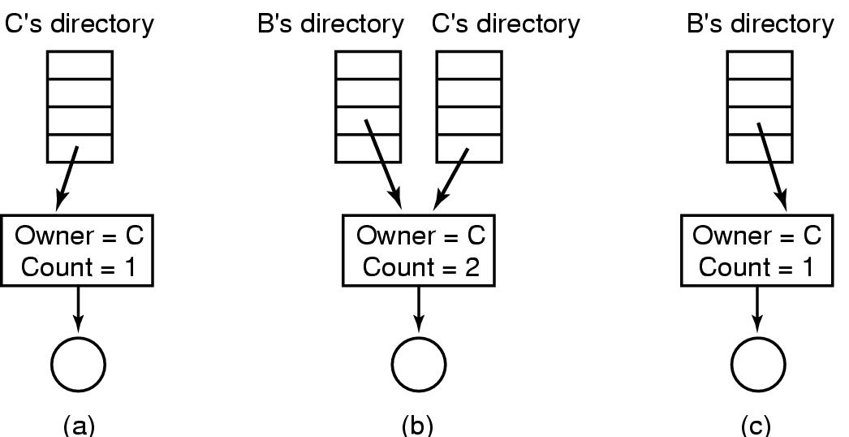
Shared Files (2)
(a) Situation prior to linking
(b) After the link is created
(c) After the original owner removes the file
(d) Symbolic and hard links

Slide 38
Summary
We studied
The file abstraction and file API.
File structure, directory structure and storage allocation.
Unix file system case study.
Next class we will explore distributed file system.

