Slide 1
Inter-process Communication Models
Chapter 4 and other emerging technologies

Slide 2
Topics for discussion
Interprocess communication in distributed system
High level language API/libraries for IPC and networking
Application layer: HTML, XML, SOAP and REST

Slide 3
Interprocess communication (IPC)
Is about characteristics of protocols for communication between processes in a distributed systems.
IP provides datagram and stream processing (What is the difference?)
APIs are available for IPC: Ch.4 discusses a Java API; these provide support for programming high level communication services (Ch.4 and Ch.5)
We limit the discussion to point-to-point but it can be easily extended to other models.
API to TCP provides the abstract of a two-way stream between pairs of processes for streams of data.

Slide 4
HLL APIs/libraries for TCP
Java networking:
https://docs.oracle.com/javase/8/docs/technotes/guides/net/index.html
Python API: https://docs.python.org/3/howto/sockets.html
Go lang API: https://appliedgo.net/networking/

Slide 5
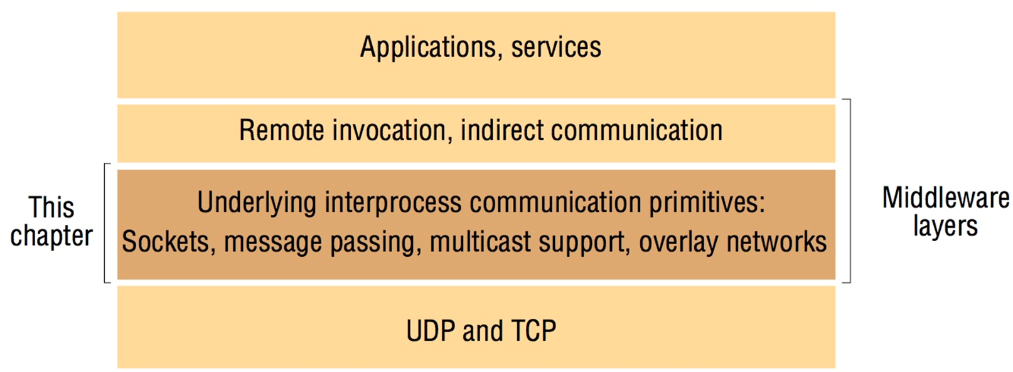
Application Layers

Slide 6
IPC Characteristics
Message passing between processes is supported by “send” and “receive”
Synchronous or asynchronous communication
Message destination specification: addressing
Reliability
Ordering

Slide 7
Sockets and ports
any port
agreed port
socket
socket
message
client
server
other ports
Internet address = 138.37.94.248
Internet address = 138.37.88.249
Instructor’s Guide for Coulouris, Dollimore, Kindberg and Blair, Distributed Systems: Concepts and Design Edn. 5 © Pearson Education 2012

Slide 8
Java API
InetAddress = InetAddress.getByName(“timberlake.cse.buffalo.edu”);
128.205.32.8
Will return 4 bytes for IPV4 and 16 bytes for IPV6
UDP packet:
Array of bytes, length of message, Internet address, Port Number

Slide 9
UDP client sends a message to the server and gets a reply
import java.net.*;
import java.io.*;
public class UDPClient{
public static void main(String args[]){
// args give message contents and server hostname
DatagramSocket aSocket = null;
try {
aSocket = new DatagramSocket();
byte [] m = args[0].getBytes();
InetAddress aHost = InetAddress.getByName(args[1]);
int serverPort = 6789;
DatagramPacket request = new DatagramPacket(m, m.length(), aHost, serverPort);
aSocket.send(request);
byte[] buffer = new byte[1000];
DatagramPacket reply = new DatagramPacket(buffer, buffer.length);
aSocket.receive(reply);
System.out.println("Reply: " + new String(reply.getData()));
}catch (SocketException e){System.out.println("Socket: " + e.getMessage());
}catch (IOException e){System.out.println("IO: " + e.getMessage());}
}finally {if(aSocket != null) aSocket.close();}
}
}
Instructor’s Guide for Coulouris, Dollimore, Kindberg and Blair, Distributed Systems: Concepts and Design Edn. 5 © Pearson Education 2012

Slide 10
UDP server repeatedly receives a request and sends it back to the client
import java.net.*;
import java.io.*;
public class UDPServer{
public static void main(String args[]){
DatagramSocket aSocket = null;
try{
aSocket = new DatagramSocket(6789);
byte[] buffer = new byte[1000];
while(true){
DatagramPacket request = new DatagramPacket(buffer, buffer.length);
aSocket.receive(request);
DatagramPacket reply = new DatagramPacket(request.getData(),
request.getLength(), request.getAddress(), request.getPort());
aSocket.send(reply);
}
}catch (SocketException e){System.out.println("Socket: " + e.getMessage());
}catch (IOException e) {System.out.println("IO: " + e.getMessage());}
}finally {if(aSocket != null) aSocket.close();}
}
}
Instructor’s Guide for Coulouris, Dollimore, Kindberg and Blair, Distributed Systems: Concepts and Design Edn. 5 © Pearson Education 2012

Slide 11
Lets examine upper level protocols
HTTP : Hyper Text Transfer Protocol
HTML: Hyper Text Markup Language
XML: eXtensible Markup Language
Resource references on the web
Web services
SOAP: Simple Object Request Protocol
REST: Representational State Transfer

Slide 12
HTTP
Protocol for communication among web entities.
It is a standard from IETF (Internet Engineering Task Force) and W3C: (World Wide Web Consortium)
Request-response model for client-server systems
HTTP operates by sending requests with operations to be performed on resources referred by Uniform Resource Identifiers (URI)
Request methods are: HEAD, GET, POST, PUT, DELETE, TRACE,… PATCH (just a few standard commands)

Slide 13
HTML
Hyper text mark-up language
Standard markups for structural organization of web pages
Example:
<tr> <td style="vertical-align: top;"><br> </td> <td style="vertical-align: top;">File System<br> </td> <td style="vertical-align: top;"><a href=“ThisPres.pptx">FileSys</a><br> </td> <td style="vertical-align: top;"><br> </td> </tr>

Slide 14
HTML over HTTP
Web server
http://www.cse.buffalo.edu/faculty/bina
Request:
Get http:…
Web Browser
browser interpretation of
index.html
Response:
index.html
Web Browser
Web Browser

Slide 15
XML
XML is a markup language, developed by W3C (World Wide Web Consortium), mainly to overcome the limitations of HTML.
But it took a life of its own and has become a very popular part of distributed systems.
We will examine its definition, associated specifications (DTD, XSLT etc.), Java APIs available to process XML, protocols and services based on XML, and the role XML plays in a distributed computing environment.

Slide 16
First Look at XML
It has no predefined tags.
Such as in HTML
Domains may specify their own set of standard tags
It is stricter.
Most html document have errors and the browser have to built to take care of these.
On the other hand XML has a strict syntax.
There is a notion of validity and
A notion of well-formed.

Slide 17
An Example: Memo
See the two documents enclosed: one in html and the other in XML formats.
Observe the meaningful tags in XML.
Compare it to a class definition: it looks like a class with data definitions and accessors (tags).

Slide 18
Memo.html vs memo.xml
<!DOCTYPE html PUBLIC "-//W3C//DTD HTML 4.01 Transitional//EN">
<html>
<head>
<meta http-equiv="content-type"
content="text/html; charset=ISO-8859-1">
<title>memo.html</title>
</head>
<body>
<h3>Hello World</h3>
Bina<br>
CSE486 DS Students <br>
Wake up everyone<br>
BR<br>
<br>
</body>
</html>
<?xml version="1.0" ?>
<!DOCTYPE memo (View Source for full doctype...)>
- <memo>
<header>Hello World</header>
<from>bina</from>
<to>CSE486 DS Students</to>
<body>Wake up everyone</body>
<sign>br</sign>
</memo>

Slide 19
XML
SOAP
XML
HTTP/Others
TCP/IP
REST

Slide 20
XML to SOAP
Simple xml can facilitate sending message to receive information.
The message could be operations to be performed on objects.
Simple Object Access Protocol (SOAP)
Representational State Transfer (REST) is an architectural pattern on HTTP’s methods

Slide 21
SOAP Request
<soap:Envelope xmlns:soap="http://schemas.xmlsoap.org/soap/envelope/">
<soap:Body>
<getProductDetails xmlns="http://warehouse.example.com/ws">
<productId>827635</productId>
</getProductDetails>
</soap:Body>
</soap:Envelope>

Slide 22
SOAP Reply
<soap:Envelope xmlns:soap="http://schemas.xmlsoap.org/soap/envelope/">
<soap:Body>
<getProductDetailsResponse xmlns="http://warehouse.example.com/ws">
<getProductDetailsResult>
<productName>Toptimate 3-Piece Set</productName>
<productId>827635</productId>
<description>3-Piece luggage set. Black Polyester.</description>
<price>96.50</price>
<inStock>true</inStock>
</getProductDetailsResult>
</getProductDetailsResponse>
</soap:Body>
</soap:Envelope>

Slide 23
SOAP→Web Services (WS)→SOA
Read this paper by Tim Berners Lee on WS:
http://www.w3.org/DesignIssues/WebServices.html
Service-oriented Architecture (SOA)
Precursor to micro services
But a monolithic collection of related functions/services

Slide 24
WS Stack
WSFL
Service Flow
UDDI
Service Discovery
UDDI
Service Publication
Security
Quality of Service
Management
Service Description
WSDL
SOAP
XML-based Messaging
HTTP, FTP, MQ
Email, IIOP
Network

Slide 25
WS Interoperability Infrastructure
Service Description
WSDL
XML Messaging
SOAP
Network
HTTP
Do you see any platform or language dependencies here?

Slide 26
Summary
We looked at foundational concepts supporting web services: XML, SOAP, WSDL and Web Services standards.
We also illustrated the concepts using sample programs.
We will discuss REST-based web services and WDSL in the next lectures.

