Slide 1
Indirect Communication Paradigms (or Messaging Methods)
Ch. 6 and extra notes
B.Ramamurthy

Slide 2
Introduction
How important is this topic? Messaging?
Essence of indirect communication is to communicate through an intermediary and hence have no direct coupling between the sender and one or more receivers.

Slide 3
Different types
Group communication: communication via a group, sender is unaware of the identity of the recipient. Example: tweet
Publish-subscribe: Disseminating events to multiple recipients through an intermediary; Events+ listeners; Example: stock price limit notification (buy/sell)
Message queue: messages are sent to a queue, receivers extract it from the queue; Example: task schedulers
Shared-memory: an abstraction of global shared memory; example: Google (whiteboard) docs

Slide 4
Space and Time Coupling
 | Time Coupled | Time uncoupled
Space coupled | Communicate directly towards a given receiver(s) that must exist at that time. Ex: RPC/RMI | Communication directed toward a receiver(s) that can have independent lifetime Eg. Email
Space uncoupled | Sender need not know the identity of the receiver(s); receivers must exist Ex: IP Multicast; audio, video streaming | Sender need not know identity of receiver(s); receivers can have independent lifetime Ex: pub/sub? Ch.6

Slide 5
Topics for discussion
Group Communication
Publish – Subscribe systems
Message queues
Shared Memory approaches

Slide 6
I. Group Communication
Group communication is an important building block for distributed systems:
Key areas of application include:
  Reliable dissemination of information to a number of clients
  Support for collaborative applications
  Support for a range of fault-tolerant strategies, including consistent update of replicated data
  Load balancing strategies

Slide 7
Programming model: key concepts
Group and group membership
Processes to join and leave group
Process to send a message to subset (multicast) and all (broadcast)
Closed and open groups: people outside can send if it is open
Overlapping and non-overlapping
Synchronous and asynchronous
Reliability and ordering of messages: FIFO, Causal,Total

Slide 8
Open and closed groups
Instructor’s Guide for Coulouris, Dollimore and Kindberg Distributed Systems: Concepts and Design Edn. 4
© Pearson Education 2005

Slide 9
The role of group membership management
Group
address
expansion
Group
Leave
send
Multicast
Group membership
communication
Fail
management
Join
Process group
Instructor’s Guide for Coulouris, Dollimore, Kindberg and Blair, Distributed Systems: Concepts and Design Edn. 5
© Pearson Education 2012

Slide 10
Group Membership Management
Provide interface for group membership changes
Failure detection (unreachable etc.)
Notifying members about changes
Performing group address expansion
Example application of group communication: Whatsapp (read about its history for inspiration)

Slide 11
II. Publish Subscribe Model
Distributed event based system
Most widely used indirect communication system (?)
A publish-subscribe system is a system where publishers publish structured events to an event service and subscribers express interest by subscriptions.
The task of the pub/sub system is to match the published events and ensure correct delivery of event notifications.
Fundamentally one-to-many communication paradigm.
Heterogeneity of components
Asynchronicity in operation
Delivery guarantees (3 secs realtime delivery assurance by Bloomberg!)
Do you see the difference between group comm and oub/sub?

Slide 12
Applications of Pub/Sub
Financial information systems
Cooperative working
Ubiquitous computing
Monitoring applications

Slide 13
Stock Dealing Room (Ex: Bloomberg, FactSet)
Dealer’s computer
External
Dealer’s computer
source
Dealer
Notification
Notification
Dealer
Notification
Information
provider
Notification
Notification
Notification
Notification
Dealer’s computer
Dealer’s computer
Notification
Information
provider
Notification
Dealer
Notification
Dealer
External
source

Slide 14
The Programming Model
Small set of operations: publish(e), subscribe(f) where f is the filter or pattern of possible events, unsubscribe(f);
Filter model: Channel based, topic based, content-based, type-based.

Slide 15
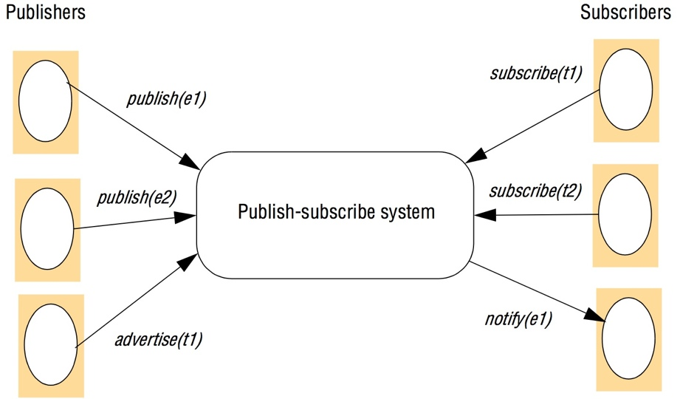
Figure 6.8
The publish-subscribe paradigm
Instructor’s Guide for Coulouris, Dollimore and Kindberg Distributed Systems: Concepts and Design Edn. 4
© Pearson Education 2005

Slide 16
Implementation Issues
Main task: ensure that events are delivered efficiently to all subscribers that have filters defined that match the event.
Additional requirements: security, scalability, failure handling, concurrency, and QoS

Slide 17
Centralized vs. Distributed Implementations
Simplest architecture is to centralize the implementation in a single node with a server on that node acting as a event broker.
Publishers publish events to this broker, and subscribers send subscriptions to the broker and receive notifications in return.
Communication is point to point messages.
In a distributed implementation single broker is replaced by a network of brokers.
Consider a fully P2P system!

Slide 18
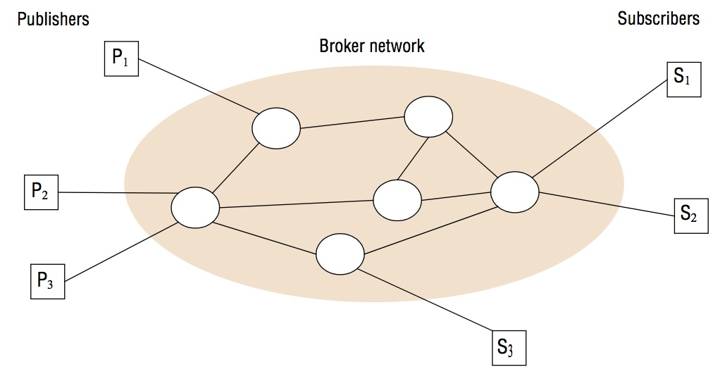
A network of brokers

Slide 19
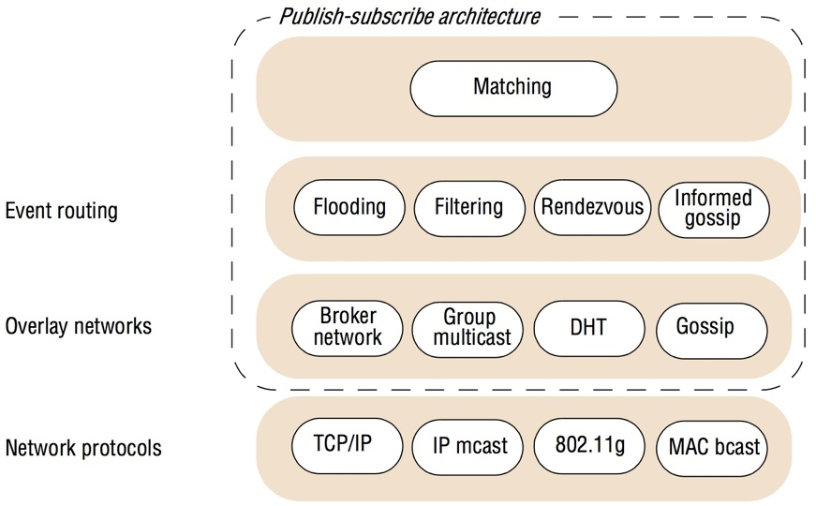
Overall System architecture

Slide 20
Content-based Event Routing
Flooding:
  Simply send an event notification to all publisher nodes in the network. Matching carried out at the end.
  Alternatively the brokers can be arranged in a acyclic graph each forwarding incoming notifications to all its neighbors.

Slide 21
Content-based Event Routing (contd.)
Filtering: Apply filtering in the network of brokers: filtering-based routing.
  Propagating subscription information through the network towards potential publishers.
  Each broker maintains a table of its neighbors, list of all directly connected subscribers and a routing table with subscriptions.

Slide 22
Filtering-based routing
upon receive publish(event e) from node x 1
matchlist := match(e, subscriptions) 2
  send notify(e) to matchlist; 3
    fwdlist := match(e, routing); 4
      send publish(e) to fwdlist - x; 5
upon receive subscribe(subscription s) from node x 6
if x is client then 7
  add x to subscriptions; 8
    else add(x, s) to routing; 9
      send subscribe(s) to neighbours - x; 10
Instructor’s Guide for Coulouris, Dollimore and Kindberg Distributed Systems: Concepts and Design Edn. 4
© Pearson Education 2005

Slide 23
Issues with Filerting-based Routing
Pure filtering based approach generates a lot of messages.
Two solutions:
advertisements() based approach
Rendezvous based approach

Slide 24
Rendezvous-based routing
upon receive publish(event e) from node x at node i
rvlist := EN(e);
if i in rvlist then begin
  matchlist :=match(e, subscriptions);
  send notify(e) to matchlist;
end
send publish(e) to rvlist - i;
upon receive subscribe(subscription s) from node x at node i
rvlist := SN(s);
if i in rvlist then
  add s to subscriptions;
else
  send subscribe(s) to rvlist - i;
Instructor’s Guide for Coulouris, Dollimore and Kindberg Distributed Systems: Concepts and Design Edn. 4
© Pearson Education 2005

