Slide 1
Indirect Communication Paradigms (or Messaging Methods)
Ch. 6 and extra notes
B.Ramamurthy

Slide 2
Introduction
How important is this topic? Messaging?
Essence of indirect communication is to communicate through an intermediary and hence have no direct coupling between the sender and one or more receivers.

Slide 3
Different types
Group communication: communication via a group, sender is unaware of the identity of the recipient. Example: tweet
Publish-subscribe: Disseminating events to multiple recipients through an intermediary; Events+ listeners; Example: stock price limit notification (buy/sell)
Message queue: messages are sent to a queue, receivers extract it from the queue; Example: task schedulers
Shared-memory: an abstraction of global shared memory; example: Google (whiteboard) docs

Slide 4
Space and Time Coupling
 | Time Coupled | Time uncoupled
Space coupled | Communicate directly towards a given receiver(s) that must exist at that time. Ex: RPC/RMI | Communication directed toward a receiver(s) that can have independent lifetime Eg. Email
Space uncoupled | Sender need not know the identity of the receiver(s); receivers must exist Ex: IP Multicast; audio, video streaming | Sender need not know identity of receiver(s); receivers can have independent lifetime Ex: pub/sub? Ch.6

Slide 5
Topics for discussion
Group Communication
Publish – Subscribe systems
Message queues
Shared Memory approaches

Slide 6
I. Group Communication
Group communication is an important building block for distributed systems:
Key areas of application include:
Reliable dissemination of information to a number of clients
Support for collaborative applications
Support for a range of fault-tolerant strategies, including consistent update of replicated data
Load balancing strategies

Slide 7
Programming model: key concepts
Group and group membership
Processes to join and leave group
Process to send a message to subset (multicast) and all (broadcast)
Closed and open groups: people outside can send if it is open
Overlapping and non-overlapping
Synchronous and asynchronous
Reliability and ordering of messages: FIFO, Causal,Total

Slide 8
Open and closed groups
Instructor’s Guide for Coulouris, Dollimore and Kindberg Distributed Systems: Concepts and Design Edn. 4 © Pearson Education 2005

Slide 9
The role of group membership management
Group
address
expansion
Group
Leave
send
Multicast
Group membership
communication
Fail
management
Join
Process group
Instructor’s Guide for Coulouris, Dollimore, Kindberg and Blair, Distributed Systems: Concepts and Design Edn. 5 © Pearson Education 2012

Slide 10
Group Membership Management
Provide interface for group membership changes
Failure detection (unreachable etc.)
Notifying members about changes
Performing group address expansion
Example application of group communication: Whatsapp (read about its history for inspiration)

Slide 11
II. Publish Subscribe Model
Distributed event based system
Most widely used indirect communication system (?)
A publish-subscribe system is a system where publishers publish structured events to an event service and subscribers express interest by subscriptions.
The task of the pub/sub system is to match the published events and ensure correct delivery of event notifications.
Fundamentally one-to-many communication paradigm.
Heterogeneity of components
Asynchronicity in operation
Delivery guarantees (3 secs realtime delivery assurance by Bloomberg!)
Do you see the difference between group comm and oub/sub?

Slide 12
Applications of Pub/Sub
Financial information systems
Cooperative working
Ubiquitous computing
Monitoring applications

Slide 13
Stock Dealing Room (Ex: Bloomberg, FactSet)
Dealer’s computer
External
Dealer’s computer
source
Dealer
Notification
Notification
Dealer
Notification
Information
provider
Notification
Notification
Notification
Notification
Dealer’s computer
Dealer’s computer
Notification
Information
provider
Notification
Dealer
Notification
Dealer
External
source

Slide 14
The Programming Model
Small set of operations: publish(e), subscribe(f) where f is the filter or pattern of possible events, unsubscribe(f);
Filter model: Channel based, topic based, content-based, type-based.

Slide 15
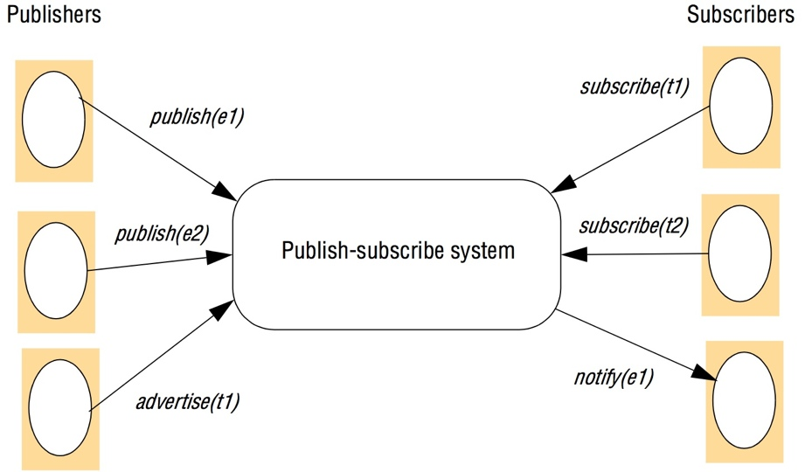
Figure 6.8 The publish-subscribe paradigm
Instructor’s Guide for Coulouris, Dollimore and Kindberg Distributed Systems: Concepts and Design Edn. 4 © Pearson Education 2005

Slide 16
Implementation Issues
Main task: ensure that events are delivered efficiently to all subscribers that have filters defined that match the event.
Additional requirements: security, scalability, failure handling, concurrency, and QoS

Slide 17
Centralized vs. Distributed Implementations
Simplest architecture is to centralize the implementation in a single node with a server on that node acting as a event broker.
Publishers publish events to this broker, and subscribers send subscriptions to the broker and receive notifications in return.
Communication is point to point messages.
In a distributed implementation single broker is replaced by a network of brokers.
Consider a fully P2P system!

Slide 18
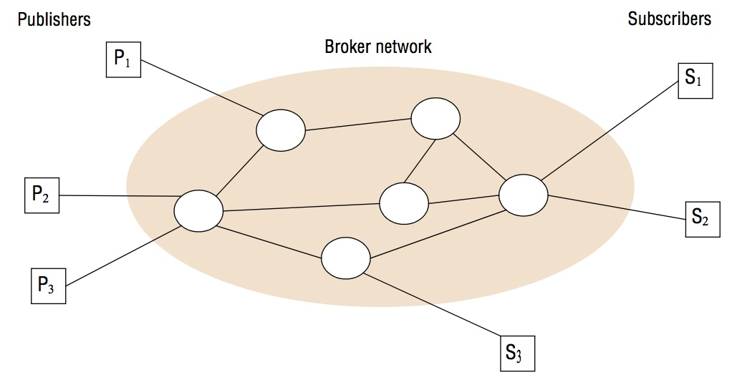
A network of brokers

Slide 19
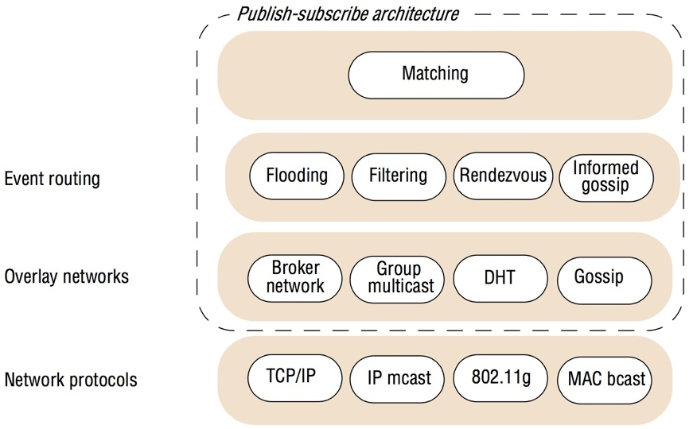
Overall System architecture

Slide 20
Content-based Event Routing
Flooding:
Simply send an event notification to all publisher nodes in the network. Matching carried out at the end (at the publisher node closest to the subscriber).
Alternatively the brokers can be arranged in a acyclic graph each forwarding incoming notifications to all its neighbors.

Slide 21
Content-based Event Routing (contd.)
Filtering: Apply filtering in the network of brokers: filtering-based routing.
Propagating subscription information through the network towards potential publishers.
Each broker maintains a table of its neighbors, list of all directly connected subscribers and a routing table with subscriptions.

Slide 22
Filtering-based routing
upon receive publish(event e) from node x 1
matchlist := match(e, subscriptions) 2
send notify(e) to matchlist; 3
fwdlist := match(e, routing); 4
send publish(e) to fwdlist - x; 5
upon receive subscribe(subscription s) from node x 6
if x is client then 7
add x to subscriptions; 8
else add(x, s) to routing; 9
send subscribe(s) to neighbours - x; 10
Instructor’s Guide for Coulouris, Dollimore and Kindberg Distributed Systems: Concepts and Design Edn. 4 © Pearson Education 2005

Slide 23
Issues with Filerting-based Routing
Pure filtering based approach generates a lot of messages.
Two solutions:
advertisements() based approach
Rendezvous based approach

Slide 24
Rendezvous based routing (RBR)
Certain authoritative brokers are defined that act like the “routers” in a regular network.
To achieve RBR, we define functions
SN(s) that given a subscription returns a set of “rendezvous” nodes that are responsible for the subscription. Maintains a list and forwards a matching event to subscribers.
EN(e) that when an event e is published, EN(e) returns a set of nodes that are responsible for matching e against subscriptions in the system.
If reliability is an issue, we can have EN(e) and SN(s) return more than one node.

Slide 25
Rendezvous-based routing
upon receive publish(event e) from node x at node i
rvlist := EN(e);
if i in rvlist then begin
matchlist :=match(e, subscriptions);
send notify(e) to matchlist;
end
send publish(e) to rvlist - i;
upon receive subscribe(subscription s) from node x at node i
rvlist := SN(s);
if i in rvlist then
add s to subscriptions;
else
send subscribe(s) to rvlist - i;
Instructor’s Guide for Coulouris, Dollimore and Kindberg Distributed Systems: Concepts and Design Edn. 4 © Pearson Education 2005

Slide 26
DHT Approach
An interesting implementation of rendezvous routing is to map the event space on to a distributed hash table (DHT).
The key idea here is that hash functions can be used to map (i) subscriptions (ii) events onto the corresponding rendezvous node for the management of such subscriptions.

Slide 27
Examples?
Kafka of Linkedin fame, now a open source project at Apache
Reading:
Apache Kafka: https://kafka.apache.org/

Slide 28
Gossip and Informed Gossip
One way of achieving scale is by using gossip.
Gossip is a means by which nodes in a network periodically and probabilistically exchange events with neighboring nodes.
In an informed gossip, you can content to the gossip, and this is especially suitable for highly dynamic environment.
We WILL discuss these in the context of blockchain and hashgraph later in the semester.

Slide 29
Message Queue
Groups and pub/sub: style of communication is one to many model
How about point-to-point?
Message queues provide point-to-point service using the concept of message queue as an indirection, thus achieving space and time decoupling.
RabbitMQ, Microsoft MSMQ, Oracle’s AQ

Slide 30
Programming Model
Very simple: It offers an approach to communication is distributed systems through queues.
A producer process send messages to the queue and a consumer process can receive messages from the queue.
Three styles of receive:
A blocking receive, which will block until a message is available
A non-blocking receive (a polling operation) which will check the status of the queue and return a message if available or not
A notify operation which will issue a notification when a message is available in the associated queue.

Slide 31
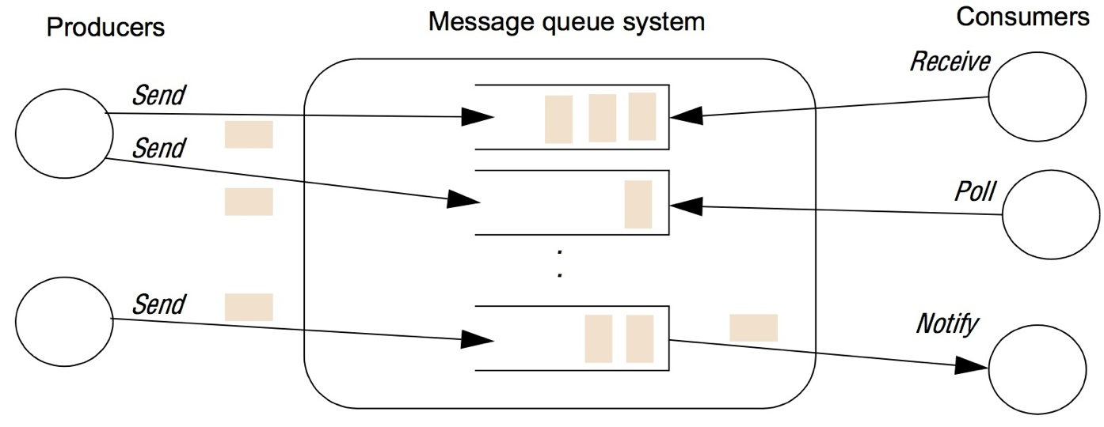
The message queue paradigm
Instructor’s Guide for Coulouris, Dollimore and Kindberg Distributed Systems: Concepts and Design Edn. 4 © Pearson Education 2005

Slide 32
Queuing Policy
FIFO
Consumers can select based on properties
A message consists of destination and meta data about the message
Oracle AQ has a interesting structure: the messages are stored in a relational table rows, so consumers can query the “MQ” to find their message!

Slide 33
Persistence Property
One crucial property of a message queue is that messages are persistent.
Messages will held indefinitely until consumed.
Also for reliability sake a they are also committed to data store.

Slide 34
Additional Functionality
Messages can be contained within a transaction. All or nothing delivery. All the requirements of Tx is applied
Message transformation can be supported: arbitrary transformation can be performed on an arriving message: say, to address data format, internationalization, heterogeneity etc.
Improved security: Confidential transmission through end-to-end encryption.

Slide 35
Implementation Issues
Key implementation issue for message queue is the choice between centralized and distributed implementation.
This is the case for many of your systems.
IBM introduced a very important concept of message channels
Customized topologies using agents and channels: trees, meshes, bus-based, hub-and-spoke
Nice reading: https://www.incognito.com/tutorials/understanding-messaging-part-one-the-basics-2/

Slide 36
Shared Memory Approaches
Shared memory techniques were developed for parallel computing (Message Passing Interface: MPI)
Distributed Shared Memory (DSM) is an abstraction for sharing data between computers that do not share physical memory
Based on simple “read” and “write” of data or messages with specific addresses
Reading: https://computing.llnl.gov/tutorials/mpi/

Slide 37
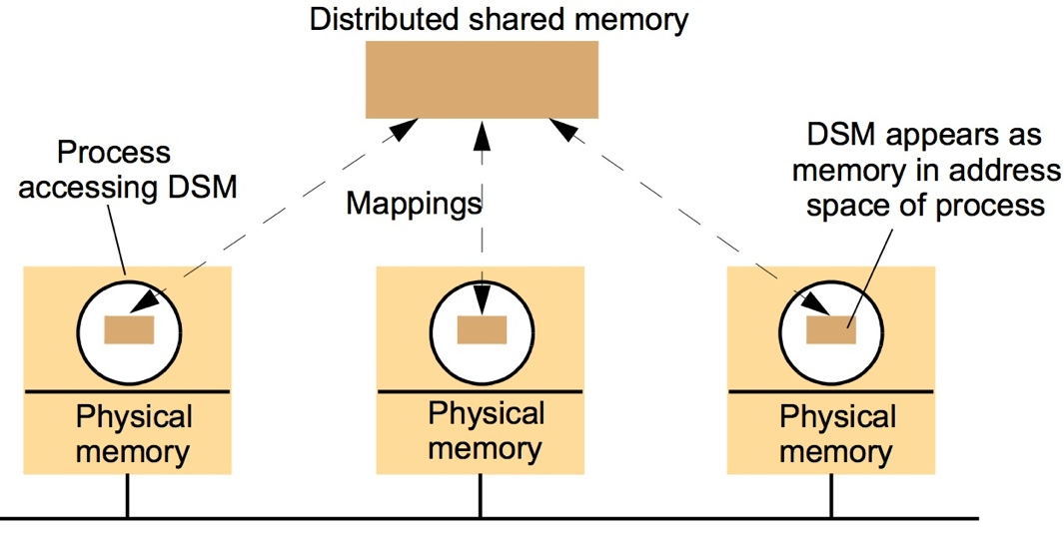
The distributed shared memory abstraction
Instructor’s Guide for Coulouris, Dollimore and Kindberg Distributed Systems: Concepts and Design Edn. 3 © Addison-Wesley Publishers 2000

Slide 38
Tuple Space Abstraction of Message Passing
An alternative approach to shared memory is tuple space: that is associative memory with capability of content addressability
A consolidated memory is visible to the computing processing
They access them by the content: write operation will insert, take operation will match, read operation will fetch the data needed for computation.
Check this UK geography tuple space:

Slide 39
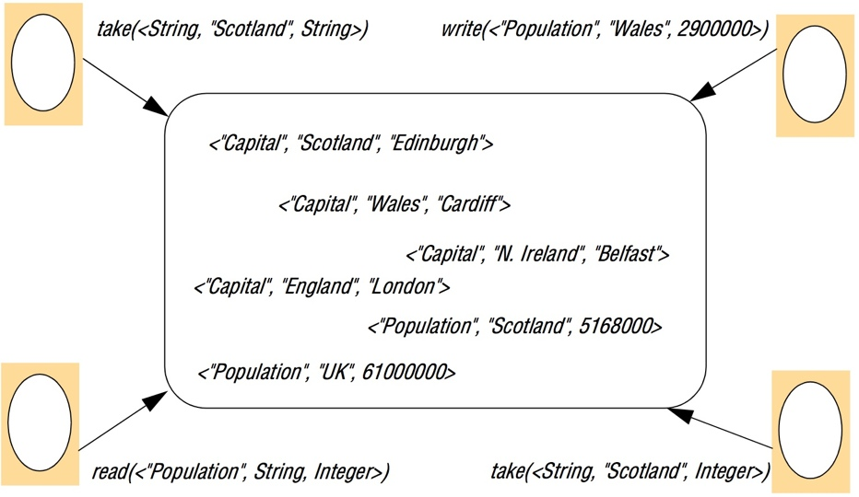
The tuple space abstraction
Instructor’s Guide for Coulouris, Dollimore and Kindberg Distributed Systems: Concepts and Design Edn. 4 © Pearson Education 2005

Slide 40
Summary
We studied “indirect communication”
It is a big deal in the current context.
We covered:
Group communications
Pub/sub systems
Message queues
Distributed shared memory
Tuple space

Slide 41
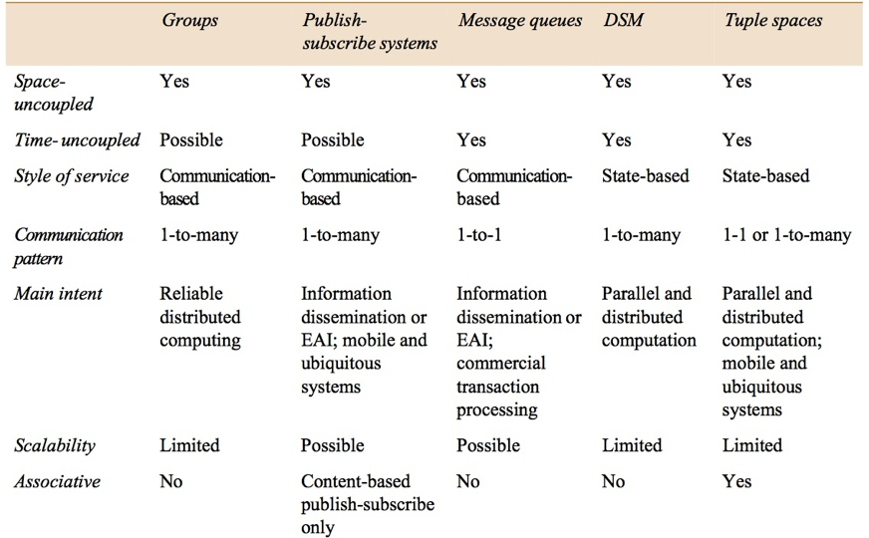
Summary of indirect communication styles
Instructor’s Guide for Coulouris, Dollimore and Kindberg Distributed Systems: Concepts and Design Edn. 4 © Pearson Education 2005

