Slide 1
Networking and Internetworking Chapter 3

Slide 2
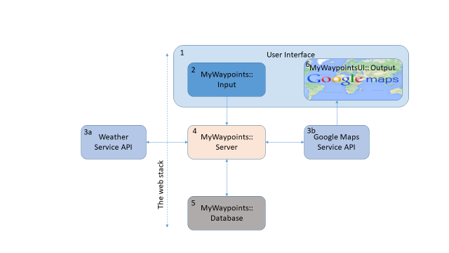
Project 1 Architectural Model
7

Slide 3
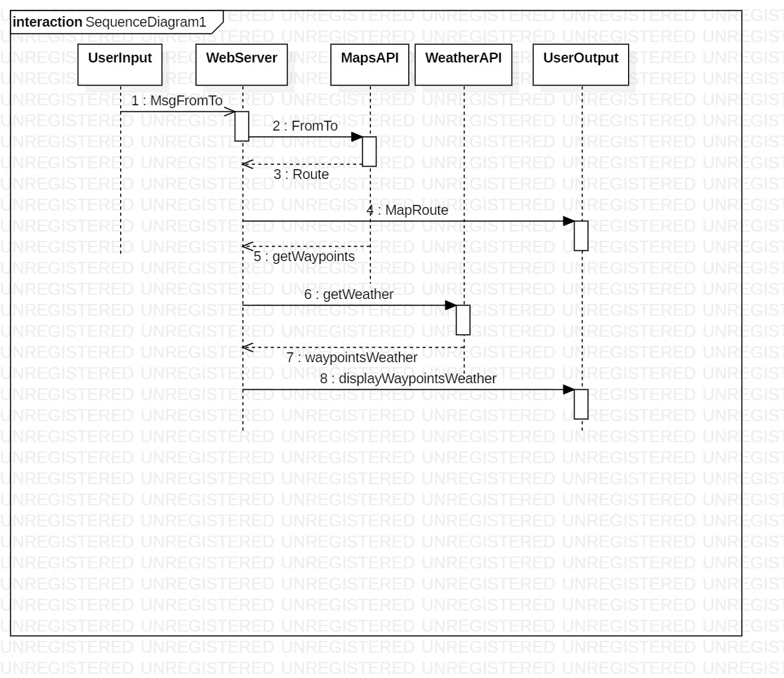
Project 1: Interaction Model : Phase1 UML sequence diagram

Slide 4
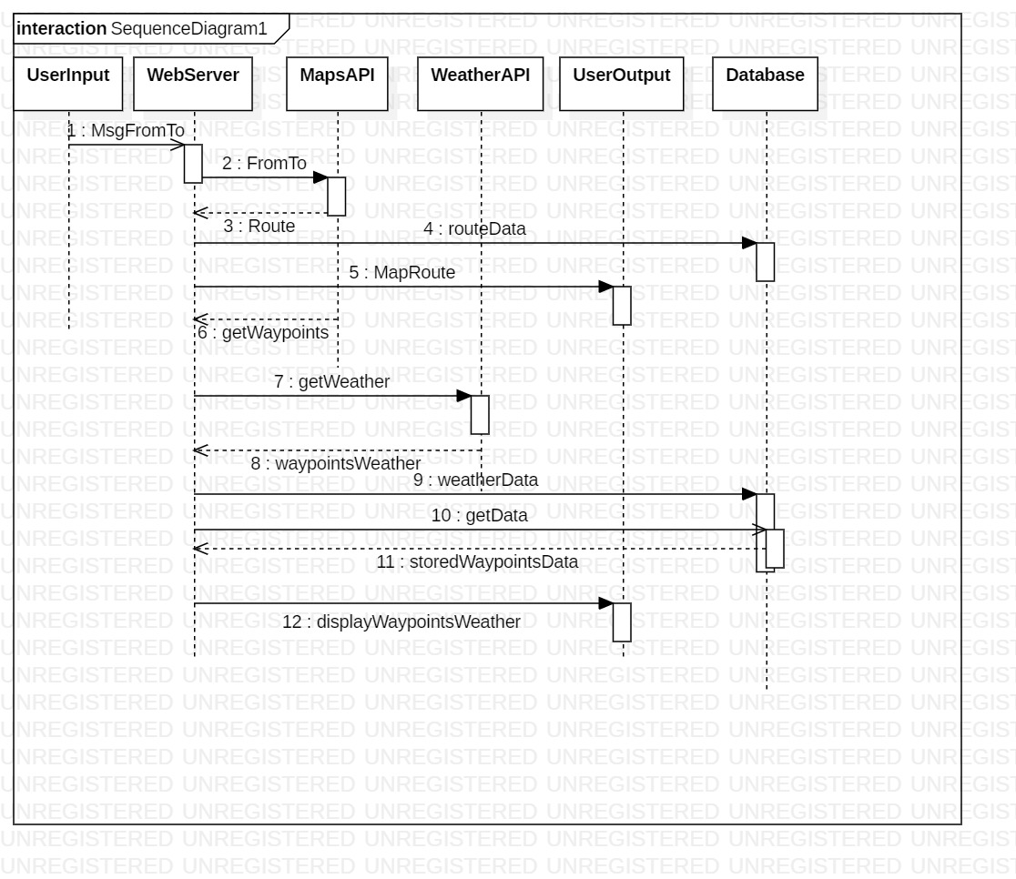
Project 1: Interaction Model : Phase2 UML sequence diagram

Slide 5
Distributed Systems (1)
Distributed systems use local area networks, wide area networks, and interworks for communication.
The performance, reliability, scalability, mobility, and quality of service characteristics of the underlying networks impact the behavior of distributed systems and hence their design.
User demands resulted in the emergence of wireless network and QoS guarantees.
Solutions:
protocol layering, packet switching, routing and data streaming.
Integration of heterogeneous systems
IPV4 to IPV6 to address enormous growth in space
Improvements in mobility, security, and QoS
Standards: Ethernet, IEEE 802.11 (WiFi), Bluetooth

Slide 6
Distributed Systems (2)
Networks in a distributed system are built from a variety of transmission media: wire, cable, fiber, wireless channels; hardware devices bridges, routers, hubs, repeaters, etc. Software including protocol stacks, communication handlers and drivers; These form the communication subsystem.
Computers on the communication subsystem are known as hosts;
The Internet is a single communication subsystem providing communication between hosts
The Internet is constructed of many subnets
Chapter 3 provides an overview of communication requirements of distributed systems

Slide 7
Networking Issues in Distributed Systems
It began with a simple applications and their requirements: file transfer, email, newsgroup.
It has moved to hotly debated social applications with not only stringent security requirements but also “fact or lies” type of requirement.
Lets look at some common requirements:

Slide 8
Performance
Latency and point-to-point transfer rate.
Latency: the delay that occurs after a send operation is executed and before data starts to arrive at the destination computer.
Data Transfer rate: the speed at which data can be transferred between two computers once transmission has begun, specified in bits per second.
Combining:
Message tx time = latency + length/data transfer rate
Total system bandwidth of a network is a measure of throughput– the total volume of traffic that can be transferred across the network in a given time.
For example, in Ethernet full transmission capacity is used for every transmission capacity of the network.
Therefore in Ethernet, bandwidth is same a data transfer rate.
In other networks with different channels sending simultaneously, total bandwidth and transfer rates are different.

Slide 9
Scalability
Computer networks are an indispensable part of infrastructure of modern societies.
Industry experts now predict that the number of Internet-connected devices will exceed 15 billion nodes by 2015 and top 50 billion by 2020.—Electronic Weekly, 2013.
It is now in the order of trillion nodes.
Check this out:
“Both IPv4 and IPv6 addresses come from finite pools of numbers. For IPv4, this pool is 32-bits (2³²) in size and contains 4,294,967,296 IPv4 addresses. The IPv6 address space is 128-bits (2¹²⁸) in size, containing 340,282,366,920,938,463,463,374,607,431,768,211,456 IPv6 addresses.” --https://www.ripe.net/about-us/press-centre/understanding-ip-addressing
How do you scale to this many devices? Simple application such as web depend on the number of users and of course, degree of locality.

Slide 10
Reliability
Communication errors; Guarantee error-free communication
Server reliability; fail-over or fail-stop
Dependability = availability + fault-tolerance + reliability

Slide 11
Security
First level of defense for many organizations is to protect its networks and computers with a firewall.
A firewall runs on a gateway computer that stands at the network entry point to an organization’s intranet. A firewall receives and filters all of the messages organization’s security policy to allow certain incoming and outgoing message to pass in and out and reject all others.
Fine-grained form of security can be realized using cryptographic techniques.
End-to-end encryption, authentication.

Slide 12
Other requirements
Mobility: wireless network address the mobility requirement
Quality of service: Response time and ability to meet deadlines; multi-media guarantees for bandwidth, bounded latencies.
Multicasting: Broadcast has become common mode of communication. Network has to support the simultaneously transmission of messages to several recipients.

Slide 13
Types of network
Many types of network evolved to address the requirements:
Personal area network: WPAN wireless PAN: devices carried by users on them, low power and low energy network
Local Area Network: LAN: Ethernet connected computers: 10gbs bandwidth
Wide area network WAN: WAN carry messages at lower speeds between nodes that are often different organizations and separated by large distances. Communication medium is circuits linking a set of dedicated computers called routers.
Metropolitan area network (MANs): Based on fiber optic cabling for transmission of video, voice, and other data.
Equivalent wireless versions of the above: WALNs, WMANs, WWANs, intranet

Slide 14
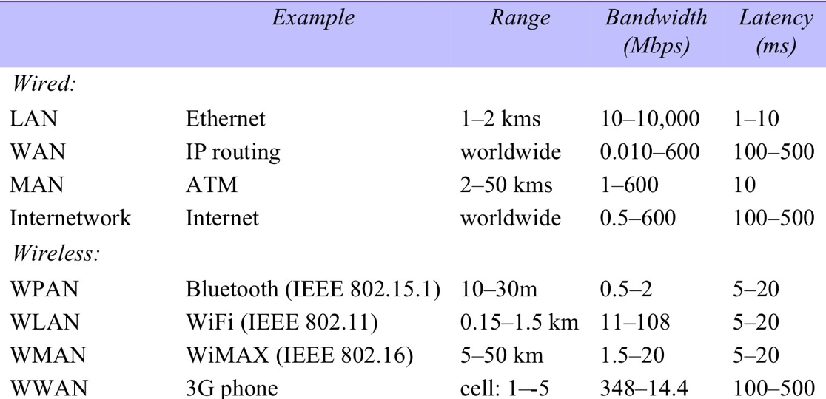
Figure 3.1 Network performance
km
4G 100 megabits per second (Mbit/s)
5G 20 Gigabits peak
Instructor’s Guide for Coulouris, Dollimore, Kindberg and Blair, Distributed Systems: Concepts and Design Edn. 5 © Pearson Education 2012

Slide 15
Network Principles: Packet Switching
Packet switching: Basis for all computer networks is packet switching technique.
Packets for different destinations. Packets are queued in a buffer and transmitted when the communication link is available.
Communication is asynchronous, packets arrived out of order and need to be ordered.
Packets take finite time to travel through the network.
Packet transmission
In most applications requirement is for the transmission of logical units of information or messages.
Before transmission, message is divided into packets of binary data with addressing information for identifying the source and destination.
Need to use optimal packet size to allow for buffering, and avoid delays in transmission.

Slide 16
Network Principles: Data Streaming
Transmission for display of audio and video in real time is referred to as streaming.
Data compression becomes important due to high volumes of data
Hard deadline for delivery of packets: if it does not arrive in time it is useless
Data flow needs to be continuous as opposed to intermittent traffic generated by typical client/server system.
Timely delivery of audio and video streams depends upon the availability of connections with adequate QoS – bandwidth, latency, and reliability
Need to reserve channels, and have adequate buffering
All these are done by upper level protocols at the network and transport layers.
Lesson: When things get complex create a new layer of abstraction.

Slide 17
Figure 3.2 Conceptual layering of protocol software
Message sent
Message received
Layer n
Layer 2
Layer 1
Sender
Communication
Recipient
medium
Instructor’s Guide for Coulouris, Dollimore, Kindberg and Blair, Distributed Systems: Concepts and Design Edn. 5 © Pearson Education 2012

Slide 18
Network Principles: Switching Schemes
A network consists of a set of nodes connected together by circuits. To transmit information between two arbitrary nodes, a switching system is required.
Broadcast: no switching, everything is transmitted to every node.
Circuit switching: This came from the historical precedence that most early networks were telecommunication networks
Packet Switching: The advent of digital technology and computers brought many new possibilities for telecommunication. “storage” and “processing” brought about innovations. For example, “Store and forward” network. Nothing new, digital version of Pony express.
Frame relay: Frames of packets are relayed quickly through the network. Was a fancy a while ago. ATM is an example: Asynchronous Transmission Mode

Slide 19
Network Principles: Protocols
What is a protocol? Is a well-known set of rules and formats to be used for communication between processes in order to perform a given task.
A network protocol has two essential parts:
A specification of the sequence of messages that must be exchanged.
A specification of the format of the data in the messages.
A protocol is implemented by a matched pair of software modules located in the sending and receiving computers.

Slide 20
Internet protocol : A little bit of history
The Internet emerged from TWO decades of research and development work on wide area network in the USA. ➔ ARPANET
ARPANET first large scale network (~1970)
Main contribution is the TCP/IP protocol suite
TCP transmission control protocol
IP Internet Protocol
Many application level protocols emerged based on the TCP/IP foundation:
Web (HTTP, HTTPS), email (SMTP, POP), file transfer (ftp, sftp)
For example HTTP WAS directly transported on top of TCP, when end-to-end security was required, the TLS protocol is layered on to of TCP to produce secure channels…! Retrofitted security.
HTTPS: is simply facilitating mostly payment based transactions!

Slide 21
Figure 3.3 Encapsulation as it is applied in layered protocols
Instructor’s Guide for Coulouris, Dollimore, Kindberg and Blair, Distributed Systems: Concepts and Design Edn. 5 © Pearson Education 2012

Slide 22
Protocol Layers
Network software is arranged in a hierarchy of layers;
Each layer presents an interface to the layer above it that extends the properties of the underlying communication system.
Each layer is represented by a module in every computer connected to the network.
Each layer of the connected computers seems to be interacting with the corresponding layer on the connected computer.
Each layer provides a service to the layer above.
At the bottom is the physical layer: communication medium: satellite comm channels, fiber, copper wire etc.

Slide 23
Protocol Suites
A complete set of protocol layers is referred to as a protocol suite or a protocol stack, reflecting the layered architecture.
ISO International standards organization’s Open System Interconnection standard (OSI)
Protocol layering brings substantial benefits in simplifying and generalization the software interfaces for access to the communication services of networks, but it also carries significant performance costs. Consider the costs…N layers, N transfers?

Slide 24
Figure 3.4 Protocol layers in the ISO Open Systems Interconnection (OSI) model
Instructor’s Guide for Coulouris, Dollimore, Kindberg and Blair, Distributed Systems: Concepts and Design Edn. 5 © Pearson Education 2012

Slide 25
Figure 3.5 OSI protocol summary
Layer
Description
Examples
Application
Protocols that are designed to meet the communication requirements of
HTTP,
FTP
,
SMTP,
specific applications, often defining the interface to a service.
CORBA IIOP
Presentation
Protocols at this level transmit data in a network representation that is
Secure Sockets
independent of the representations used in individual computers, which may
(
SSL),CORBA Data
differ. Encryption is also performed in this layer, if required.
Rep.
Session
At this level reliability and adaptation are performed, such as detection of
failures and automatic recovery.
Transport
This is the lowest level at which messages (rather than packets) are handled.
TCP,
UDP
Messages are addressed to communication ports attached to processes,
Protocols in this layer may be connection-oriented or connectionless.
Network
Transfers data packets between computers in a specific network. In a WAN
IP,
ATM virtual
or an internetwork this involves the generation of a route passing through
circuits
routers. In a single LAN no routing is required.
Data link
Responsible for transmission of packets between nodes that are directly
Ethernet MAC,
connected by a physical link. In a WAN transmission is between pairs of
ATM cell transfer,
routers or between routers and hosts. In a LAN it is between any pair of hosts.
PPP
Physical
The circuits and hardware that drive the network. It transmits sequences of
Ethernet base- band
binary data by analogue signalling, using amplitude or frequency modulation
signalling,
ISDN
of electrical signals (on cable circuits), light signals (on fibre optic circuits)
or other electromagnetic signals (on radio and microwave circuits).
Instructor’s Guide for Coulouris, Dollimore, Kindberg and Blair, Distributed Systems: Concepts and Design Edn. 5 © Pearson Education 2012

Slide 26
Packets, Ports and Addresses
Packets have a header and data field
Data is variable length, and header is fixed length (typically), limits such maximum transfer unit MTU can set the length of a packet.
Ports: Provide network-independent message transport layer between a pair of network ports.
Ports are software defined software defined destination points at a host computer.
Ports are “bound” or attached to a processes, enabling data transmission to be addressed to a specific process at a destination node.
Example: Http: 80, ftp: 21, https 443, sftp (ssh) 22 are reserved
Addresses are specified by network address of the host computer and the port number.
Transport layer is responsible for delivering messages to destination with address as specified above.
There are different types of delivery: datagram and virtual circuit, we will not go into details.
Next lets look at routing:

Slide 27
Routing
Routing is a function that is required in all networks except LANs such as Ethernet that provides direct connection between all pairs of attached hosts.
Delivery of packets is the collective responsibility of special dedicated computers called routers located at strategic points within a network.
Best route for communication between two points is re-evaluated periodically taking into account current traffic and any faults such as broken connections and routers.
A routing algorithm has two functions:
Decide the route taken by each packet as it travels through the network.
Dynamically update its knowledge of the network based on traffic monitoring and the detection of configuration changes or failures.
A simple Routing Information Protocol (RIP): This is a basic algorithm that has been improved many folds and the information maintained at the routers also have increased. This has lead to smart and efficient routing.

Slide 28
Figure 3.7 Routing in a wide area network
A
1
B
Hosts
2
3
Links
4
or local
C
networks
5
D
6
E
Routers
Instructor’s Guide for Coulouris, Dollimore, Kindberg and Blair, Distributed Systems: Concepts and Design Edn. 5 © Pearson Education 2012

Slide 29
Figure 3.8 Routing tables for the network in Figure 3.7
Routings from A
Routings from B
Routings from C
To
Link
Cost
To
Link
Cost
To
Link
Cost
A
local
0
A
1
1
A
2
2
B
1
1
B
local
0
B
2
1
C
1
2
C
2
1
C
local
0
D
3
1
D
1
2
D
5
2
E
1
2
E
4
1
E
5
1
Routings from D
Routings from E
To
Link
Cost
To
Link
Cost
A
3
1
A
4
2
B
3
2
B
4
1
C
6
2
C
5
1
D
local
0
D
6
1
E
6
1
E
local
0
Instructor’s Guide for Coulouris, Dollimore, Kindberg and Blair, Distributed Systems: Concepts and Design Edn. 5 © Pearson Education 2012

Slide 30
RIP Description
Periodically or whenever the local routing table changes SEND the table to all accessible neighbors (outgoing links)
When a “new” table is received from a neighbor on an incoming link, update the local table, if better routes are present.
When you are reviewing the algorithm: look for these three conditions:
New node such as F is added to the network: Condition (Rr is not in Tl)
Faulty or broken link has been identified: condition (Rr.cost>= Rl.cost and Rl.link==n) --- sender knows something; Example link2 to C is broken
Shorter route is found: condition (Rr.cost < Rl.cost) ; Example: broken link2 to C is restored
Show the updated tables for Router A, for the conditions discussed above.

Slide 31
Figure 3.9: Oldest distance-based algorithm Pseudo-code for RIP routing algorithm
Send: Each t seconds or when Tl changes, send Tl on each non-faulty outgoing link.
Receive: Whenever a routing table Tr is received on link n:
for all rows Rr in Tr {
if (Rr.link # n) {
Rr.cost = Rr.cost + 1;
Rr.link = n;
if (Rr.destination is not in Tl) add Rr to Tl;
// add new destination to Tl
else for all rows Rl in Tl {
if (Rr.destination == Rl.destination and
(Rr.cost < Rl.cost or Rl.link == n)) Rl = Rr;
// Rr.cost < Rl.cost : remote node has better route
// Rl.link = n : remote node is more authoritative
}
}
}
Instructor’s Guide for Coulouris, Dollimore, Kindberg and Blair, Distributed Systems: Concepts and Design Edn. 5 © Pearson Education 2012

Slide 32
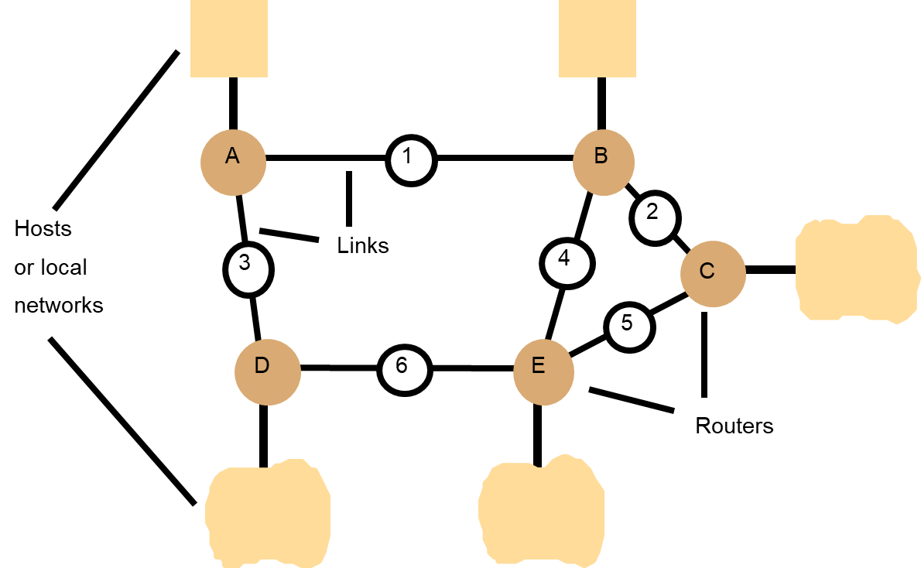
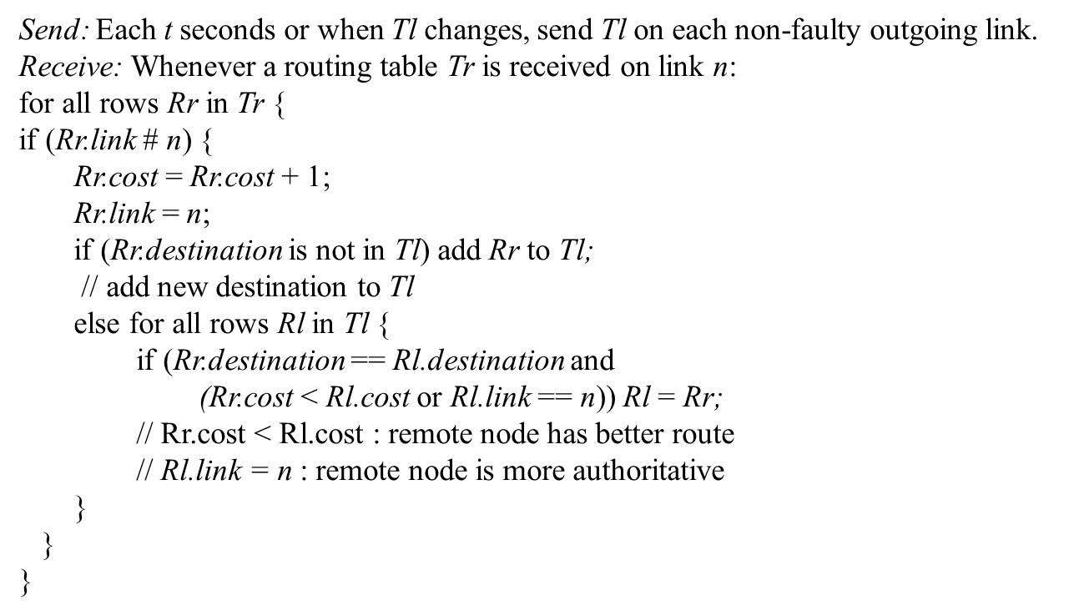
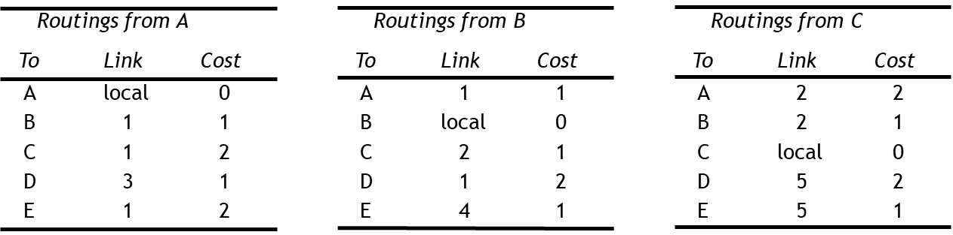
Problem (Definition)
Solution: Algorithm
Solution: Data Structure

Slide 33
Figure 3.11 Tunnelling for IPv6 migration
IPv6 encapsulated in IPv4 packets
IPv4 network
IPv6
IPv6
A
B
Encapsulators
Instructor’s Guide for Coulouris, Dollimore, Kindberg and Blair, Distributed Systems: Concepts and Design Edn. 5 © Pearson Education 2012

Slide 34
Figure 3.13 Encapsulation in a message transmitted via TCP over an Ethernet
Application message
TCP header
port
IP header
TCP
Ethernet header
IP
Ethernet frame
Instructor’s Guide for Coulouris, Dollimore, Kindberg and Blair, Distributed Systems: Concepts and Design Edn. 5 © Pearson Education 2012

Slide 35
Figure 3.14 The programmer's conceptual view of a TCP/IP Internet
Instructor’s Guide for Coulouris, Dollimore, Kindberg and Blair, Distributed Systems: Concepts and Design Edn. 5 © Pearson Education 2012

Slide 36
Figure 3.15 Internet address structure, showing field sizes in bits
28
Instructor’s Guide for Coulouris, Dollimore, Kindberg and Blair, Distributed Systems: Concepts and Design Edn. 5 © Pearson Education 2012

Slide 37
Figure 3.16 Decimal representation of Internet addresses
octet 1
octet 2
octet 3
Range of addresses
Network ID
Host ID
Class A:
1 to 127
0 to 255
0 to 255
0 to 255
1.0.0.0 to
127.255.255.255
Network ID
Host ID
Class B:
128 to 191
0 to 255
0 to 255
0 to 255
128.0.0.0 to
191.255.255.255
Network ID
Host ID
Class C:
192 to 223
0 to 255
0 to 255
1 to 254
192.0.0.0 to
223.255.255.255
Multicast address
Class D (multicast):
224 to 239
0 to 255
0 to 255
1 to 254
224.0.0.0 to
239.255.255.255
Class E (reserved):
240 to 255
0 to 255
0 to 255
1 to 254
240.0.0.0 to
255.255.255.255
Instructor’s Guide for Coulouris, Dollimore, Kindberg and Blair, Distributed Systems: Concepts and Design Edn. 5 © Pearson Education 2012

Slide 38
Figure 3.17 IP packet layout
Instructor’s Guide for Coulouris, Dollimore, Kindberg and Blair, Distributed Systems: Concepts and Design Edn. 5 © Pearson Education 2012

Slide 39
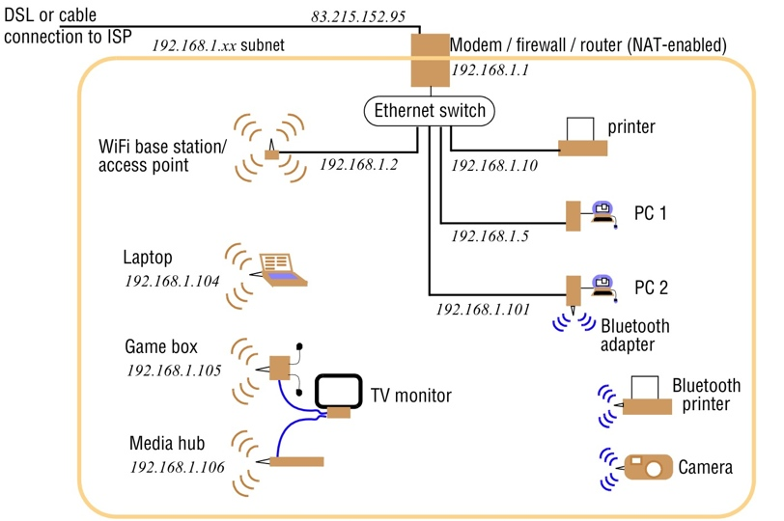
Figure 3.18 A typical NAT-based home network
Instructor’s Guide for Coulouris, Dollimore, Kindberg and Blair, Distributed Systems: Concepts and Design Edn. 5 © Pearson Education 2012

Slide 40
Figure 3.19 IPv6 header layout
Version (4 bits)
Traffic class (8 bits)
Flow label (20 bits)
Payload length (16 bits)
Next header (8 bits)
Hop limit (8 bits)
Source address
(128 bits)
Destination address
(128 bits)
Instructor’s Guide for Coulouris, Dollimore, Kindberg and Blair, Distributed Systems: Concepts and Design Edn. 5 © Pearson Education 2012

Slide 41
Figure 3.22 IEEE 802 network standards
IEEE No.
Name
Title
Reference
802.3
Ethernet
CSMA/CD Networks (Ethernet)
[IEEE 1985a]
802.4
Token Bus Networks
[IEEE 1985b]
802.5
Token Ring Networks
[IEEE 1985c]
802.6
Metropolitan Area Networks
[IEEE 1994]
802.11
WiFi
Wireless Local Area Networks
[IEEE 1999]
802.15.1
Bluetooth
Wireless Personal Area Networks
[IEEE 2002]
802.15.4
ZigBee
Wireless Sensor Networks
[IEEE 2003]
802.16
WiMAX
Wireless Metropolitan Area Networks
[IEEE 2004a]
Instructor’s Guide for Coulouris, Dollimore, Kindberg and Blair, Distributed Systems: Concepts and Design Edn. 5 © Pearson Education 2012

Slide 42
Figure 3.23 Ethernet ranges and speeds
10Base5
10BaseT
100BaseT
1000BaseT
Data rate
10 Mbps
10 Mbps
100 Mbps
1000 Mbps
Max. segment lengths:
Twisted wire (UTP)
100 m
100 m
100 m
25 m
Coaxial cable (STP)
500 m
500 m
500 m
25 m
Multi-mode fibre
2000 m
2000 m
500 m
500 m
Mono-mode fibre
25000 m
25000 m
20000 m
2000 m
Instructor’s Guide for Coulouris, Dollimore, Kindberg and Blair, Distributed Systems: Concepts and Design Edn. 5 © Pearson Education 2012

Slide 43
Figure 3.24 Wireless LAN configuration
Instructor’s Guide for Coulouris, Dollimore, Kindberg and Blair, Distributed Systems: Concepts and Design Edn. 5 © Pearson Education 2012

Slide 44
Figure 3.25 Bluetooth frame structure
bits: 72
18
18
18
0 - 2744
Access code
Header
Header copy 2
Header
Data for transmission
copy 1
copy 3
Header
bits: 3
1
1
1
4
8
Destination
Flow
Ack
Seq
Type
Header checksum
Address within
= ACL, SCO,
Piconet
poll, null
SCO packets (e.g. for voice data) have a 240-bit payload containing 80 bits of data triplicated, filling exactly one timeslot.
Instructor’s Guide for Coulouris, Dollimore, Kindberg and Blair, Distributed Systems: Concepts and Design Edn. 5 © Pearson Education 2012

