Slide 1
Distributed Systems through Web Services
Ch. 9 and extra notes
B.Ramamurthy

Slide 2
Preamble
Chapter 7: Operating Systems: We have a full course covering this topic: CSE4/521
Chapter 8: Distributed Objects and Components : yet another solution to building distributed system.

Slide 3
Introduction to WS
Chapter 9
A web service provides a service interface enabling clients to interact with servers in a more general way than a browsers do.
Clients access the operations in the interface of a web service by means of requests and replies formatted in XML-like languages, and transmitted over HTTP.
Enable global interaction between computers
Models: B2B integration, mashups, third party development of applications.
WS is the technology enabling grid computing and cloud computing.

Slide 4
Evolution of the service concept
A service is a meaningful activity that a computer program performs on request of another computer program.
Technical definition: A service a remotely accessible, self-contained application module.
From IBM,
Object/
Class
Component
Service

Slide 5
Class, Component and Service
Class is a core concept is object-oriented architectures. An object is instantiated form a class.
Focus on client side, single address space programs.
Then came the component/container concept to improve scalability and deployability. Ex: EJBs.
Focus on server side business objects and separation of resources from code.
Service came into use when publishing, discoverability, on-demand operation among interacting enterprise became necessity.
Focus of enterprise level activities, contracts, negotiations, reservations, audits, etc.

Slide 6
Object-oriented programming
Object-oriented programming
Encapsulation of data and function in a class, instances of a class is called an object
Objects communicate through messages (invoking methods)
Class represents a type from which another type can be derived resulting inheritance hierarchy.
Problem: level of abstraction and granularity exposed is fine to enable reuse.
Data and functions are tightly coupled.
The concept of interface
Service-orientation assumes that data and functionality are separated.

Slide 7
WS vs API
WS is a complex monolithic application on the server that exposes an interface for web applications to call and execute an operation. (uses XML-RPC over HTTP)
API is an interface for access data, data structures, functions associated with a service.
WS is an API and not the other way.
API is used to write applications, WS itself is an application that is invoked to carry out an operation. (often uses JSON)
Web browser-web client is a well defined general purpose interaction. WS provides more richer interaction between Web server and web client.

Slide 8
Web services infrastructure and components
Applications
Directory service
Security
Choreography
Web Services
Service descriptions (in WSDL)
SOAP
URIs (URLs or URNs)
XML
HTTP, SMTP or other transport
Instructor’s Guide for Coulouris, Dollimore, Kindberg and Blair, Distributed Systems: Concepts and Design Edn. 5 © Pearson Education 2012

Slide 9
Web services (WS): Example
What better example than amazon web services? AWS
Many other businesses allow clients to access and manipulate their data through web services: ebay, google, etc.

Slide 10
Web Services and the Cloud
Web Service is a technology that allows for applications to communicate with each other in a standard format.
A Web Service exposes an interface that can be accessed through XML messaging.
A Web service uses XML based protocol to describe an operation or the data exchange with another web service. Ex: SOAP, REST
A group of web services collaborating accomplish the tasks of an application. The architecture of such an application is called Service-Oriented Architecture (SOA).
Web service is an important enabling technology of cloud computing: software-as-a-service (SaaS), platform-as-a-service(PaaS), infrastructure-as-a-service (IaaS), now Blockchain as a service (BaaS)

Slide 11
The ‘travel agent service’ combines other web services
flight booking
a
flight booking
b
Client
Travel Agent
Service
hire car booking
a
hire car booking
b
hotel booking
a
hotel booking
b
Instructor’s Guide for Coulouris, Dollimore, Kindberg and Blair, Distributed Systems: Concepts and Design Edn. 5 © Pearson Education 2012

Slide 12
Travel agent scenario
1. The client asks the travel agent service for information about a set of services; for example, flights, car hire and hotel bookings.
2. The travel agent service collects prices and availability information and sends it to the client, which chooses one of the following on behalf of the user:
(a) refine the query, possibly involving more providers to get more information, then repeat step 2;
(b) make reservations;
(c) quit.
3. The client requests a reservation and the travel agent service checks availability.
4. Either all are available;
or for services that are not available;
either alternatives are offered to the client who goes back to step 3;
or the client goes back to step 1.
5. Take deposit.
6. Give the client a reservation number as a confirmation.
7. During the period until the final payment, the client may modify or cancel reservations
Instructor’s Guide for Coulouris, Dollimore, Kindberg and Blair, Distributed Systems: Concepts and Design Edn. 5 © Pearson Education 2012

Slide 13
WS Features
Combination of web services
Communication patterns for better response
Loose coupling
Representation of messages (XML, JSON etc.)
Service references (URI)
Activation of services
Transparency (users don’t have to worry about marshaling details)
WS orchestration (tools)
WS coordination using chereography

Slide 14
WS applications
Compute grid
Amazon web services
Google App Engine
Compare these services with how you use the Google APIs to understand the difference between APIs and WS.

Slide 15
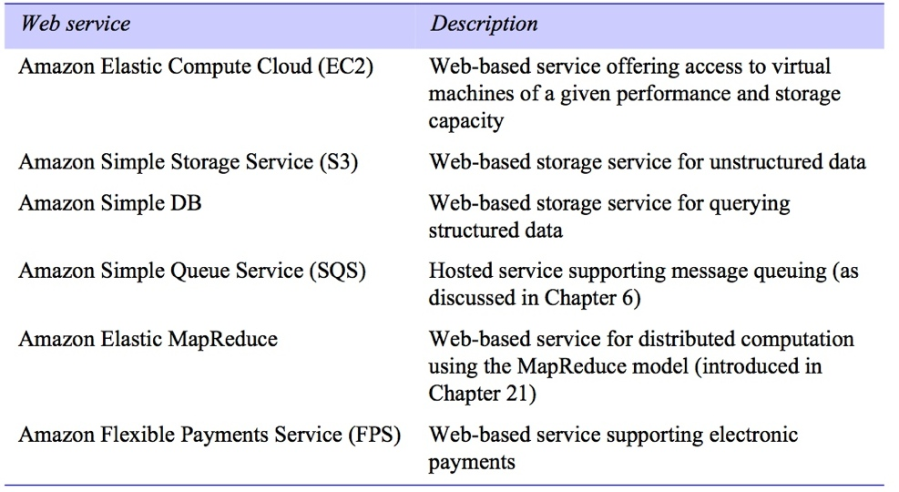
A selection of Amazon Web Services
Instructor’s Guide for Coulouris, Dollimore, Kindberg and Blair, Distributed Systems: Concepts and Design Edn. 5 © Pearson Education 2012

Slide 16
Summary
Many businesses are moving towards APIs and micro services for agility and independent development and monitoring and management capabilities.
Yet, web services do play an important role in the cloud hosting of computing.

Slide 17
Lets explore amazon aws
As we do so, compare your Project 1 API access to AWS services.
Now, do you understand the difference between API and WS?

