Slide 1
Graph Algorithms
Ch. 4 Lin and Dyer

Slide 2
Graphs
Are everywhere
Manifest in the flow of emails
Connections on social network
Bus or flight routes

Slide 3
Graph algorithms
  Graph search and path planning:: shortest path to a node
  Graph clustering:: diving the graphs into smaller related clusters
  Minimum spanning tree:: graph that covers the nodes in an efficient way
  Bipartite graph match:: div graph into two mapping sets: job seekers and employers
  Maximum flow:: designate source and sink; determine max flow between the two: transportation
  Identifying special nodes: authoritative nodes: containment of spread of diseases; Broad street water pump in London, cholera and beginnings of epidemiology

Slide 4
Graph Representations
n1
n2
n5
n3
n4
How do you represent this
visual diagram as data?

Slide 5
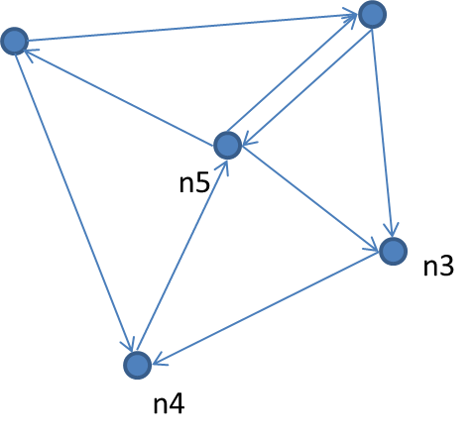
Simple, Baseline Data Structure
n1
n2
n3
n4
n5
n1
n2
n1
0 | 1 | 0 | 1 | 0
0 | 0 | 1 | 0 | 1
0 | 0 | 0 | 1 | 0
0 | 0 | 0 | 0 | 1
1 | 1 | 1 | 0 | 0
n2
n3
n4
n5
Adjacency matrix – this
Is good for linear algebra;
But most web links and social
Networks are sparse
x/ 1000000000
Space req. is O(n²)
n1 [n2, n4]
n2 [n3, n5]
n3 [n4]
n4 [n5]
n5 [n1,n2,n3]
(ii) Adjacency lists

Slide 6
single source shortest path problem
Sequential solution: Dijkstra’s algorithm 5.2
Dijkstra (G, w, s)
d[s] ← 0
for all other vertices d[v] ←∞
Q ← {V} // Q is priority queue based on distances
While Q# 0
u ← min(Q)
for all vertex v in u.adjacencyList
if d[v] > d[u] + w[u,v]
d[v] ← d[u] + w[u,v]
At each iteration of while the algorithm expands the node with the shortest distance and updates distances to all reachable nodes

Slide 7

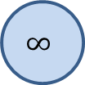



Sample graph
n2
n4
$$∞$$
1
$$∞$$
10
9
0
2
3
4
6
n1
7
5
$$∞$$
$$∞$$
2
n3
n5

