Slide 1
Hbase: Hadoop Database
B. Ramamurthy

Slide 2
Motivation-1
HDFS itself is “big”
Why do we need “hbase” that is bigger and more complex?
Word count, web logs …are simple compared to web pages…consider what a web crawler encounters…
http://www.cse.buffalo.edu
http://www.math.buffalo.edu/index.shtml

Slide 3
Introduction
Persistence is realized (implemented) in traditional applications using Relational Database Management System (RDBMS)
Relations are expressed using tables and data is normalized
Well-founded in relational algebra and functions
Related data are located together
However social relationship data and network demand different kind of data representation
Relationships are multi-dimensional
Data is by choice not normalized (i.e, inherently redundant)
Column-based tables rather than row-based (Consider Friends relation in Facebook)
Sparse table
Solution is Hbase: Hbase is database built on HDFS

Slide 4
Motivation-2
Google: GFS ➔ Big Table➔ Colossus
Facebook: HDFS➔Hive➔ Cassandra➔ Hbase
Yahoo: HDFS➔ Hbase
To source a MR workflow and to sink the output of MR workflow;
To organize data for large scale analytics
To organize data for querying
To organize data for warehousing; intelligence discovery
NO-SQL (see salesforce.com)
Compare storing a Bank Account details and a Facebook User Account details

Slide 5
Hbase
Hbase reference : http://hbase.apache.org
Main concept: millions of rows and billions of columns on top of commodity infrastructure (say, HDFS)
Hbase is a data repository for big-data
It can be a source and sink to HDFS workflow
Hbase includes base classes for supporting and backing MR workflows, Pig and Hive as sink as well as source

Slide 6
When to use Hbase?
When you need high volume data to be stored
Un-structured data
Sparse data
Column-oriented data
Versioned data (same data template, captured at various time, time-elapse data)
When you need high scalability (you are generating data from an MR workflow: you need to store sink it somewhere…)
When you have long rows that a table needs to be split within a traditional row…shrading into horizontal partition.

Slide 7
Hbase: A Definitive Guide
By George Lars
Online version available
Also look at http://www.larsgeorge.com/2009/10/hbase-architecture-101-storage.html

Slide 8
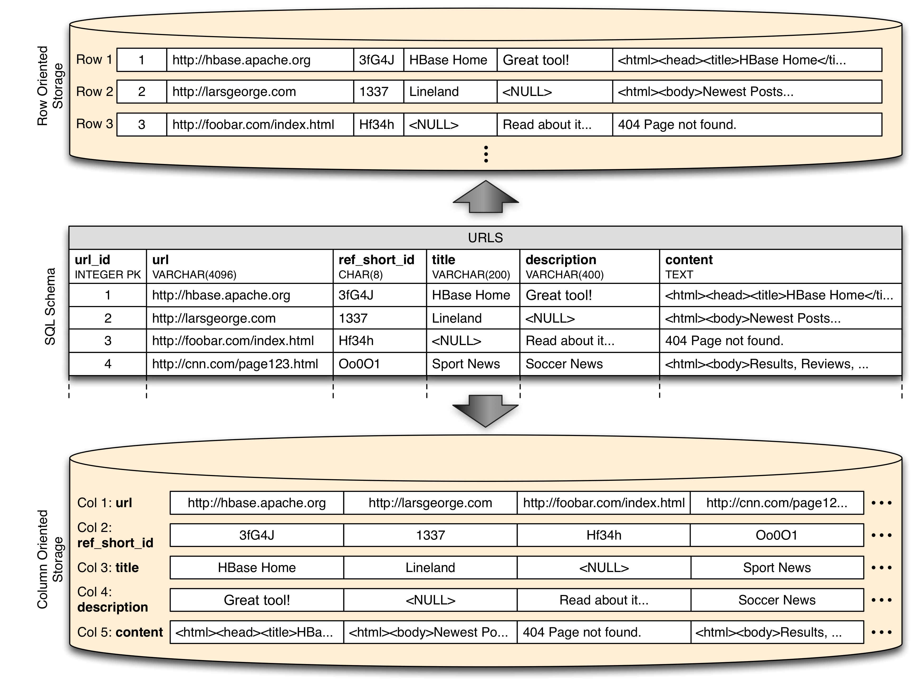
Column-based

Slide 9
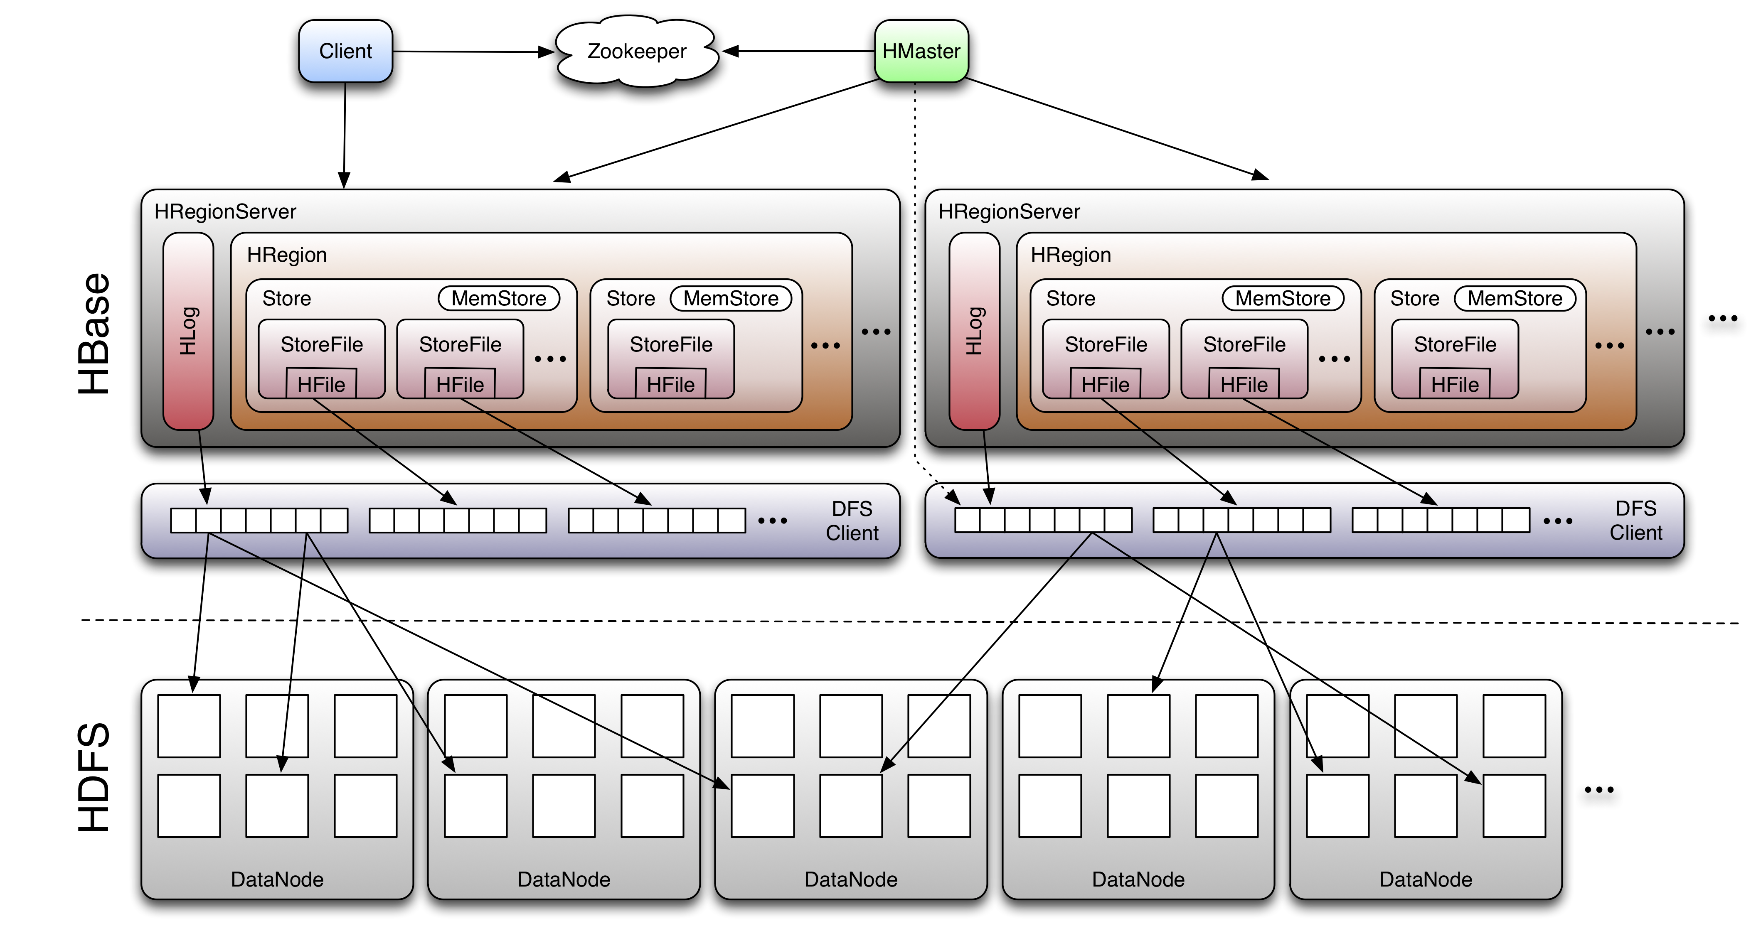
Hbase Architecture

Slide 10
Data Model
http://hbase.apache.org/architecture.html
Table
Row# is some uninterrupted number
Column Families (courses: mth309, courses:cse241)
Region
Region File

