Slide 1
Hadoop EcoSystem
B.Ramamurthy

Slide 2
References
Programming Hive by Edward Capriolo , Dean Wampler , Jason Rutherglen, Oreilly, 2012.
Hive A Warehousing Solution Over MapReduce Framework, by Facebook Infrastructure Team, VLDB 2009, Lyons, France.

Slide 3
Introduction
Google GFS and MapReduce were originally introduced to support data & algorithms for analysis of unstructured text for enabling their “search”
Yahoo and later apache reverse engineered an open source version of this in Yahoo: Hadoop and HDFS came about, later became Apache open source project.
Big Table was created by Google to manage large scale structured data. Hbase is apache’s equivalent to this.
Thus Hadoop ecosystem kept growing…Pig, Hive, Hama,…CloudStack..
On the Google end.. Pregel (graph processing), Dremel,…

Slide 4
Lets examine the current landscape
Structure vs unstructured data (bank account vs news report)
Table vs key,value store
Normalized vs denormalized
Relevance of operations as join, select of SQL-likes
Row-based vs column-based tables
Query vs analysis
Indexed access vs scan of large amount of data for analysis
Complete vs incomplete information (prevalence of null value)
Static vs dynamic (Google uses the term static search)
MR programming vs higher level platform
Historically huge investment & workforce in SQL like interface
Programming vs workflow assembly (why does very to MR for wordcount or classification?)…..

Slide 5
Databases, warehouses
Most databases and warehouses are accessed using SQL-like language.
Hive lowers the barrier for moving data to Hadoop by providing a tool suite similar to SQL.

Slide 6
Architecture of Hadoop Family
MR Applications (in Java/python, ..)
MapReduce Engine
Hadoop Infrastructure/HDFS
Virtual machine (if needed)
Operating system
Hardware infrastructure

Slide 7
Architecture of Hadoop Family
Higher level platforms and tools to access MR, new lang., compiler and all
MR Applications (in Java/python, ..)
MapReduce Engine
Hadoop Infrastructure/HDFS
Virtual machine (if needed)
Operating system
Hardware infrastructure

Slide 8
Higher Level Platforms
Yahoo worked on Pig to facilitate application deployment on Hadoop.
Paltform for large scale analysis of unstructured data
High level language for expressing data analysis program
Complied (!) language; turn programs into MR jobs
Simultaneously Facebook started working on deploying warehouse solutions on Hadoop that resulted in Hive TLP in Apache.
The size of data being collected and analyzed in industry for business intelligence (BI) is growing rapidly making traditional warehousing solution prohibitively expensive.
Analogous to HLL and assembly language
Many opportunities: correctness, audit, evaluation, optimization

Slide 9
Hadoop MR
MR is very low level and requires customers to write custom programs.
HIVE supports queries expressed in SQL-like language called HiveQL which are compiled into MR jobs that are executed on Hadoop.
Hive also allows MR scripts
It also includes MetaStore that contains schemas and statistics that are useful for data explorations, query optimization and query compilation.
At Facebook Hive warehouse contains tens of thousands of tables, stores over 700TB and is used for reporting and ad-hoc analyses by 200 Fb users(that was then).. 15TB data set in 2007 to a 2PB data set in 2009….30PB in Jan 2011…

Slide 10
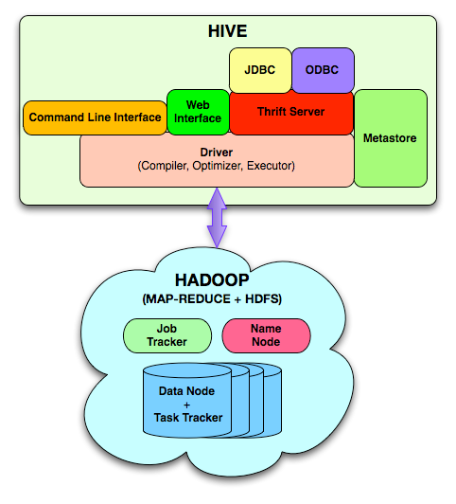
Hive architecture (from the paper)

Slide 11
Data model
Hive structures data into well-understood database concepts such as: tables, rows, cols, partitions
It supports primitive types: integers, floats, doubles, and strings
Hive also supports:
associative arrays: map<key-type, value-type>
Lists: list<element type>
Structs: struct<file name: file type…>
SerDe: serialize and deserialized API is used to move data in and out of tables (check your knowledge about serialization)

Slide 12
Query Language (HiveQL)
Subset of SQL
Meta-data queries
Limited equality and join predicates
No inserts on existing tables (to preserve worm property)
Can overwrite an entire table

Slide 13
Wordcount in Hive
FROM (
MAP doctext USING 'python wc_mapper.py' AS (word, count)
FROM docs
CLUSTER BY word
) a
REDUCE word, count USING 'pythonwc_reduce.py';

Slide 14
Wordcount in HiveQL
CREATE TABLE docs (line STRING);
LOAD DATA INPATH ‘docs’ OVERWRITE TABLE docs;
CREATE TABLE word_counts AS
SELECT word, count(1) AS count FROM
(SELECT EXPLODE(split(line,’\s’)) AS word FROM docs) w
GROUP BY word; // aggregates
ORDER BY word; // orders

Slide 15
Session/tmstamp example
FROM (
FROM session_table
SELECT sessionid, tstamp, data
DISTRIBUTE BY sessionid SORT BY tstamp
) a
REDUCE sessionid, tstamp, data USING 'session_reducer.sh';

Slide 16
Data Storage
Tables are logical data units; table metadata associates the data in the table to hdfs directories.
Hdfs namespace: tables (hdfs directory), partition (hdfs subdirectory), buckets (subdirectories within partition)
/user/hive/warehouse/test_table is a hdfs directory

Slide 17
Hive architecture (from the paper)

Slide 18
Architecture
Metastore: stores system catalog
Driver: manages life cycle of HiveQL query as it moves thru’ HIVE; also manages session handle and session statistics
Query compiler: Compiles HiveQL into a directed acyclic graph of map/reduce tasks
Execution engines: The component executes the tasks in proper dependency order; interacts with Hadoop
HiveServer: provides Thrift interface and JDBC/ODBC for integrating other applications.
Client components: CLI, web interface, jdbc/odbc inteface
Extensibility interface include SerDe, User Defined Functions and User Defined Aggregate Function.
Thrift: thrift --gen <language> <Thrift filename>

Slide 19
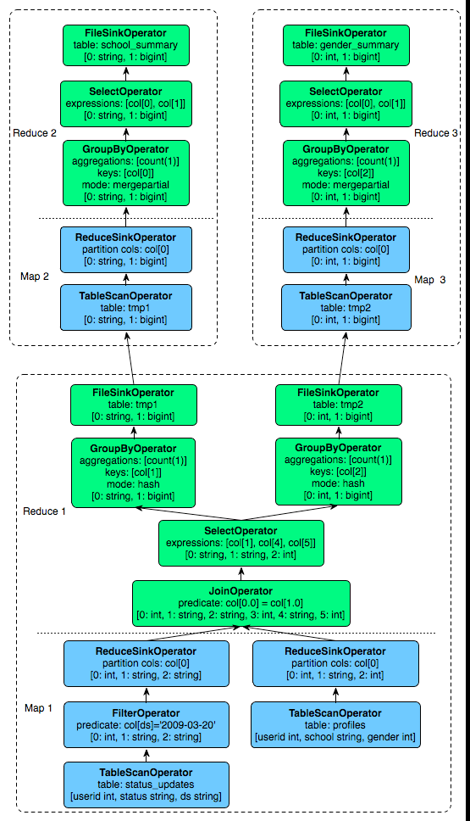
Sample Query Plan

Slide 20
Hive Usage
Hive and Hadoop are extensively used in Facbook for different kinds of operations.
700 TB = 2.1Petabyte after replication! (2009)
Think of other application model that can leverage Hadoop MR.
Think of improving the internals of the tools: optimizations, better code generation, verification, evaluation etc.

