Slide 1
Inverted Indexing for Text Retrieval
Chapter 4 Lin and Dyer

Slide 2
Introduction
Web search is a quintessential large-data problem.
So are any number of problems in genomics.
  Google, amazon (aws) all are involved in research and discovery in this area
Web search or full text search depends on a data structure called inverted index.
Web search problem breaks down into three major components:
  Gathering the web content (crawling) (project 1)
  Construction of inverted index (indexing) (project 2)
  Ranking the documents given a query (retrieval) (exam 2)

Slide 3
Issues with these components
Crawling and indexing have similar characteristics: resource consumption is high
Retrieval is very different from these: spikey, variability is high, quick response is a requirement, many concurrent users;
There are many requirements for a web crawler or in general a data aggregator..
  Etiquette, bandwidth resources, multilingual, duplicate contents, frequency of changes…

Slide 4
Inverted Indexes
Regular index: Document → terms
Inverted index term→documents
Example:
term1 → {d1,p}, {d2, p}, {d23, p}
term2 → {d2, p}. {d34, p}
term3 → {d6, p}, {d56, p}, {d345, p}
Where d is the doc id, p is the payload (example for payload: term frequency… this can be blank too)

Slide 5
Retrieval
Once the inverted index is developed, when a query comes in, retrieval involves fetching the appropriate docs.
The docs are ranked and top k docs are listed.
It is good to have the inverted index in memory.
If not , some queries may involve random disk access for decoding of postings.
Solution: organize the disk accesses so that random seeks are minimized.

Slide 6
Pseudo Code
Pseudo code → Baseline implementation → value-key conversion pattern implementation→…

Slide 7
Baseline implementation
procedure map (docid n, doc d)
H ← new Associative array
for all terms in doc d
H{t} ← H{t} + 1
for all term in H
emit(term t, posting <n, H{t}>)

Slide 8
Reducer for baseline implmentation
procedure reducer( term t, postings[<n1, f1> <n2, f2>, …])
P ← new List
for all posting <a,f> in postings
Append (P, <a,f>)
Sort (P) // sorted by docid
Emit (term t, postings P)

Slide 9
Shuffle an sort phase
Is a very large group by term of the postings
Lets look at a toy example
Fig. 4.3 some items are incorrect in the figure

Slide 10
Revised Implementation
Issue: MR does not guarantee sorting order of the values.. Only by keys
So the sort in the reducer is an expensive operation esp. if the docs cannot be held in memory.
Lets check a revised solution
(term t, posting<docid, f>) to
(term<t,docid>, tf f)

Slide 11
Modified mapper
Map (docid n, doc d)
H ← new AssociativeArray
For all terms t in doc
H{t} ← H{t} + 1
For all terms in H
emit (tuple<t,n>, H{t})

Slide 12
Modified Reducer
Initialize
tprev ← 0
P ← new PostingList
method reduce (tuple <t,n>, tf [f1, ..])
if t # tprev ^ tprev # 0
{ emit (term t, posting P);
reset P; }
P.add(<n,f>)
tprev ← t
Close
emit(term t, postings P)

Slide 13
Other modifications
Partitioner and shuffle have to deliver all related <key, value> to same reducer
Custom partitioner so that all terms t go to the same reducer.
Lets go through a numerical example

Slide 14
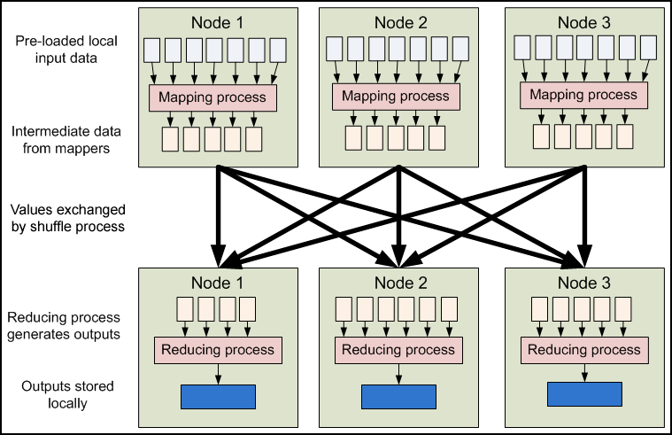
From Yahoo site

Slide 15
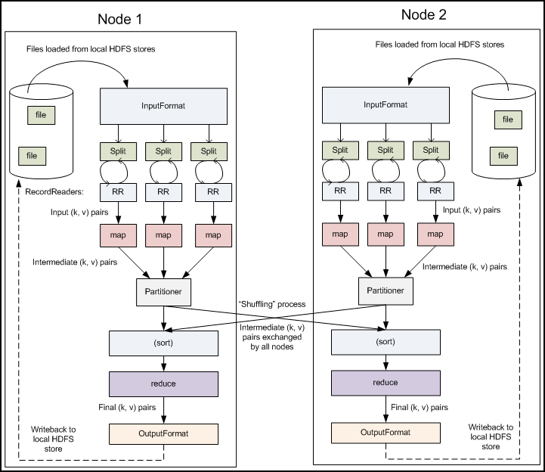

Slide 16
