Slide 1
MapReducing Graph Algorithms
Lin and Dyer’s Chapter 5

Slide 2
Issues in processing a graph in MR
Goal: start from a given node and label all the nodes in the graph so that we can determine the shortest distance
Representation of the graph (of course, generation of a synthetic graph)
Determining the <key,value> pair
Iterating through various stages of processing and intermediate data
When to terminate the execution

Slide 3
Input data format for MR
Node: nodeId, distanceLabel, adjancency list {nodeId, distance}
This is one split
Input as text and parse it to determine <key, value>
From mapper to reducer two types of <key, value> pairs
<nodeid n, Node N>
<nodeid n, distance until now label>
Need to keep the termination condition in the Node class
Terminate MR iterations when none of the labels change, or when the graph has reached a steady state or all the nodes have been labeled with min distance
Now lets look at the algorithm given in the book

Slide 4
Mapper
Class Mapper
method map (nid, Node N)
d ← N.distance
emit(nid, N)
for all m in N. Adjacencylist
emit(nid m, d+1)

Slide 5
Reducer
Class Reducer
method Reduce(nid m, [d1, d2, d3..])
dmin = 100000;
Node M ← null
for all d in [d2,d2, ..]
{ if d is a Node then M ← d
else if d < dmin then dmin ← d}
M.distance ← dmin
emit (nid m, Node M)

Slide 6
Trace with sample Data
1 0 2:3:
2 10000 3:4:
3 10000 2:4:5
4 10000 5:
5 10000 1:4

Slide 7
Intermediate data
1 0 2:3:
2 1 3:4:
3 1 2:4:5:
4 10000 5:
5 10000 1:4:

Slide 8
Intermediate Data
1 0 2:3:
2 1 3:4:
3 1 2:4:5:
4 2 5:
5 2 1:4:

Slide 9
Final Data
1 0 2:3:
2 1 3:4:
3 1 2:4:5:
4 2 5:
5 2 1:4:

Slide 10
Sample Data
1 0 2:3:
2 10000 3:4:
3 10000 2:4:5
4 10000 5:
5 10000 1:4
1 0 2:3:
2 1 3:4:
3 1 2:4:5
4 10000 5:
5 10000 1:4
1 0 2:3:
2 1 3:4:
3 1 2:4:5
4 2 5:
5 2 1:4

Slide 11
Project 1 hints
For co-occurrence you need to update record reader to use paragraph as context
No relative freq, but absolute count
For graph processing you need to use “counters” (that is a class in the new version of Hadoop) to collect state between iterations. This is to stop the iterations of MR.

Slide 12
PageRank
http://ilpubs.stanford.edu:8090/422/1/1999-66.pdf
Larry Page and Sergei Brin (Standford Ph.D. students)
Rajeev Motwani and Terry Winograd (Standford Profs)

Slide 13
General idea
Consider the world wide web with all its links.
Now imagine a random web surfer who visits a page and clicks a link on the page
Repeats this to infinity
Pagerank is a measure of how frequently will a page will be encountered.
In other words it is a probability distribution over nodes in the graph representing the likelihood that a random walk over the linked structure will arrive at a particular node.

Slide 14
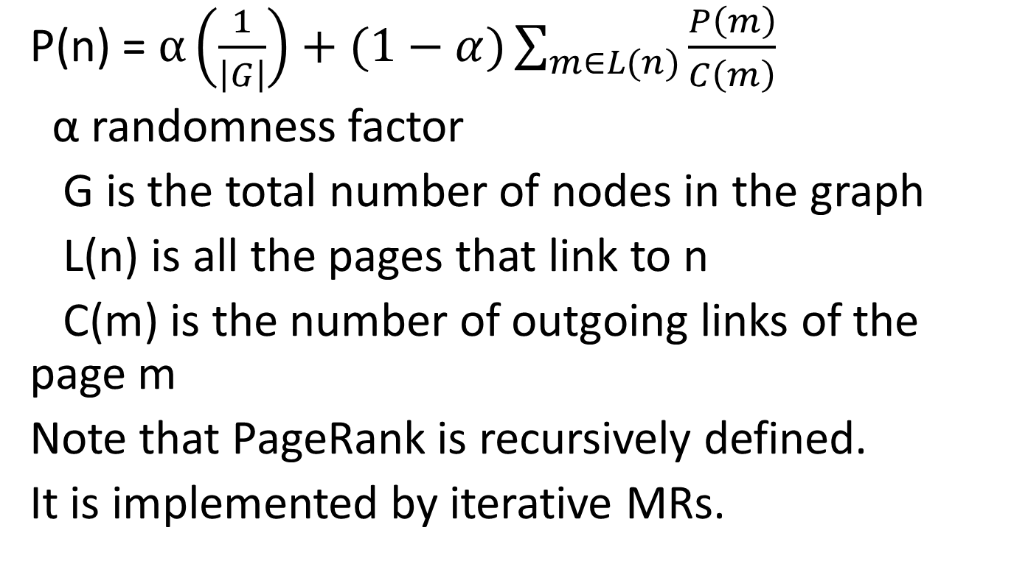
PageRank Formula
P(n) = $α\left(\frac{1}{\left|G\right|}\right)+(1−α)\sum_{m∈L(n)}{\frac{P\left(m\right)}{C\left(m\right)}}$
α randomness factor
G is the total number of nodes in the graph
L(n) is all the pages that link to n
C(m) is the number of outgoing links of the page m
Note that PageRank is recursively defined.
It is implemented by iterative MRs.

Slide 15
Example
Figure 5.7
Alpha is assumed to be zero
Lets look at the MR

Slide 16
Mapper for PageRank
Class Mapper
method map (nid, Node N)
p ← N.Pagerank/|N.Adajacency|
emit(nid, N)
for all m in N. Adjacencylist
emit(nid m, p)
“divider”

Slide 17
Reducer for Pagerank
Class Reducer
method Reduce(nid m, [p1, p2, p3..])
Node M ← null; s = 0;
for all p in [p1,p2, ..]
{ if p is a Node then M ← p
else s ← s+p}
M.pagerank ← s
emit (nid m, Node M)
“aggregator”

Slide 18
Lets trace with sample data

Slide 19
Issues
How to account for dangling nodes: one that has many incoming links and no outgoing links
Simply redistributes its pagerank to all
One iteration requires pagerank computation + redistribution of “unused” pagerank
Pagerank is iterated until convergence: when is convergence reached?
Probability distribution over a large network means underflow of the value of pagerank.. Use log based computation
MR: How do PRAM alg. translate to MR? how about other math algorithms?

