Slide 1
Design of Pig
B. Ramamurthy

Slide 2
Pig’s data model
Scalar types: int, long, float (early versions, recently float has been dropped), double, chararray, bytearray
Complex types: Map,
Map: chararray to any pig element; in fact , this <key> to <value> mapping; map constants [‘name’#’bob’, ‘age’#55] will create a map with two keys name and age, first value is chararray and the second value is an integer.
Tuple: is a fixed length ordered collection of Pig data elements. Equivalent to a roq in SQL. Order, can refer to elements by field position. (‘bob’, 55) is a tuple with two fields.
Bag: unodered collection of tuples. Cannot reference tuple by position. Eg. {(‘bob’,55), (‘sally’,52), (‘john’, 25)} is a bog with 3 tuples; bogs may become large and may spill into disk from “in-memory”
Null: unknown, data missing; any data element can be null; (In Java it is Null pointers… the meaning is different in Pig)

Slide 3
Pig schema
Very relaxed wrt schema.
Scheme is defined at the time you load the data
Table 4-1
Runtime declaration of schemes is really nice.
You can operate without meta data.
On the other hand, meta data can be stored in a repository Hcatalog and used. For example JSON format… etc.
Gently typed: between Java and Perl at two extremes

Slide 4
Schema Definition
divs = load ‘NYSE_dividends’ as (exchange:chararray, symbol:chararray, date:chararray, dividend:double);
Or if you are lazy
divs = load ‘NYSE_dividends’ as (exchange, symbol, date, dividend);
But what if the data input is really complex? Eg. JSON objects?
One can keep a scheme in the HCatalog (apache incubation), a meta data repository for facilitating reading/loading input data in other formats.
divs = load ‘mydata’ using HCatLoader();

Slide 5
Pig Latin
Basics: keywords, relation names, field names;
Keywords are not case sensitive but relation and fields names are! User defined functions are also case sensitive
Comments /* */ or single line comment –
Each processing step results in data
Relation name = data operation
Field names start with aplhabet

Slide 6
More examples
No pig-schema
daily = load ‘NYSE_daily’;
calcs = foreach daily generate $7/100.0, SUBSTRING($0,0,1), $6-$3);
Here – is only numeric on Pig)
No-schema filter
daily = load ‘NYSE_daily’;
fltrd = filter daily by $6 > $3;
Here > is allowed for numeric, bytearray or chararray.. Pig is going to guess the type!
Math (float cast)
daily = load ‘NYSE_daily’ as (exchange, symbol, date, open, high:float,low:float, close, volume:int, adj_close);
rough = foreach daily generate volume * close; -- will convert to float
Thus the free “typing” may result in unintended consequences.. Be aware. Pig is sometimes stupid.
For a more in-depth view look at also hoe “casts” are done in Pig.

Slide 7
Load (input method)
Can easily interface to hbase: read from hbase
using clause
divs = load ‘NYSE_dividends’ using HBaseStorage();
divs = load ‘NYSE_dividends’ using PigStorage();
divs = load ‘NYSE_dividends’ using PigStorage(,);
as clause
daily = load ‘NYSE_daily’ as (exchange, symbol, date, open, high,low, close, volume);

Slide 8
Store & dump
Default is PigStorage (it writes as tab separated)
store processed into ‘/data/example/processed’;
For comma separated use:
store processed into ‘/data/example/processed’ using PigStorage(,);
Can write into hbase using HBaseStorage():
store ‘processed’ using into HBaseStorage();
Dump for interactive debugging, and prototyping

Slide 9
Relational operations
Allow you to transform by sorting, grouping, joining, projecting and filtering
foreach supports as array of expressions: simplest is constants and field references.
rough = foreach daily generate volume * close;
calcs = foreach daily generate $7/100.0, SUBSTRING($0,0,1), $6-$3);
UDF (User Defined Functions) can also be used in expressions
Filter operation
CMsyms = filter divs by symbol matches ‘CM*’;

Slide 10
Operations (cntd)
Group operation collects together records with the same key.
grpd = group daily by stock; -- output is <key, bag>
counts = foreach grpd generate group, COUNT(daily);
Can also group by multiple keys
grpd = group daily by (stock, exchange);
Group forces the “reduce” phase of MR
Pig offers mechanism for addressing data skew and unbalanced use of reducers (we will not worry about this now)

Slide 11
Order by
Strict total order…
Example:
daily = load “NYSE_daily” as (exchange, symbol, close, open,…)
bydate = order daily by date;
bydateandsymbol = order daily by date, symbol;
byclose = order by close desc, open;

Slide 12
More functions
distinct primitive: to remove duplicates
Limit:
divs = load ‘NYSE_dividends’;
first10 = limit divs 10;
Sample
divs = load ‘NYSE_dividends’;
some = sample divs 0.1;

Slide 13
More functions
Parallel
daily = load ‘NYSE_daily’;
bysym = group daily by symbol parallel 10;
(10 reducers)
Register, piggybank.jar
register ‘piggybank.jar’
divs = load ‘NYSE_dividens’;
backwds = foreach divs generate Reverse(symbol);
Illustrate, describe …

Slide 14
How do you use pig?
To express the logical steps in big data analytics
For prototyping?
For domain experts who don’t want to learn MR but want to do big data
For a one-time job: probably will not be repeated
Quick demo of the MR capabilities
Good for discussion of initial MR design & planning (group, order etc.)
Excellent interface to a data warehouse

Slide 15
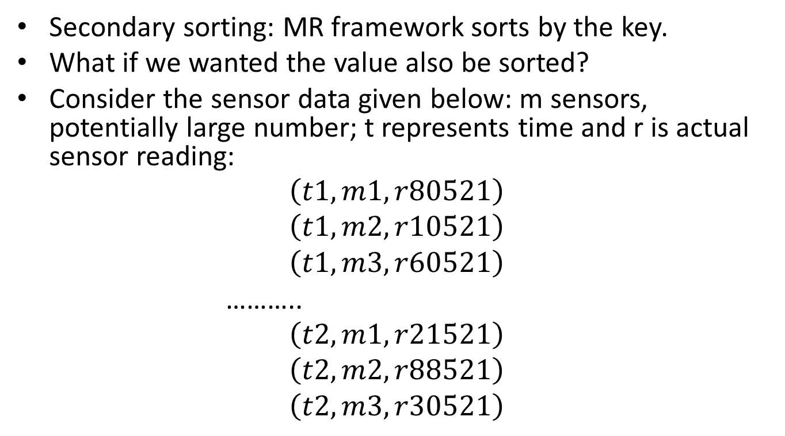
Back to Chapter 3
Secondary sorting: MR framework sorts by the key.
What if we wanted the value also be sorted?
Consider the sensor data given below: m sensors, potentially large number; t represents time and r is actual sensor reading:
$$\left(t1, m1, r80521\right)$$
$$\left(t1, m2, r10521\right)$$
$$\left(t1, m3, r60521\right)$$
………..
$$\left(t2, m1, r21521\right)$$
$$\left(t2, m2, r88521\right)$$
$$\left(t2, m3, r30521\right)$$

Slide 16
Secondary Sorting
Problem: monitor activity
m1→ (t1, r80521) this is group by sensor mx…
But the group itself will not be in temporal order for each sensor.
Solution 1: reducer doing the sort…
Problems: in-memory buffering potential scalability bottleneck; what if the readings are over long period of time? What if it is a high frequency sensor? What if we are working with large complex objects?
We did this by making the key:
(m1, t1) → [(r80521)]
You must write the sort order.. For the framework and need a custom partitioner for all keys related to the same sensor (mx) are routed to the same reducer.
Why is it alright to sort at the infrastructure level?

Slide 17
Data Warehousing
Popular application of Hadoop. (remember Hive)
Vast repository of data, foundation for Business intelligence (BI)
Stores semi-structured as well as unstructured data
Problem: how to implement relational joins?

Slide 18
Relational joins
Relation S
Relation T
(k1, s1, S1)
(k2, s2, S2)
(k3, s3, S3)
(k1, t1, T1)
(k2, t2, T2)
(k3, t3, T3)
k is the key, s/t is the tuple id, and S/T attributes of the tuple
Example: S is a collection of user profiles, k –user id, tuple demographic info
(age, gender, income, etc.),
T online log of activity of the people; page view, money spent, time spent on page etc.
Joining S and T helps in determining the spending habits by say demographics.

Slide 19
Join Solutions
Reduce-side join: simple map both relations and emit the <k, (sn, Sn), (tx, Tx)> for the reducer to work with.
One-one join: not a lot of work for reducer
One-many join: many-many join
Map-side join: read both relations into map and let the hadoop infrastructure do the sorting/join.

