Slide 1
Algorithms for Data Analytics
Chapter 3

Slide 2
Plans
Introduction to Data-intensive computing (Week 1)
Statistical Inference: Foundations of statistics (Chapter 2) (Week 2)
This week we will look at Algorithms for data analytics (Chapter 3)
  A Data Scientist: Stat (Ch.2) + Algorithms (Ch.3) + BigData (Lin&Dyer’s text)
  Uniqueness of this course
  Using the right tools and pre-existing libraries “creatively” (see Project 1)
  Statistical inference comes from statisticians (nothing new)
  Algorithms come from Computer Scientists (nothing new)
  Both area have taken a new meaning in the context of Big-data

Slide 3

The Data Science Process
Exploratory data analysis
Raw data collected
Data is processed
Data is cleaned
Machine learning algorithms;
Statistical models
Build data products
Communication
Visualization
Report Findings
Make decisions

Slide 4
Data Collection in Automobiles
Large volumes of data is being collected the increasing number of sensors that are being added to modern automobiles.
Traditionally this data is used for diagnostics purposes.
How else can you use this data?
How about predictive analytics? For example, predict the failure of a part based on the historical data and on-board data collected?
On-board-diagnostics (OBDI) is a big thing in auto domain.

Slide 5
Three Types of Data Science Algorithms
Pipelines (data flow) to prepare data
Three types:
Data preparation algorithms such as sorting, MapReduce, and Pregel
Optimization algorithms stochastic gradient descent, least squares…
Machine learning algorithms…

Slide 6
Machine Learning Algorithms
Comes from Artificial Intelligence
No underlying generative process
Build to predict or classify something
Read the very nice comparison between alg and stat on p.53
-- parameters have real-world interpretations – algs do not focus on parameters but on the process itself
-- there is no concept confidence intervals in algs
-- algs are non-parametric solutions. No assumptions about underlying distributions.

Slide 7
Three Basic Algorithms
Three algorithms are discussed: linear regression, k-nn, k-means
We will start with k-means…and move backwards
K-means “clustering” algorithm
K-NN “classification” algorithm
Linear regression – statistical model

Slide 8
K-means
K-means is unsupervised: no prior knowledge of the “right answer”
Goal of the algorithm is to determine the definition of the right answer by finding clusters of data
Kind of data g+ data, survey data, medical data, SAT scores
Assume data {age, gender, income, state, household, size}, your goal is to segment the users.
Lets understand kmeans using an example.
Also read about “birth of statistics” in John Snow’s classic study of Cholera epidemic in London 1854: “cluster” around Broadstreet pump: http://www.ph.ucla.edu/epi/snow.html

Slide 9
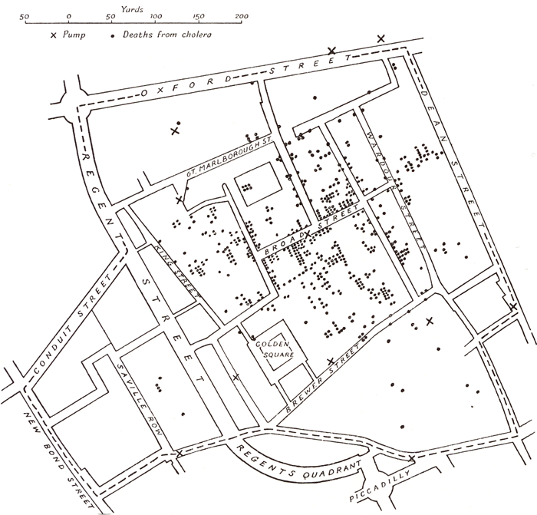

Slide 10
K-means
Clustering algorithm : no classes known apriori
Partitions n observations into k clusters
Clustering algorithm where there exists k bins
Clusters in d dimensions where d is the number of features for each data point
Lets understand k-means

Slide 11
K-means Algorithm
Initially pick k centroids
Assign each data point to the closest centroid
After allocating all the data points, recomputed the centroids
If there is no change or an acceptable small change, clustering is complete
Else continue step 2 with the new centroids.
Assert: K clusters
Example: disease clusters (regions)
John Snow’s London Cholera mapping (big cluster around Broad Street)

Slide 12
Issues
How to choose k?
Convergence issues?
Sometimes the result is useless… often
Side note: in 2007 D. Arthur and S.Vassilvitskii developed k-mean++ addresses convergence issues by optimizing the initial seeds…

Slide 13
Lets look at an example
23 25 24 23 21 31 32 30 31 30 37 35 38 37 39 42 43 45 43 45
K = 3

Slide 14
2D version (x,y)

Slide 15
K-NN
K- nearest neighbor
Supervised ML
You know the “right answers” or at least data that is “labeled”: training set
Set of objects have been classified or labeled (training set)
Another set of objects are yet to be labeled or classified (test set)
Your goal is to automate the processes of labeling the test set.
Intuition behind k-NN is to consider most similar items --- similarity defined by their attributes, look at the existing label and assign the object a label.

Slide 16
K-NN
No assumption about underlying data distribution (non-parametric)
Classification algorithm; supervised learning
Lazy classification: no explicit training set
  Data set in which some of them are labeled and other(s) are not
Intuition: Your goal is to learn the labeled set (training data) and use that to classify the unlabeled data
What is k? K-nearest neighbor of the unlabeled data “vote” on the class/label of the unlabeled data: majority vote wins
It is “local” approximation, quite fast for few dimensions
Lets look at some examples.

Slide 17
Data Set 1 (head)
Age | income | Credit rating
69 | 3 | low
66 | 57 | low
49 | 79 | low
49 | 17 | low
58 | 26 | high
44 | 71 | high

Slide 18
Intentionally left blank

Slide 19
Issues in K-NN
How to choose K? # of neighbors
  Small K: you overfit
  Large K : you may underfit
  Or base it on some evaluation measure for k
    choose one that results in least % error for the training data
How do you determine the neighbors?
  Euclidian distance
  Manhattan distance
  Cosine similarity etc.
Curse of dimensionality… in multiple dimensions.. Too long
  Perhaps MR could help here…think about this.

Slide 20
Linear Regression (intuition only)
Consider x and y
(x1, y2) (x2, y2)…
(1,25) (10,250) (100,2500) (200, 5000)
y = 25* x (model)
How about (7,276) (3,43), (4,82), (6,136), (10,417), (9,269)…..?
You have bunch of lines.
y = β.x (fit the model: determine the β matrix)
Best fit may be the line where the distance
of the points from the line is least.
---sum of squares of the vertical distances of predicted
and observed is minimal gives the best fit…

Slide 21
Summary
We will revisit these basic algorithms after we learn about MR.
You will experience using K-means in R in Project 2
Xindong Wu, Vipin Kumar, J. Ross Quinlan, Joydeep Ghosh, Qiang Yang, Hiroshi Motoda, Geoffrey J. McLachlan, Angus Ng, Bing Liu, Philip S. Yu, Zhi-Hua Zhou, Michael Steinbach, David J. Hand and Dan Steinberg, Top 10 Algorithms in Data Mining, Knowledge and Information Systems, 14(2008), 1: 1-37.
We hosted an expert Dr. James Zhang from Bloomberg to talk on 3/4/2014 on Machine Learning (Sponsored by Bloomberg, CSE and ACM of UB).

Slide 22
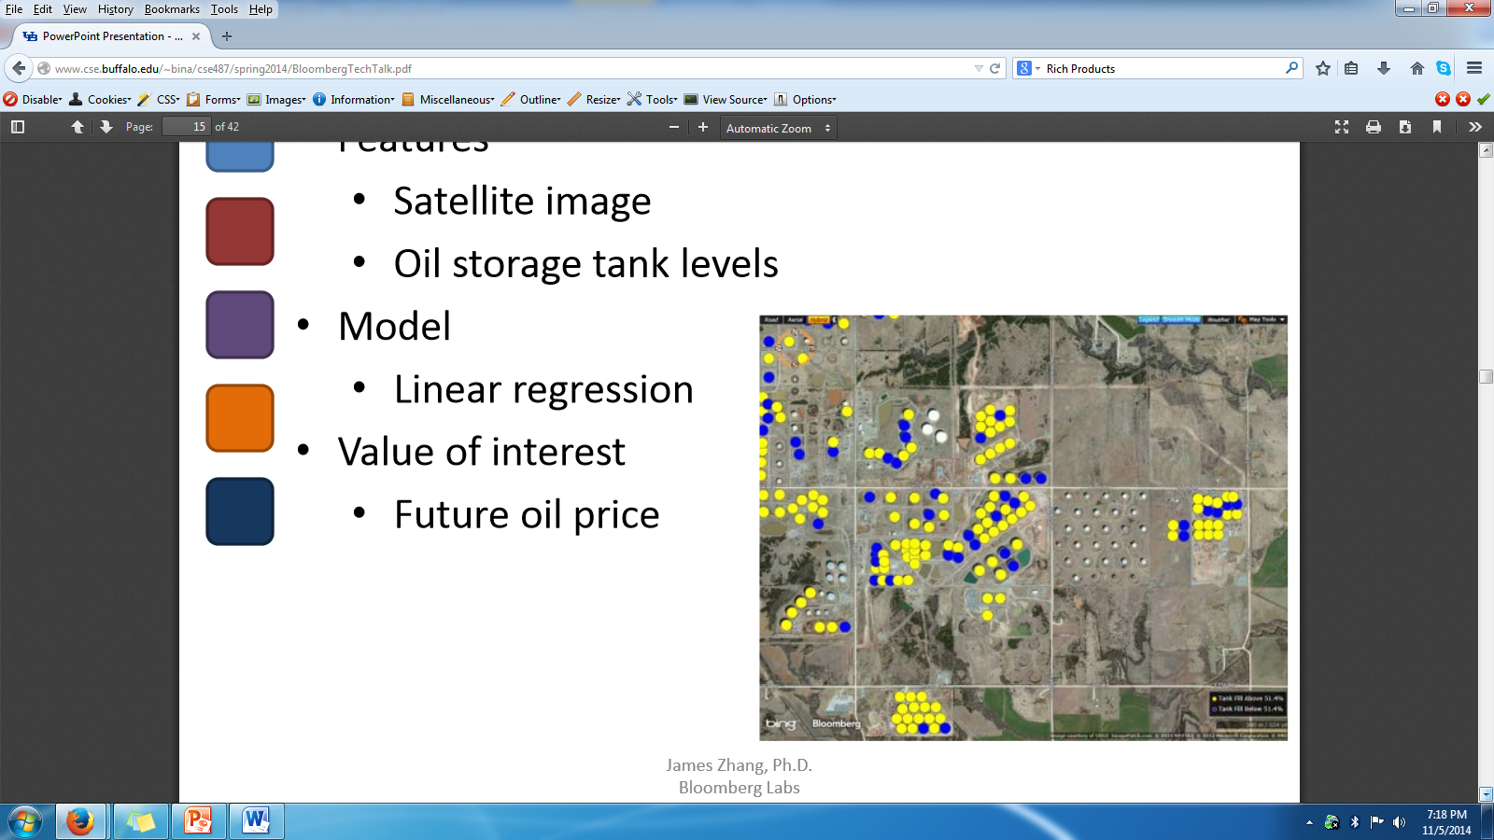
Oil Price Prediction

