Slide 1
Data-Intensive Computing
B.Ramamurthy

Slide 2
Data-intensive computing
The phrase was initially coined by National Science Foundation (NSF)
What is it?
Volume, velocity, variety, veracity (uncertainty) (Gartner, IBM)
How is it addressed?
Why now?
What do you expect to extract by processing this large data?
Intelligence for decision making
What is different now?
Storage models, processing models
Big Data, analytics and cloud infrastructures
Summary

Slide 3
Motivation
Tremendous advances have taken place in statistical methods and tools, machine learning and data mining approaches, and internet based dissemination tools for analysis and visualization.
Many tools are open source and freely available for anybody to use.
Is there an easy entry-point into learning these technologies?
Can we make these tools easily accessible to the students, researchers and decision makers similar to how “office” productivity software is used?

Slide 4
High Level Goals for the course
Understand foundations of data analytics so that you can interpret and communicate results and make informed decisions
Study and learn to apply common statistical methods and machine learning algorithms to solve business problems
Learn to work with popular tools to analyze and visualize data; more importantly encourage consistency across departments on analytics/tools used
Working with cloud for data storage and for deployment of applications
Learn methods for mastering and applying emerging concepts and technologies for continuous data-driven improvements to your research/work/business processes
Transform complex analytics into routine processes

Slide 5
Newer kinds of Data
New kinds of data from different sources (see p.23 of Data Science book) : tweets, geo location, emails, blogs
Two major types: structured and unstructured data
Structured data: data collected and stored according to well defined schema; Realtime stock quotes
Unstructured data: messages from social media, news, talks, books, letters, manuscripts, court documents..
“Regardless of their differences, they work in tandem in any effective big data operation. Companies wishing to make the most of their data should use tools that utilize the benefits of both.”⁵
We will discuss methods for analyzing both structured and unstructured data

Slide 6
Data Deluge: smallest to largest
Bioinformatics data: from about 3.3 billion base pairs in a human genome to huge number of sequences of proteins and the analysis of their behaviors
The internet: web logs, facebook, twitter, maps, blogs, etc.: Analytics …
Financial applications: that analyze volumes of data for trends and other deeper knowledge
Health Care: huge amount of patient data, drug and treatment data
The universe: The Hubble ultra deep telescope shows 100s of galaxies each with billions of stars: Sloan Digital Sky Survey: http://www.sdss.org/

Slide 7
Big-data Problem Solving Approaches
Algorithmic: after all we have working towards this for ever: scalable/tracktable
High Performance computing (HPC: multi-core) CCR has machines that are: 16 CPU , 32 core machine with 128GB RAM: openmp, MPI, etc.
GPGPU programming: general purpose graphics processor (NVIDIA)
Statistical packages like R running on parallel threads on powerful machines
Machine learning algorithms on super computers
Hadoop MapReduce like parallel processing.
Spark like approaches providing in-memory computing models

Slide 8
Processing Granularity
Data size: small
Single-core
Single-core, single processor
Single-core, multi-processor
Multi-core
Multi-core, single processor
Multi-core, multi-processor
Cluster
Cluster of processors (single or multi-core) with shared memory
Cluster of processors with distributed memory
Grid of clusters
Embarrassingly parallel processing
MapReduce, distributed file system
Cloud computing
Pipelined Instruction level
Concurrent Thread level
Service Object level
Indexed File level
Mega Block level
Virtual System Level
Data size: large

Slide 9
A Golden Era in Computing
Heavy societal involvement
Superior software methodologies
Virtualization leveraging the powerful hardware
Wider bandwidth for communication
Proliferation of devices
Explosion of domain applications
Powerful multi-core processors

Slide 10
Intelligence and Scale of Data
Intelligence is a set of discoveries made by federating/processing information collected from diverse sources.
Information is a cleansed form of raw data.
For statistically significant information we need reasonable amount of data.
For gathering good intelligence we need large amount of information.
As pointed out by Jim Grey in the Fourth Paradigm book enormous amount of data is generated by the millions of experiments and applications.
Thus intelligence applications are invariably data-heavy, data-driven and data-intensive.
Data is gathered from the web (public or private, covert or overt), generated by large number of domain applications.

Slide 11
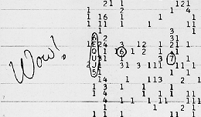
Intelligence (or origins of Big-data computing?)
Search for Extra Terrestrial Intelligence (seti@home project)
The Wow signal http://www.bigear.org/wow.htm

Slide 12
Characteristics of intelligent applications
Google search: How is different from regular search in existence before it?
It took advantage of the fact the hyperlinks within web pages form an underlying structure that can be mined to determine the importance of various pages.
Restaurant and Menu suggestions: instead of “Where would you like to go?” “Would you like to go to CityGrille”?
Learning capacity from previous data of habits, profiles, and other information gathered over time.
Collaborative and interconnected world inference capable: facebook friend suggestion
Large scale data requiring indexing
…Do you know amazon is going to ship things before you order? Here

Slide 13
Data-intensive application characteristics
Models
Algorithms (thinking)
Data structures (infrastructure)
AggregatedContent (Raw data)
Reference
Structures
(knowledge)

Slide 14
Basic Elements
Aggregated content: large amount of data pertinent to the specific application; each piece of information is typically connected to many other pieces. Ex: DBs
Reference structures: Structures that provide one or more structural and semantic interpretations of the content. Reference structure about specific domain of knowledge come in three flavors: dictionaries, knowledge bases, and ontologies
Algorithms: modules that allows the application to harness the information which is hidden in the data. Applied on aggregated content and some times require reference structure Ex: MapReduce
Data Structures: newer data structures to leverage the scale and the WORM characteristics; ex: MS Azure, Apache Hadoop, Google BigTable

Slide 15
Examples of data-intensive applications
Search engines
Recommendation systems:
CineMatch of Netflix Inc. movie recommendations
Amazon.com: book/product recommendations
Biological systems: high throughput sequences (HTS)
Analysis: disease-gene match
Query/search for gene sequences
Space exploration
Financial analysis

Slide 16
More intelligent data-intensive applications
Social networking sites
Mashups : applications that draw upon content retrieved from external sources to create entirely new innovative services.
Portals
Wikis: content aggregators; linked data; excellent data and fertile ground for applying concepts discussed in the text
Media-sharing sites
Online gaming
Biological analysis
Space exploration

Slide 17
Algorithms
Statistical inference
Machine learning is the capability of the software system to generalize based on past experience and the use of these generalization to provide answers to questions related old, new and future data.
Data mining
Soft computing
Deep learning
We also need algorithms that are specially designed for the emerging storage models and data characteristics.

Slide 18
Different Type of Storage
Internet introduced a new challenge in the form web logs, web crawler’s data: large scale “peta scale”
But observe that this type of data has an uniquely different characteristic than your transactional or the “customer order” data, or “bank account data” :
The data type is “write once read many (WORM)” ;
Privacy protected healthcare and patient information;
Historical financial data;
Other historical data
Relational file system and tables are insufficient.
Large <key, value> stores (files) and storage management system.
Built-in features for fault-tolerance, load balancing, data-transfer and aggregation,…
Clusters of distributed nodes for storage and computing.
Computing is inherently parallel

Slide 19
Big-data Concepts
Originated from the Google File System (GFS) is the special <key, value> store
Hadoop Distributed file system (HDFS) is the open source version of this. (Currently an Apache project)
Parallel processing of the data using MapReduce (MR) programming model
Challenges
Formulation of MR algorithms
Proper use of the features of infrastructure (Ex: sort)
Best practices in using MR and HDFS
An extensive ecosystem consisting of other components such as column-based store (Hbase, BigTable), big data warehousing (Hive), workflow languages, etc.

Slide 20
Data & Analytics
We have witnessed explosion in algorithmic solutions.
“In pioneer days they used oxen for heavy pulling, when one couldn’t budge a log they didn’t try to grow a larger ox. We shouldn’t be trying for bigger computers, but for more systems of computers.” Grace Hopper
What you cannot achieve by an algorithm can be achieved by more data.
Big data if analyzed right gives you better answers: Center for disease control prediction of flu vs. prediction of flu through “search” data 2 full weeks before the onset of flu season! http://www.google.org/flutrends/

Slide 21



Cloud Computing
Cloud is a facilitator for Big Data computing and is an indispensable in this context
Cloud provides processor, software, operating systems, storage, monitoring, load balancing, clusters and other requirements as a service
Cloud offers accessibility to Big Data computing
Cloud computing models:
platform (PaaS), Microsoft Azure
software (SaaS), Google App Engine (GAE)
infrastructure (IaaS), Amazon web services (AWS)
Services-based application programming interface (API)

Slide 22
Top Ten Largest Databases
Ref: http://www.comparebusinessproducts.com/fyi/10-largest-databases-in-the-world/
Notes:
22

Slide 23
Top Ten Largest Databases in 2007 vs Facebook ‘s cluster in 2010
21 PetaByte
In 2010
Facebook
Ref: http://www.comparebusinessproducts.com/fyi/10-largest-databases-in-the-world
Notes:
23

Slide 24
Data Strategy
In this era of big data, what is your data strategy?
Strategy as in simple “Planning for the data challenge”
It is not only about big data: all sizes and forms of data
Data collections from customers used to be an elaborate task: surveys, and other such instruments
Nowadays data is available in abundance: thanks to the technological advances as well as the social networks
Data is also generated by many of your own business processes and applications
Data strategy means many different things: we will discuss this next

Slide 25
Components of a data Strategy¹
Data integration
Meta data
Data modeling
Organizational roles and responsibilities
Performance and metrics
Security and privacy
Structured data management
Unstructured data management
Business intelligence
Data analysis and visualization
Tapping into social data
This course will provide training in emerging technologies, tools, environments and APIs available for developing and implementing one or more of these components.

Slide 26
Data Strategy for newer kinds of data
How will you collect data? Aggregate data? What are your sources? (Eg. Social media)
How will you store them? And Where?
How will you use the data? Analyze them? Analytics? Data mining? Pattern recognition?
How will you present or report the data to the stakeholders and decision makers? visualization?
Archive the data for provenance and accountability.

Slide 27
Tools for Analytics
Elaborate tools with nifty visualizations; expensive licensing fees: Ex: Tableau, Tom Sawyer
Software that you can buy for data analytics: Brilig, small, affordable but short-lived
Open sources tools: Gephi, sporadic support
Open source, freeware with excellent community involvement: R system
Some desirable characteristics of the tools: simple, quick to apply, intuitive, useful, flat learning curve
A demo to prove this point: data → actions /decisions

Slide 28
Demo: Exam1 Grade: Traditional reporting 1
Question 1..5, total, mean, median, mode; mean ver1, mean ver2

Slide 29
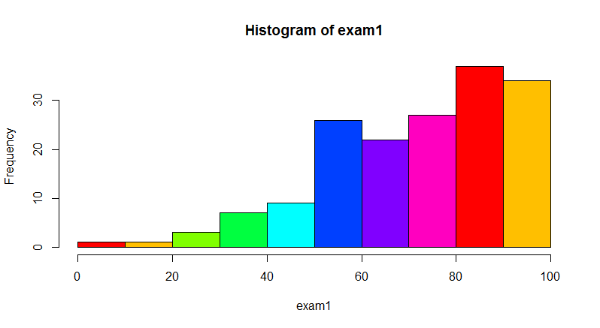
Traditional approach 2: points vs #students
Distribution of exam1 points

Slide 30
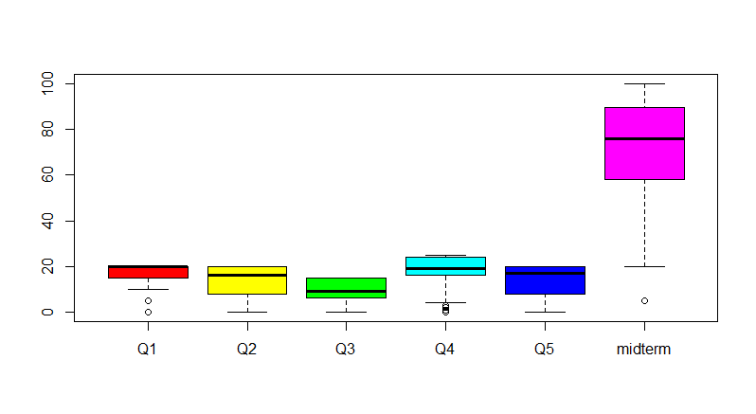
Individual questions analyzed..

Slide 31
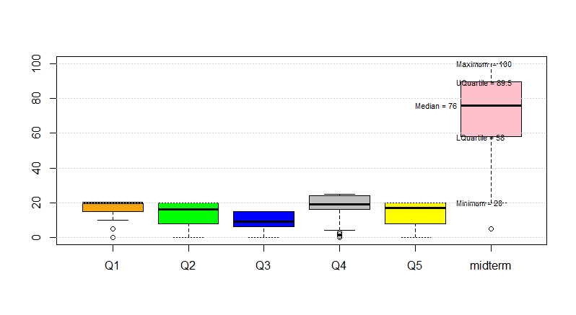
Interpretation and action/decisions

Slide 32
R-code
data2<-read.csv(file.choose())
exam1<-data2$midterm
hist(exam1, col=rainbow(8))
boxplot(data2, col=rainbow(6))
boxplot(data2,col=c("orange","green","blue","grey","yellow", "sienna"))
fn<-boxplot(data2,col=c("orange","green","blue","grey","yellow", "pink"))$stats
text(5.55, fn[1,6], paste("Minimum =", fn[1,6]), adj=0, cex=.7)
text(5.55, fn[2,6], paste("LQuartile =", fn[2,6]), adj=0, cex=.7)
text(5.0, fn[3,6], paste("Median =", fn[3,6]), adj=0, cex=.7)
text(5.55, fn[4,6], paste("UQuartile =", fn[4,6]), adj=0, cex=.7)
text(5.55, fn[5,6], paste("Maximum =", fn[5,6]), adj=0, cex=.7)
grid(nx=NA, ny=NULL)

Slide 33
Demo Details
Grade data stored in excel file and common input format
Converted this file to csv
Start a R Studio project
Read in the csv data (using a file chooser option) into data2
boxplot(data2)
That is it.
You can now add legends, colors, and labels to make it presentable.
Export the plot as a image or pdf to report the results

Slide 34
Today’s Topic: Exploratory data analysis (EDA)
The R Programming language
The R project for statistical computing
R Studio integrated development environment (IDE)
Data analysis with R: charts, plots, maps, packages
Also look at the CRAN: Comprehensive R Archive Network
Understanding your data
Basic statistical analysis
Chapter 1 : What is Data Science?
Chapter 2: Exploratory Data Analysis and Data Science Process

Slide 35
R Language
R is a software package for statistical computing.
R is an interpreted language
It is open source with high level of contribution from the community
“R is very good at plotting graphics, analyzing data, and fitting statistical models using data that fits in the computer’s memory.”
“It’s not as good at storing data in complicated structures, efficiently querying data, or working with data that doesn’t fit in the computer’s memory.”

Slide 36
R Programming Language^{3,4}
R is popular language for statistical analysis of data, visualization and reporting.
It is a complete “programming” language.
R is a free software: Gnu General Public Licensing (GPL)
R Studio is a powerful IDE for R.
R is not a tool for data acquisition/collection/data entry. This is a major point on which it differs from Excel and other data input applications.

Slide 37
Why R?
There are many packages available for statistical analysis such as SAS and SPSS but they are expensive (user license based) and are proprietary.
R is open source and it can pretty much do what SAS can do but free.
R is considered one of the best statistical tools in the world.
People can submit their own R packages/libraries, using latest cutting edge techniques.
To date R has got almost 5,000 packages in the CRAN (Comprehensive R Archive Network – The site which maintains the R project) repository.
R is great for exploratory data analysis (EDA): for understanding the nature of your data and quickly create useful visualization

Slide 38
R Packages
An R package is a set of related functions
To use a package you need to load it into R
R offers a large number of packages for various vertical and horizontal domains:
Horizontal: display graphics, statistical packages, machine learning
Verticals: wide variety of industries: analyzing stock market data, modeling credit risks, social sciences, automobile data

Slide 39
R Packages
A package is a collection of functions and data files bundled together.
In order to use the components of a package it needs to be installed in the local library of the R environment.
Loading packages
Custom packages
Building packages
Activity: explore what R packages are available, if any, for your domain http://cran.r-project.org/web/packages/available_packages_by_name.html
Later on, try to create a custom package for your business domain.

Slide 40
Library
Library→ Package→ Class→
R also provides many data sets for exploring its features

Slide 41
Learning R
R Basics, fundamentals
The R language
Working with data
Statistics with R language
R syntax
R Control structures
R Objects
R formulas
Install and use packages
Quick overview and tutorial

Slide 42
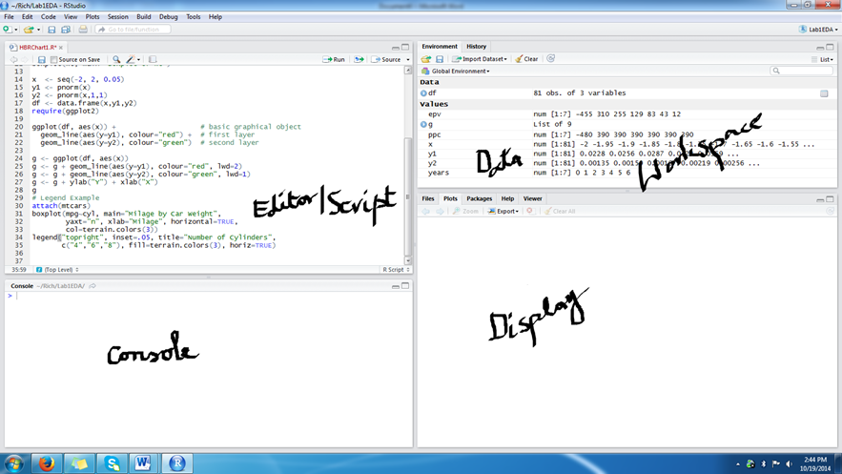
R Studio
Lets examine the R studio environment

Slide 43
Input Data sources
Data for the analytics can be from many different sources: simple .csv file, relational database, xml based web documents, sources on the cloud (dropbox, storage drives).
Today we will examine how to input data into R from: csv file and by scraping the web files.
This will allow you to input any web data and excel data you have into R for processing and analytics.
We will discuss ODBC and cloud sources in a later lecture.

Slide 44
Features of RStudio
Regions of RStudio: (i) console, (ii) data, (iii) script, (iv) plots and packages
Primary feature: Project is a collection of files: data, graphs, R script: lets create a new project
R allows all the basic arithmetic: +, - , variables
Vectors: collection of same type of elements; very important data element
Creating a vector; changing a vector; factoring a vector
x<- c(1,4,9,19)
Calling a function: mean (x)
Missing data: NA (not available), NULL(absence of anything)
z<- c(8, NA, 19)
z <- c(8,NULL, 18)
znew<-na.omit(z)

Slide 45
Features (contd.)
Ingesting (reading) data into R
Reading csv
Reading from the web
We will spend some time here to plan your data collection strategy
Data included with R
Lot of historical data (old data is easy to publicize/declassify)
Simple commands to work with data sets
summary(data)
head(data)

Slide 46
References
[1] S. Adelman, L. Moss, M. Abai. Data Strategy. Addison-Wesley, 2005.
[2] T. Davenport. A Predictive Analytics Primer. Sept2, 2014, Harvard Business Review. http://blogs.hbr.org/2014/09/a-predictive-analytics-primer/
[3] The R project, http://www.r-project.org/
[4] J.P. Lander. R for Everyone: Advanced Analytics and graphics. Addison Wesley. 2014.
[5] M. NemSchoff. A quick guide to structured and unstructured data. In Smart Data Collective, June 28, 2014.

Slide 47
Summary
We are entering a watershed moment in the internet era.
This involves in its core and center, big data analytics and tools that provide intelligence in a timely manner to support decision making.
Newer storage models, processing models, and approaches have emerged.
We will learn about these and develop software using these newer approaches to data.

