Slide 1
MR-PageRank

Slide 2
Large scale data splits
Map <key, 1>
<key, value>pair
Reducers (say, Count)
Parse-hash
Count
P-0000
, count1
Parse-hash
Count
P-0001
, count2
Parse-hash
Count
P-0002
Parse-hash
,count3

Slide 3
PageRank
Original algorithm (huge matrix and Eigen vector problem.)
Larry Page and Sergei Brin (Standford Ph.D. students)
Rajeev Motwani and Terry Winograd (Standford Profs)

Slide 4
General idea
Consider the world wide web with all its links.
Now imagine a random web surfer who visits a page and clicks a link on the page
Repeats this to infinity
Pagerank is a measure of how frequently will a page will be encountered.
In other words it is a probability distribution over nodes in the graph representing the likelihood that a random walk over the linked structure will arrive at a particular node.

Slide 5
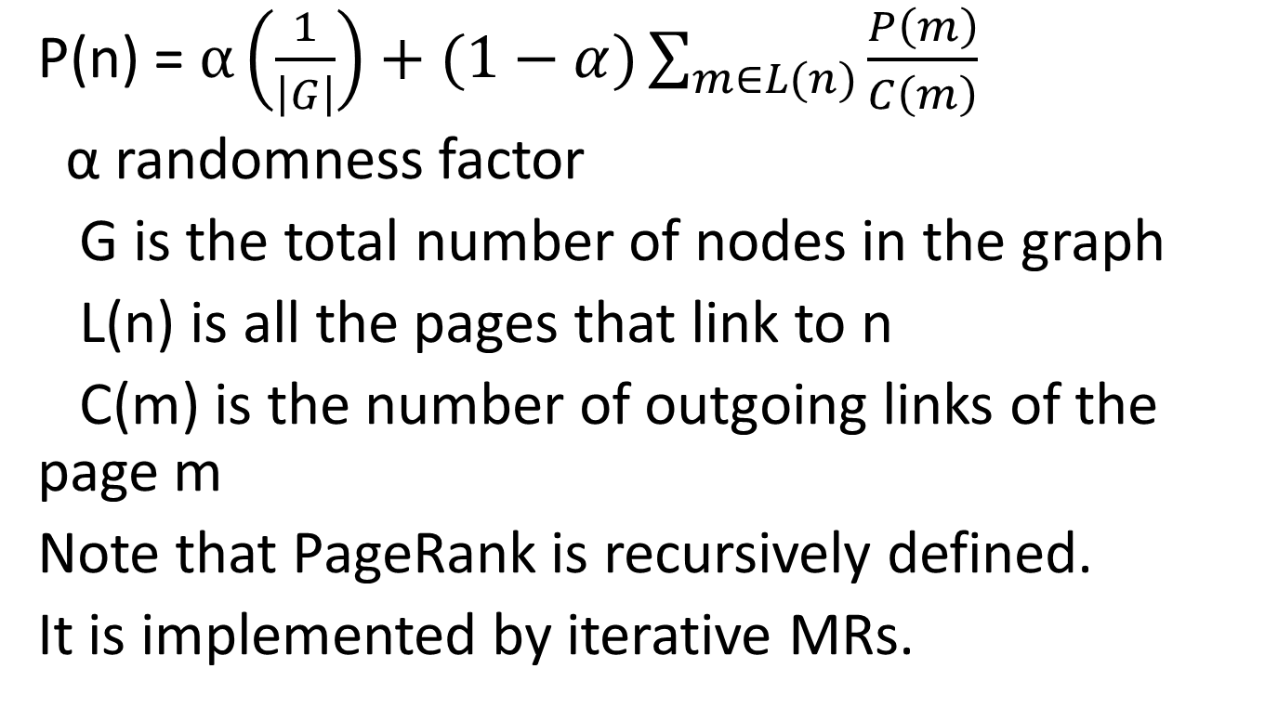
PageRank Formula
P(n) = $α\left(\frac{1}{\left|G\right|}\right)+(1−α)\sum_{m∈L(n)}{\frac{P\left(m\right)}{C\left(m\right)}}$
α randomness factor
G is the total number of nodes in the graph
L(n) is all the pages that link to n
C(m) is the number of outgoing links of the page m
Note that PageRank is recursively defined.
It is implemented by iterative MRs.

Slide 6
PageRank: Walk Through
0.066
0.166
0.2
0.2
n1
n2
n1
0.1
n2
0.033
0.1
0.066
0.033
0.1
0.066
0.1
0.1
0.083
0.1
0.083
n5
n5
0.3
0.2
0.2
0.066
0.3
0.1
n3
n3
n4
0.2
n4
0.166
0.2
0.166
0.2
0.3
0.1
0.133
n1
n2
n5
0.383
n3
n4
0.183
0.2

Slide 7
Mapper for PageRank
Class Mapper
method map (nid n, Node N)
p ← N.Pagerank/|N.AdajacencyList|
emit(nid n, N)
for all m in N. AdjacencyList
emit(nid m, p)
“divider”

Slide 8
Reducer for Pagerank
Class Reducer
method Reduce(nid m, [p1, p2, p3..])
node M ← null; s = 0;
for all p in [p1,p2, ..]
{ if p is a Node then M ← p
else s ← s+p }
M.pagerank ← s
emit (nid m, node M)
“aggregator”

Slide 9
Discussion
How to account for dangling nodes: one that has many incoming links and no outgoing links
Simply redistributes its pagerank to all
One iteration requires pagerank computation + redistribution of “unused” pagerank
Pagerank is iterated until convergence: when is convergence reached?
Probability distribution over a large network means underflow of the value of pagerank.. Use log based computation
MR: How do PRAM alg. translate to MR? how about other math algorithms?

Slide 10
References & useful links
Amazon AWS: http://aws.amazon.com/free/
AWS Cost Calculator: http://calculator.s3.amazonaws.com/calc5.html
Google App Engine (GAE): http://code.google.com/appengine/docs/whatisgoogleappengine.html
For miscellaneous information: http://www.cse.buffalo.edu/~bina
http://www.cse.buffalo.edu/~bina/DataIntensive

