Slide 1
Big-data Computing: Hadoop Distributed File System
B. Ramamurthy

Slide 2
Reference
Apache Hadoop: http://hadoop.apache.org/
http://wiki.apache.org/hadoop/
Hadoop: The Definitive Guide, by Tom White, 2nd edition, Oreilly’s , 2010
Dean, J. and Ghemawat, S. 2008. MapReduce: simplified data processing on large clusters. Communication of ACM 51, 1 (Jan. 2008), 107-113.
B. Hedlund’s blog: http://bradhedlund.com/2011/09/10/understanding-hadoop-clusters-and-the-network/

Slide 3
Background
Problem space is experiencing explosion of data
Solution space: emergence of multi-core, virtualization, cloud computing
Inability of traditional file system to handle data deluge
The Big-data Computing Model
MapReduce Programming Model (Algorithm)
Google File System; Hadoop Distributed File System (Data Structure)
Microsoft Dryad ( Large scale Data-base processing model)

Slide 4

Examples
Computational models that focus on data: large scale and/or complex data
Example1: web log
fcrawler.looksmart.com - - [26/Apr/2000:00:00:12 -0400] "GET /contacts.html HTTP/1.0" 200 4595 "-" "FAST-WebCrawler/2.1-pre2 (ashen@looksmart.net)"
fcrawler.looksmart.com - - [26/Apr/2000:00:17:19 -0400] "GET /news/news.html HTTP/1.0" 200 16716 "-" "FAST-WebCrawler/2.1-pre2 (ashen@looksmart.net)"
ppp931.on.bellglobal.com - - [26/Apr/2000:00:16:12 -0400] "GET /download/windows/asctab31.zip HTTP/1.0" 200 1540096 "http://www.htmlgoodies.com/downloads/freeware/webdevelopment/15.html" "Mozilla/4.7 [en]C-SYMPA (Win95; U)"
123.123.123.123 - - [26/Apr/2000:00:23:48 -0400] "GET /pics/wpaper.gif HTTP/1.0" 200 6248 "http://www.jafsoft.com/asctortf/" "Mozilla/4.05 (Macintosh; I; PPC)"
123.123.123.123 - - [26/Apr/2000:00:23:47 -0400] "GET /asctortf/ HTTP/1.0" 200 8130 "http://search.netscape.com/Computers/Data_Formats/Document/Text/RTF" "Mozilla/4.05 (Macintosh; I; PPC)"
123.123.123.123 - - [26/Apr/2000:00:23:48 -0400] "GET /pics/5star2000.gif HTTP/1.0" 200 4005 "http://www.jafsoft.com/asctortf/" "Mozilla/4.05 (Macintosh; I; PPC)"
123.123.123.123 - - [26/Apr/2000:00:23:50 -0400] "GET /pics/5star.gif HTTP/1.0" 200 1031 "http://www.jafsoft.com/asctortf/" "Mozilla/4.05 (Macintosh; I; PPC)"
123.123.123.123 - - [26/Apr/2000:00:23:51 -0400] "GET /pics/a2hlogo.jpg HTTP/1.0" 200 4282 "http://www.jafsoft.com/asctortf/" "Mozilla/4.05 (Macintosh; I; PPC)"
123.123.123.123 - - [26/Apr/2000:00:23:51 -0400] "GET /cgi-bin/newcount?jafsof3&width=4&font=digital&noshow HTTP/1.0" 200 36 "http://www.jafsoft.com/asctortf/" "Mozilla/4.05 (Macintosh; I; PPC)"
Example 2: Climate/weather data modeling

Slide 5
Traditional Storage Solutions
Off system/online storage/ secondary memory
File system abstraction/ Databases
Offline/ tertiary memory/ DFS
RAID: Redundant Array of Inexpensive Disks
NAS: Network Accessible Storage
SAN: Storage area networks

Slide 6
Solution Space

Slide 7
Google File System
Internet introduced a new challenge in the form web logs, web crawler’s data: large scale “peta scale”
But observe that this type of data has an uniquely different characteristic than your transactional or the “customer order” data : “write once read many (WORM)” ;
Privacy protected healthcare and patient information;
Historical financial data;
Other historical data
Google exploited this characteristics in its Google file system (GFS)

Slide 8
Hadoop
Projects Nutch and Lucene were started with “search” as the application in mind;
Hadoop Distributed file system and mapreduce were found to have applications beyond search.
HDFS and MapReduce were moved out of Nutch as a sub-project of Lucene and later promoted into a apache project Hadoop
Lets look at HDFS as in Hadoop 1.0: You have to understand the basics of Hadoop1.0 to understand and appreciate its evolution to Hadoop 2.0

Slide 9
Basic Features: HDFS
Highly fault-tolerant
High throughput
Suitable for applications with large data sets
Streaming access to file system data
Can be built out of commodity hardware
HDFS provides Java API for applications to use.
It also provides a streaming API for other languages.
(See MR in python here)
A HTTP browser can be used to browse the files of a HDFS instance.

Slide 10
Hadoop

Slide 11
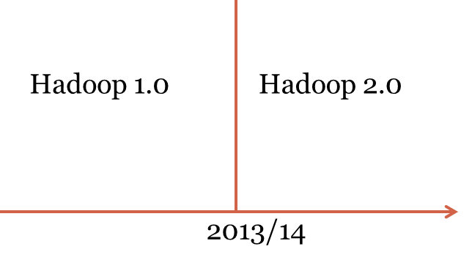
Hadoop

Slide 12
What has changed? Hmm…
We moved from “running” on Hadoop DFS to “running” in Hadoop operating system “YARN”

Slide 13
Basic Features: HDFS
Highly fault-tolerant
High throughput
Suitable for applications with large data sets
Streaming access to file system data
Can be built out of commodity hardware
HDFS core principles are the same in both major releases of Hadoop.

Slide 14
Hadoop Distributed File System
HDFS Server
Masters: Job tracker,
Name node,
Secondary name node
HDFS Client
Application
Local file system
Block size: 2K
Slaves: Task tracker, Data Nodes
Block size: 128M
Replicated

Slide 15
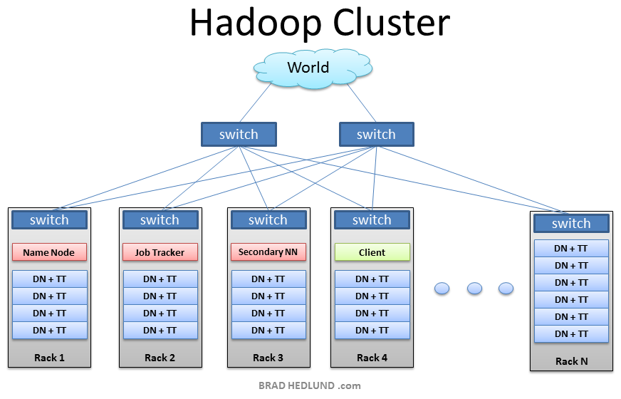
From Brad Hedlund: a very nice picture

Slide 16
Hadoop (contd.)
What are : Job tracker, Name node, Secondary name node, data node, task tracker…?
What are their roles?

Slide 17
Architecture

Slide 18
Namenode and Datanodes
Master/slave architecture
HDFS cluster consists of a single Namenode, a master server that manages the file system namespace and regulates access to files by clients.
There are a number of DataNodes usually one per node in a cluster.
The DataNodes manage storage attached to the nodes that they run on.
HDFS exposes a file system namespace and allows user data to be stored in files.
A file is split into one or more blocks and set of blocks are stored in DataNodes.
DataNodes: serves read, write requests, performs block creation, deletion, and replication upon instruction from Namenode.

Slide 19
HDFS Architecture
Namenode
Metadata(Name, replicas..)
(/home/foo/data,6. ..
Metadata ops
Client
Block ops
Read
Datanodes
Datanodes
B
replication
Blocks
Rack1
Write
Rack2
Client

Slide 20
File system Namespace
Hierarchical file system with directories and files
Create, remove, move, rename etc.
Namenode maintains the file system
Any meta information changes to the file system recorded by the Namenode.
An application can specify the number of replicas of the file needed: replication factor of the file. This information is stored in the Namenode.

Slide 21
Data Replication
HDFS is designed to store very large files across machines in a large cluster.
Each file is a sequence of blocks.
All blocks in the file except the last are of the same size.
Blocks are replicated for fault tolerance.
Block size and replicas are configurable per file.
The Namenode receives a Heartbeat and a BlockReport from each DataNode in the cluster.
BlockReport contains all the blocks on a Datanode.

Slide 22
Replica Placement
The placement of the replicas is critical to HDFS reliability and performance.
Optimizing replica placement distinguishes HDFS from other distributed file systems.
Rack-aware replica placement:
Goal: improve reliability, availability and network bandwidth utilization
Many racks, communication between racks are through switches.
Network bandwidth between machines on the same rack is greater than those in different racks.
Namenode determines the rack id for each DataNode.
Replicas are typically placed on unique racks
Simple but non-optimal
Writes are expensive
Replication factor is 3
Replicas are placed: one on a node in a local rack, one on a different node in the local rack and one on a node in a different rack.
1/3 of the replica on a node, 2/3 on a rack and 1/3 distributed evenly across remaining racks.

Slide 23
Replica Selection
Replica selection for READ operation: HDFS tries to minimize the bandwidth consumption and latency.
If there is a replica on the Reader node then that is preferred.
HDFS cluster may span multiple data centers: replica in the local data center is preferred over the remote one.

Slide 24
Safemode Startup
On startup Namenode enters Safemode.
Replication of data blocks do not occur in Safemode.
Each DataNode checks in with Heartbeat and BlockReport.
Namenode verifies that each block has acceptable number of replicas
After a configurable percentage of safely replicated blocks check in with the Namenode, Namenode exits Safemode.
It then makes the list of blocks that need to be replicated.
Namenode then proceeds to replicate these blocks to other Datanodes.

Slide 25
Filesystem Metadata
The HDFS namespace is stored by Namenode.
Namenode uses a transaction log called the EditLog to record every change that occurs to the filesystem meta data.
For example, creating a new file.
Change replication factor of a file
EditLog is stored in the Namenode’s local filesystem
Entire filesystem namespace including mapping of blocks to files and file system properties is stored in a file FsImage. Stored in Namenode’s local filesystem.

Slide 26
Namenode
Keeps image of entire file system namespace and file Blockmap in memory.
4GB of local RAM is sufficient to support the above data structures that represent the huge number of files and directories.
When the Namenode starts up it gets the FsImage and Editlog from its local file system, update FsImage with EditLog information and then stores a copy of the FsImage on the filesytstem as a checkpoint.
Periodic checkpointing is done. So that the system can recover back to the last checkpointed state in case of a crash.

Slide 27
Datanode
A Datanode stores data in files in its local file system.
Datanode has no knowledge about HDFS filesystem
It stores each block of HDFS data in a separate file.
Datanode does not create all files in the same directory.
It uses heuristics to determine optimal number of files per directory and creates directories appropriately:
When the filesystem starts up it generates a list of all HDFS blocks and send this report to Namenode: Blockreport.

Slide 28
Protocol

Slide 29
The Communication Protocol
All HDFS communication protocols are layered on top of the TCP/IP protocol
A client establishes a connection to a configurable TCP port on the Namenode machine. It talks ClientProtocol with the Namenode.
The Datanodes talk to the Namenode using Datanode protocol.
RPC abstraction wraps both ClientProtocol and Datanode protocol.
Namenode is simply a server and never initiates a request; it only responds to RPC requests issued by DataNodes or clients.

Slide 30
Robustness

Slide 31
Possible Failures
Primary objective of HDFS is to store data reliably in the presence of failures.
Three common failures are: Namenode failure, Datanode failure and network partition.

Slide 32
DataNode failure and heartbeat
A network partition can cause a subset of Datanodes to lose connectivity with the Namenode.
Namenode detects this condition by the absence of a Heartbeat message.
Namenode marks Datanodes without Hearbeat and does not send any IO requests to them.
Any data registered to the failed Datanode is not available to the HDFS.
Also the death of a Datanode may cause replication factor of some of the blocks to fall below their specified value.

Slide 33
Re-replication
The necessity for re-replication may arise due to:
A Datanode may become unavailable,
A replica may become corrupted,
A hard disk on a Datanode may fail, or
The replication factor on the block may be increased.

Slide 34
Cluster Rebalancing
HDFS architecture is compatible with data rebalancing schemes.
A scheme might move data from one Datanode to another if the free space on a Datanode falls below a certain threshold.
In the event of a sudden high demand for a particular file, a scheme might dynamically create additional replicas and rebalance other data in the cluster.
These types of data rebalancing are not yet implemented: research issue.

Slide 35
Data Integrity
Consider a situation: a block of data fetched from Datanode arrives corrupted.
This corruption may occur because of faults in a storage device, network faults, or buggy software.
A HDFS client creates the checksum of every block of its file and stores it in hidden files in the HDFS namespace.
When a clients retrieves the contents of file, it verifies that the corresponding checksums match.
If does not match, the client can retrieve the block from a replica.

Slide 36
Metadata Disk Failure
FsImage and EditLog are central data structures of HDFS.
A corruption of these files can cause a HDFS instance to be non-functional.
For this reason, a Namenode can be configured to maintain multiple copies of the FsImage and EditLog.
Multiple copies of the FsImage and EditLog files are updated synchronously.
Meta-data is not data-intensive.
The Namenode could be single point failure: automatic failover has been recently added with a backup namenode.

Slide 37
Data Organization

Slide 38
Data Blocks
HDFS support write-once-read-many with reads at streaming speeds.
A typical block size is 64MB (or even 128 MB).
A file is chopped into 64MB chunks and stored.

Slide 39
Staging
A client request to create a file does not reach Namenode immediately.
HDFS client caches the data into a temporary file. When the data reached a HDFS block size the client contacts the Namenode.
Namenode inserts the filename into its hierarchy and allocates a data block for it.
The Namenode responds to the client with the identity of the Datanode and the destination of the replicas (Datanodes) for the block.
Then the client flushes it from its local memory.

Slide 40
Staging (contd.)
The client sends a message that the file is closed.
Namenode proceeds to commit the file for creation operation into the persistent store.
If the Namenode dies before file is closed, the file is lost.
This client side caching is required to avoid network congestion; also it has precedence is AFS (Andrew file system).

Slide 41
Replication Pipelining
When the client receives response from Namenode, it flushes its block in small pieces (4K) to the first replica, that in turn copies it to the next replica and so on.
Thus data is pipelined from Datanode to the next.

Slide 42
API (Accessibility)

Slide 43
FS Shell, Admin and Browser Interface
HDFS organizes its data in files and directories.
It provides a command line interface called the FS shell that lets the user interact with data in the HDFS.
The syntax of the commands is similar to bash and csh.
Example: to create a directory /foodir
/bin/hadoop dfs –mkdir /foodir
There is also DFSAdmin interface available
Browser interface is also available to view the namespace.

Slide 44
Space Reclamation
When a file is deleted by a client, HDFS renames file to a file in be the /trash directory for a configurable amount of time.
A client can request for an undelete in this allowed time.
After the specified time the file is deleted and the space is reclaimed.
When the replication factor is reduced, the Namenode selects excess replicas that can be deleted.
Next heartbeat transfers this information to the Datanode that clears the blocks for use.

Slide 45
MapReduce Engine

Slide 46
Large scale data splits
Map <key, 1>
<key, value>pair
Reducers (say, Count)
Parse-hash
Count
P-0000
, count1
Parse-hash
Count
P-0001
, count2
Parse-hash
Count
P-0002
Parse-hash
,count3

Slide 47
MapReduce Engine
MapReduce requires a distributed file system and an engine that can distribute, coordinate, monitor and gather the results.
Hadoop provides that engine through (the file system we discussed earlier) and the JobTracker + TaskTracker system.
JobTracker is simply a scheduler.
TaskTracker is assigned a Map or Reduce (or other operations); Map or Reduce run on node and so is the TaskTracker; each task is run on its own JVM on a node.

Slide 48
Job Tracker
Is a service with Hadoop system
It is like a scheduler
Client application is sent to the JobTracker
It talks to the Namenode, locates the TaskTracker near the data (remember the data has been populated already).
JobTracker moves the work to the chosen TaskTracker node.
TaskTracker monitors the execution of the task and updates the JobTracker through heartbeat. Any failure of a task is detected through missing heartbeat.
Intermediate merging on the nodes are also taken care of by the JobTracker

Slide 49
TaskTracker
It accepts tasks (Map, Reduce, Shuffle, etc.) from JobTracker
Each TaskTracker has a number of slots for the tasks; these are execution slots available on the machine or machines on the same rack;
It spawns a sepearte JVM for execution of the tasks;
It indicates the number of available slots through the hearbeat message to the JobTracker

Slide 50
Summary
We discussed the features of the Hadoop File System, a peta-scale file system to handle big-data sets.
We discussed: Architecture, Protocol, API, etc.
Also MapReduce Engine, Application Architecture
Next task is to understand mapreduce and implement a simple mapreduce job on HDFS

