Slide 1
An Innovative Approach to Parallel Processing Data
Bina Ramamurthy
Partially Supported by
NSF DUE Grant: 0737243, 0920335

Slide 2
The Context: Big-data
Man on the moon with 32KB (1969); my laptop had 2GB RAM (2009)
Google collects 270PB data in a month (2007), 20PB a day (2008) …
2010 census data is a huge gold mine of information
Data mining huge amounts of data collected in a wide range of domains from astronomy to healthcare has become essential for planning and performance.
We are in a knowledge economy.
Data is an important asset to any organization
Discovery of knowledge; Enabling discovery; annotation of data
We are looking at newer
programming models, and
Supporting algorithms and data structures
National Science Foundation refers to it as “data-intensive computing” and industry calls it “big-data” and “cloud computing”

Slide 3
More context
Rear Admiral Grace Hopper: “In pioneer days they used oxen for heavy pulling, and when one ox couldn't budge a log, they didn't try to grow a larger ox. We shouldn't be trying for bigger computers, but for more systems of computers.”
---From the Wit and Wisdom of Grace Hopper (1906-1992), http://www.cs.yale.edu/homes/tap/Files/hopper-wit.html

Slide 4
Introduction : Ch.1 (Lin and Dyer’s text)
Text processing: web-scale corpora (singular corpus)
Simple word count, cross reference, n-grams, …
A simpler technique on more data beat a more sophisticated technique on less data.
Google researchers call this: “unreasonable effectiveness of data”
--Alon Halevy, Peter Norvig, and Fernando Pereira. The unreasonable effectiveness of data. Communications of the ACM, 24(2):8:12, 2009.

Slide 5
MapReduce

Slide 6
What is MapReduce?
MapReduce is a programming model Google has used successfully in processing its “big-data” sets (~ 20 peta bytes per day in 2008)
Users specify the computation in terms of a map and a reduce function,
Underlying runtime system automatically parallelizes the computation across large-scale clusters of machines, and
Underlying system also handles machine failures, efficient communications, and performance issues.
-- Reference: Dean, J. and Ghemawat, S. 2008. MapReduce: simplified data processing on large clusters. Communication of ACM 51, 1 (Jan. 2008), 107-113.

Slide 7
Big idea behind MR
Scale-out and not scale-up: Large number of commodity servers as opposed large number of high end specialized servers
Economies of scale, ware-house scale computing
MR is designed to work with clusters of commodity servers
Research issues: Read Barroso and Holzle’s work
Failures are norm or common:
With typical reliability, MTBF of 1000 days (about 3 years), if you have a cluster of 1000, probability of at least 1 server failure at any time is nearly 100%

Slide 8
Big idea (contd.)
Moving “processing” to the data: not literally, data and processing are co-located versus sending data around as in HPC
Process data sequentially vs random access: analytics on large sequential bulk data as opposed to search for one item in a large indexed table
Hide system details from the user application: user application does not have to get involved in which machine does what. Infrastructure can do it.
Seamless scalability: Can add machines / server power without changing the algorithms: this is in-order to process larger data set

Slide 9
Issues to be addressed
How to break large problem into smaller problems? Decomposition for parallel processing
How to assign tasks to workers distributed around the cluster?
How do the workers get the data?
How to synchronize among the workers?
How to share partial results among workers?
How to do all these in the presence of errors and hardware failures?
MR is supported by a distributed file system that addresses many of these aspects.

Slide 10
MapReduce Basics
Fundamental concept:
Key-value pairs form the basic structure of MapReduce <key, value>
Key can be anything from a simple data types (int, float, etc) to file names to custom types.
Examples:
<docid, docitself>
<yourName, yourLifeHistory>
<graphNode, nodeCharacteristicsComplexData>
<yourId, yourFollowers>
<word, itsNumofOccurrences>
<planetName, planetInfo>
<geneNum, <{pathway, geneExp, proteins}>
<Student, stuDetails>

Slide 11
From CS Foundations to MapReduce (Example#1)
Consider a large data collection:
{web, weed, green, sun, moon, land, part, web, green,…}
Problem: Count the occurrences of the different words in the collection.
Lets design a solution for this problem;
We will start from scratch
We will add and relax constraints
We will do incremental design, improving the solution for performance and scalability

Slide 12
Word Counter and Result Table
{web, weed, green, sun, moon, land, part, web, green,…}
web | 2
weed | 1
green | 2
sun | 1
moon | 1
land | 1
part | 1
Data
collection

Slide 13

Multiple Instances of Word Counter
web | 2
weed | 1
green | 2
sun | 1
moon | 1
land | 1
part | 1
Data
collection
Observe:
Multi-thread
Lock on shared data

Slide 14
Improve Word Counter for Performance
No
No need for lock
web | 2
weed | 1
green | 2
sun | 1
moon | 1
land | 1
part | 1
Data
collection
Separate counters
KEY | web | weed | green | sun | moon | land | part | web | green | …….
VALUE

Slide 15
Peta-scale Data
Data
collection
web | 2
weed | 1
green | 2
sun | 1
moon | 1
land | 1
part | 1
KEY | web | weed | green | sun | moon | land | part | web | green | …….
VALUE

Slide 16
Addressing the Scale Issue
Single machine cannot serve all the data: you need a distributed special (file) system
Large number of commodity hardware disks: say, 1000 disks 1TB each
Issue: With Mean time between failures (MTBF) or failure rate of 1/1000, then at least 1 of the above 1000 disks would be down at a given time.
Thus failure is norm and not an exception.
File system has to be fault-tolerant: replication, checksum
Data transfer bandwidth is critical (location of data)
Critical aspects: fault tolerance + replication + load balancing, monitoring
Exploit parallelism afforded by splitting parsing and counting
Provision and locate computing at data locations

Slide 17
Peta-scale Data
Data
collection
web | 2
weed | 1
green | 2
sun | 1
moon | 1
land | 1
part | 1
KEY | web | weed | green | sun | moon | land | part | web | green | …….
VALUE

Slide 18
Peta Scale Data is Commonly Distributed
Data
collection
Data
collection
web | 2
weed | 1
green | 2
sun | 1
moon | 1
land | 1
part | 1
Data
collection
Data
collection
Data
collection
Issue: managing the
large scale data
KEY | web | weed | green | sun | moon | land | part | web | green | …….
VALUE

Slide 19
Write Once Read Many (WORM) data
Data
collection
Data
collection
web | 2
weed | 1
green | 2
sun | 1
moon | 1
land | 1
part | 1
Data
collection
Data
collection
Data
collection
KEY | web | weed | green | sun | moon | land | part | web | green | …….
VALUE

Slide 20
WORM Data is Amenable to Parallelism
Data
collection
Data
collection
Data with WORM characteristics : yields to parallel processing;
Data without dependencies: yields to out of order processing
Data
collection
Data
collection
Data
collection

Slide 21
Divide and Conquer: Provision Computing at Data Location
One node
For our example,
#1: Schedule parallel parse tasks
#2: Schedule parallel count tasks
Data
collection
This is a particular solution;
Lets generalize it:
Our parse is a mapping operation:
MAP: input → <key, value> pairs
Our count is a reduce operation:
REDUCE: <key, value> pairs reduced
Map/Reduce originated from Lisp
But have different meaning here
Runtime adds distribution + fault tolerance + replication + monitoring +
load balancing to your base application!
Data
collection
Data
collection
Data
collection

Slide 22
Mapper and Reducer
MapReduceTask
Mapper
Reducer
YourReducer
Counter
YourMapper
Parser
Remember: MapReduce is simplified processing for larger data sets

Slide 23
Map Operation
weed | 1
weed | 1
green | 1
sun | 1
moon | 1
land | 1
land | 1
web | 1
green | 1
… | 1
KEY | VALUE
MAP: Input data ➔ <key, value> pair
web | 1
weed | 1
green | 1
sun | 1
moon | 1
land | 1
part | 1
web | 1
green | 1
web | 1
KEY | VALUE
Map
Data
Collection: split1
web | 1
weed | 1
green | 1
sun | 1
moon | 1
land | 1
part | 1
web | 1
green | 1
green | 1
KEY | VALUE
web | 1
weed | 1
green | 1
sun | 1
moon | 1
land | 1
part | 1
web | 1
green | 1
… | 1
KEY | VALUE
Split the data to
Supply multiple
processors
web | 1
weed | 1
green | 1
sun | 1
moon | 1
land | 1
part | 1
web | 1
green | 1
part | 1
KEY | VALUE
Data
Collection: split 2
Map
……
…
Data
Collection: split n

Slide 24
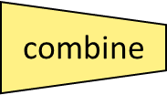
MapReduce Example #2
Cat
Bat
Dog
Other
Words
(size:
TByte)
reduce
combine
map
part0
split
reduce
combine
part1
split
map
reduce
combine
map
part2
split
split
map
barrier

Slide 25
MapReduce Design
You focus on Map function, Reduce function and other related functions like combiner etc.
Mapper and Reducer are designed as classes and the function defined as a method.
Configure the MR “Job” for location of these functions, location of input and output (paths within the local server), scale or size of the cluster in terms of #maps, # reduce etc., run the job.
Thus a complete MapReduce job consists of code for the mapper, reducer, combiner, and partitioner, along with job configuration parameters. The execution framework handles everything else.
The way we configure has been evolving with versions of hadoop.

Slide 26
The code
1: class Mapper
2: method Map(docid a; doc d)
3: for all term t in doc d do
4: Emit(term t; count 1)
1: class Reducer
2: method Reduce(term t; counts [c1; c2; : : :])
3: sum = 0
4: for all count c in counts [c1; c2; : : :] do
5: sum = sum + c
6: Emit(term t; count sum)

Slide 27
Text Word Count Problem
This is a cat
Cat sits on a roof
The roof is a tin roof
There is a tin can on the roof
Cat kicks the can
It rolls on the roof and falls on the next roof
The cat rolls too
It sits on the can
Problem: Count the word frequency. Include all the words. We will worry about stop words and stemming later.

Slide 28
MapReduce Example: Mapper (new and improved)
This is a cat
Cat sits on a roof
<this 1> <is 1> <a 1> <cat 1> <cat 1> <sits 1> <on 1><a 1> <roof 1>
The roof is a tin roof
There is a tin can on the roof
<the 1> <roof 1> <is 1> <a 1> <tin 1 ><roof 1> <there 1> <is 1> <a 1> <tin 1><can 1> <on 1><the 1> <roof 1>
Cat kicks the can
It rolls on the roof and falls on the next roof
<cat 1> <kicks 1> <the 1><can 1> <it 1> <rolls 1> <on 1> <the 1> <roof 1> <and 1> <falls 1><on 1> <the 1> <next 1> <roof 1>
The cat rolls too
It sits on the can
<the 1> <cat 1> <rolls 1> <too 1> <it 1> <sits 1> <on 1> <the 1> <can 1>

Slide 29
MapReduce Example: Shuffle to the Reducer
Output of Mappers:
<this 1> <is 1> <a 1> <cat 1> <cat 1> <sits 1> <on 1><a 1> <roof 1>
<the 1> <roof 1> <is 1> <a 1> <tin 1 ><roof 1> <there 1> <is 1> <a 1> <tin 1><can 1> <on 1><the 1> <roof 1>
<cat 1> <kicks 1> <the 1><can 1> <it 1> <rolls 1> <on 1> <the 1> <roof 1> <and 1> <falls 1><on 1> <the 1> <next 1> <roof 1>
<the 1> <cat 1> <rolls 1> <too 1> <it 1> <sits 1> <on 1> <the 1> <can 1>
Input to the reducer: delivered sorted... By key
..
<can <1, 1>>
<cat <1,1,1,1>>
…
<roof <1,1,1,1,1,1>>
..…
Reduce (sum in this case) the counts: comes out sorted!!!
..
<can 2>
<cat 4>
..
<roof 6>

Slide 30
More on MR
All Mappers work in parallel.
Barriers enforce all mappers completion before Reducers start.
Mappers and Reducers typically execute on the same machine
You can configure job to have other combinations besides Mapper/Reducer: ex: identify mappers/reducers for realizing “sort” (that happens to be a Benchmark)
Mappers and reducers can have side effects; this allows for sharing information between iterations.
Notes:
er

Slide 31
MapReduce Characteristics
Very large scale data: peta, exa bytes
Write once and read many data: allows for parallelism without mutexes
Map and Reduce are the main operations: simple code
There are other supporting operations such as combine and partition: we will look at those later.
Operations are provisioned near the data.
Commodity hardware and storage.
Runtime takes care of splitting and moving data for operations.
Special distributed file system: Hadoop Distributed File System and Hadoop Runtime.

Slide 32
Classes of problems “mapreducable”
Benchmark for comparing: Jim Gray’s challenge on data-intensive computing. Ex: “Sort”
Google uses it (we think) for wordcount, adwords, pagerank, indexing data.
Simple algorithms such as grep, text-indexing, reverse indexing
Bayesian classification: data mining domain
Facebook uses it for various operations: demographics
Financial services use it for analytics
Astronomy: Gaussian analysis for locating extra-terrestrial objects.
Expected to play a critical role in semantic web and web3.0

Slide 33
Scope of MapReduce
Data size: small
Single-core
Single-core, single processor
Single-core, multi-processor
Multi-core
Multi-core, single processor
Multi-core, multi-processor
Cluster
Cluster of processors (single or multi-core) with shared memory
Cluster of processors with distributed memory
Grid of clusters
Embarrassingly parallel processing
MapReduce, distributed file system
Cloud computing
Pipelined Instruction level
Concurrent Thread level
Service Object level
Indexed File level
Mega Block level
Virtual System Level
Data size: large

Slide 34
Lets Review Map/Reducer
Map function maps one <key,value> space to another. One to many: “expand” or “divide”
Reduce does that too. But many to one: “merge”
There can be multiple “maps” in a single machine…
Each mapper(map) runs parallel with and independent of the other (think of a bee hive)
All the outputs from mappers are collected and the “key space” is partitioned among the reducers. (what do you need to partition?)
Now the reducers take over. One reduce/per key (by default)
Reduce operation can be anything.. Does not have to be just counting…(operation [list of items]) – You can do magic with this concept.

Slide 35
Hadoop

Slide 36
What is Hadoop?
At Google MapReduce operation are run on a special file system called Google File System (GFS) that is highly optimized for this purpose.
GFS is not open source.
Doug Cutting and Yahoo! reverse engineered the GFS and called it Hadoop Distributed File System (HDFS).
The software framework that supports HDFS, MapReduce and other related entities is called the project Hadoop or simply Hadoop.
This is open source and distributed by Apache.

Slide 37
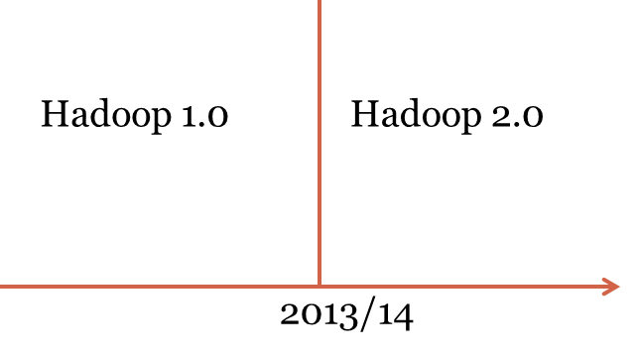
Hadoop

Slide 38
What has changed? Hmm…

Slide 39
Basic Features: HDFS
Highly fault-tolerant
High throughput
Suitable for applications with large data sets
Streaming access to file system data
Can be built out of commodity hardware
HDFS core principles are the same in both major releases of Hadoop.

Slide 40
Hadoop Distributed File System
HDFS Server
Masters: Job tracker,
Name node,
Secondary name node
HDFS Client
Application
Local file system
Block size: 2K
Slaves: Task tracker, Data Nodes
Block size: 128M
Replicated

Slide 41
Hadoop Distributed File System
HDFS Server
Masters: Job tracker,
Name node,
Secondary name node
HDFS Client
Application
Local file system
Block size: 2K
Slaves: Task tracker, Data Nodes
Block size: 128M
Replicated

Slide 42
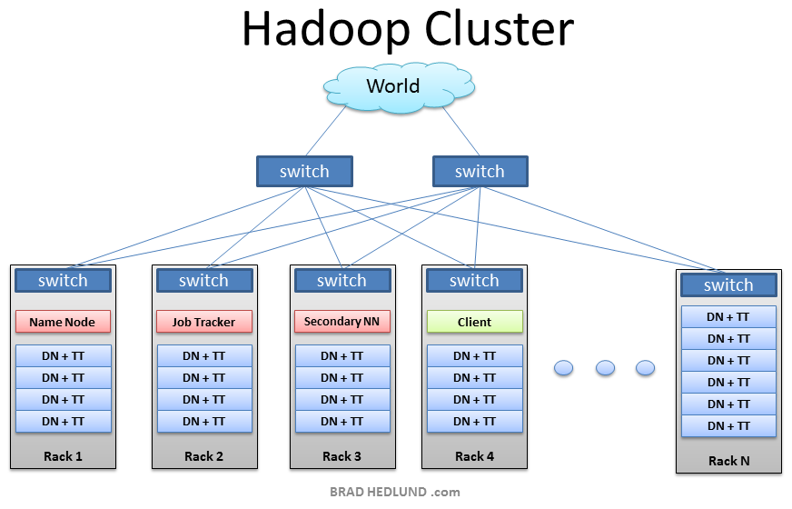
From Brad Hedlund: a very nice picture

Slide 43
Hadoop (contd.)
What are : Job tracker, Name node, Secondary name node, data node, task tracker…?
What are their roles?
Before we discuss those: lets look a demo of mapreduce on Hadoop MapReduce

