Slide 1
MapReduce Basics
Chapter 2 Lin and Dyer &
http://developer.yahoo.com/hadoop/tutorial/

Slide 2
Lin and Dyer’s text
Chapter 1: Please read: sets the context for MR
Chapter 2: MR Basics: analysis of a sample problem analysis/walkthrough
Chapter 3: MR Algorithm Design (up to p.60)
Chapter 4: Inverted index for text retrieval
Chapter 5: Graph algorithms (pagerank and other classical algorithms)

Slide 3
Divide and Conquer Algorithm
How do we break up a large problem into smaller tasks? More specifically, how do we decompose the problem so that the smaller tasks can be executed in parallel?
How do we assign tasks to workers distributed across a potentially large number of machines (while keeping in mind that some workers are better suited to running some tasks than others, e.g., due to available resources, locality constraints, etc.)?
How do we ensure that the workers get the data they need?
How do we coordinate synchronization among the different workers?
How do we share partial results from one worker that is needed by another?
How do we accomplish all of the above in the face of software errors and hardware faults?

Slide 4
Basics
map: (k1,v1) --> [(k2,v2)]
reduce: (k2,[v2])-->[(k3,v3)]
Implicit between map and reduce is the implicit "group by" operation of intermediate keys
Hadoop does not have the GFS restriction that reducer's input key and output key type should be same.

Slide 5
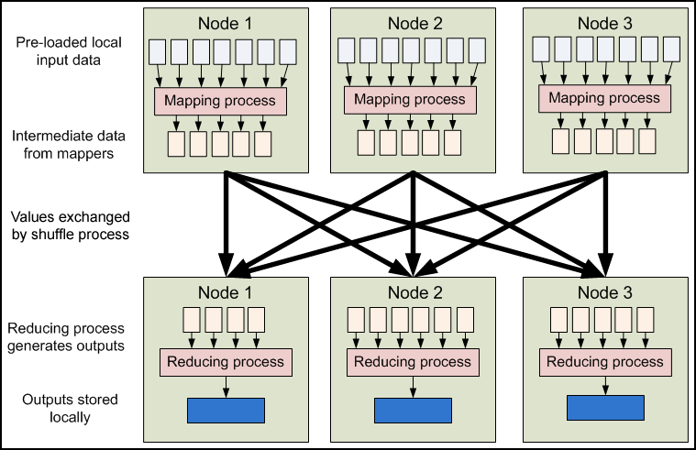
Architecture http://developer.yahoo.com/hadoop/tutorial

Slide 6
Combiners and Partitioners
Combiner: combines the same “keys” at the output of a mapper
Runs after the Mapper and before the Reducer. Usage of the Combiner is optional.
The Combiner will receive as input all data emitted by the Mapper instances on a given node.
The output from the Combiner is then sent to the Reducers, instead of the output from the Mappers.
The Combiner is a "mini-reduce" process which operates only on data generated by one machine.
This process of moving map outputs to the reducers is known as shuffling.
A different subset of the intermediate key space is assigned to each reduce node; these subsets (known as "partitions") are the inputs to the reduce tasks.
Default partition function is a hash function.
Each map task may emit (key, value) pairs to any partition; all values for the same key are always reduced together regardless of which mapper is its origin.

Slide 7
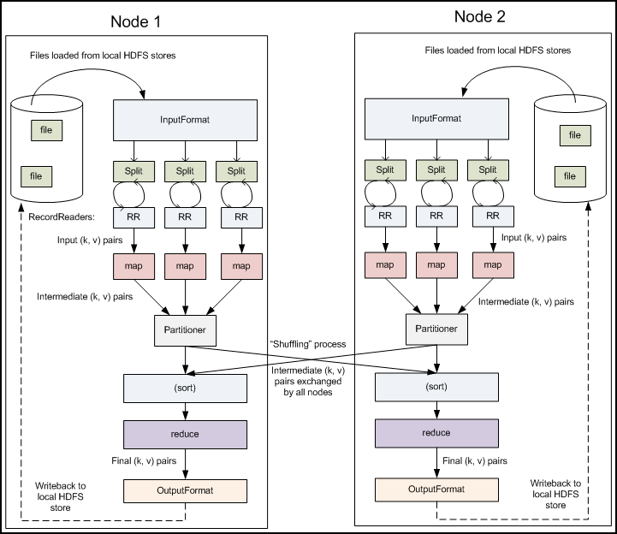
MR Workflow

Slide 8
Complete Example
Figure 2.2: Simplified MR process (picture)
Figure 2.3: MR Algorithm (pseudo code)
Figure 2.4: MR process with combiners and partitioners (picture)
Your answers to midterm questions should be in this format.
Lets go through couple of examples: (i) word count (ii) max value for each key

