Slide 1
Statistical Inference, Exploratory Data Analysis and Data Science Process
Chapter 2

Slide 2
Drew Conway’s Venn Diagram on DS (p.7)
Math& Statistics Knowledge
Substantive Expertise
Hacking Skills
Traditional
research
ML
DS
Danger
zone

Slide 3
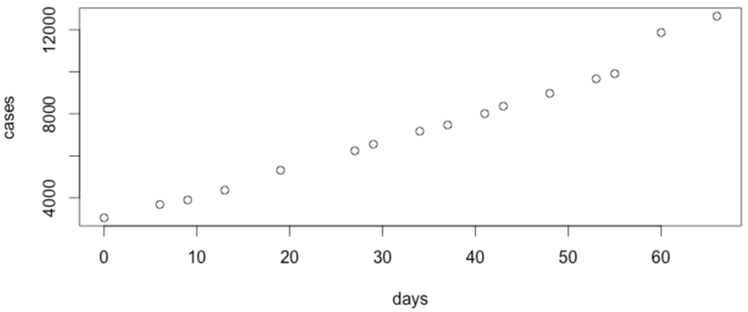
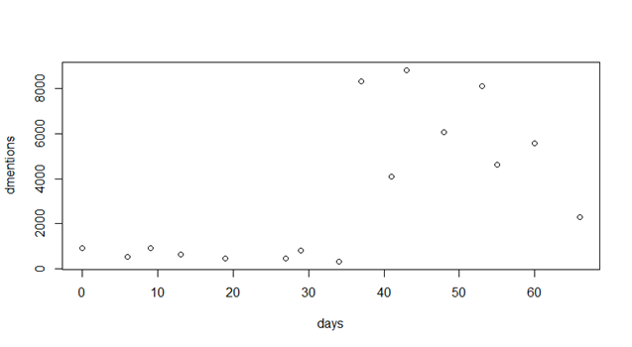
2014 West African Ebola outbreak: This is real data collected during Ebola crisis. We have # mentions in twitter and number of cases plotted against days. Data from Twitter and CDC.gov

Slide 4
Chapter 1
Lot of discussion of the authors’ context
What is the skill set needed for a data-computer scientist? Read chapter 1: add “coding” to that. See code.org
Preface page xix.: Pay attention to the extensive list of supplemental reading on various topics related to DS.
Lets self-assess where each of us stand as individuals and as a class.

Slide 5
Chapter 1 and 2 Data Science
Read Chapter 1 to get a perspective on “big data”
Chapter 2: Statistical thinking in the age of big data
You build models to understand the data and extract meaning and information from the data: statistical inference

Slide 6
Introduction
Data represents the traces of the real-world processes.
  What traces we collect depends on the sampling methods
  You build models to understand the data and extract meaning and information from the data: statistical inference
Two sources of randomness and uncertainty:
  The process that generates data is random
  The sampling process itself is random
Your mind-set should be “statistical thinking in the age of big-data”
  Combine statistical approach with big-data
Our goal for this chapter: understand the statistical process in dealing with data

Slide 7
Uncertainty and Randomness
A mathematical model for uncertainty and randomness is offered by probability theory.
A world/process is defined by one or more variables. The model of the world is defined by a function:
Model == f(w) or f(x,y,z) (A multivariate function)
The function is unknown➔ model is unclear, at least initially. Typically our task is to come up with the model, given the data.
Uncertainty: is due to lack of knowledge: this week’s weather prediction (e.g. 90% confident)
Randomness: is due lack of predictability: 1-6 face of when rolling a die
Both can be expressed by probability theory

Slide 8
Statistical Inference
World ➔ Collect Data➔ Capture the understanding/meaning of data through models or functions ➔ statistical estimators for predicting things about➔ world
Development of procedures, methods, and theorems that allow us to extract meaning and information from data that has been generated by stochastic (random) processes

Slide 9
Population and Sample
Population is complete set of traces/data points
  US population 314 Million, world population is 7 billion for example
  All voters, all things
Sample is a subset of the complete set (or population): how we select the sample introduces biases into the data
See an example in http://www.sca.isr.umich.edu/
Here out of the 314 Million US population, 250000 households are form the sample (monthly)
Population ➔mathematical model ➔ sample
(My) big-data approach for the world population: k-nary tree (MR) of 1 billion (of the order of 7 billion) : I basically forced the big-data solution/did not sample: This is possible in the age of big-data infrastructures

Slide 10
Population and Sample (contd.)
Example: Emails sent by people in the CSE dept. in a year.
Method 1: 1/10 of all emails over the year randomly chosen
Method 2: 1/10 of people randomly chosen; all their email over the year
Both are reasonable sample selection method for analysis.
However estimations pdfs (probability distribution functions) of the emails sent by a person for the two samples will be different.

Slide 11
Big Data vs statistical inference
Sample size N
For statistical inference N < All
For big data N == All
For some atypical big data analysis N == 1
  world model through the eyes of a prolific twitter user
  Followers of Ashton Kuchar

Slide 12
New Kinds of Data
Traditional: numerical, categorical, or binary
Text: emails, tweets, NY times articles ( ch.4, 7)
Records: user-level data, time-stamped event data, json formatted log files (ch.6,8)
Geo-based location data (ch.2)
Network data ( ch.10) (How do you sample and preserve network structure?)
Sensor data ( covered in Lin and Dyer’s)
Images

Slide 13
Big-data context
Analysis for inference purposes you don’t need all the data.
At Google (at the originator big data algs.) people sample all the time.
However if you want to render, you cannot sample.
Some DNA-based search you cannot sample.
Say we make some conclusions with samples from Twitter data we cannot extend it beyond the population that uses twitter. And this is what is happening now…be aware of biases.
Another example is of the tweets pre- and post- hurricane Sandy..
Yelp example..

Slide 14
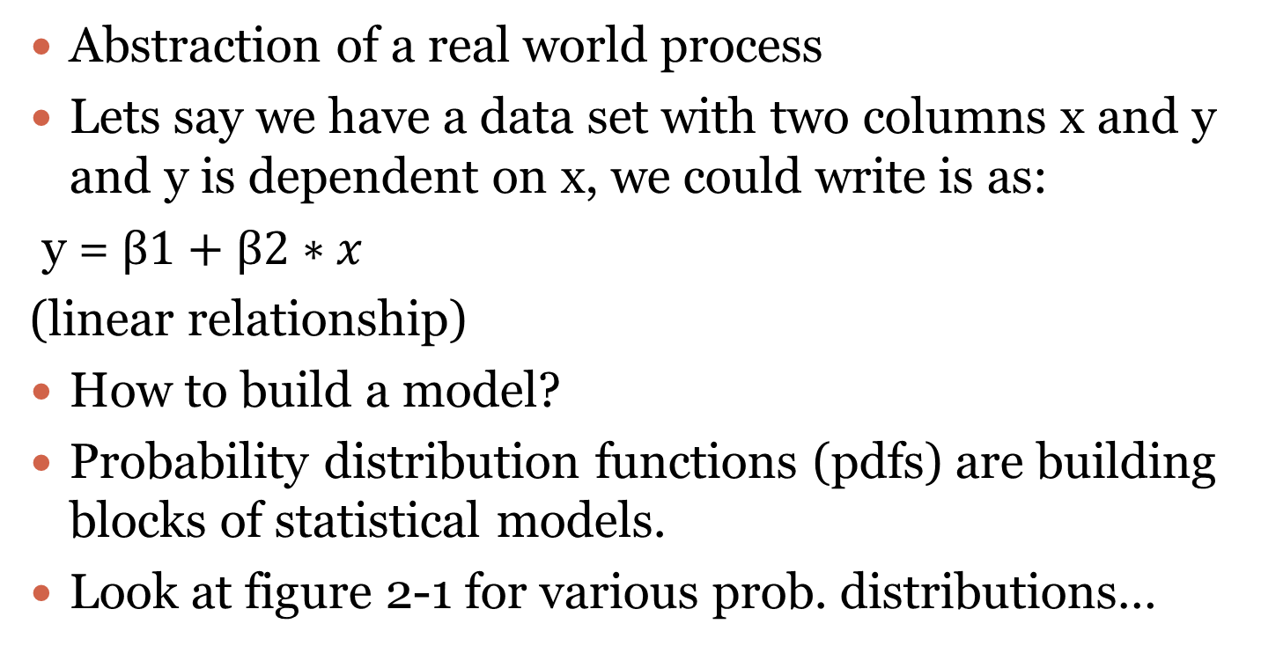
Modeling
Abstraction of a real world process
Lets say we have a data set with two columns x and y and y is dependent on x, we could write is as:
y = $β1+β2∗x$
(linear relationship)
How to build a model?
Probability distribution functions (pdfs) are building blocks of statistical models.
Look at figure 2-1 for various prob. distributions…

Slide 15
Probability Distributions
Normal, uniform, Cauchy, t-, F-, Chi-square, exponential, Weibull, lognormal,..
They are know as continuous density functions
Any random variable x or y can be assumed to have probability distribution p(x), if it maps it to a positive real number.
For a probability density function, if we integrate the function to find the area under the curve it is 1, allowing it to be interpreted as probability.
Further, joint distributions, conditional distribution..

Slide 16
Fitting a Model
Fitting a model means estimating the parameters of the model: what distribution, what are the values of min, max, mean, stddev, etc.
Don’t worry R has built-in optimization algorithms that readily offer all these functionalities
It involves algorithms such as maximum likelihood estimation (MLE) and optimization methods…
Example: y = β1+β2∗𝑥 ➔ y = 7.2 + 4.5*x

Slide 17
Exploratory Data Analysis (EDA)
Traditionally: histograms
EDA is the prototype phase of ML and other sophisticated approaches; See Figure 2.2
Basic tools of EDA are plots, graphs, and summary stats.
It is a method for “systematically” going through data, plotting distributions, plotting time series, looking at pairwise relationships using scatter plots, generating summary stats.eg. mean, min, max, upper, lower quartiles, identifying outliers.
Gain intuition and understand data.
EDA is done to understand Big data before using expensive bid data methodology.

Slide 18

The Data Science Process
Exploratory data analysis
Raw data collected
Data is processed
Data is cleaned
Machine learning algorithms;
Statistical models
Build data products
Communication
Visualization
Report Findings
Make decisions

Slide 19
Summary
An excellent tool supporting EDA is R
We will go through the demo discussed in the text.
Something to do this weekend:
  Read chapter 2
  Work on the sample R code in the chapter though it is not in your domain
  Find some data sets from your work, import it to R, analyze and share the results with your team
You collect or can collect a lot of data through existing channels you have.
Can you re-purpose the data using modern approaches to gain insights into your business?
We will now introduce Jupyter notebook environment that be used for understanding lab problems, designing and implementing solutions.

Slide 20
Data Collection in Automobiles
Large volumes of data is being collected the increasing number of sensors that are being added to modern automobiles.
Traditionally this data is used for diagnostics purposes.
How else can you use this data?
How about predictive analytics? For example, predict the failure of a part based on the historical data and on-board data collected?
On-board-diagnostics (OBDI) is a big thing in auto domain.
How can we do this?

Slide 21
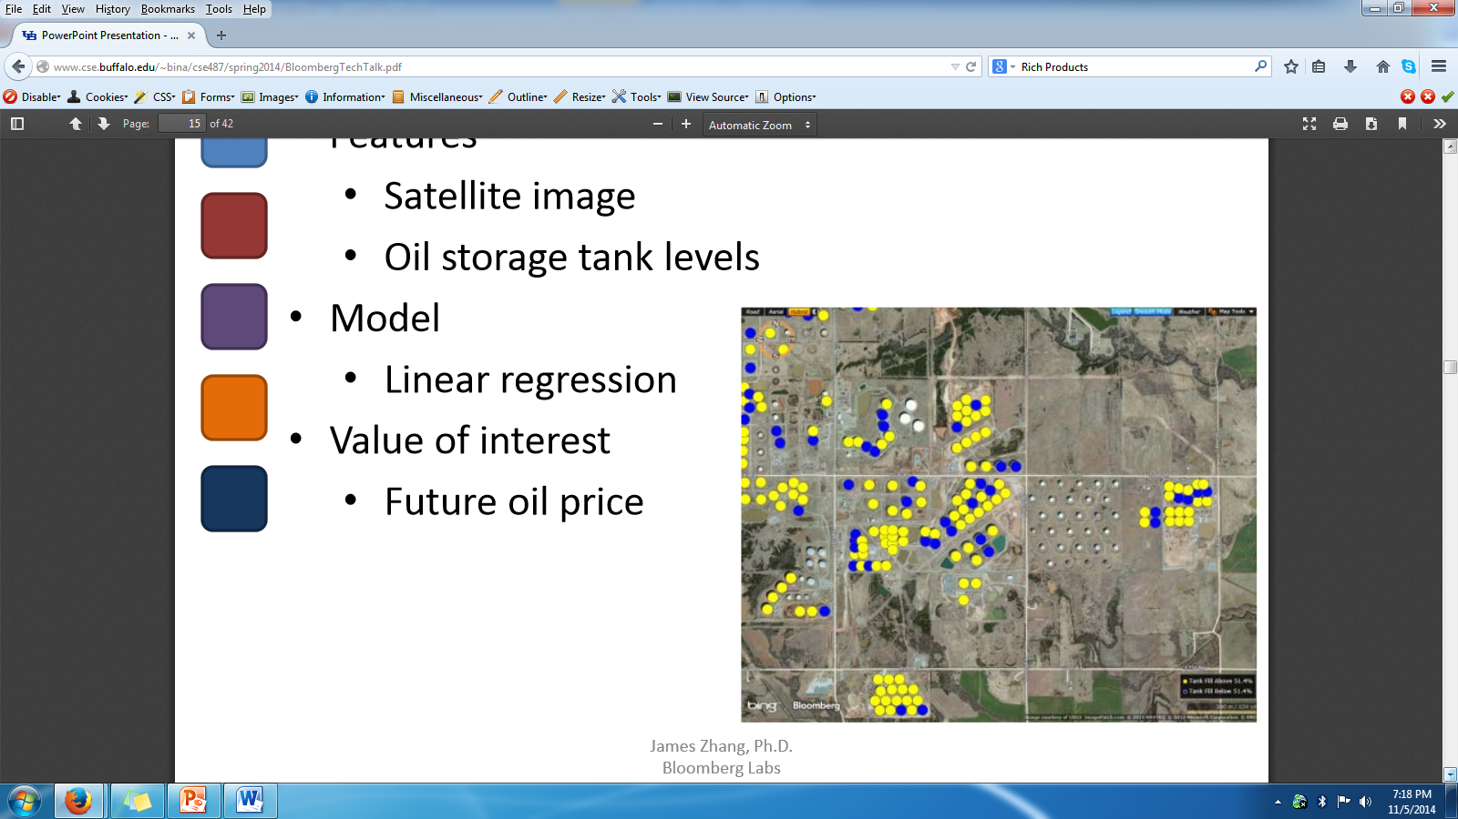
Oil Price Prediction

