Slide 1
Evaluating Classifiers (& other algorithms)
Still in Chapter 8

Slide 2
Evaluation
Rank the ads according to click logistic regression, and display them accordingly
Measures of evaluation:
{lift, accuracy, precision, recall, f-score)
Error evaluation: in fact often the equation is written in with an error factor.
For example, for logit we rewrite the equation as
  logit(P(ci=1|xi) = α + β^{t} Xi + err

Slide 3
Evaluation (contd.)
Lift: You use a classifier, and apply the results to a business process.
  What is the change in the outcomes since you applied the new methods/model?
  E.g., How many more people are clicking (or buying) because of the introduction of the model?
Accuracy: How often is the correct outcome predicted?

Slide 4
Positive and Negative Classifications
In most business applications of classification, you are looking for one class more so than the other.
For example, you are looking for promising stocks over potential poor performers.
There are two aspects to how well a classifier performs: You want the classifier to “flag” items you are looking for but also NOT flag thinks you are NOT looking for.
“Flag” aggressively, you will be get a lot of false positives
“Flag” conservatively, you will be leaving out items that should have flagged. Esp. dangerous in certain situations, e.g., Screening for cancer.

Slide 5
True Positive Rate
True positive rate (TPR).
Of all the things that should be flagged by our classifier, this is the fraction that actually gets flagged. We want it to be high 1.0, if perfect!
False positive rate (FPR. Of all the things that should NOT be flagged, this is fraction that still ends up getting flagged. We want this to be low, 0.0 to be perfect!
Here is a graph explaining it.

Slide 6
1.0
Many false positives
A happy medium
True positive rate
Anything in this lower triangle
is not good
Many false
negatives
0,0
False positive rate
1.0

Slide 7
Roc: Receiver Operating Characteristic (ROC) Curve
ROC curve was designed during World War II for detecting enemy objects in the battle field.
Now it is extensively used in medicine and statistical evaluation of classifiers.
Here is an example for multiple-classifier comparison using ROC curve

Slide 8
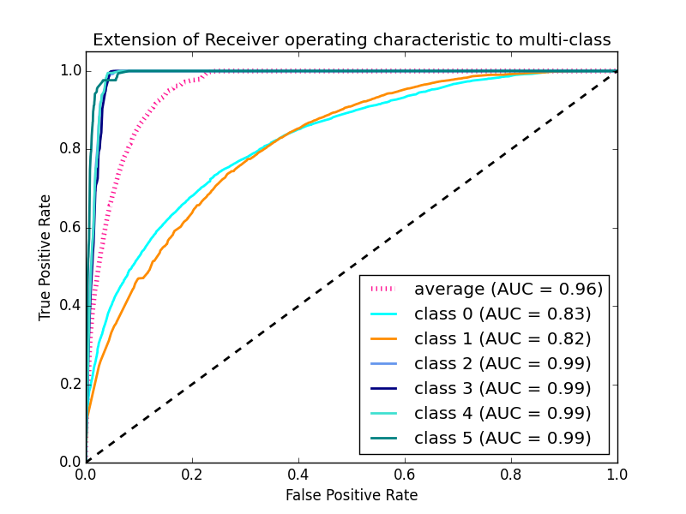
https://towardsdatascience.com/fraud-detection-under-extreme-class-imbalance-c241854e60c

Slide 9
Area under ROC, AUC or AUROC
In the last slide you also saw another metric comparing the various methods: AUC: Area under the curve (AUC)
This provides are under the ROC, a numerical quantity for comparing the various curves.
A good curve will approach 1.0 and shallow curve will be around 0.5.
A higher value is better measure of AUC.
You can evaluate all these using Spark mllib !

Slide 10
Other Performance Metrics
Precision: #True positives/ (#True positives+ #False positives)
Recall: #True positives/(#True positives + #False negatives)
F-score: mean of precision and accuracy = 2*precision*recall/(precision+recall)

Slide 11
Confusion Matrix for Multiclass Classifiers
A simple way to apply the evaluation we learned so far is to form a “confusion matrix”

Slide 12
Confusion Matrix
Here is an example from your Lab3:
Class | Sports | Business | World | USA
Sports | 35 | 4 | 1 | 5
Business | 5 | 40 | 3 | 15
World | 6 | 3 | 45 | 5
USA | 4 | 3 | 1 | 30

Slide 13
Confusion Matrix
Simple binary classifier confusion matrix and calculations:
http://www.dataschool.io/simple-guide-to-confusion-matrix-terminology/
Lets work out an example.

Slide 14
Summary
We looked at various evaluation matrix for assessing the quality of the classification.
We worked with a simple binary classification confusion matrix.
Apply the multi-class classification confusion matrix to evaluate your Lab3 results.

