Slide 1
Data-intensive Computing - Review
B. Ramamurthy

Slide 2
Overview
1. Data Science Roadmap
2. Fourth Paradigm (Data Everywhere)
Just one area: Climate change
3. Javascript everywhere (Here is one for your toolbox)
4. Final Exam Review
5. Material for summer explorations (References)

Slide 3
The Fourth Paradigm edited by Jim Grey [1]
Available at Microsoft
https://www.microsoft.com/en-us/research/wp-content/uploads/2009/10/Fourth_Paradigm.pdf
Defines Data-intensive computing in four areas of great interest
Many experts in their respective fields have contributed.

Slide 4
Science paradigms (chronologically)
Thousands of years ago:
Science was empirical
Describing natural phenomena
Last few hundred years
Theoretical branch
Models and generalizations
Last few decades
Computational branch
Simulating complex phenomena
Today
Data exploration/data science (The Fourth Paradigm)
Unify theory, experiment and simulation
Data captured by simulator or instrument
Processed by software
Info/knowledge/ intelligence
Analysis and visualization

Slide 5
Fourth Paradigm: Area 1: Environmental Sciences

Slide 6
Three Phases
Phase 1: largely discipline-oriented: geology, atmospheric chemistry, ecosystems
Phase 2: study of interacting element earth sciences, human behavior and systems: Complex systems and models for explaining these systems emerged; knowledge developed for scientific understanding
Phase 3: knowledge developed for practical decisions and actions
This new knowledge endeavor is termed “Science of environmental applications”

Slide 7
Knowledge and Queries
Integration of knowledge from many disciplines: physics, biogeochemical, engineering, and human processes (demographics, practices).
Snow-melt problem affects 1 billion people in the world: it is discussed in detail.
Models have to consider interactions among various systems: traditional approaches may not suffice.
My opinion: We may need a compendium of methods and the knowledge derived from these methods have to be unified.

Slide 8
Consideration for designing models
Need driven vs. curiosity driven
Externally constrained
Consequential and recursive (knowledge generates more knowledge)
Useful even when incomplete
Scalable
Robust
Data-intensive

Slide 9
Development of New Knowledge Types and Tools
For acquiring knowledge multiple sources: satellite imagery, energy-balancing reconstruction, etc.
Practical answers, intellectually captivating models, knowledge for policy making, etc.
Equally important is using this knowledge in everyday lives: esp. with the availability of mobile devices and the Internet. Ex: Hurricane models, knowledge and consequences

Slide 10
Simple Example
Figure 1:
Sierra Nevada and Central Valley of CA geography image
NASA satellite images at various spectral bands
Use these two collection to arrive at the snow cover model
Something of a scientific “mashup”

Slide 11
Figure 1

Slide 12
Ecological Sciences Systems (p.24..)
This is especially relevant in the context of recent anomalies such as super storms we are experiencing.
Navigating the ecological data flood
Step1: in ecological scientific analysis is data discovery and harmonization…sources, conversions, scrapping, web services, RSS, namespace mediation, search portals, wikipedia, …
Step 2: Moving ecological synthesis into the cloud: CSV MATlab ready data files from hundreds of sites; analysis on the cloud; SQL Server Analysis Data Cube on the cloud;

Slide 13
Ecological Sciences Systems (contd.)
Step 2 (contd.): analysis will download 3 terabyte of imagery, 4000 CPU hours, and generate < 100MB results.
Challenges: complex visualization, diversity of the data set, data semantics, data publisher, meta data, collaboration tools.
So you think these are NOT CSE problems, take a look at this site: http://climatechange.cs.umn.edu/

Slide 14
Areas Discussed
Earth and Environment (we discussed this)
Heath and Wellbeing
Scientific Infrastructure
Scholarly Communication (Text in the data world!)
Think about these!

Slide 15
Summary
Climate research is one of the critical application area of research for data-intensive computing.
We looked at some of the sample applications.
We also observed “mashup” of data from various sources is a common approach used in these applications.
Read the book when you have some time.

Slide 16
Javascript Everywhere and The three amigos… A Report from IBM [2]

Slide 17
Trends
Web boom
1.5 millions apps
Engaging enterprise
Interactions leading to transactions
“…the number of technologies, application programming interfaces (APIs) and techniques that an enterprise application developer must master these days. I like to use the notion of a “concept-count” to represent the number of concepts that a reasonable developer needs to keep in their heads to accomplish a task.”
Concept count: how many concepts do you have to know to design and implement an application? 8+ he says

Slide 18
Javascript everywhere
“The “JavaScript everywhere” movement holds the promise of dramatically reducing the concept-count for developers.”
Lets look at the examples from three.js, d3.js, and other frameworks: angular, react,..
Exists in all smart phones, all web pages, .. Found in NoSQL DBs.
Most used language
Ranked #1 by RedMonk.
http://redmonk.com/sogrady/2018/03/07/language-rankings-1-18/

Slide 19
What are the three amigos?
“The “three amigos” are jQuery, Node.JS (with Google V8) and MongoDB.”
V8 open source highperf js engine from Goog; chrome is built using JS!
Jquery: Js library: Rapid web development
Node (.js): powerful open source server application development system
Mondodb: open source JS interfaced document based NoSQl DB: With MongoDB, JavaScript can be used in queries, and aggregation functions (such as MapReduce) are sent directly to the database to be executed.

Slide 20
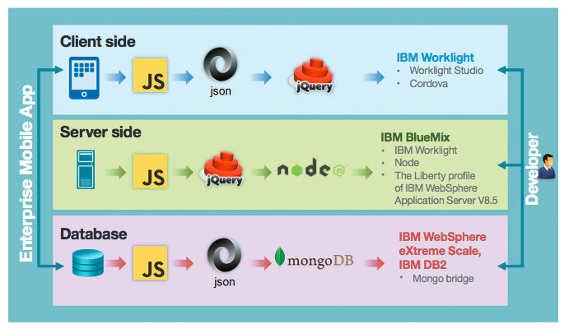
3A concept

Slide 21
What’s the point?
Learn JS and frameworks.
One more addition to your TOOL box!

Slide 22
Our Data Science Roadmap
Exploratory data analysis EDA
R/Rstudio+
Raw data collected
Data is processed
Data is cleaned
Big data methods
MapReduce
Build data products
Machine learning algorithms;
Statistical models
Spark ML
Communication
Visualization
Report Findings
Make decisions

Slide 23
Topics for Final Exam
Data-Intensive Text Processing with MapReduce
by Jimmy Lin and Chris Dyer
Ch. 2, 3 upto p.57
Ch. 5
Text processing, MR, and graph processing including shortest path and page rank
Naïve Bayes and Bayesian Classification (Class notes)
Apache Spark
RDD paper by Zaharia et al
Motivation for Spark
Spark APIs
Lab3 details
More details in the next two lectures

Slide 24
References: Summer Explorations
J. Grey Editor, The Fourth Paradigm, https://www.microsoft.com/en-us/research/wp-content/uploads/2009/10/Fourth_Paradigm.pdf. Last viewed 2018.
J. Cuomo, Javascript Everywhere and the Three Amigos. http://www.cse.buffalo.edu/~bina/cse487/threeamigosjs.pdf, last viewed 2018.
Marijn Haverbeke, Eloquent Javascript. https://eloquentjavascript.net/, last viewed 2018.

Slide 25
Lets take a survey on ublearns:
Goodjob is the password.

