Slide 1
Machine Learning Overview
Chapter 6 and 8 skip 7

Slide 2
Learning Objectives
Common features of ML algorithms

Slide 3
The big Picture
Read Chapter 6,8
Given a data set, a real-world classification problem, and constraints, you need to determine
Which classifier to use?
Which optimization method to employ?
Which loss function to minimize?
Which features to consider?
Which evaluation metric to use?

Slide 4
More..
Understand your problem domain: If election data, know how election results are computed?
Runtime is a serious concern in many analytic applications.
Simpler models are more interpretable, but aren’t as good performers.
The question of which algorithm works best is problem dependent and also “question” dependent. (What do you want to know?)
It is also constraint-dependent. What are the problem/data

Slide 5
Common Features
Analysis is done using computers, leveraging them to perform calculations that would be intractable by hand. Ex: your lab3 multi-class classification
It ingests data as input.
The data points are thought of as being samples from some underlying real world problem.
Data features are numerical, binary, categorical. Typically tabular or converted into tabular form before applying ML.
ML is born out of AI.
Computer Scientists research ML algorithms to improve performance whereas Data Scientists (you) learn to apply them. Ex: lab3

Slide 6
Supervised vs unsupervised
The author classifies ML into two categories: unsupervised and supervised
Unsupervised: raw data ➔ finding patterns; Example: K-means
Supervised: Some data points are labeled or have target value/class associated with them. The goal of the algorithms is to figure out some way to estimate the (unknown) target value of the other data points. Ex: your lab3 classification of news articles into Biz, Science, World etc.

Slide 7
Training data and Testing Data sets
Given a data collection you random divide the data set into (Training, Testing) sets: typically 80%, 20%
If you are rigorous you could also divide it into Training, Testing and validation data sets.
Error metric is important: how accurate is your classification?
Also periodic retraining is important esp. in dynamically evolving data sets. For example, features of Sport articles in March may not be the same in May or June; also geo-location matters.

Slide 8
ML Classification
Chapter 8

Slide 9
Classification
What? Identify the “class” of a data item based on prior knowledge.
Why?
To target the subsequent operations based on the classes.
To get insights about underlying data
Concerns: bad features will lead to bad classification
Data science is about understanding the data sets and the domain application well enough that you can extract meaningful features.
From Wikipedia: ``..a feature is an individual measurable property or characteristic of a phenomenon being observed. Choosing informative, discriminating and independent features is a crucial step for effective algorithms in pattern recognition, classification and regression.”

Slide 10
Binary vs multiclass
Binary classification is about 1 or 0, yes or no; example: email classification spam or not spam
Multiclass: when a problem has k labels such as in our Lab3, the standard solution is to train k binary classifiers: one for each label X, classifying points as being X or not X.
Take a look at this output data about news classification:

Slide 11
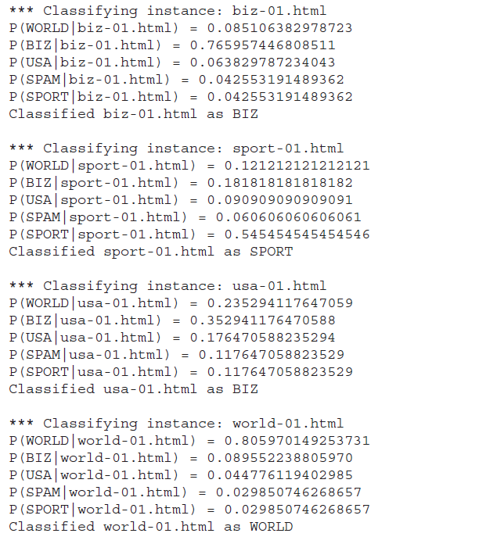
Here the classes are WORLD, BIZ,
USA, SPAM, SPORT
Actually 4 known classes + other
You could also classify it as:
WORLD vs nonWORLD
Many binary classifications making
a multi-classifier
The % may not be this sharp in your
output. It will be fuzzy.
{0.3, 0.4, 0.05, 0.14, 0.1} for example.
You choose the highest!

Slide 12
Decision Tree
Tree structure for multi-class classification
Cooke county chart determining the severity of a stroke in an emergency room situation.
Lets look at the example discussed in your text:
SubjectId | Age | Height | Gender | Class
123 | .. | .. | ..
124 | 29 | 5.6 | F | ?
125 | 15 | 3.8 | M | ?
.. | .. | .. | ..

Slide 13
Multi-class Decision Tree
Age>14?
Y or N?
Height <4?
Y or N?
Class 1 or 2
0: 0.5; 1: 0.5
Class 2
0:0.9; 1; 0.1
Gender: F?
Y or N?
Class 3
0:0.8;1:0.2
Class 1
0:0.3;1:0.7
Features: Age>14?, Female? Height<4?
Of course, you have to transform the
table into data format usable by the decision
tree; more features, more depth, more accuracy.

Slide 14
Logistic Regression
What is it?
It is an approach for calculating the odds of event happening vs other possibilities…Odds ratio is an important concept
Lets discuss this with examples
Why are we studying it?
To use it for classification
It is a discriminative classification vs Naïve Bayes’ generative classification scheme (what is this?)
Linear (continuous).. Logistic (categorical): Logit function bridges this gap
According to Andrew Ng and Michael Jordon logistics regression classification has better error rates in certain situations than Naïve Bayes (eg. large data sets) Big data? Lets discuss this…
Goal of logistic regression based classification is to fit the regression curve according to the training data collected (dependent vs independent variables) .
During production this curve will be used to predict the class of a dependent variable.

Slide 15
Logistic Regression
Mortality of injured patients
If a patient has a given disease (Recall that we did this using Bayes) (binary classification using a variety of data like age, gender, BMI, blood tests etc.)
If a person will vote Democratic or Republican
The odds of a failure of a process, system or a product
A customer’s propensity to purchase a product
Odds of a person staying in the workforce
Odds of a homeowner defaulting on a loan
Conditional Random Field (CRF) an extension of logistic regression to sequential data, are used in NLP. It is labeling a sequence of items so that an entity can be recognized (named entity recognition).
The appropriate regression analysis to conduct when the dependent variable is dichotomous (binary).
Like all regression analyses, the logistic regression is a predictive analysis. Logistic regression is used to describe data and to explain the relationship between one dependent binary variable and one or more nominal, ordinal, interval or ratio-level independent variables.

Slide 16
Basics
Odds ratio: $\frac{p}{1−p}$
Basic function is: logit ➔ logistic regression
Definition:
logit(p) = log($\frac{p}{1−p}$) = log(p) – log(1-p)
The logit function takes x values in the range [0,1] and transforms them to y values along the entire real line
Inverse logit does the reverse, takes a x value along the real line and transforms them in the range [1,0]

Slide 17
Logit Use case
Media6Degrees is tech company in online ( and now mobile) advertising space
This chapter is written for data science problem in this domain by its CIO.
The problem: need to match MD6 clients with users of the products by the clients.
In general, ad companies want to target users based on user’s likelihood to click.
Problem simplifies: probability that a user will click on a given ad. 1 or 0

Slide 18
Three Core Problems
Feature engineering: figuring out which features to use
User-level conversion prediction: predicting when someone will click
Bidding; How much is it worth to show a given ad to a given user? Monetizing?

Slide 19
Lets derive this from first principles
Let ci be the set of labels .. For binary classification (yes or no) it is i = 0, 1, clicked or not
Let xi be the features for user i , here it is the urls he/she visited
P(ci|xi) =
P(ci=1|xi) = eqn4
P(ci=0|xi) = eqn5
log Odds ratio = log (eqn4/eqn5)
logit(P(ci=1|xi) = α + β^{t} Xi where xi are features of user i and β^{t} is vector of weights/likelihood of the features.
Now the task is to determine α and β
Methods are available for this.. Out of the scope our discussion.
Use the logistic regression curve in step 7 to estimate probabilities and determine the class according to rules applicable to the problem.
In the logit equation, α is base click rate and β the slope of the logit curve/function.

Slide 20
Multiple Features
click | url1 | url2 | url3 | url4 | url5
1 | 0 | 0 | 0 | 1 | 0
1 | 0 | 1 | 1 | 0 | 1
0 | 1 | 0 | 0 | 1 | 0
1 | 0 | 0 | 0 | 0 | 0
1 | 1 | 0 | 1 | 0 | 1
“train” data
Fit the model using the command
Fit1 <- glm(click~ url1+url2 + url3+url4+url5, data=“train”, family=binomial(logit))
In the Fit1 logit equation, α is base click rate and
β the slope of the logit curve/function.

Slide 21
Demo on R
Ages of people taking Regents exam, single feature Age
Age Total Regents
Do EDA
Observe the outcome, if sigmoid➔
Fit the logistic regression model➔ use the fit/plot to classify
This is for small data of 25, how about Big data? MR?
Realtime response? Twitter model

Slide 22
R code: data file “exam.csv”
data1 <- read.csv("c://Users/bina/exam.csv")
summary(data1)
head(data1)
plot(Regents/Total ~Age, data=data1)
glm.out = glm(cbind(Regents, Total-Regents) ~Age, family=binomial(logit), data=data1)
plot(Regents/Total ~ Age, data = data1)
lines(data1$Age, glm.out$fitted, col="red")
title(main="Regents Data with fitted Logistic Regression Line")
summary(glm.out)

Slide 23
Logistic Regression Calculation
The logistic regression equation for lung cancer odds:
logit(p) = −4.48 + 0.11 x AGE + 1.16 x SMOKING
So for 40 years old cases who do smoke logit(p) equals 1.08. Logit(p) can be back-transformed to p by the following formula:
Logit(p) back transformation
https://www.medcalc.org/manual/logit_transformation_table.php
Alternatively, you can use the Logit table. For logit(p)=1.08 the probability p of having a positive outcome (for cancer) equals 0.75.
Reference: https://www.medcalc.org/manual/logistic_regression.php

Slide 24
Evaluation
Rank the ads according to click logistic regression, and display them accordingly
Measures of evaluation:
{lift, accuracy, precision, recall, f-score)
Error evaluation: in fact often the equation is written in with an error factor.
For example, for logit we rewrite the equation as
logit(P(ci=1|xi) = α + β^{t} Xi + err

Slide 25
Evaluation (contd.)
Lift: How much more people are clicking (or buying) because of the introduction of the model?
Accuracy: How often is the correct outcome predicted?
Precision: #True positives/ (#True positives+ #False positives)
Recall: #True positives/(#True positives + #False negatives)
F-score: mean of precision and accuracy

Slide 26
Confusion Matrix

