Slide 1
MapReduce Algorithm Design
Chapter 3
Lin and Dyer’s text

Slide 2
Map Reduce Solution
You design the map and the reduce; ➔ Map and Reduce
Configure the environment for
Number of mappers,
Number of reducers,
location of input for mappers
Location of output from reducer
Besides Map and Reduce, you can do local aggregation (to save some space during intermediate shuffle operation)
Given these parameters, lets explore how we can optimize the map-reduce process.

Slide 3
Basic MR for wordcount

Slide 4
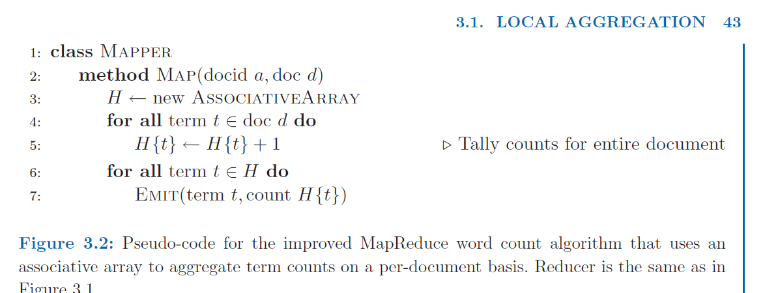
Improved Mapper
The mapper has an associative array to aggregate term counts on a per-document basis.
Reducer is same as before.

Slide 5
Combiner
Combiner is a local aggregator at the end of every mapper.
It may work with word count and other text problems but when it may not work with numeric problem when the operations are not transitive.
For example consider these this code for a simple MR for finding mean or average.
Wordcount(list1,list2,list3) == wordcount(list1), wordcount(list2), wordcount(list3)
Mean(list1, list2, list3) # Mean (list1), Mean (list2), Mean (list3)

Slide 6
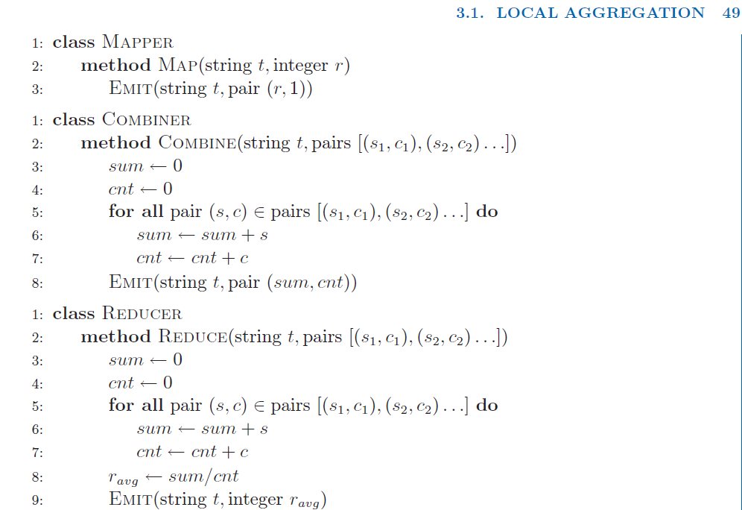
Sum, Mean using MR and Combiner

