Slide 1
Naïve Bayes

Slide 2
Goals
Classification is placing things where they belong
Why? To learn from classification
To discover patterns
To learn from history as to what our response is to a given class of events, for example.

Slide 3
Classification
Classification relies on apriori reference structures that divide the space of all possible data points into a set of classes that are not overlapping. (what do you do the data points overlap?)
What are the problems it (classification) can solve?
What are some of the common classification methods?
Which one is better for a given situation? (meta classifier)

Slide 4
Classification examples in daily life
Restaurant menu: appetizers, salads, soups, entrée, dessert, drinks,…
Library of congress (LIC) system classifies books according to a standard scheme
Injuries and diseases classification is physicians and healthcare workers
Classification of all living things: eg., Home Sapiens (genus, species)
Classification very large application in automobile domain from services (classes), parts (classes), incidents (classes) etc.

Slide 5
Categories of classification algorithms
With respect to underlying technique two broad categories:
Statistical algorithms
  Regression for forecasting
  Bayes classifier depicts the dependency of the various attributes of the classification problem.
Structural algorithms
  Rule-based algorithms: if-else, decision trees
  Distance-based algorithm: similarity, nearest neighbor
  Neural networks

Slide 6
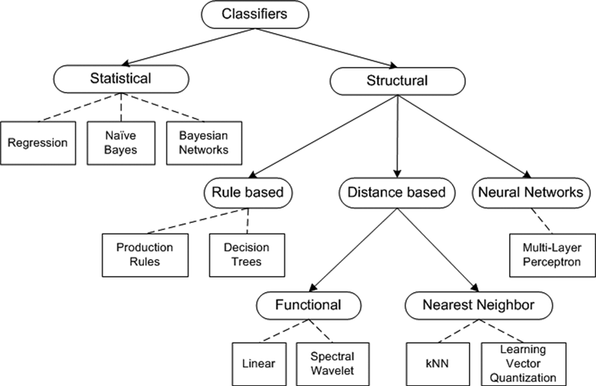
Classifiers

Slide 7
Advantages and Disadvantages
Decision tree, simple and powerful, works well for discrete (0,1- yes-no)rules;
Neural net: black box approach, hard to interpret results
Distance-based ones work well for low-dimensionality space
..

Slide 8
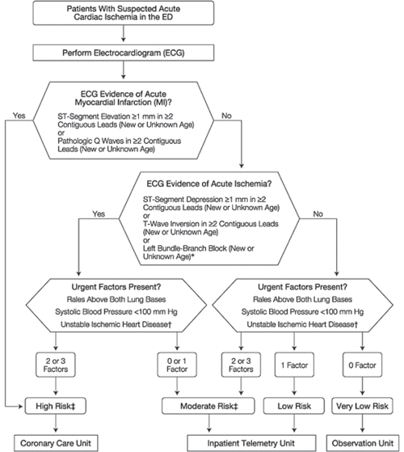
This decision tree hangs in the ER of Cooke County hospital, Chicago, IL

Slide 9
Naïve Bayes
Naïve Bayes classifier
One of the most celebrated and well-known classification algorithms of all time.
Probabilistic algorithm
Typically applied and works well with the assumption of independent attributes, but also found to work well even with some dependencies.
Was discovered centuries ago but is heavily used today in many predictive analytic applications

Slide 10
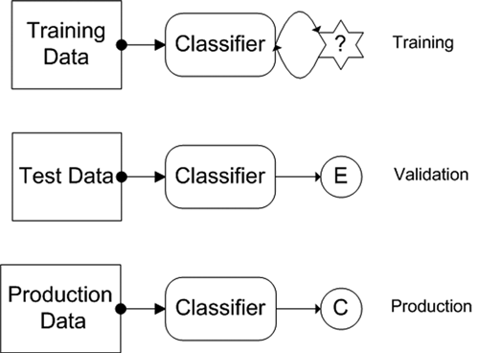
Life Cycle of a classifier: training, testing and production

Slide 11
Training Stage
Provide classifier with data points for which we have already assigned an appropriate class.
Purpose of this stage is to determine the parameters

Slide 12
Validation Stage
Testing or validation stage we validate the classifier to ensure credibility for the results.
Primary goal of this stage is to determine the classification errors.
Quality of the results should be evaluated using various metrics
Training and testing stages may be repeated several times before a classifier transitions to the production stage.
We could evaluate several types of classifiers and pick one or combine all classifiers into a metaclassifier scheme.

Slide 13
Production stage
The classifier(s) is used here in a live production system.
It is possible to enhance the production results by allowing human-in-the-loop feedback.
The three steps are repeated as we get more data from the production system.

Slide 14
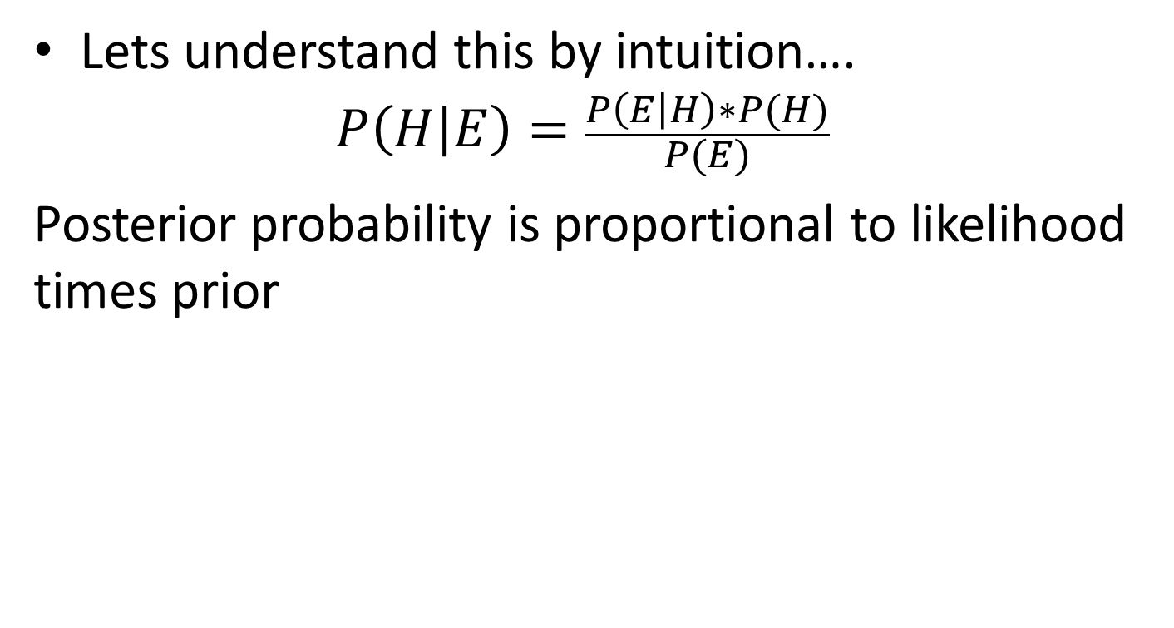
Bayesian Inference

Slide 15
Naïve Bayes Example
Reference: http://en.wikipedia.org/wiki/Bayes_Theorem
Suppose there is a school with 60% boys and 40% girls as its students. The female students wear trousers or skirts in equal numbers; the boys all wear trousers. An observer sees a (random) student from a distance, and what the observer can see is that this student is wearing trousers. What is the probability this student is a girl? The correct answer can be computed using Bayes' theorem.

Slide 16
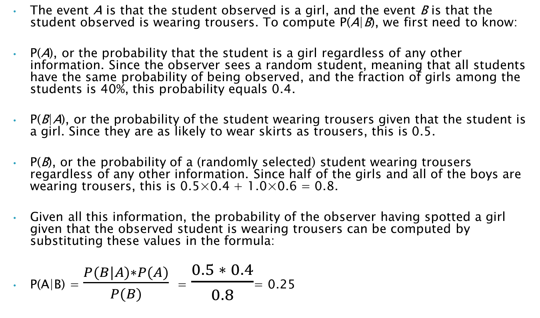
Discussion
The event A is that the student observed is a girl, and the event B is that the student observed is wearing trousers. To compute P(A|B), we first need to know:
P(A), or the probability that the student is a girl regardless of any other information. Since the observer sees a random student, meaning that all students have the same probability of being observed, and the fraction of girls among the students is 40%, this probability equals 0.4.
P(B|A), or the probability of the student wearing trousers given that the student is a girl. Since they are as likely to wear skirts as trousers, this is 0.5.
P(B), or the probability of a (randomly selected) student wearing trousers regardless of any other information. Since half of the girls and all of the boys are wearing trousers, this is 0.5×0.4 + 1.0×0.6 = 0.8.
Given all this information, the probability of the observer having spotted a girl given that the observed student is wearing trousers can be computed by substituting these values in the formula:
P(A|B) = $\frac{P(B|A)∗P(A)}{P(B)}$= $\frac{0.5 ∗ 0.4}{0.8}$= 0.25

Slide 17
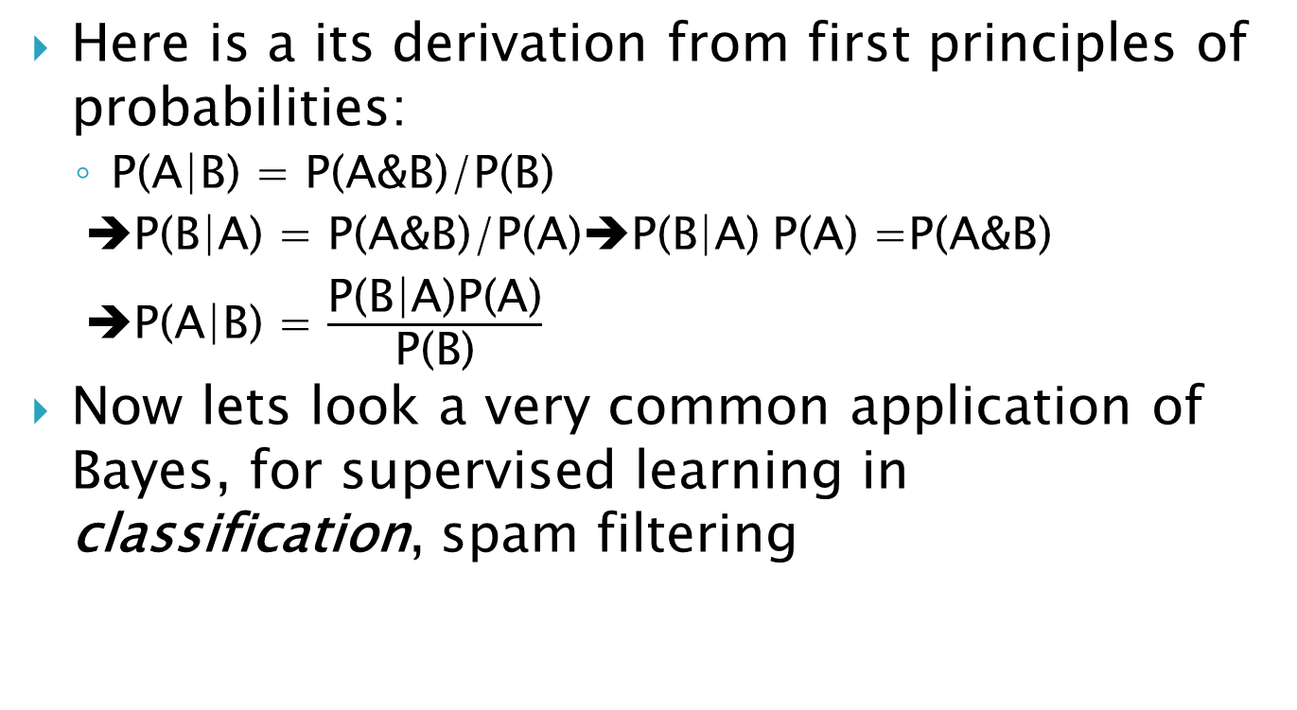
Intuition
Here is a its derivation from first principles of probabilities:
  P(A|B) = P(A&B)/P(B)
  ➔P(B|A) = P(A&B)/P(A)➔P(B|A) P(A) =P(A&B)
  ➔P(A|B) = $\frac{\text{P}\text{(}\text{B}\text{|}\text{A}\text{)}\text{P}\text{(}\text{A}\text{)}}{\text{P}\text{(}\text{B}\text{)}}$
Now lets look a very common application of Bayes, for supervised learning in classification, spam filtering

Slide 18
Classification
Training set ➔ design a model
Test set ➔ validate the model
Classify data set using the model
Goal of classification: to label the items in the set to one of the given/known classes
For spam filtering it is binary class: spam or nit spam(ham)

Slide 19
Why not use methods we discussed earlier?
Linear regression is about continuous variables, not binary class
K-nn cannot accommodate multi-features: curse of dimensionality: 1 distinct word ➔1 feature➔ 10000 words ➔10000 features!
Then what can we use? Naïve Bayes

Slide 20
Lets Review
A rare disease where 1%
We have highly sensitive and specific test that is
  99% positive for sick patients
  99% negative for non-sick
If a patients test positive, what is probability that he/she is sick?
Approach: patient is sick : sick, tests positive +
P(sick/+) = P(+/sick) P(sick)/P(+)= 0.99*0.01/(0.99*0.01+0.99*0.01) = 0.099/2*(0.099) = ½ = 0.5

Slide 21
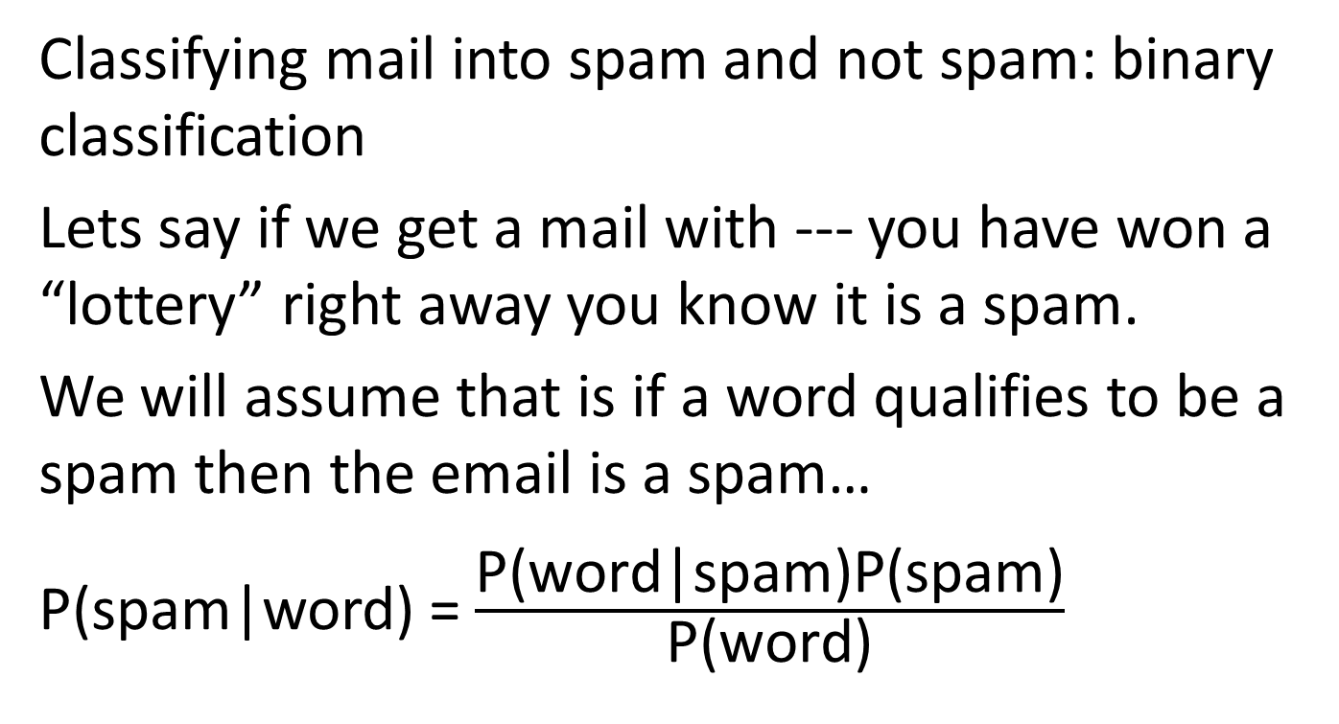
Spam Filter for individual words
Classifying mail into spam and not spam: binary classification
Lets say if we get a mail with --- you have won a “lottery” right away you know it is a spam.
We will assume that is if a word qualifies to be a spam then the email is a spam…
P(spam|word) = $\frac{\text{P}\text{(}\text{word}\text{|}\text{spam}\text{)}\text{P}\text{(}\text{spam}\text{)}}{\text{P}\text{(}\text{word}\text{)}}$

Slide 22
Sample data
Enron data set
Enron employee emails
A small subset chosen for EDA
1500 spam, 3672 ham
Test word is “meeting”…that is, your goal is label a email with word “meeting” as spam or ham (not spam)
Run an simple shell script and find out that 16 “meeting”s in spam, 153 “meetings” in ham
Right away what is your intuition? Now prove it using Bayes

Slide 23
Further discussion
Lets call good emails “ham”
P(ham) = 1- P(spam)
P(word) = P(word|spam)P(spam) + P(word|ham)P(ham)

Slide 24
Calculations
P(spam) = 1500/(1500+3672) = 0.29
P(ham) = 0.71
P(meeting|spam) = 16/1500= 0.0106
P(meeting|ham) = 15/3672 = 0.0416
P(meeting) = P(meeting|spam)P(spam) + P(meeting|ham)P(ham) = 0.0106 *0.29 + 0.0416+0.71= 0.03261
P(spam|meeting) = P(meeting|spam)*P(spam)/P(meeting)
= 0.0106*0.29/0.03261 = 0.094 ➔ 9.4%

Slide 25
Why not use other methods?
Linear regression is about continuous variables, not binary class
K-nn can accommodate multi-features: curse of dimensionality: 1 distinct word ➔1 feature➔ 10000 words ➔10000 features!

Slide 26
Lets Review: one more example.
A rare disease where 1%
We have highly sensitive and specific test that is
  99% positive for sick patients
  99% negative for non-sick
If a patients test positive, what is probability that he/she is sick?

Slide 27
Discussion
P(sick/+) = P(+/sick) P(sick)/P(+)=
0.99*0.01/(0.01*0.99+0.99*0.01) =
0.099/2*(0.099) = ½ = 0.5

Slide 28
Summary
Learn Naïve Bayes Rule
Application to spam filtering in emails
Work the example/understand the example discussed in class: disease detection, a spam filter..
Possible question➔ problem statement ➔ classification model using Naïve Bayes
If you have time, summer reading,
  https://ai.stanford.edu/~ang/papers/nips01-discriminativegenerative.pdf

