Slide 1
Spark
From many sources

Slide 2
References
Advanced Analytics with Spark by S. Ryza, U. Laserson, S. Owen and J. Wills, O’Reilly, April 2015.
Apache Spark documentation: http://spark.apache.org/
Apache Spark: http://spark.apache.org/docs/latest/programming-guide.html
Pyspark: http://spark.apache.org/docs/latest/api/python/pyspark.html
http://www.trongkhoanguyen.com/
Stackoverflow.com
M. Zaharia et al. Resilient Distributed Dataset: A Fault-tolerant Abstraction for in-Memory Cluster Computing. https://www.usenix.org/system/files/conference/nsdi12/nsdi12-final138.pdf

Slide 3
Challenges in data science
Data cleaning: Vast majority of the work that goes into analyses lies in pre-processing data: Data is messy; munging, fusing, mushing and cleansing. We need computational methods to clean data and data pipeline certainly should include an important step of “data cleaning” and “feature engineering”.
  Choosing from many features, the relevant features.
  Designing a math model from a 2D array (Ex: page rank)
Iteration: Iteration is a fundamental part of data science. Modeling and analysis require typically multiple passes over the same data. Machine learning algorithms and statistical procedures like stochastic gradient and expected maximization involve repeated scans to reach convergence.
  Choosing the right features, picking the right algorithms, running the right significance tests, finding the right hyperparameters: all require experimentation
  Need to avoid delays in repeated reading of data

Slide 4
Challenges (contd.)
Information updates: The results of data analysis will be presented in a visually and the application becomes part of the production system. This system has be frequently or in real time updating itself driven by the availability of new data such as in fraud detection system.
How about the existing approaches? C++, Java are not good for EDA. R does is slow for large data sets and does not integrate well with production stacks, Read-Evaluate-Print(REPL) are good for interaction but does not yield well to production systems.
We want a framework that makes modeling easy but is also a good fit for production systems is a huge win…that is Spark from AmpLab at Berkeley.

Slide 5
Apache Spark
Apache Spark is an open-source, distributed processing system commonly used for big data workloads.
Apache Spark utilizes in-memory caching
Optimized execution for fast performance,
It supports general batch processing, streaming analytics, machine learning, graph databases, and ad hoc queries.
Berkeley AMPLab Ion Stoica’s keynote

Slide 6
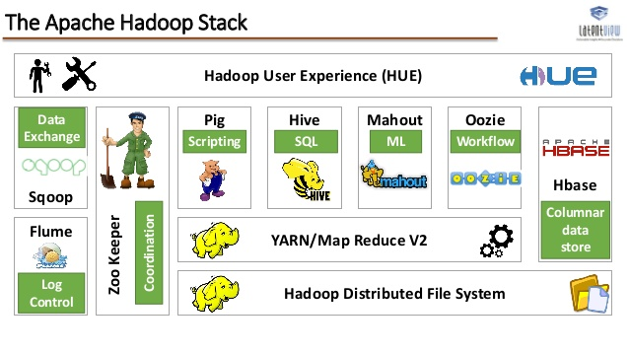
Hadoop Eco System

Slide 7
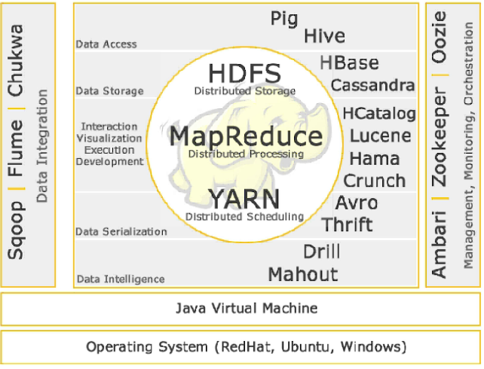

Slide 8
Pig: Abstraction layer for MR
Raw MR is difficult to install and program (Do we know about this? Then why did I ask you do this?)
There are many models that simplify designing MR applications:
  MRJob for python developers
  Elastic Map Reduce (EMR) from amazon aws
  Pig from Apache via Yahoo
  Hive from Apache via Facebook
  And others
It is a data flow language, so conceptually closer to the way we solve problems…

Slide 9
Pig Data flow Language
Pig data flow language describes a directed acyclic graph (DAG) where edges are data flows and nodes are operations.
There are no if statements or for loop in pig, since procedural language and object-oriented languages describe control flow and data flow is a side-effect.
Pig focuses on data flow.

Slide 10
Sample Pig script: simple data analysis
2 4 5
-2 3 4
3 5 6
-4 5 7
-7 4 6
4 5
A = LOAD 'data3' AS (x,y,z);
B = FILTER A by x> 0;
C = GROUP B BY x;
D = FOREACH C GENERATE group,COUNT(B);
STORE D INTO 'p6out';

Slide 11
See the pattern?
LOAD
FILTER
GROUP
GENERATE (apply some function from piggybank)
STORE (DUMP for interactive debugging)

Slide 12
Simple Examples
A = LOAD 'input' AS (x, y, z);
B = FILTER A BY x > 5;
DUMP B;
C = FOREACH B GENERATE y, z;
STORE C INTO 'output';
-----------------------------------------------------------------------------
A = LOAD 'input' AS (x, y, z);
B = FILTER A BY x > 5;
STORE B INTO 'output1';
C = FOREACH B GENERATE y, z;
STORE C INTO 'output2'

Slide 13
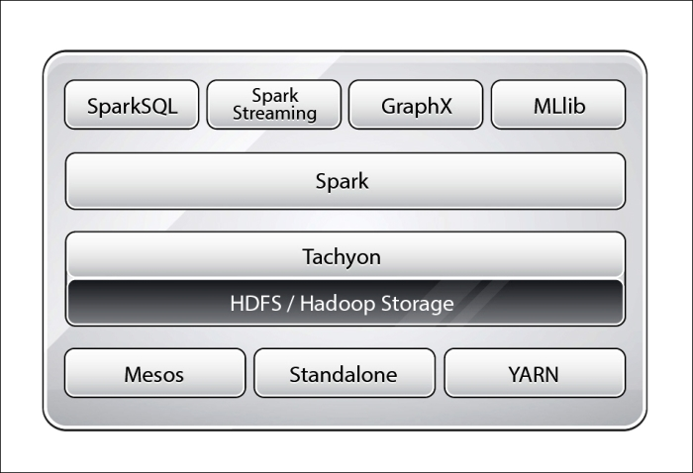
Spark Architecture

Slide 14
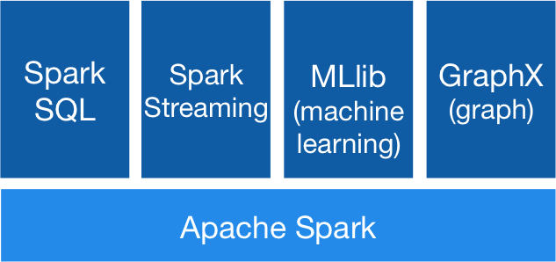
Spark Stack

Slide 15
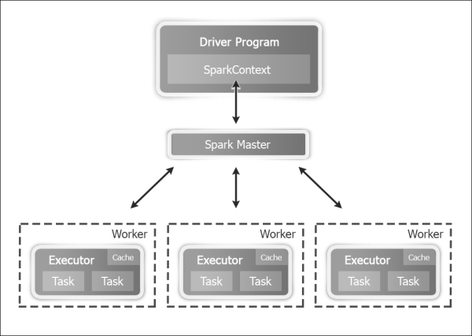
Spark Architecture

Slide 16
MapReduce
MR offer linear scalability and fault tolerance for processing very large data sets.
Spark maintains this revolutionary approach brought about by MR.
It also improves it in four different ways:
Whereas MR executes a single Map and Reduce, Spark executes a series of operations specified a directed acyclic graph (DAG) thus allowing one stage of MR to automatically send the results to the next stage. (Similar to Dryad of Microsoft)
Spark provides a rich set of transformations to express computations more naturally. (Similar to Apache Pig)
Spark extends its predecessors with in-memory computations through its Resilient Distributed Data (RDD) abstraction. Future steps dealing with the same data as the current set do not have reload it from the disk.
It is well-suited for highly iterative computing.

Slide 17
Pre-packaged Algorithms
Biggest bottleneck in data applications is not CPU, disk, or network but analyst productivity.
If only we could collapse the entire pipeline from preprocessing of data to model evaluation into a single programming environment, that can speed up development.
It transcends seamlessly between exploratory analytics and operational analytics.

Slide 18
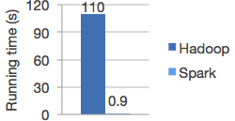
Speed vs Hadoop MR

Slide 19
Ease of programming
text_file = spark.textFile("hdfs://...")
text_file.flatMap(lambda line: line.split())
.map(lambda word: (word, 1))
.reduceByKey(lambda a, b: a+b)
Word count in Spark's Python API

Slide 20
Runs everywhere
Spark runs on Hadoop, Mesos, standalone, or in the cloud. It can access diverse data sources including HDFS, Cassandra, HBase, and S3.

Slide 21
Generality

Slide 22
RDD API
The building block of the Spark API (http://spark.apache.org/docs/latest/programming-guide.html#resilient-distributed-datasets-rdds)
In RDD API there are two types of operations:
  Transformations that define a new data set based on previous ones
  Actions which kick off a job to execute on a cluster
On top of the RDD API, high level APIs are provides:
  Dataframe API
  Machine Learning API

Slide 23
Examples
We use few transformations to build a dataset and store into a file:
text-file = sc.textFile(“hdfs://…”)
counts= text_file.flatMap(lambda line: line.split(“ “))
.map(lambda word: (word,1))
.reduceByKey(lambda a,b: a+b)
counts.saveAsTextFile(“hdfs://..”)

Slide 24
Python’s Lambda functions
See http://www.secnetix.de/olli/Python/lambda_functions.hawk more explanation.

Slide 25
Spark APIs
Scala API, Java API, Python API, Dataframes API (R API ..in the works)

Slide 26
Programming Model
Spark Context: sc
RDD: Resilient Distributed Datasets
Transformations and actions
Diverse set of data sources: HDFS, relational databases
JavaAPI, Python API, Scale API, dataframe API, (R API)

Slide 27
Spark Context
Spark Context (sc) is an object.
Main entry point for Spark applications
Just like any object it has methods associated with it.
We can see what those methods are (in Scala sc.[\t])
Some of the methods:
  getConf
  runJob
  addFile
  cancelAllJobs
  makeRDD

Slide 28
Scala Spark Shell
spark-shell –master local[*]
scala>sc
scala>sc.{tab}

Slide 29
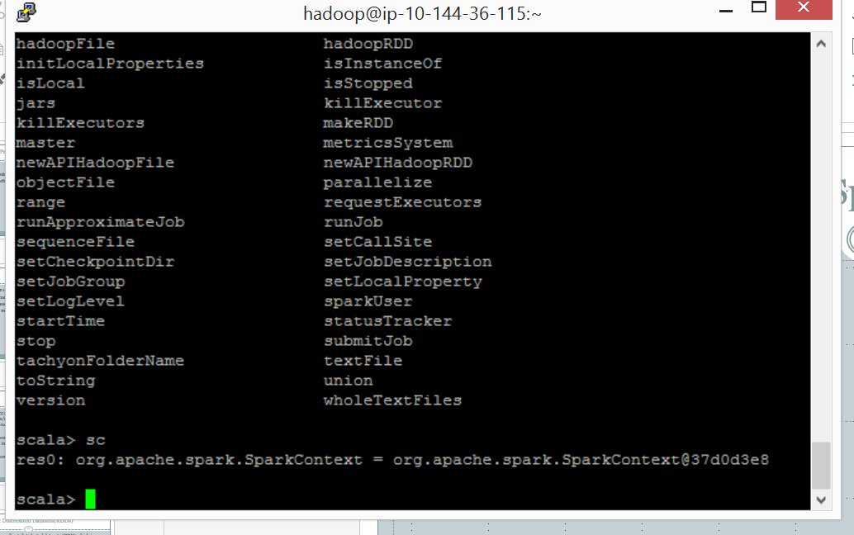

Slide 30
Resilient Distributed Datasets(RDDs)
A core Spark concept is resilient distributed datasets (RDD) which is a fault tolerant collection of elements that can be operated in parallel.
RDD is a convenient way to describe the computations that we want to perform in small independent steps and in parallel.
There are two ways to create RDDs:
  Parallelizing an existing collection in the driver program; performing a transformation on one or more existing RDDs, like filtering records, aggregating records by a common key or by joining multiple RDDs together.
  Using SparkContext to create an RDD from an external dataset in an external storage system such as a shared filesystem, HDFS, Hbase or any data source offering a Hadoop Inputformat

Slide 31
RDDs
A distributed memory abstraction that enables in-memory computations on large clusters in a fault-tolerant manner.
Motivated by two types of computation: iterative algorithms, interactive data mining tool.
In both cases above keeping data in memory will help enormously for performance improvement.
RDDs are parallel data structures allowing coarse grained transformations.
It provides fault tolerance by storing the lineage as opposed to the actual data as done in Hadoop. If RDD is lost enough information is stored to compute the current version of the RDD.

Slide 32
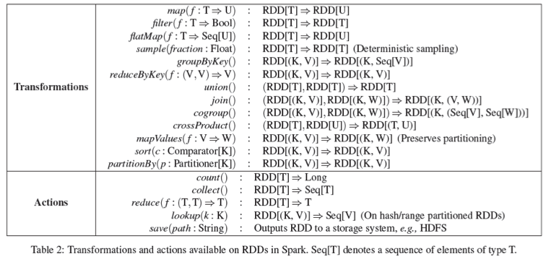

Slide 33
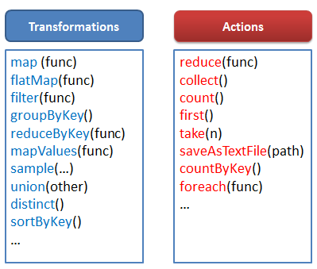

Slide 34
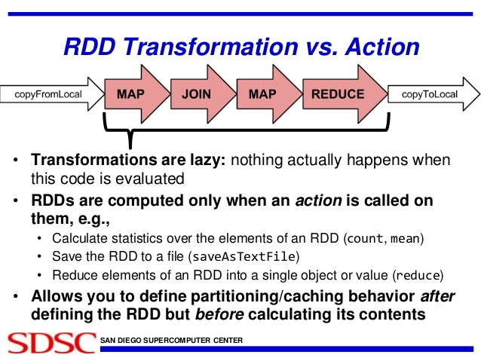

Slide 35
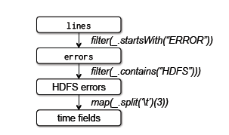
Lineage Graph

Slide 36
RDDs and Lineage Graph
An RDD can depend on zero or more other RDDs. For example when you say x = y.map(...), x will depend on y. These dependency relationships can be thought of as a graph.
You can call this graph a lineage graph, as it represents the derivation of each RDD. It is also necessarily a DAG, since a loop is impossible to be present in it.
Narrow dependencies, where a shuffle is not required (think map and filter) can be collapsed into a single stage. Stages are a unit of execution, and they are generated by the DAGScheduler from the graph of RDD dependencies. Stages also depend on each other. The DAGScheduler builds and uses this dependency graph (which is also necessarily a DAG) to schedule the stages.

Slide 37
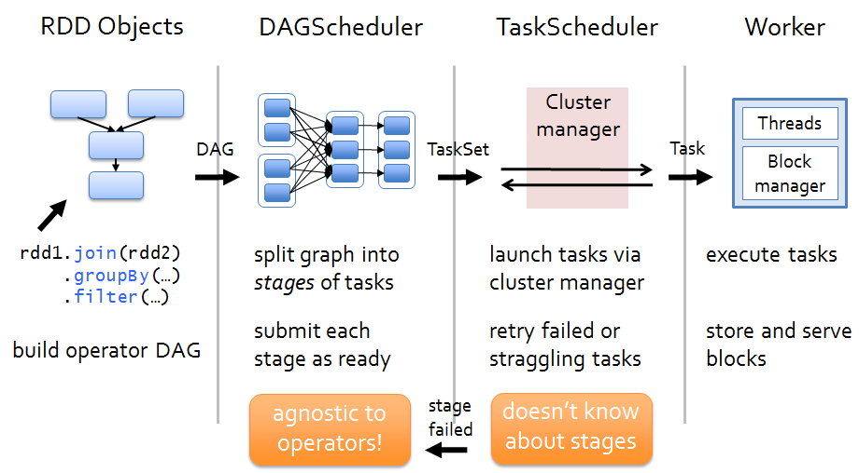
http://www.trongkhoanguyen.com/

Slide 38
Scala API
spark-shell --master local[*]
sc
sc.{tab}
val rdd = sc.parallelize(Array(1,2,2,4),4) //transformation
rdd.count() //action
rdd.collect() //action
rdd.saveAsTextfile(…)

Slide 39
Python API
pyspark
pyspark --master local[4]
data= [1, 3,4,5,6]
distdata = sc.parallelize(data)
rdd =sc.parallelize(range(1,4).map(lambda x: (x, “a” * x))
rdd.saveAsSequenceFile(“mydata”)
sorted(sc.sequenceFile(“mydata”).collect())

Slide 40
Sample Program
textfile = sc.textFile("s3://elasticmapreduce/samples/hive-ads/tables/impressions/dt=2009-04-13-08-05/ec2-0-51-75-39.amazon.com-2009-04-13-08-05.log")
linesWithCartoonNetwork = textfile.filter(lambda line: "cartoonnetwork.com" in line).count()
linesWithCartoonNetwork

Slide 41
Simple data operations
# Creates a DataFrame based on a table named "people"
# stored in a MySQL database.
url = \
"jdbc:mysql://yourIP:yourPort/test?user=yourUsername;password=yourPassword"
df = sqlContext \
.read \
.format("jdbc") \
.option("url", url) \
.option("dbtable", "people") \
.load()
# Looks the schema of this DataFrame.
df.printSchema()
# Counts people by age
countsByAge = df.groupBy("age").count()
countsByAge.show()
# Saves countsByAge to S3 in the JSON format.
countsByAge.write.format("json").save("s3a://...")

Slide 42
Prediction with Logistic Regression
# Every record of this DataFrame contains the label and
# features represented by a vector.
df = sqlContext.createDataFrame(data, ["label", "features"])
# Set parameters for the algorithm.
# Here, we limit the number of iterations to 10.
lr = LogisticRegression(maxIter=10)
# Fit the model to the data.
model = lr.fit(df)
# Given a dataset, predict each point's label, and show the results.
model.transform(df).show()

Slide 43
Pagerank in Scala
val links =sc.textFile(..).map(..).persist() // RDD is (URL,outlinks)
var ranks = RDD of (url, rank) pairs
for (i <- 1 to ITERATIONS)
{ // build RDD of (targetURL, float) pairs
val contribs = links.join(ranks).flatmap
{
(url, (link,rank)) =>
links.map(dest =>(dest,rank/links.size))
}
ranks = contribs.reduceByKey((x,y)=> x+y).mapValues(sum => a/N+(1-a)*sum)
}

Slide 44
Sample Program : pagerank
// Load the edges as a graph
val graph = GraphLoader.edgeListFile(sc, "graphx/data/followers.txt")
// Run PageRank
val ranks = graph.pageRank(0.0001).vertices
// Join the ranks with the usernames
val users = sc.textFile("graphx/data/users.txt").map { line =>
val fields = line.split(",")
(fields(0).toLong, fields(1))
}
val ranksByUsername = users.join(ranks).map {
case (id, (username, rank)) => (username, rank)
}
// Print the result
println(ranksByUsername.collect().mkString("\n"))

Slide 45
Representing RDDs
Each RDD is represented through a common interface that exposes 5 pieces of information:
A set of partitions, atomic pieces of datasets
Set of dependencies on the parent RDDs
Function for computing the RDD from the parents
Metadata about partitioning scheme
Data placement
See table 3 in the RDD paper.

Slide 46
Dependencies
Narrow dependencies: where each parent RDD partition is used by at most one child RDD; example map()
Wide dependencies: where multiple child partitions may depend on a parent RDD; example join()
Narrow dependencies
  allow pipelined execution: example map() and filter() in iterative fashion
  Recovery after node failure is more efficient
Single failed node in a wide dependency lineage graph may cause loss of partition in many ancestral dependencies.
Sample operations on RDDs resulting in other RDDs: mappedRDD, union, join, sample,..

