Slide 1
Word Co-occurrence
Chapter 3, Lin and Dyer

Slide 2
Review 1: Mapreduce Algorithm Design
"simplicity" is the theme
Fast "simple operation" on a large set of data
Most web-mobile-internet application data yield to embarrassingly parallel processing
General Idea; you write the Mapper and Reducer (Combiner and Partitioner); the execution framework takes care of the rest.
Of course, you configure...the splits, the # of reducers, input path, output path,.. etc.

Slide 3
Review 2:
Programmer has NO control over
-- where a mapper or reducer runs (which node in the cluster)
-- when a mapper or reducer begins or finishes
--which input key-value pairs are processed by a specific mapper
--what intermediate key-value pair is processed by a specific reducer

Slide 4
Review 3
However what control does a programmer have?
1. Ability to construct complex structures as keys and values to store and communicate partial results
2. The ability to execute user-specified code at the beginning of a map or a reduce task; and termination code at the end;
3. Ability to preserve state in both mappers and reducers across multiple input /intermediate values: counters
4. Ability to control sort order, order of distribution to reducers
5. ability to partition the key space to reducers

Slide 5
Lets move on co-occurrence (Section 3.2)
Word counting is not the only example..
Another example: co-occurrence matrix
large corpus: nXn matrix where n is the number of unique words in the corpus. (corpora is plural)
Lets assume m words, i and j row and column index, m(i.j) cell will have the number of times w(i) co-occurred with w(j)
For example <Winnie> is w(i) and <South Africa> w<j> on twitter feed today is 1000
The same for a month ago would have 0, <Winnie, Pooh> would have been more.
Lets look at the algorithm. You need this for your Lab2.

Slide 6
Word Co-occurrence – Pairs version
1: class Mapper
2: method Map(docid a; doc d)
3: for all term w 2 doc d do
4: for all term u 2 Neighbors(w) do
5: Emit(pair (w; u); count 1) . Emit count for each co-occurrence
1: class Reducer
2: method Reduce(pair p; counts [c1; c2; : : :])
3: s <- 0
4: for all count c in counts [c1; c2; : : :] do
5: s s + c . Sum co-occurrence counts
6: Emit(pair p; count s)

Slide 7
Word Co-occurrence – Stripes version
1.class Mapper
2: method Map(docid a; doc d)
3: for all term w in doc d do
4: H <-new AssociativeArray
5: for all term u in Neighbors(w) do
6: H{u} <-H{u} + 1 . //Tally words co-occurring with w
7: Emit(Term w; Stripe H)
1: class Reducer
2: method Reduce(term w; stripes [H1;H2;H3; : : :])
3: Hf <-new AssociativeArray
4: for all stripe H in stripes [H1;H2;H3; : : :] do
5: Sum(Hf ,H) // Element-wise sum lots of small values into big value
6: Emit(term w; stripe Hf )

Slide 8
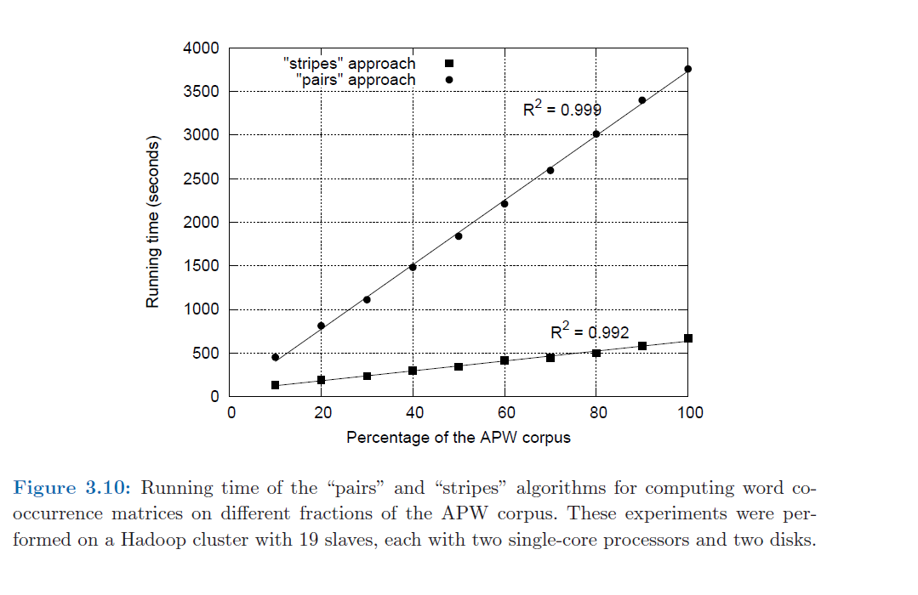
Run it on AWS and evaluate the two approaches

Slide 9
Summary/Observation
1.Word co-occurrence is proposed as solution for evaluating association!
2. Two methods proposed: pairs, stripes
3. MR implementation designed (pseudo code)
4. Implemented on MR on amazon cloud
5. Evaluated and relative performance studied (R², runtime, scale)

