Slide 1
Statistical Models and Machine Learning Algorithms
B. Ramamurthy

Slide 2
Review of Last Class
R and RStudio
Data science process
R demo of some useful plots
How is the lab 1 going? Submission?

Slide 3
Predictive Analytics
Linear regression- statistical method
Simple but powerful and popular
Twitter vs CDC Ebola data
K-means clustering machine learning algorithm
Application: customer segmentation
K-NN classification machine learning algorithm
Prediction of a class through training and learning
We are just going explore these in R. We may cover just the first one today, the other two next lecture.
hands-on demo work using several data sets

Slide 4
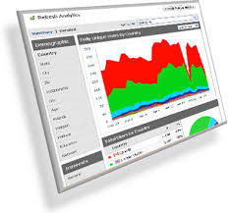
Transforming data into analytics➔ Strategies/decisions
Vertical domain
Probability-Statistics-Stochastic
Randomness,
Uncertainty
Machine learning algorithms
Food services data
Results
Decisions
Diagnosis
Strategies
Horizontal domain
Social/ media data/ web data

Slide 5

The Data Science Process (contd.)
4
Exploratory data analysis
1
Raw data collected
Data is processed
3
2
Data is cleaned
Machine learning algorithms;
Statistical models
5
Build data products
7
Communication
Visualization
Report Findings
6
Make decisions
Micro-level data strategy

Slide 6
The Seven Steps
Collect data
Prepare data
Clean data
EDA
Visualize + understand
Fit Models/apply algorithms + analyze + predict + understand (deeper) + visualize
Build data products

Slide 7

EDA to Data Product
Fit model
Build data tool
EDA
Extract parameters
Deploy on the cloud
Use it

Slide 8
Demos
We will illustrate the three algorithms using simple exercises
You may need to install several packages within R Studio, as and when needed

Slide 9
Plots, Graphs and Models
Plots, graphs, maps provide the ability to visualize data and the results of model fitting
Models provide you parameters that you can use to
Get a deeper understanding of the data characteristics
Build data tools based on the parameter so that you automate the analysis
Algorithms drive the model (fitting) of your data
For example,
if your guess is a linear relationship for the data, then use linear regression;
if you want to see clusters in your data you can use K-means;
if you want to classify the data into classes then you may want to use K-NN

Slide 10
Algorithms
Three types of algorithms:
Data munging or data engineering or data wrangling: mapping raw and dirty data to a format that is usable in tools for analysis.
By some estimates (NYT) this is about 50% of a data scientists time.
Start-ups to do this kind of work: re-package data and sell it.
Optimization algorithms for parameter estimation: Least squares, Newton’s methods, Stochastic gradients descent
R has many functions readily available do to this
Example: lsfit(x, y, … tolerance = 1e-07,…)
Machine Learning algorithms
Used to predict, classify and cluster

Slide 11
Linear Regression
Vey simple, easy to understand
Expresses the relationship between two variables/attributes
You assume a linear relationship between an outcome variable (dependent variable, response variable/ label) and the predictor(s) (independent variables, features, explanatory variables)
Examples: company sales vs money spent on ads
Number of friends vs time spent on social media

Slide 12
Linear regression (contd)
y = f(x) where y = β₀ + β₁ x
For this revenue table you can see y = 25x
How about this head(data1)?
Not so obvious
Need to “fit the model”
Subscribers x | Revenue y
5 | 125
10 | 250
15 | 375
20 | 500
7 | 276
3 | 43
4 | 83
6 | 136
10 | 417

Slide 13
Fitting the model
Least squares method to improve the fit
We will now look at R exercise for linear regression and extract the parameters
Fitted model can be evaluated and can be refined or updated.
Many variations of linear regression exists and can be used as the need arises for these.

Slide 14
Multiple Regression
Regression with multiple predictors
y = β0+ β1.x1 + β2.x2+.. + Є
We are considering data table/frame of one dependent variable y, and multiple independent variables.
Model fitting using R.
model<- lm(y ~ x0+x1+x2)
model <-lm(y ~ x0+x1+x2*x3) where predictors x2 and x3 have interaction between them.
Example: y :
price of oil ~
x1= # full oil storage tanks, x2= #half tanks, x3= #empty tanks

Slide 15
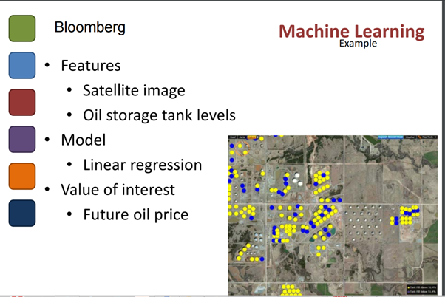
Oil Price Prediction By Dr. Zhang

Slide 16
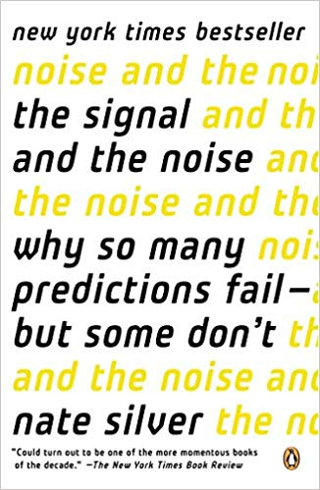
Signal and Noise
https://fivethirtyeight.com/
Nate Silver’s stats analysis is the only one
that predicted the possibility of a Trump
Win in 2017.

Slide 17
Synthetic data
You can generate synthetic data to explore, learn and/or hypothesize and evaluate a certain model
Usually the generating functions for random number is “r” followed by distribution function.
Examples:
runif(10,0.0,100.0) # generate 10 numbers between 0.0 and 100.0 : uniform distribution
rpois(100,56)# generate 100 numbers with mean of 56 according to Poisson distribution
rnorm(100,mean=56,sd=9) # generate 100 numbers with mean 56, std.dev 9, according to Normal distribution

Slide 18
Synthetic Data
Generate 30 random numbers in a given range.
x<-sample(0:100, 30)
Non-numerical data:
sts<- sample(state.name,12)
Try this twice and observe the randomness
You can set seed to avoid pseudo randomness
set.seed(5)
You can also save the synthetic data generated for later use in another experiment by using the command:
write.csv(data6, “mydata.csv”, row.names=FALSE)

Slide 19
Machine Learning Methods
Learning: three major categories of algorithms
Unsupervised ? ➔ ? (Known)
Supervised (Known, Known) (?, ?) ➔ (Known, Known) (Known, Known)
Semi-supervised (Known, ?,?) ➔ (Known, Known, Known)
Another categorization: generative vs discriminative
(We will discuss this later)
Clustering: putting items together in clusters
Given a collection of items, bin them into groups with similar characteristics.
K-means
Classification: label a set of items based on prior knowledge of classes
Given a collection of items, label them according to their properties
K-NN : semi-supervised
Training set, test set, unlabeled data➔ labeled data

Slide 20
K-means
K-means is unsupervised: no prior knowledge of the “right answer”
Goal of the algorithm is to determine the definition of the right answer by finding clusters of data
Kind of data: social data, survey data, medical data, SAT scores, customer data
Assume data {age, gender, income, state, household, size}, your goal is to segment the users.
Lets understand k-means using an example.

Slide 21
K-means Algorithm
Choose the number of clusters k (by some requirement)
The centers (centroids/means) are initialized to some value (by some strategy)
Choosing centroid itself can be special step/algorithm; it can be random.
Then the algorithm proceeds in two steps:
Reassign all the points in the data to the closest centroid thus creating clusters around the centroid
Recalculate the centroid based on this assignment
The above reassign-recalculate process continues until there is no change in centroid values, or points stop switching clusters.
Input data will have to be in a table/matrix with each column representing a (influencing) feature

Slide 22
Theory Behind K-means
K-means searches for the minimum sum of squares assignment;
It minimizes unnormalized variance (=total_SS) by assigning points to cluster centers.
In order for k-means to converge, two conditions are considered:
Re-assigning points reduces the sum of squares
Re-computing the mean reduces the sum of squares
As there is only finite number of combinations, you cannot infinitely reduce this value and the algorithm must converge at some point to a local optimum.
Good measure of convergence: between_SS/total_SS

Slide 23
K-means Theory (contd.)
Functional principal component analysis
K-means algorithm is not distance based; it minimizes the variances to arrive a cluster.
That’s why the axes are labeled by the discriminating component value.

Slide 24
Lets examine an example
{Age, income range, education, skills, social, paid work}
Lets take just the age { 23, 25, 24, 23, 21, 31, 32, 30,31, 30, 37, 35, 38, 37, 39, 42, 43, 45, 43, 45}
Classify this data using K-means
Lets assume K = 3 or 3 groups
Give me a guess of the centroids?

Slide 25
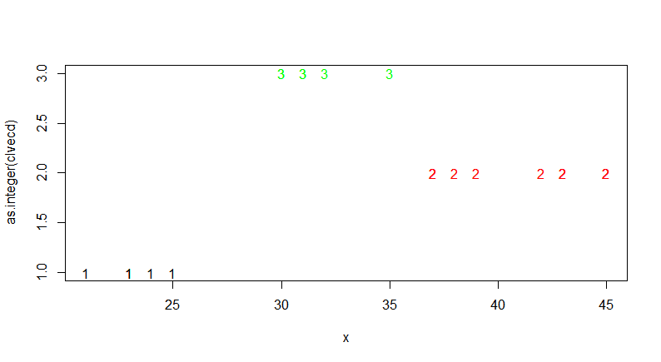
Results for K=3

Slide 26
R code
age<-c(23, 25, 24, 23, 21, 31, 32, 30,31, 30, 37, 35, 38, 37, 39, 42, 43, 45, 43, 45)
clust<-kmeans(age,centers=3)
plotcluster(age,clust$cluster)

Slide 27
Discussion on K-means
We discussed the problem with a small data set.
Obviously the R code given in the previous slide is same irrespective of the size
Typically for really big-data and also for building a data tool,
We will take the parameters from the K-means model fitted or generated by R code and
Write a program that can automate the K-means clustering
Kmeans(x, centers, iter.max=10, algorithm=c(“Hattigan-wong”, “Lyoyd”, “Forgy”, “MacQueen”))

Slide 28
R Data sets
Anderson’s Iris dataset is a very popular dataset available with R package
The iris data set gives the measurements in centimeters of the variables sepal length and width and petal length and width, respectively, for 50 flowers from each of 3 species of iris. The species are Iris setosa , versicolor, and virginica (coded 1, 2 and 3 respectively, some times)

Slide 29
K-means application: Customer Segmentation
Clustering (& classification) are important data analysis methods for customer segmentation for understanding your customers and target your business practices.
Ex: Obama’s election 2008: 230 M voters, 59% voted, 2.2 M (between 18-29), 66% voted for Obama, 1.5M; in some states like Indiana this accounted for the small 1% margin! Election that was won by computing and social media.

Slide 30
K-NN
Semi-supervised ML
You know the “right answers” or at least data that is “labeled”: training set
Set of objects have been classified or labeled (training set)
Another set of objects are yet to be labeled or classified (test set)
Your goal is to automate the processes of labeling the test set.
Intuition behind k-NN is to consider most similar items --- similarity defined by their attributes, look at the existing label and assign the object a label.

Slide 31
K-NN Classification
A set of objects have been classified or labeled in some way
Other similar objects with unknown class need to be labeled / classified
Goal of a classification algorithm (K-NN) is to automatically label these objects
NN stands for nearest neighbor
How do you determine the closeness? Euclidian distance; color, shape or similar features.

Slide 32
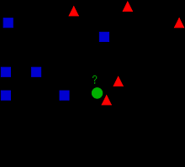
Example²
Label1
Label2
What is class of
unknown item
indicated by green
circle?
K = 3
K =5

Slide 33
Intuition (K = 3)
Label1
Label2
What is class of
unknown object
indicated by green
circle?
K = 3
The unknown object gets 2 votes and 1 vote➔ label of unclassified object is

Slide 34
Intuition (K = 5)
Label1
Label2
What is the class of
unknown object
indicated by green
circle?
K = 5
The unknown object gets 2 votes and 3 votes → label of unknown object is

Slide 35
Discussion on K-NN
How do you select K, the number of voters/objects with known labels?
Three phases: training, test and classification/labeling of actual data
Lets generate some synthetic data and experiment with K-NN.

Slide 36
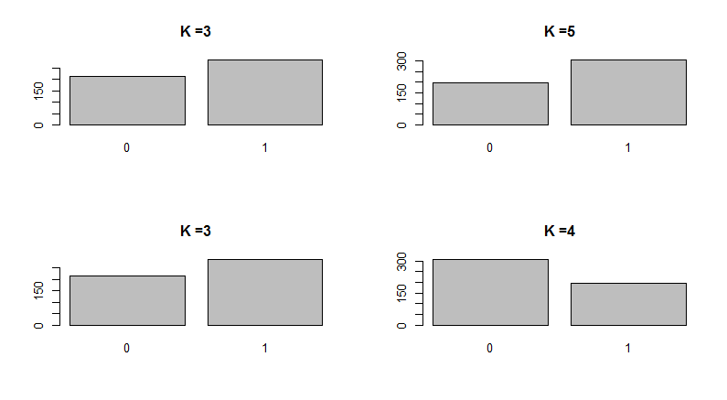
Different Values of K

Slide 37
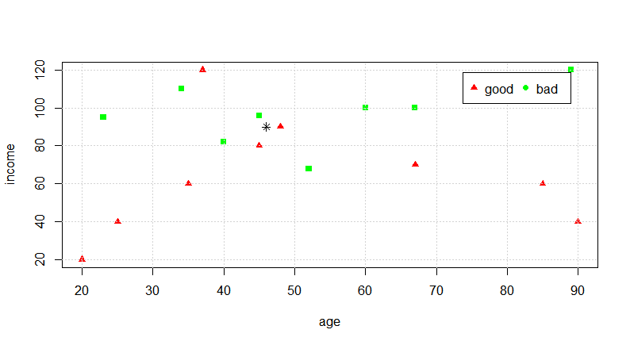
K-NN application: Credit Rating
Predict credit rating as “good” or “bad” based on a set of known data

Slide 38
R code for the previous example
age<-c(25,35,45,20,37,48,67,90,85) # good rating
income<-c(40,60,80,20,120,90,70,40,60)
plot(income~age, pch=17, col="red")
xn<-c(52,23,40,60,48,33,67,89,34,45) #bad rating
yn<-c(68,95,82,100,220,150,100,120,110,96)
points(yn~xn,pch=15, col="green")
grid(nx=NULL,ny=NULL)
x<-46 # predict the rating of this customer
y<-90
points(y~x, pch=8)
legend("topright", inset=.05, pch=c(17,19),c("good","bad"), col=c("red","green"), horiz=TRUE)

Slide 39
Application of the K-NN process
Decide on your similarity or distance metric
Split the original data into training and test data
Pick an evaluation metric (misclassification rate is a good one)
Run k-NN a few and check the evaluation metric
Optimize k by picking one with the best evaluation measure
Once k is chosen, create the new test data with no labels and predict the “class” for the test data

Slide 40
Discussion
How to apply these methods and techniques to data problems at your work? See exercises at the end of the lab handout.
When you launch on a data analytics project here are some of the questions to ask:
What are the basic variables?
What are underlying processes?
What influences what?
What are the predictors?
What causes what?
What do you want to know?: This needs a domain expert

Slide 41
Summary
We covered 3 of the 10 top data mining algorithms
We studied:
Linear regression
Clustering algorithm K-means
Classification algorithm K-NN
Powerful methods for predicting and discovering intelligence
R /Rstudio provides convenient functions to model your datasets for these algorithms

Slide 42
References
N. Harris, Visualizing K-means Clustering, http://www.naftaliharris.com/blog/visualizing-k-means-clustering/, 2014.
Example figure, http://en.wikipedia.org/wiki/K-nearest_neighbors_algorithm, 2014
R Nutshell online version of the book: http://web.udl.es/Biomath/Bioestadistica/R/Manuals/r_in_a_nutshell.pdf
https://www.datasciencecentral.com/profiles/blogs/top-10-machine-learning-algorithms
We covered 3 of the top 10 algorithms

