Slide 1
R
Bina Ramamurthy

Slide 2
R is a language
R is a language for statistical analysis based language S by John Chambers of AT&T labs.
To be exact: In 1976, John Chambers, Rick Becker, and Allan Wilks developed S, the first open source statistical language at Bell Labs.
(the year Apple made it debut)

Slide 3
R Language
R is a software package for statistical computing.
R is an interpreted language
It is open source with high level of contribution from the community
“R is very good at plotting graphics, analyzing data, and fitting statistical models using data that fits in the computer’s memory.”
“It’s not as good at storing data in complicated structures, efficiently querying data, or working with data that doesn’t fit in the computer’s memory.”

Slide 4
Tools for Analytics
Elaborate tools with nifty visualizations; expensive licensing fees: Ex: Tableau, Tom Sawyer
Software that you can buy for data analytics: Brilig, small, affordable but short-lived
Open sources tools: Gephi, sporadic support
Open source, freeware with excellent community involvement: R system
Some desirable characteristics of the tools: simple, quick to apply, intuitive, useful, flat learning curve
A demo to prove this point: data → actions /decisions

Slide 5
Why R?
There are many packages available for statistical analysis such as SAS and SPSS but there are expensive (user license based) and are proprietary.
R is open source and it can pretty much do what SAS can do but free.
R is considered one of the best statistical tools in the world.
For R people can submit their own packages/libraries, using the latest cutting edge techniques.
To date R has got almost 15,000 packages in the CRAN (Comprehensive R Archive Network – The site which maintains the R project) repository.
R is great for exploratory data analysis (EDA): for understanding the nature of your data before you launch serious analytics.
Many tutorial vignettes are available for you to learn.

Slide 6
R Packages
An R package is a set of related functions
To use a package you need to load into R
R offers a large number of packages for various vertical and horizontal domains:
Horizontal: display graphics, statistical packages, machine learning
Verticals: wide variety of industries: analyzing microarray data, modeling credit risks, social sciences, automobile data (none so far on sensor data from automobiles!)

Slide 7
Library
Library→ Package→ Class→
R considers every item as a class/object
Thousands of Online libraries
150000 packages
CRAN: Comprehensive R Archive Network
Look at all the packages available in CRAN
http://cran.r-project.org/
R-Forge is another source for people to collaborate on R projects

Slide 8
Approach to learning R
R Basics, fundamentals
The R language
Working with data
Statistics with R language

Slide 9
R Basics
Obtaining the R package
Installing it
Install and use packages
Quick overview and tutorial

Slide 10
A quick demo of R’s capabilities
See p.98 onwards till p.102 of
simpleR: Using R for introductory statistics
By J. Verzani
http://cran.r-project.org/doc/contrib/Verzani-SimpleR.pdf
R in a nutshell, by Joseph Adler, O’reilly, 2010
Chapter 3 Basics, Ch.4 packages,
(search for this online)
Look for these resources online…and try these.
See Rhandout.pdf linked to today’s lecture

Slide 11
Packages
A package is a collection of functions and data files bundled together.
In order to use the components of a package it needs to be installed in the local library of the R environment.
Loading packages
Custom packages
Building packages

Slide 12
More R
R syntax
R Control structures
R Objects
R formulas

Slide 13
R Syntax
R language is composed of series of expression resulting in a value
Examples of expression include assignment statements, conditional statements, and arithmetic expressions
> a<- 42
> b <- a% 5
> if (b == 0) " a divisible evenly by 5" else " not evenly divisible by 5"
[1] " not evenly divisible by 5"
Variables in R are called symbols

Slide 14
R Objects
All items vectors, lists, even functions are considered as objects in R
Example : a vector of integers , and then floats
  p<- c(6, 8,4,5,78)
  p
  q<- c(5.6, 4.5, 7.8, 9.3)
  Q
A list can be made of items of any type
> r<- list(p, q, "this demo")
> r
[[1]]
[1] 6 8 4 5 78
[[2]]
[1] 5.6 4.5 7.8 9.3
[[3]]
[1] "this demo“

Slide 15
Special Values
> v <- c(1,2,3)
> v
[1] 1 2 3
> length(v) <- 4
> v
[1] 1 2 3 NA
NA : not defined or not available
Very Large and very small numbers:
> 2 ^ 1024
[1] Inf
> - 2 ^ 1024
[1] -Inf

Slide 16
Curly braces
Curly braces are used to group a set of operations in the body of a function:
> f <- function() {x <- 1; y <- 2; x + y}
> f()
[1] 3

Slide 17
Control Structures
> i <-4
> repeat {if (i > 25) break else {print(i); i <- i + 5;}}
[1] 4
[1] 9
[1] 14
[1] 19
[1] 24

Slide 18
Demo: Exam Grade: Traditional reporting 1
Question 1..5, total, mean, median, mode; mean ver1, mean ver2

Slide 19
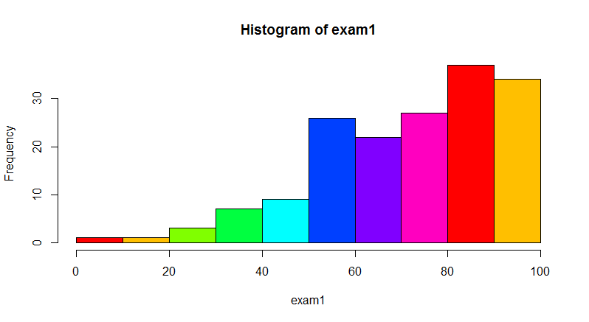
Traditional approach 2: points vs #students
Distribution of exam1 points

Slide 20
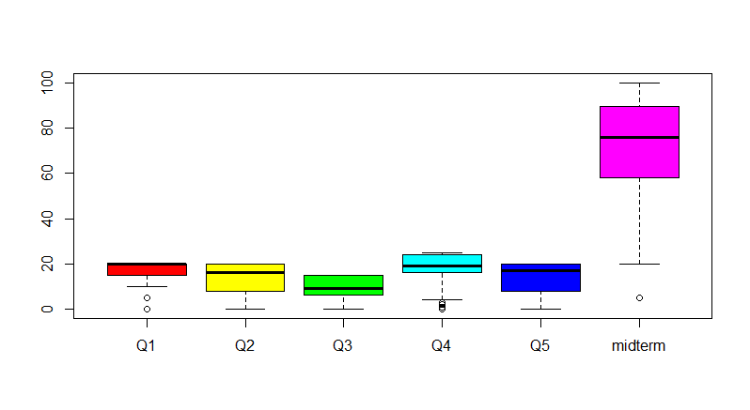
Individual questions analyzed..

Slide 21
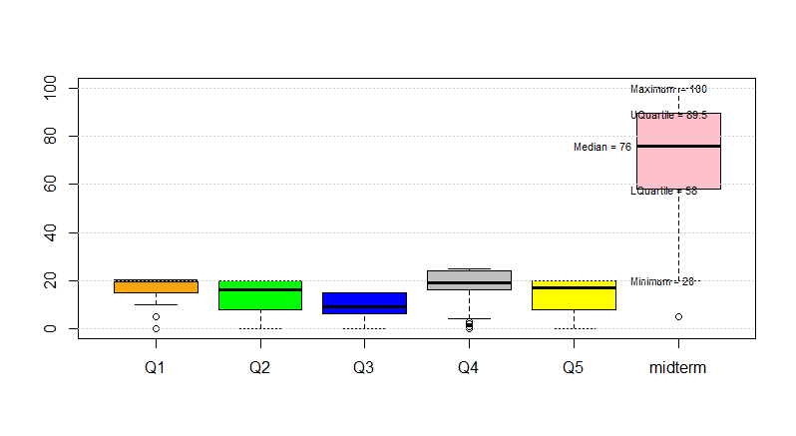
Interpretation and action/decisions
Do you see the difference?

Slide 22
R-code
data2<-read.csv(file.choose())
exam1<-data2$midterm
hist(exam1, col=rainbow(8))
boxplot(data2, col=rainbow(6))
boxplot(data2,col=c("orange","green","blue","grey","yellow", "sienna"))
fn<-boxplot(data2,col=c("orange","green","blue","grey","yellow", "pink"))$stats
text(5.55, fn[1,6], paste("Minimum =", fn[1,6]), adj=0, cex=.7)
text(5.55, fn[2,6], paste("LQuartile =", fn[2,6]), adj=0, cex=.7)
text(5.0, fn[3,6], paste("Median =", fn[3,6]), adj=0, cex=.7)
text(5.55, fn[4,6], paste("UQuartile =", fn[4,6]), adj=0, cex=.7)
text(5.55, fn[5,6], paste("Maximum =", fn[5,6]), adj=0, cex=.7)
grid(nx=NA, ny=NULL)

Slide 23
One last example
survey.results <- factor( c("Disagree", "Neutral", "Strongly Disagree", "Neutral", "Agree", "Strongly Agree","Disagree", "Strongly Agree", "Neutral","Strongly Disagree", "Neutral", "Agree"),levels=c("Strongly Disagree", "Disagree", "Neutral", "Agree", "Strongly Agree"),ordered=TRUE)
survey.results
R will automatically compute the numbers in each category!
There are many more functions and operations available in R that are related to data.

Slide 24
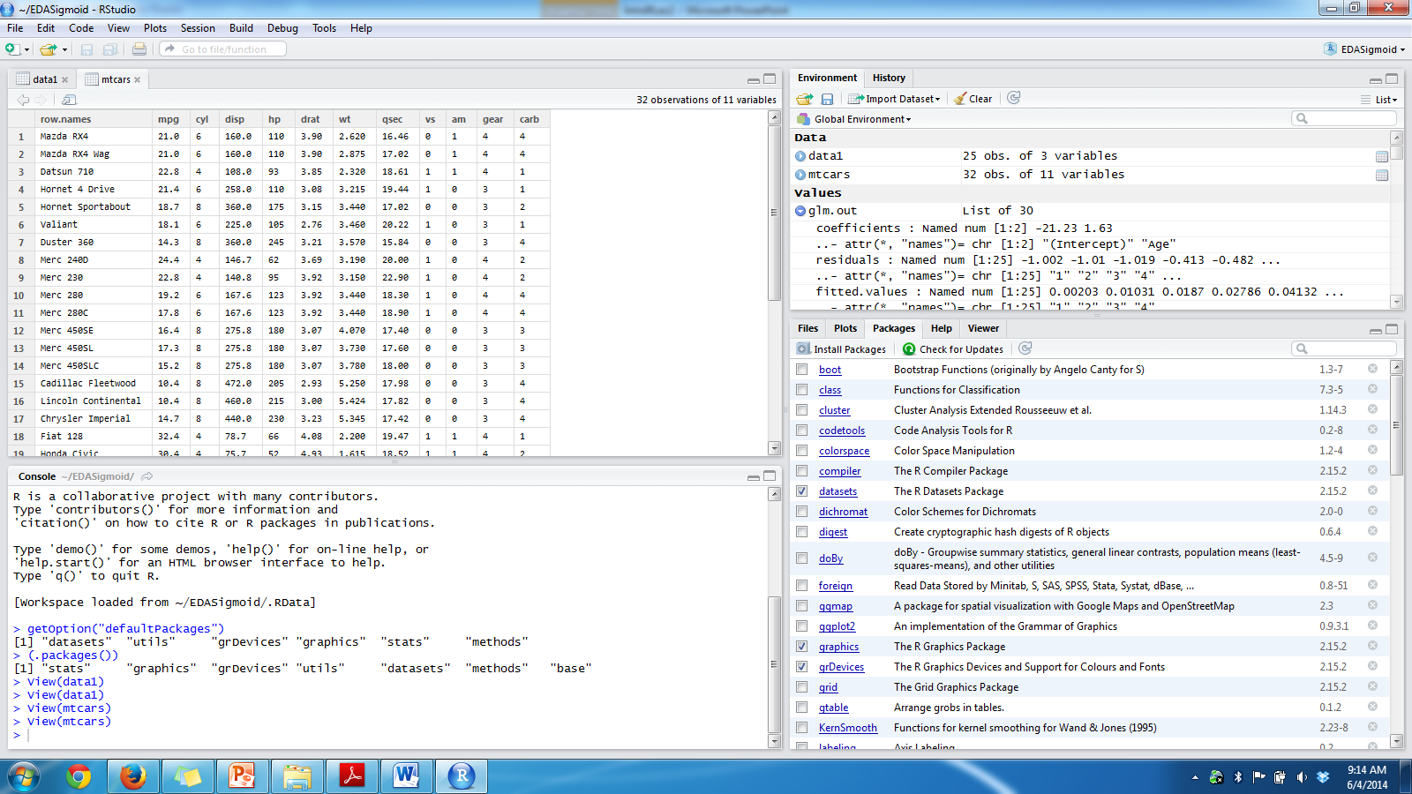
Lets explore RStudio

Slide 25
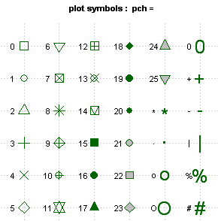
What is in pch?

Slide 26
Let do a EDA of cars data
Look at the tutorial in handout#1
R is good for Exploratory Data Analytics
It is really good for most statistical computing you will you in your domain.
You can repeat the same on Jupyter.
We will also look at real “click” data from Nytimes from Oneill and Schutt’s text. See the data in today’s notes.

