Slide 1
Logistic Regression

Slide 2
The big Picture
Given a data set, a real-world classification problem, and constraints, you need to determine
Which classifier to use?
Which optimization method to employ?
Which loss function to minimize?
Which features to consider?
Which evaluation metric to use?

Slide 3
More..
Understand your problem domain: If election data, know how election results are computed?
Runtime is a serious concern in many analytic applications.
Simpler models are more interpretable, but aren’t as good performers.
The question of which algorithm works best is problem dependent and also “question” dependent. (What do you want to know?)
It is also constraint-dependent. What are the problems and data?

Slide 4
Classification
What? Identify the “class” of a data item based on prior knowledge.
Why?
  To target the subsequent operations based on the classes.
  To get insights about underlying data
Concerns: bad features will lead to bad classification
Data science is about understanding the data sets and the domain application well enough that you can extract meaningful features.
From Wikipedia: ``..a feature is an individual measurable property or characteristic of a phenomenon being observed. Choosing informative, discriminating and independent features is a crucial step for effective algorithms in pattern recognition, classification and regression.”

Slide 5
Binary vs multiclass
Binary classification is about 1 or 0, yes or no; example: email classification spam or not spam
Multiclass: when a problem has k labels such as in our Lab3, the standard solution is to train k binary classifiers: one for each label X, classifying points as being X or not X.
Take a look at this output data about news classification:

Slide 6
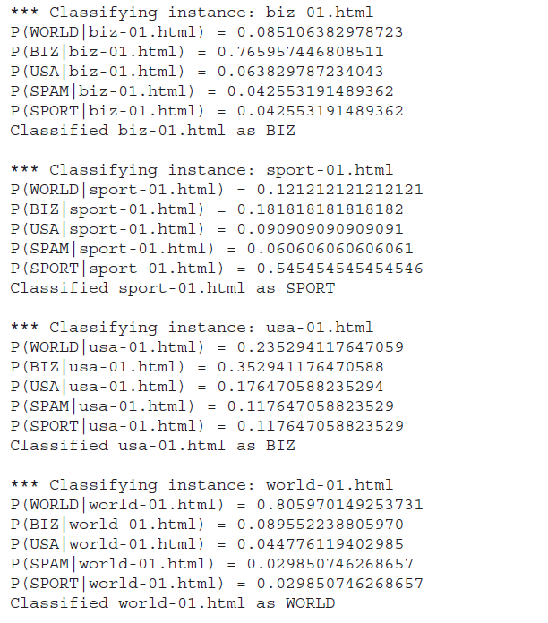
Here the classes are WORLD, BIZ,
USA, SPAM, SPORT
Actually 4 known classes + other
You could also classify it as:
WORLD vs nonWORLD
Many binary classifications making
a multi-classifier
The % may not be this sharp in your
output. It will be fuzzy.
{0.3, 0.4, 0.05, 0.14, 0.1} for example.
You choose the highest!

Slide 7
Decision Tree
Tree structure for multi-class classification
Cooke county chart determining the severity of a stroke in an emergency room situation.
SubjectId | Age | Height | Gender | Class
123 | .. | .. | ..
124 | 29 | 5.6 | F | ?
125 | 15 | 3.8 | M | ?
.. | .. | .. | ..

Slide 8
Multi-class Decision Tree
Age>14?
Y or N?
Height <4?
Y or N?
Class 1 or 2
0: 0.5; 1: 0.5
Class 2
0:0.9; 1; 0.1
Gender: F?
Y or N?
Class 3
0:0.8;1:0.2
Class 1
0:0.3;1:0.7
Features: Age>14?, Female? Height<4?
Of course, you have to transform the
table into data format usable by the decision
tree; more features, more depth, more accuracy.

Slide 9
Logistic Regression
What is it?
  It is an approach for calculating the odds of event happening vs other possibilities…Odds ratio is an important concept
  Lets discuss this with examples
Why are we studying it?
  To use it for classification
  It is a discriminative classification vs Naïve Bayes’ generative classification scheme (what is this?)
  Linear (continuous).. Logistic (categorical): Logit function bridges this gap
  According to Andrew Ng and Michael Jordon logistics regression classification has better error rates in certain situations than Naïve Bayes (eg. large data sets) Big data? Lets discuss this…
Goal of logistic regression based classification is to fit the regression curve according to the training data collected (dependent vs independent variables) .
  During production this curve will be used to predict the class of a dependent variable.

Slide 10
Logistic Regression
Mortality of injured patients
If a patient has a given disease (Recall that we did this using Bayes) (binary classification using a variety of data like age, gender, BMI, blood tests etc.)
If a person will vote Democratic or Republican
The odds of a failure of a process, system or a product
A customer’s propensity to purchase a product
Odds of a person staying in the workforce
Odds of a homeowner defaulting on a loan
Conditional Random Field (CRF) an extension of logistic regression to sequential data, are used in NLP. It is labeling a sequence of items so that an entity can be recognized (named entity recognition).
The appropriate regression analysis to conduct when the dependent variable is dichotomous (binary).
Like all regression analyses, the logistic regression is a predictive analysis. Logistic regression is used to describe data and to explain the relationship between one dependent binary variable and one or more nominal, ordinal, interval or ratio-level independent variables.

Slide 11
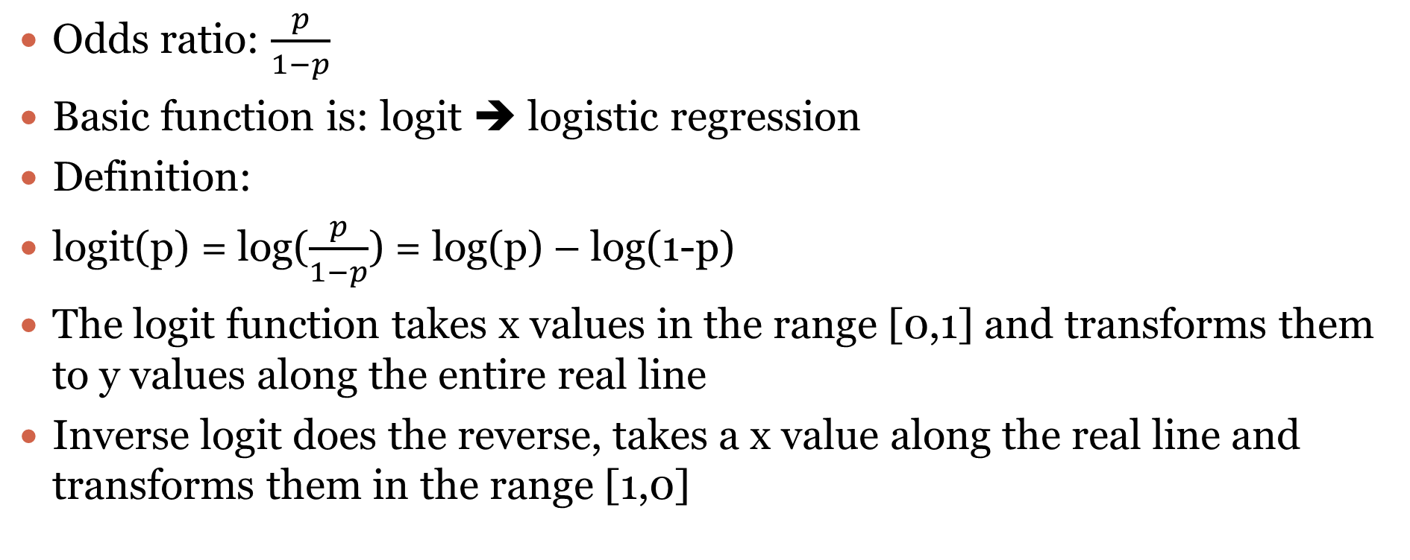
Basics
Odds ratio: $\frac{p}{1−p}$
Basic function is: logit ➔ logistic regression
Definition:
logit(p) = log($\frac{p}{1−p}$) = log(p) – log(1-p)
The logit function takes x values in the range [0,1] and transforms them to y values along the entire real line
Inverse logit does the reverse, takes a x value along the real line and transforms them in the range [1,0]

Slide 12
Logit Use case
Media6Degrees is tech company in online ( and now mobile) advertising space
This chapter is written for data science problem in this domain by its CIO.
The problem: need to match MD6 clients with users of the products by the clients.
In general, ad companies want to target users based on user’s likelihood to click.
Problem simplifies: probability that a user will click on a given ad. 1 or 0

Slide 13
Three Core Problems
Feature engineering: figuring out which features to use
User-level conversion prediction: predicting when someone will click
Bidding; How much is it worth to show a given ad to a given user? Monetizing?

Slide 14
Lets derive this from first principles
Let ci be the set of labels .. For binary classification (yes or no) it is i = 0, 1, clicked or not
Let xi be the features for user i , here it is the urls he/she visited
P(ci|xi) =
P(ci=1|xi) = eqn4
P(ci=0|xi) = eqn5
log Odds ratio = log (eqn4/eqn5)
logit(P(ci=1|xi) = α + β^{t} Xi where xi are features of user i and β^{t} is vector of weights/likelihood of the features.
Now the task is to determine α and β
Methods are available for this.. Out of the scope our discussion.
Use the logistic regression curve in step 7 to estimate probabilities and determine the class according to rules applicable to the problem.
In the logit equation, α is base click rate and β the slope of the logit curve/function.

Slide 15
Multiple Features
click | url1 | url2 | url3 | url4 | url5
1 | 0 | 0 | 0 | 1 | 0
1 | 0 | 1 | 1 | 0 | 1
0 | 1 | 0 | 0 | 1 | 0
1 | 0 | 0 | 0 | 0 | 0
1 | 1 | 0 | 1 | 0 | 1
“train” data
Fit the model using the command
Fit1 <- glm(click~ url1+url2 + url3+url4+url5, data=“train”, family=binomial(logit))
In the Fit1 logit equation, α is base click rate and
β the slope of the logit curve/function.

Slide 16
Demo on R
Ages of people taking Regents exam, single feature Age
Age Total Regents
Do EDA
Observe the outcome, if sigmoid➔
Fit the logistic regression model➔ use the fit/plot to classify
This is for small data of 25, how about Big data? MR?
Realtime response? Twitter model

Slide 17
R code: data file “exam.csv”
data1 <- read.csv("c://Users/bina/exam.csv")
summary(data1)
head(data1)
plot(Regents/Total ~Age, data=data1)
glm.out = glm(cbind(Regents, Total-Regents) ~Age, family=binomial(logit), data=data1)
plot(Regents/Total ~ Age, data = data1)
lines(data1$Age, glm.out$fitted, col="red")
title(main="Regents Data with fitted Logistic Regression Line")
summary(glm.out)

Slide 18
Logistic Regression Calculation
The logistic regression equation for lung cancer odds:
logit(p) = −4.48 + 0.11 x AGE + 1.16 x SMOKING
So for 40 years old cases who do smoke logit(p) equals 1.08. Logit(p) can be back-transformed to p by the following formula:
Logit(p) back transformation
https://www.medcalc.org/manual/logit_transformation_table.php
Alternatively, you can use the Logit table. For logit(p)=1.08 the probability p of having a positive outcome (for cancer) equals 0.75.
Reference: https://www.medcalc.org/manual/logistic_regression.php

Slide 19
Evaluation
Rank the ads according to click logistic regression, and display them accordingly
Measures of evaluation:
{lift, accuracy, precision, recall, f-score)
Error evaluation: in fact often the equation is written in with an error factor.
For example, for logit we rewrite the equation as
  logit(P(ci=1|xi) = α + β^{t} Xi + err

Slide 20
Evaluation (contd.)
Lift: How much more people are clicking (or buying) because of the introduction of the model?
Accuracy: How often is the correct outcome predicted?
Precision: #True positives/ (#True positives+ #False positives)
Recall: #True positives/(#True positives + #False negatives)
F-score: mean of precision and accuracy

Slide 21
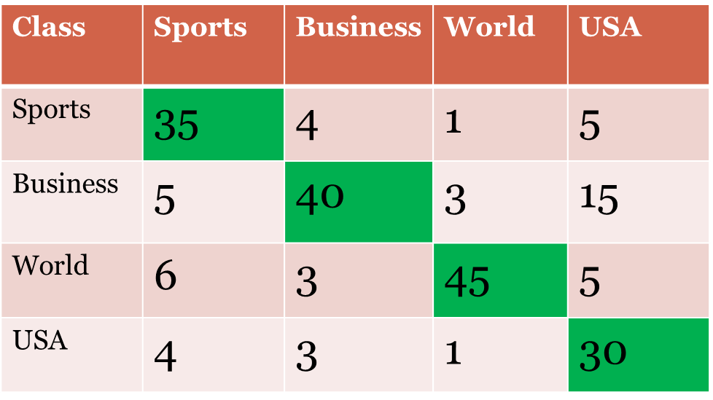
Confusion Matrix

