Slide 1
Statistical Models and Machine Learning Algorithms --Review
B. Ramamurthy

Slide 2
Lets review LM
"lm" by default seeks to find a trend line that minimizes the sum of squares of the vertical distances between the approximated or predicted and observed y's.
Evaluate the measure of goodness of our model in R-squared and p: R-square measures the the proportion of variance. p-value assesses the significance of the result.
We discuss both these measures: we want R-sqaured to high (0.0-1.0 range) and p to be low or <0.05.
R-squared is 1-(total predicted error-squared/total mean error squared)

Slide 3

Goodness of fit
R2 range is 0-1. For a good fit we would like R2 to be as close to 1 as possible.
  R2 = 1 means every point is on the linear regression line!
  The second term represents the "unexplained variance" in the fit. You want this to be as low as possible.
Quality of data p:
Low p means Null hypothesis (H0) has been rejected. We would like p <0.05 for high significance of prediction.

Slide 4
Revie of K-means
K-means is unsupervised: no prior knowledge of the “right answer”
Goal of the algorithm Is to determine the definition of the right answer by finding clusters of data
Kind of data: satisfaction survey data, survey data, medical data, SAT scores
Assume data {age, gender, income, state, household, size}, your goal is to segment the users.
Beginnings: read about “birth of statistics” in John Snow’s classic study of Cholera epidemic in London 1854: “cluster” around Broadstreet pump: http://www.ph.ucla.edu/epi/snow.html

Slide 5
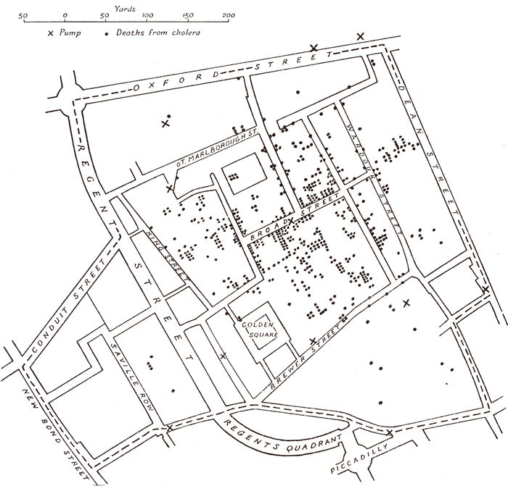
John Snow’s Cholera Map –1854 London

Slide 6
K-means algorithm
Initially pick k centroids
Assign each data point to the closest centroid
After allocating all the data points, recomputed the centroids
If there is no change or an acceptable small change in the centroids, clustering is complete
Else continue step 2 with the new centroids.
Output: K clusters
Also possible that the data may not converge. In that case, stop after certain number of iterations.
Evaluation metric: between_ss/total_ss, range 0-1, for good tight clustering, this metric is as close to 1 as possible.

Slide 7
K-NN
General idea is that a data point will similar to its neighbors. So classify it or label it accordingly.
Which neighbor(s), how many neighbors?
Decide on your similarity or distance metric
Split the original set into training and test set (learn, evaluate)
Pick an evaluation metric: Misclassification rate is a good one
Run K-NN few times, changing K and checking the evaluation metric
Once best K is chosen, create the test cases and predict the labels for these
  Euclidian distance is a good similarity metric. Scale of the features (or variable) should be almost same for this to work well.
  Manhattan distance (X+Y) is another, data need not be normalized.

Slide 8
K-NN Issues
How many nearest neighbors? In other words what is the value of k
  Small K: you overfit
  Large K : you may underfit
  Or base it on some evaluation measure for k
  choose one that results in least % error for the training data
Implications of small k and large k
How do define similarity or closeness?
  Euclidian distance
  Manhattan distance
  Cosine similarity etc.
Error rate or misclassification (k can be chosen to lower this)
  Curse of dimensionality

Slide 9
Summary
Read chapter 1-3 of Doing Data Science book.
Work out the examples there.
Prepare using R-studio and simple numeric examples.
Expect 2 questions in the midterm on the models reviewed.

