Slide 1
Word Co-occurrence
Chapter 3, Lin and Dryer

Slide 2
Why is co-occurrence important?
Read chapter 3
This will help you with Lab2 as well as Final Exam
This will also help with future projects
Help you with interview in big data analytics
A simple method with big impact
Co-occurrence is 2-gram, n-grams is an extension (Google has supported this )
And of course, how do you define co-occurrence is an domain-dependent issue: text—sentence, paragraph etc. Temporal: within a day, week, month, co-occurrence; more complex: Blei’s LDA

Slide 3
Intelligence and Scale of Data
Intelligence is a set of discoveries made by federating/processing information collected from diverse sources.
Information is a cleansed form of raw data.
For statistically significant information we need reasonable amount of data.
For gathering good intelligence we need large amount of information.
As pointed out by Jim Grey in the Fourth Paradigm book enormous amount of data is generated by the millions of experiments and applications.
Thus intelligence applications are invariably data-heavy, data-driven and data-intensive.
Data is gathered from the web (public or private, covert or overt), generated by large number of domain applications.

Slide 4
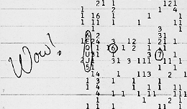
Intelligence (or origins of Big-data computing?)
Search for Extra Terrestrial Intelligence (seti@home project)
The Wow signal http://www.bigear.org/wow.htm

Slide 5
Characteristics of intelligent applications
Google search: How is different from regular search in existence before it?
It took advantage of the fact the hyperlinks within web pages form an underlying structure that can be mined to determine the importance of various pages.
Restaurant and Menu suggestions: instead of “Where would you like to go?” “Would you like to go to CityGrille”?
Learning capacity from previous data of habits, profiles, and other information gathered over time.
Collaborative and interconnected world inference capable: facebook friend suggestion
Large scale data requiring indexing
…Do you know amazon is going to ship things before you order? Here

Slide 6
Review 1: Mapreduce Algorithm Design
"simplicity" is the theme
Fast "simple operation" on a large set of data
Most web-mobile-internet application data yield to embarrassingly parallel processing
General Idea; you write the Mapper and Reducer (Combiner and Partitioner); the execution framework takes care of the rest.
Of course, you configure...the splits, the # of reducers, input path, output path,.. etc.

Slide 7
Review 2:
Programmer has NO control over -- where a mapper or reducer runs (which node in the cluster) -- when a mapper or reducer begins or finishes --which input key-value pairs are processed by a specific mapper --what intermediate key-value pair is processed by a specific reducer

Slide 8
Review 3
However what control does a programmer have? 1. Ability to construct complex structures as keys and values to store and communicate partial results 2. The ability to execute user-specified code at the beginning of a map or a reduce task; and termination code at the end; 3. Ability to preserve state in both mappers and reducers across multiple input /intermediate values: counters 4. Ability to control sort order, order of distribution to reducers 5. ability to partition the key space to reducers

Slide 9
Lets move on co-occurrence (Section 3.2)
Word counting is not the only example..
Another example: co-occurrence matrix large corpus: nXn matrix where n is the number of unique words in the corpus. (corpora is plural)
Lets assume m words, i and j row and column index, m(i.j) cell will have the number of times w(i) co-occurred with w(j)
For example <Basketball> is w(i) and <March> w<j> on twitter feed today is >1000, more than what it would been in December.
Lets look at the algorithm. You need this for your Lab2.

Slide 10
Word Co-occurrence – Pairs version
1: class Mapper
2: method Map(docid a; doc d)
3: for all term w 2 doc d do
4: for all term u 2 Neighbors(w) do
5: Emit(pair (w; u); count 1) . Emit count for each co-occurrence
1: class Reducer
2: method Reduce(pair p; counts [c1; c2; : : :])
3: s <- 0
4: for all count c in counts [c1; c2; : : :] do
5: s s + c . Sum co-occurrence counts
6: Emit(pair p; count s)

Slide 11
Word Co-occurrence – Stripes version
1.class Mapper
2: method Map(docid a; doc d)
3: for all term w in doc d do
4: H <-new AssociativeArray
5: for all term u in Neighbors(w) do
6: H{u} <-H{u} + 1 . //Tally words co-occurring with w
7: Emit(Term w; Stripe H)
1: class Reducer
2: method Reduce(term w; stripes [H1;H2;H3; : : :])
3: Hf <-new AssociativeArray
4: for all stripe H in stripes [H1;H2;H3; : : :] do
5: Sum(Hf ,H) // Element-wise sum lots of small values into big value
6: Emit(term w; stripe Hf )

Slide 12
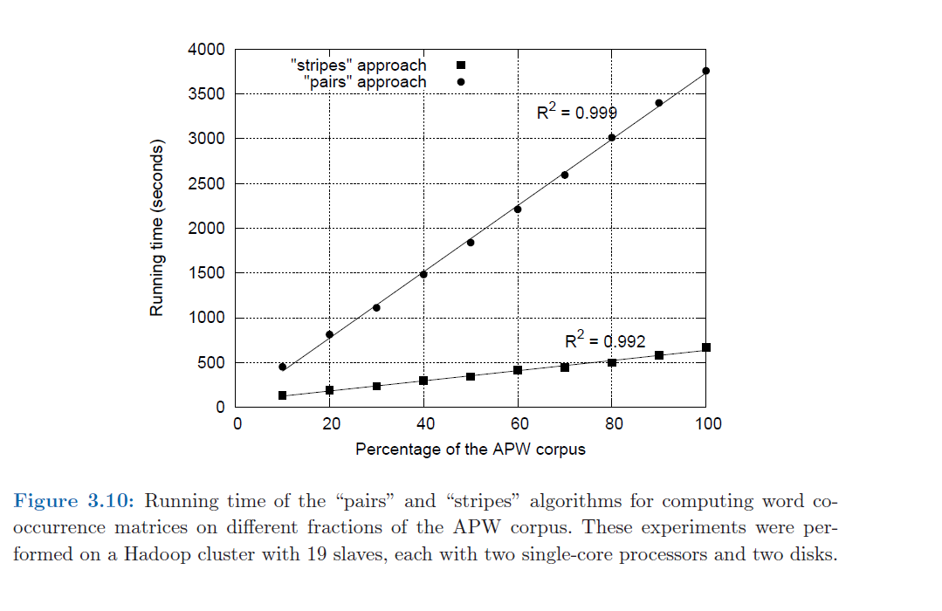
Run it on AWS and evaluate the two approaches

Slide 13
Summary/Observation
1.Word co-occurrence is proposed as solution for evaluating association!
2. Two methods proposed: pairs, stripes
3. MR implementation designed (pseudo code)
4. Implemented on MR on amazon cloud
5. Evaluated and relative performance studied (R², runtime, scale)

Slide 14
Lab2 Discussion
Build a MR data pipeline
All processing in big-data done in MR
Twitter : get tweets by keyword→ Cleaning done by MR (NOT BY R-studio)→ Analyze using MR
NYTimes: Get news by keyword→ Cleaning done by MR→ Analyze using MR
Common crawl: get data → filter by keyword using MR→ clean using MR→ Analyze using MR

