Slide 1
Working with Spark
With Focus on Lab3

Slide 2
Objectives
Learn to
Explore various features of Spark distribution
Apply the Spark APIs to solve problems
Run simple examples provided in Spark distribution
Use Spark ML libraries
Organize your toolbox for data anlytics

Slide 3
Introduction
Apache Spark™ is a unified analytics engine for large-scale data processing.
Speed
Ease of use
Generality
Run anywhere
Community contribution

Slide 4
References
https://spark.apache.org/
https://spark.apache.org/examples.html
https://databricks.com/spark/about

Slide 5
Explore the Spark Distribution
Look at the various features
Explore the various folders; lets do that
README.md
data
examples
Find out how to submit/run the examples and provision data for the execution
Run couple of simple examples

Slide 6
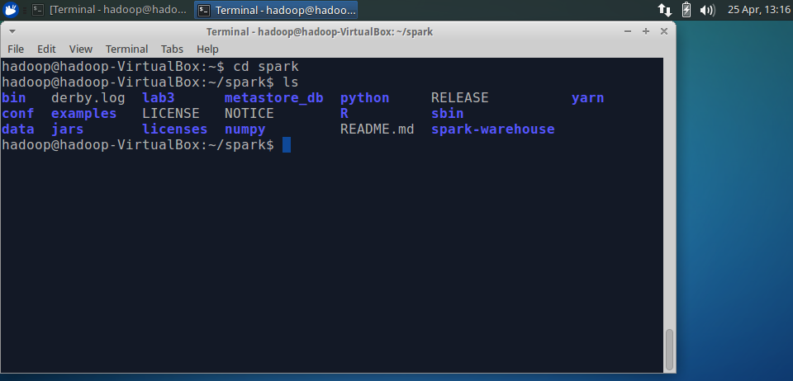
Spark Features and Folders

Slide 7
Scala API
spark-shell --master local[*]
sc
sc.{tab}
val rdd = sc.parallelize(Array(1,2,2,4),4) //transformation
rdd.count() //action
rdd.collect() //action
rdd.saveAsTextFile(…)

Slide 8
Running the examples
./bin/run-example <name of the example>
Example:
./bin/run-example SparkPi
./bin/run-example ml.KMeansExample

Slide 9
Submitting Examples
./bin/spark-submit /home/hadoop/spark/examples/src/main/python/wordcount.py LICENSE
(Thought process: Hmm..I liked the wordcount.py ; let me move it to my workspace.)
I created a folder lab3
In it data and src folders; move wordcount.py into the src folder (like cloning off git.)
Now run the same program from your workspace and make sure there are no dependencies from the old location.
./bin/spark-submit lab3/src/wordcount.py LICENSE

Slide 10
Collecting programs for your toolbox
We have gathered wordcount.py
You may want explore and move some other ml and mllib programs into to your src folder
Data needed can be moved into lab3/data folder

Slide 11
Program with Parameters
./bin/spark-submit examples/src/main/python/pagerank.py data/mllib/pagerank_data.txt 10
Lets run the pagerank from the given setting of the distribution.
Move pagerank.py to lab3/src folder
Move pagerank_data.txt to lab3/data folder
Now you execute the same submit command in your workspace:
(Thought process: Make sure it is repeatable in your environment!)
./bin/spark-submit lab3/src/pagerank.py lab3/data/pagerank_data.txt 10

Slide 12
Summarizing: Examples
The Spark distribution provides a number of examples along with data files that can readily used.
This supports the functions of a data scientist and allows her/him to focus on problem solving
You can use these solutions, update them to fit your names, and “repurpose” them to analyze your needs.
1.Understand the data representation and the algorithm
program name
2. Execute program
spark/ml/mllib
program (solved)
: java, python, scala, R
3. Interpret the output, apply it, visualize it
4. Document & Communicate
data files
output
parameters

Slide 13
Step 2 Done, How about Step 1 and 3
Step 1: How to create input data? What format? Transform real world objects, into data in format needed by the standard ml/mllib programs.
Step 3: Interpret the output data from the ml/mllib programs
Lets explore these steps with pagerank program given in the examples of the spark distribution.

Slide 14
Real-world Object: network of links
1
2
4
3

Slide 15
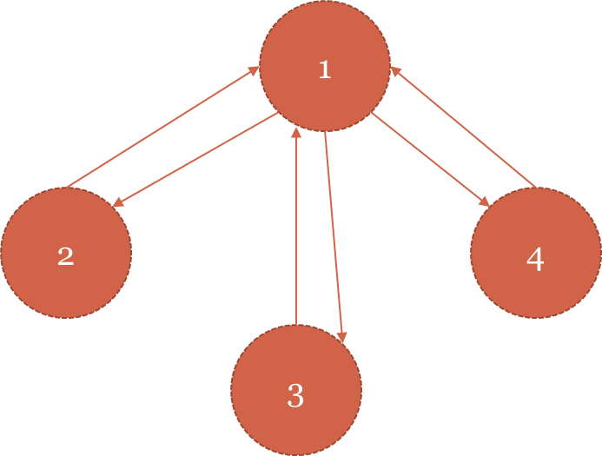
How to represent the data
Look at pagerank_data.txt1 2
1 2
1 3
1 4
2 1
3 1
4 1
One more info: each node is assigned weight /rank of 1
Which do you think is authoritative? (Thought process: Have an expected answer!)

Slide 16
Analyze and outcome
4 has rank: 0.753997565294.
2 has rank: 0.753997565294.
3 has rank: 0.753997565294.
1 has rank: 1.73800730412.
Is that what you expected?

Slide 17
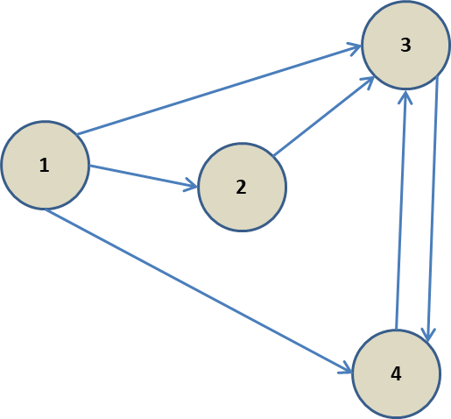
From last lectures: Recall, we hand-traced it!

Slide 18
One more example
String tokenizer:
./bin/spark-submit examples/src/main/python/mltokenizer_example.py
(Thought Process: Before you run it, find out what is your input, what is your expected output?)
Input: hard-coded: Dataframe
[(0, "Hi I heard about Spark"),
(1, "I wish Java could use case classes"),
(2, "Logistic,regression,models,are,neat")
], ["id", "sentence"])
Question: Can read your input files into the Dataframe and reuse the code?

Slide 19
Tokenizer; Output
+-----------------------------------+------------------------------------------+------+
|sentence |words |tokens|
+-----------------------------------+------------------------------------------+------+
|Hi I heard about Spark |[hi, i, heard, about, spark] |5 |
|I wish Java could use case classes |[i, wish, java, could, use, case, classes]|7 |
|Logistic,regression,models,are,neat|[logistic, regression, models, are, neat] |5 |
+-----------------------------------+------------------------------------------+------+
(Thought process: I like the tokenizer, I can use it for my lab3; let me copy it into the lab3 workspace.)

Slide 20
Summary
I can go on with many more examples…
I have shown you how to use the ml and mllib and other spark code.
What is the advantage over simple libraries/single node/non-spark implementation?
You can instantly scale your application to larger data set and to large spark cluster!
Make sure you attribute all the programs you used!
Don’t miss this fantastic opportunity to learn!

