Slide 1
Execution Framework: Hadoop 2.x
B. Ramamurthy

Slide 2
Introduction
Hadoop 2.x evolves from a distributed filesystem into an operating system that manages not only files/data storage but other resources.
Because of this it can support more than the Mapreduce like engines.
It can support Spark, and other programming models.

Slide 3
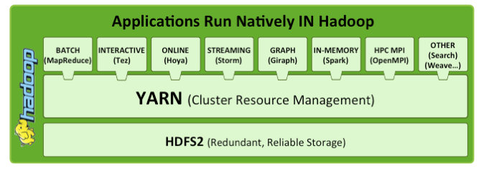
Yarn: Different applications are supported by YARN

Slide 4
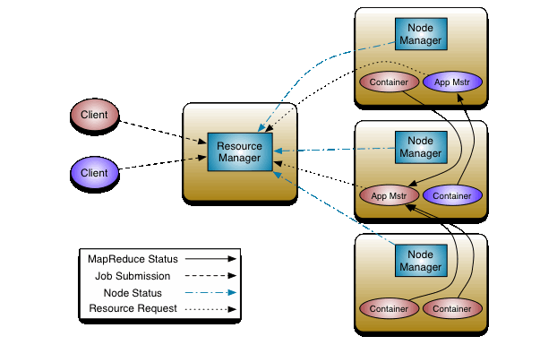
YARN Architecture

Slide 5
YARN
Enables both batch applications such MR and other streaming application run natively on Hadoop.
Resource manager, node manager and application master.
Application manager negotiates on behalf of the application for resources.
Container-based execution units.

Slide 6
References
R. Raposa, An Introduction to Hadoop 2.0. https://www.oreilly.com/ideas/an-introduction-to-hadoop-2-0-understanding-the-new-data-operating-system, O’Reilly, 2017.

