Slide 1

Globalization and Adolescence
By Nainita Madurai
ANTH 388

Slide 2
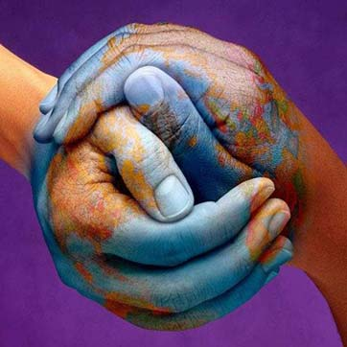

Adolescent Life Stage
Definition: puberty -> adulthood
Adolescent is not just in Western culture
Adolescence is a cross-cultural life stage that is accompanied by mental and physical changes
Globalization has both positive and negative effects on adolescence

Slide 3

The General Effects
Effects can have a positive and also a negative side
Access to new and more information
Job opportunities increase
Easier transfer of goods, services, and people
There is a creation of a multicultural, yet singular culture

Slide 4
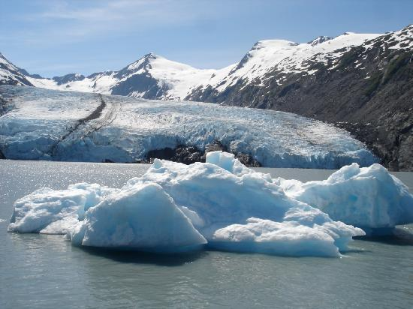
Case Study: Alaskan Inuits
Traditions, such as ice fishing and hunting, have become recreational
More and more adolescents are spending time in peer groups as opposed to family groups
They are getting a different education than their parents
With access to television, hockey has become popular among young men
Research shows that adolescent Inuits have very little hope for the continuance of their own society and culture; they believe they can’t compete with the globalization of the world and must choose what to do in life rather than traditionally staying in the village
This becomes overwhelming to adolescents and has increased suicide rates

Slide 5
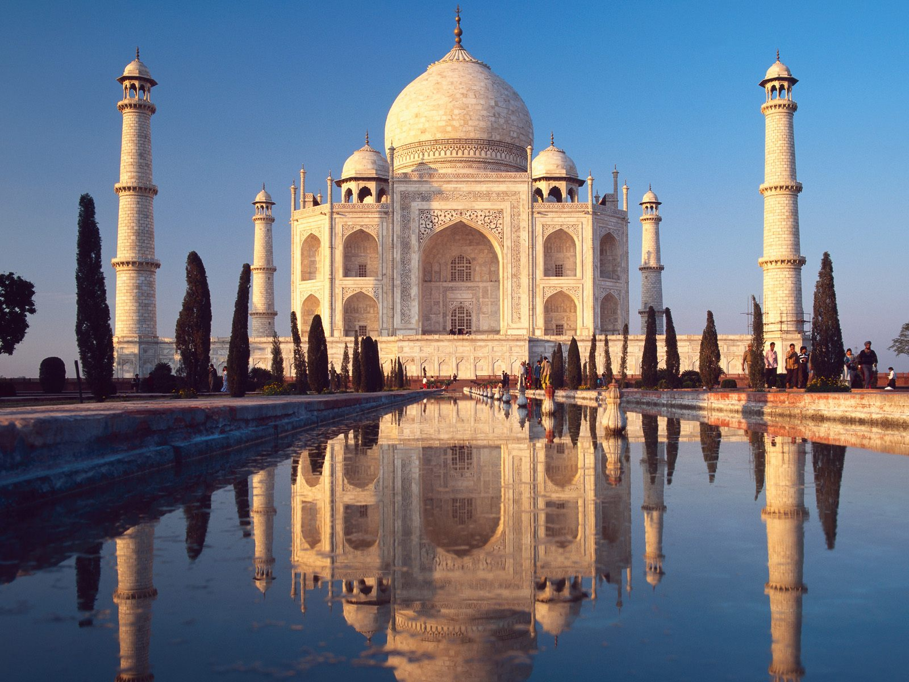
Case Study: India
Arranged marriage is greatly affected by globalization in India
Marriage is essentially the mark of when an adolescent becomes an adult
It is an incredibly important event in Indian culture and society
Adolescents will often go against their parents’ wishes and attempt to form “love marriages”
Though arranged marriages are still far more common, “love marriages” are becoming more and more prevalent and this does not follow a conservative Indian tradition
This is a society in which dating has become more prevalent and therefore safe sex is not being practiced or learned, because sex is such a taboo subject

Slide 6

Course Relevance
Identity formation and the creation of a single multicultural world
Lewellen: primordialism vs. constructionism.
Does the theory of primordialism apply with globalization? Or is it constructionism? It could even be relationalism?
Appadurai’s scapes:
Adolescents are mostly affected by Mediascapes and Ethnoscapes
Mediascapes affect them obviously through the spread of western media and the desire to imitate that
Ethnoscapes are important because adolescents are forming identity

Slide 7

Further Analysis and Summary
Overall, globalization has greatly affected the adolescent experience across the world, whether negative or positive
So why is it important to study adolescents?
Unfortunately, they are often marginalized in society.
World’s governments and societies should adjust their teaching methods

Slide 8

Sources
Jensen, Lene A. "Coming of Age in a Multicultural World: Globalization and Adolescent Cultural Identity Formation." Applied Developmental Science 7.3 (2003): 189-96. Lawrence Erlbaum Associates, Inc. Web.
Weisner, Thomas S. "Globalization and the Psychological Anthropology of Childhood and Adolescence." Diss. UCLA. Abstract. Print.
"UN Warning on Child Mental Health." BBC News. Web. <http://news.bbc.co.uk/2/hi/health/1867410.stm>.

