Slide 1
How to Solve the Israel-Palestine Conflict
By Nainita Madurai

Slide 2
Background Info
Land in question: Occupied territories which include West Bank and Gaza

Slide 3
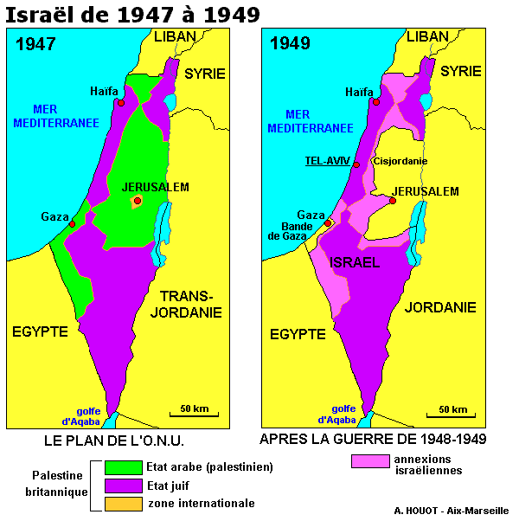

Slide 4
Importance
woohoo

Slide 5
Importance cont...
Woo woo

Slide 6
Solutions?
Two State
One-State
One-State

Slide 7
What to Do...

Slide 8
...And How to Do It

Slide 9
Final Thoughts

Slide 10
Sources

