Slide 1
Prison’s Children
La Paz, Bolivia
By Nainita Madurai

Slide 2
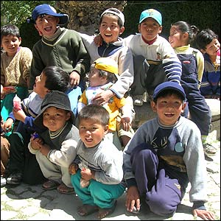
The Situation: Prison Communities
http://www.youtube.com/watch?v=folJqPu8Tyc
Prisons in La Paz are like small communities contained within the guarded walls
Inmates create a small government within their community with rules and enforcement
It is questionable whether the environment is fit for kids for many reasons

Slide 3
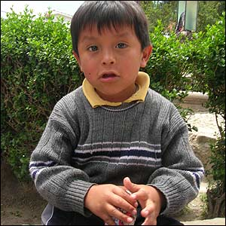
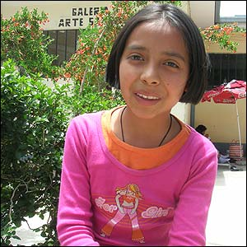
The Situation: An Environment for Children?
If you have enough money, you can buy a better cell and better food
There are day care centers and kindergartens attached to many of the jails
The unfortunate alternate for many of these children is living on their own on the streets of La, Paz slums

Slide 4
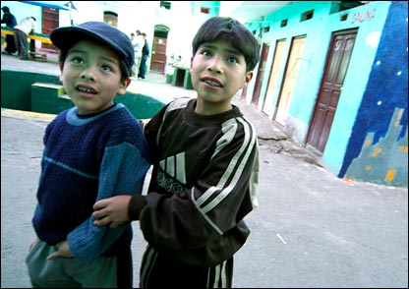
The Situation: The Problems
Despite the benefits of living in the prison, the costs are alarming and unfortunate
Violence is not very prevalent
Many of the children witness prostitution and violence
The drug trade still exists and is very prevalent
Not all inmates are looking out for the best interest of children, so some are subject to harrassment

Slide 5
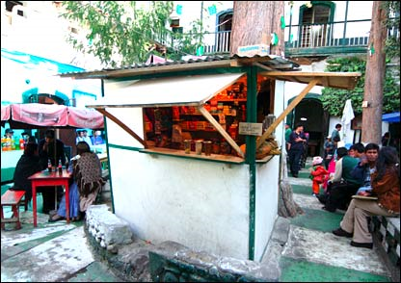
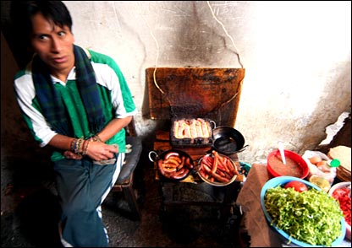
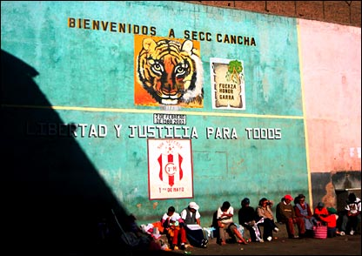
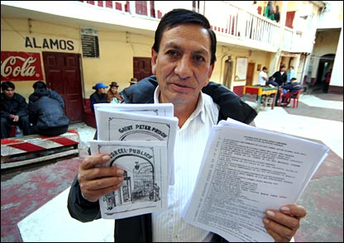
The Situation: In Photographs

Slide 6
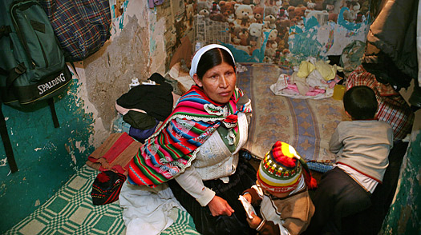
Relevance to Our Class
Family: Importance of keeping families together and how having children in the prison has a good influence on the adults in the prison
Gender: Machisimo and Marianismo still apply in the prison setting
Drugs and Violence: even in prisons drugs are part of the culture, society, and economy.

Slide 7
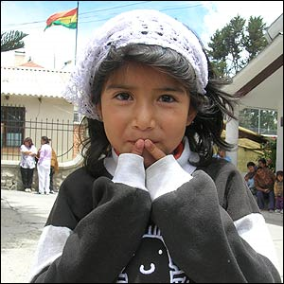
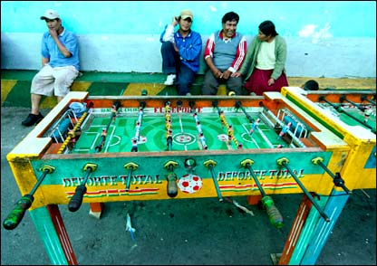
Relevance to Our Class
Modernization/Globalization: Humanitarian aid has increased for these children and some prisons have access to computers and increased technology
Identity: Living in the prisons creates a unique identity for the children, however because prison life models the world outside, they still live in a society with the strong culture

Slide 8
Work Cited
"BBC NEWS | Photo journal: Inside a Bolivian jail, Introduction." BBC NEWS | News Front Page. Web. 19 Nov. 2009. <http://news.bbc.co.uk/2/shared/spl/hi/picture_gallery/06/americas_inside_a_bolivian_jail/html/1.stm>.
"BBC NEWS | Photo journal: Inside a Bolivian jail, Introduction." BBC NEWS | News Front Page. Web. 20 Nov. 2009. <http://news.bbc.co.uk/2/shared/spl/hi/picture_gallery/06/americas_inside_a_bolivian_jail/html/1.stm>.
"Bolivia's prison children." BBC NEWS | Americas. 16 Nov. 2005. Web. 15 Nov. 2009.
"Foreign Correspondent - 14/10/2003: Bolivia - San Pedro Prison." ABC.net.au. Web. 15 Nov. 2009. <http://www.abc.net.au/foreign/stories/s963744.htm>.
Friedman-Rudovsky, Jean. "In Bolivia, Keeping Kids and Moms Together ? in Prison." TIME. 22 Apr. 2009. Web. 15 Nov. 2009.
Spedding, A. L. "Dreams of Leaving." Anthropology Today 15.2 (1999): 11-17. JSTOR. Royal Anthropological Institute of Great Britain and Ireland, Apr. 1999. Web. 16 Nov. 2009.

