Slide 1
The Kurds in Iraq
By Nainita Madurai

Slide 2
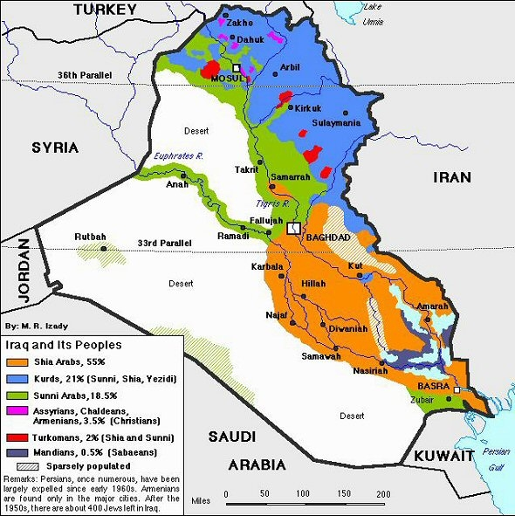
General Information
Focusing on Kurds in Iraq as opposed to Turkey or Iran
The Kurds have a long history but I will start in the 1970s
Other focuses are US involvement with Kurds and internal Kurdish divisions

Slide 3
Importance
War in Iraq has once again brought the Kurds into a spotlight in the ME
Kirkuk is a very volatile city because of oil!
Issue of Kirkuk is and has been unresolved
Preliminary elections were positive but still unsure
Clashes between parties: KDP vs. PUK

Slide 4
Sources
“Ethnic Conflict and the Kurds” by George S. Harris (1977)
“The Fate of the Kurds” by Graham E. Fuller (1993)
“As Iraqis Celebrate, The Kurds Hesitate” by Peter Galbraith (2005)
Invisible Nation by Quil Lawrence (2008)
“Kurds no closer to taking Kirkuk after Iraqi elections” by Joost Hiltermann (2010)

Slide 5
My Argument
This can go in lots of directions!
Independent state for Kurds? A possibility? Beneficial?
Corruption in the Kurdish parties posing hindrance? Why does it still exist?
Will alliances and betrayals still plague the goals of the Kurds? Why does it continue?

