Slide 1
Introduction to blockchain
A presentation to Gifted Math Program, UB, March 16, 2019, 12.30PM, Knox 109
B. RAMAMURTHY
©2019, ALL RIGHTS RESERVED
BINA@BUFFALO.EDU
HTTP://WW.CSE.BUFFALO.EDU/FACULTY/BINA
TEACHING PROFESSOR
COMPUTER SCIENCE AND ENGINEERING
DIRECTOR, BLOCKCHAIN THINKLAB
PROGRAM DIRECTOR, DATA-INTENSIVE COMPUTING PROGRAM

Slide 2

Topics for discussion
What is a blockchain?
What does it enable that current technologies cannot do?
What are some applications?
What can you do to learn and do blockchain programming?
Questions to
introduce emerging blockchain
technology

Slide 3
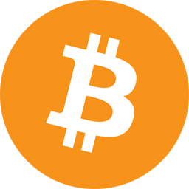
Bitcoin & Blockchain
Bitcoin was released in January 2009
2007-2008 financial meltdown
Bitcoin enabled peer-to-peer digital currency system
Innovation: blockchain technology
Idea: What worked for cryptocurrency should work for other
transactions
Heavily dependent on math: elliptic curve cryptography,
secure hashing (SHA-3 etc.), puzzle solving consensus;
{It is the combination of all the clever math that makes it work.}

Slide 4
Use case 1: It is a decentralized world!
1. A definition of decentralized system
Lets understand this!
We are all peer participants; we are unknown to each other
at this point; we form a decentralized system.
I got $100 I want to lend somebody in the audience
{For example, gifted math program
is a centralized system; participants
are known to each other.}
You are going to help me.
Who should I lend this money to?
How can I trust this person?
What else should I do to ensure that the money will be returned?

Slide 5
Lesson 1: Blockchain is a trust layer
What did we do?
-- Established trust
-- Verified the transaction
-- Recorded the transaction
Who or what will do this in a decentralized world where participants are anonymous or not known to each other?
Answer: blockchain

Slide 6
Use case 2: An immutable recorder
Where do you record the proof of actions, events, important things that happened? And How?
Here is one more activity: I am going to do somethings, and I want you all to record these.

Slide 7
Transactions → Block
Tx1: Move a yellow block
Tx2: Give TA a dollar
Tx1
Tx2
Tx3: Move anther yellow block
Tx3
Tx4
Tx4: Write a note
Many, many Tx like this.. As proof of something that happened,
various worldly facts, ideas, thoughts, financial decisions, your secret ideas, …

Slide 8
Transactions → Blocks
Tx5
Tx1
Tx6
Tx10
Tx2
Tx7
Tx11
Tx3
Tx8
Tx12
Tx4
Tx9
We have blocks of transactions? Where is the chain?
How do you make sure nobody changes the facts embedded in these Tx?

Slide 9
Blocks→Blockchain
Tx5
Tx1
Tx6
Tx10
Tx2
Tx7
Tx11
Tx3
Tx8
Tx12
Tx4
Tx9
Assume the binary
versions of Tx be:
000001
000010
000011
000100
hash
000101
000110
000111
001000
001001
hash
001010
001011
001100
hash
Chain link to next block

Slide 10
Hmm..what is the link? What is hash?
Link: Hash of the transactions
Hash: is a mathematical gist or unique essence of something
Here is one more activity: Lets compute the hash
XOR
0 xor 0 = 0
1 xor 1 = 0
0 xor 1 = 1
1 xor 0 = 1
In reality, blockchain operate on 256-bit integer math.
Lets just do 6-bit math.
Hash is one-way math function: SHA-3, SHA-256.. We will just use XOR

Slide 11


Blocks→Blockchain
Tx5
Tx1
Tx6
Tx10
Tx2
Tx7
Tx11
Tx3
Tx8
Tx12
Tx4
Tx9
Assume the binary
versions of Tx be:
000001
000010
000011
000100
hash
000101
000110
000111
001000
001001
hash
001010
001011
001100
hash
Chain link to next block
000100
000001
001101

Slide 12
Lesson 2: Records in Tx→block→blockchain
Blockchain is a Distributed Ledger -- Immutable too because of hash link
and agreement (consensus) among all participants
Just imaging you 6-bit hashing scaled up to 256-bit hashing
Finding a winner /leader who will append its block to the blockchain
Incentivized for this addition
➔Mining
Lets explore some real blockchain
https://www.blockchain.com/btc/block-height/0

Slide 13
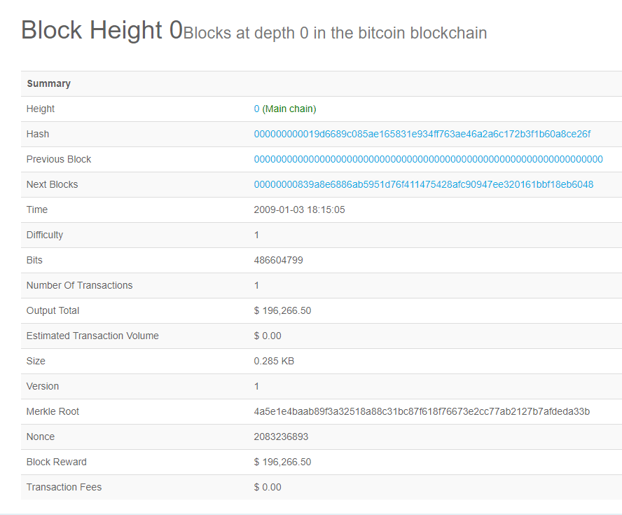
Lets explore real block (Bitcoin block 0)
Hash of this block
Previous block hash
All 0’s
Number of transactions 1
Trivia:
Sent from Satoshi to Hal Finney
Never cashed

Slide 14
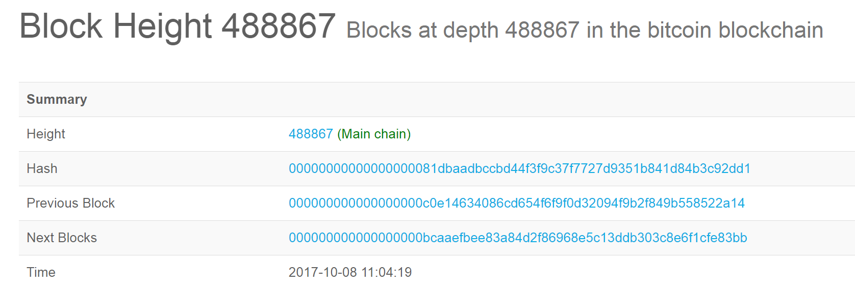

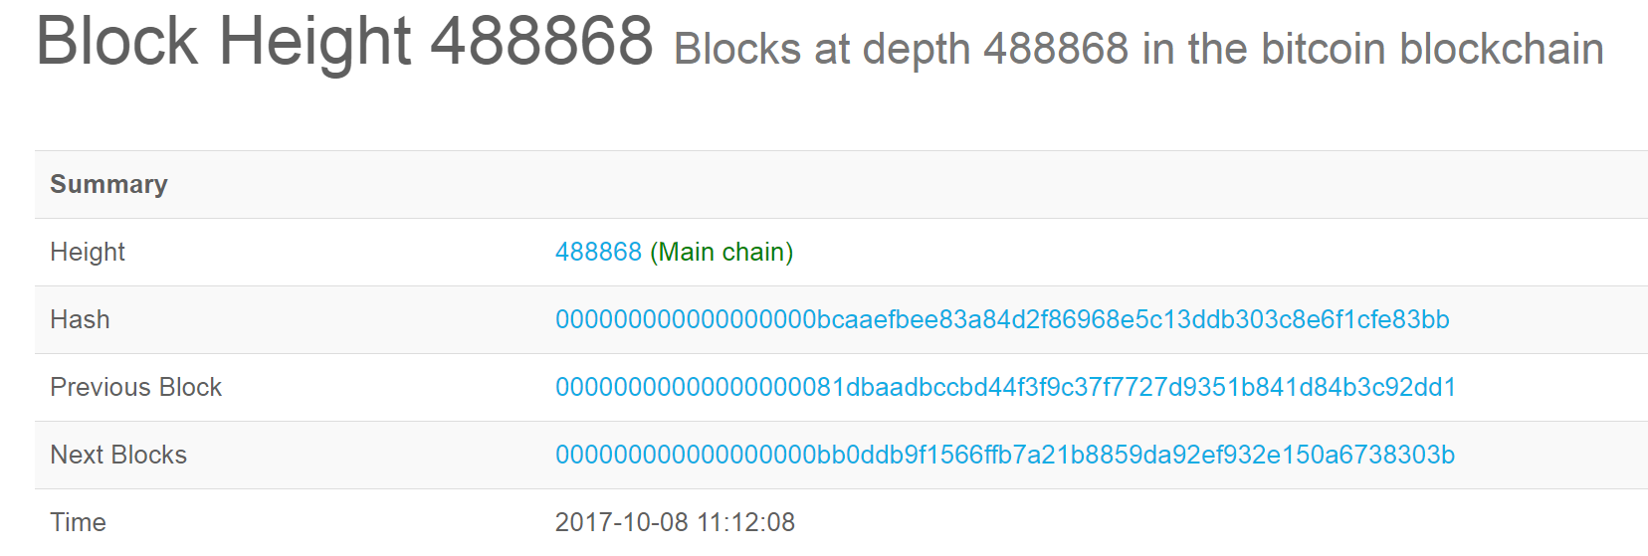
Chain of Three Blocks: 488867--488868--488869
Let's consider three blocks and see how they are chained together without going into technical details.

Slide 15

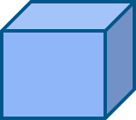
Blockchain: The Transaction
Transactions
Eve
Candidate
Block
Validate &
Gather,
Broadcast
Transactions
Consensus &
Verify &
Confirm
Block
Block
Block

Slide 16
Blockchain: The Block
Transactions
Eve
Candidate
Block
Validate &
Gather,
Broadcast
Transactions
Consensus &
Verify &
Confirm
Block
Block
Block

Slide 17
Blockchain: Chain of Blocks
Transactions
Candidate
Block
Validate &
Gather,
Broadcast
Transactions
Consensus &
Verify &
Confirm
Block
Block
Block

Slide 18
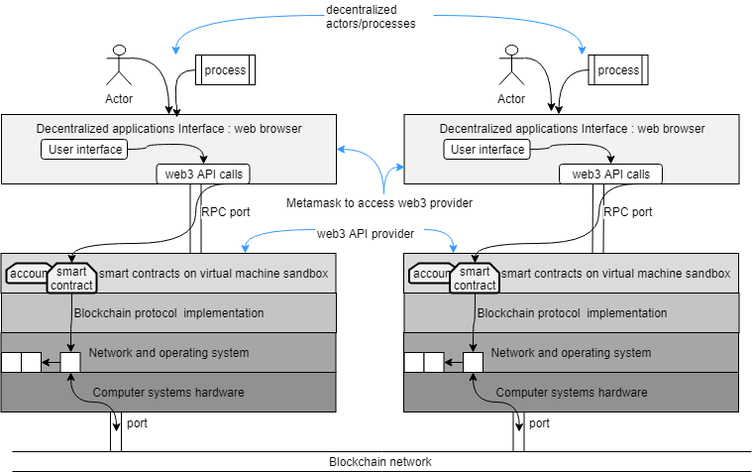
Blockchain network
Can you locate
the blockchain?

Slide 19
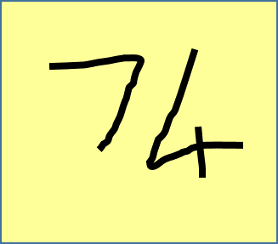
Lesson 3: Exact copy of blockchain in every full node for verification and validations
You cannot mess around with the records! Others have copies!
They can disprove you!
What can you with that!
You can prove things using these records on the blockchain!
Recorded in 2005: My secret idea

Slide 20
Key Takeaways
What is a blockchain?
Blockchain is distributed ledger (of Tx, block and blockchain) for recording facts
It can verify and validate rules
Since it automatically verifies, validates, and records, it can enable peer-peer communication among unknown participants in a decentralized world
What does it enable that current technologies cannot do?

Slide 21
Some applications
Global marketplace : any body can trade with anybody
Planetary level scientific experiments (Ex: study effects of climate change )
Trusted communication, negotiations among people
Trusted financial transfers without intermediaries
Trusted research collaborations
Efficient disaster relief /pandemic management
Accountable spending of donations (do you know how your donation is used?)

Slide 22
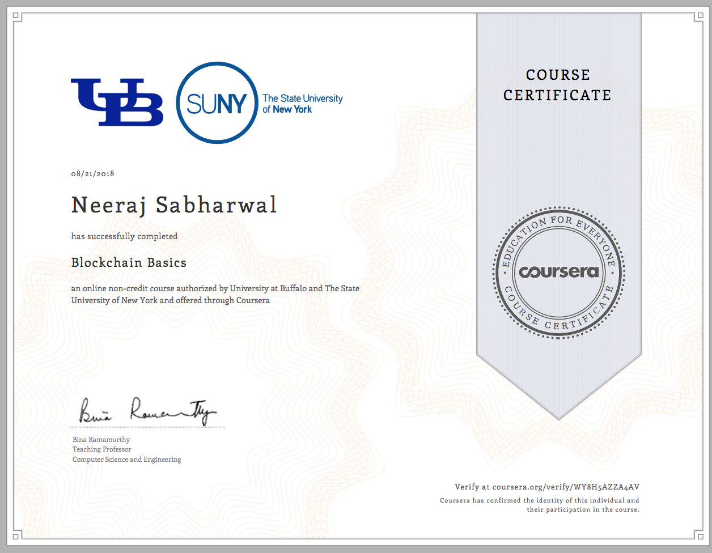
What can you do to learn and do blockchain programming and build systems?
Coursera Specialization on blockchain: Summer time: good time to get a certification
https://www.coursera.org/specializations/blockchain
Smart contracts are rules engine that verify and validate: language to write smart contracts is Solidity. Learn Solidity: Read the docs
Remix Integrated Web Environment (Remix IDE) is a webIDE that you can use to develop smart contracts. (I will demo this now)

Slide 23
Some trivia / fun
Did you know that you can embed “secret” messages in first Tx of the block?
“sknab roftuoliab dnoces fo knirb no rollecnahC 9002/naJ/30 semiT ehT”.
Message embedded by Satoshi.
Reverse it and it is not a secret anymore:
“The Times 03/Jan/2009 Chancellor on brink of second bailout for banks”.

Slide 24

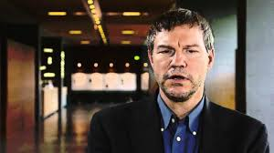
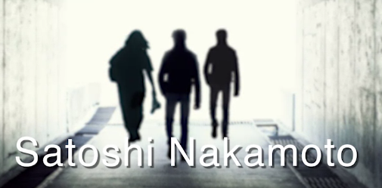
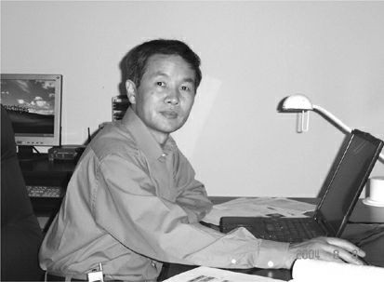
Who is Satoshi Nakamoto?
First Tx
Hal Finney (Dead)
Smart contract inventor
Wei Dai
First draft of Bitcoin (Recluse)

Slide 25
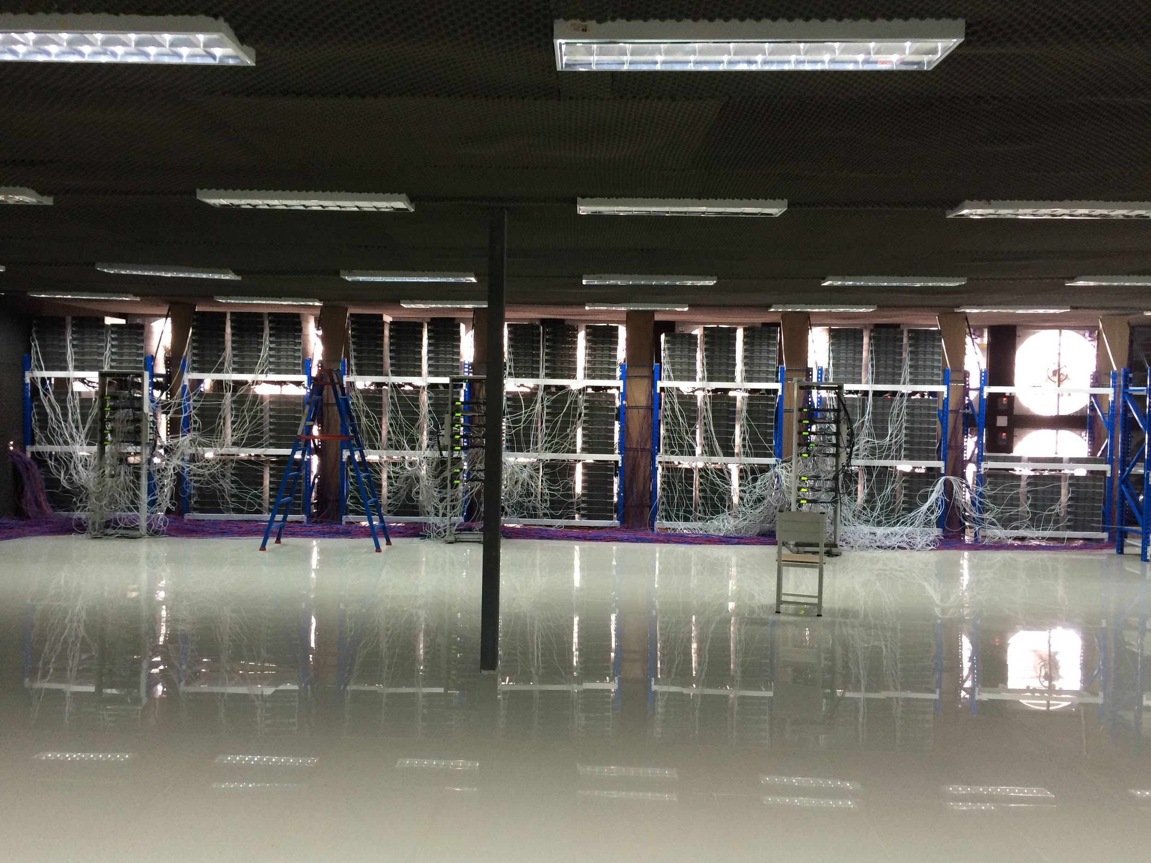
Block Mining and Incentivization Process
Each miner collects validated transactions and forms a candidate block. Then they compete to solve a puzzle. The miner who solves the puzzle first gets to add the Block to the chain.
Mining is done by powerful computers and not by humans!!!
Notes:
Common misconception is that miners are people digging through the transactions and blocks. Actually processing of transaction and blocks are carried out by computers running the Blockchain protocol (algorithms and programs).

