Slide 1
Welcome
to
CSE 331

Slide 2
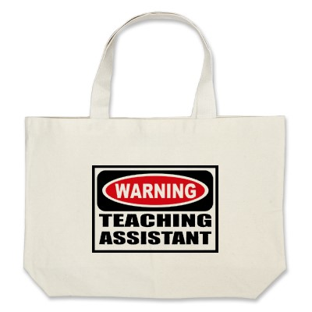
Let’s do some introductions
http://www.zazzle.com/warning_teaching_assistant_bag-149882665435161818

Slide 3
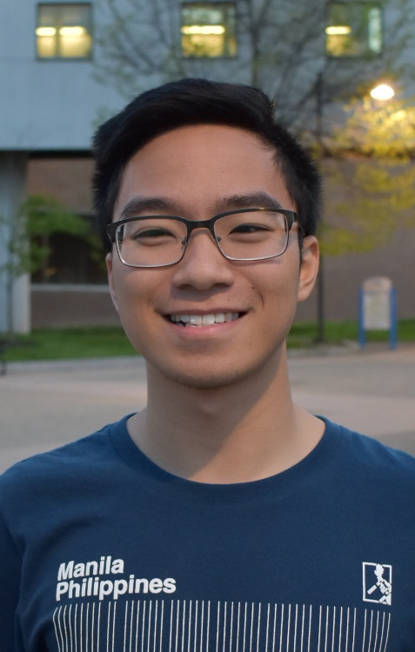
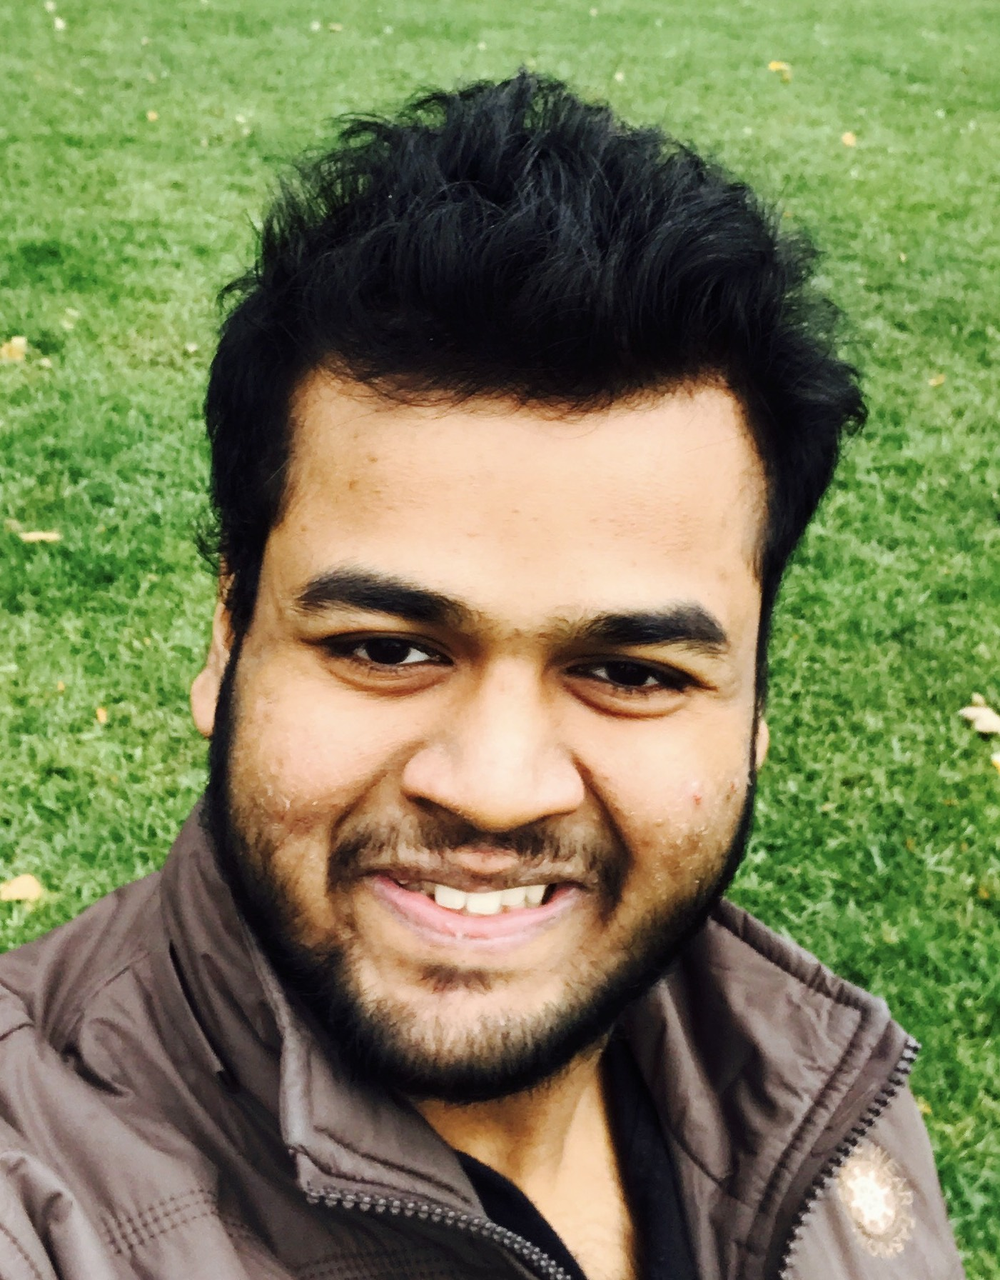
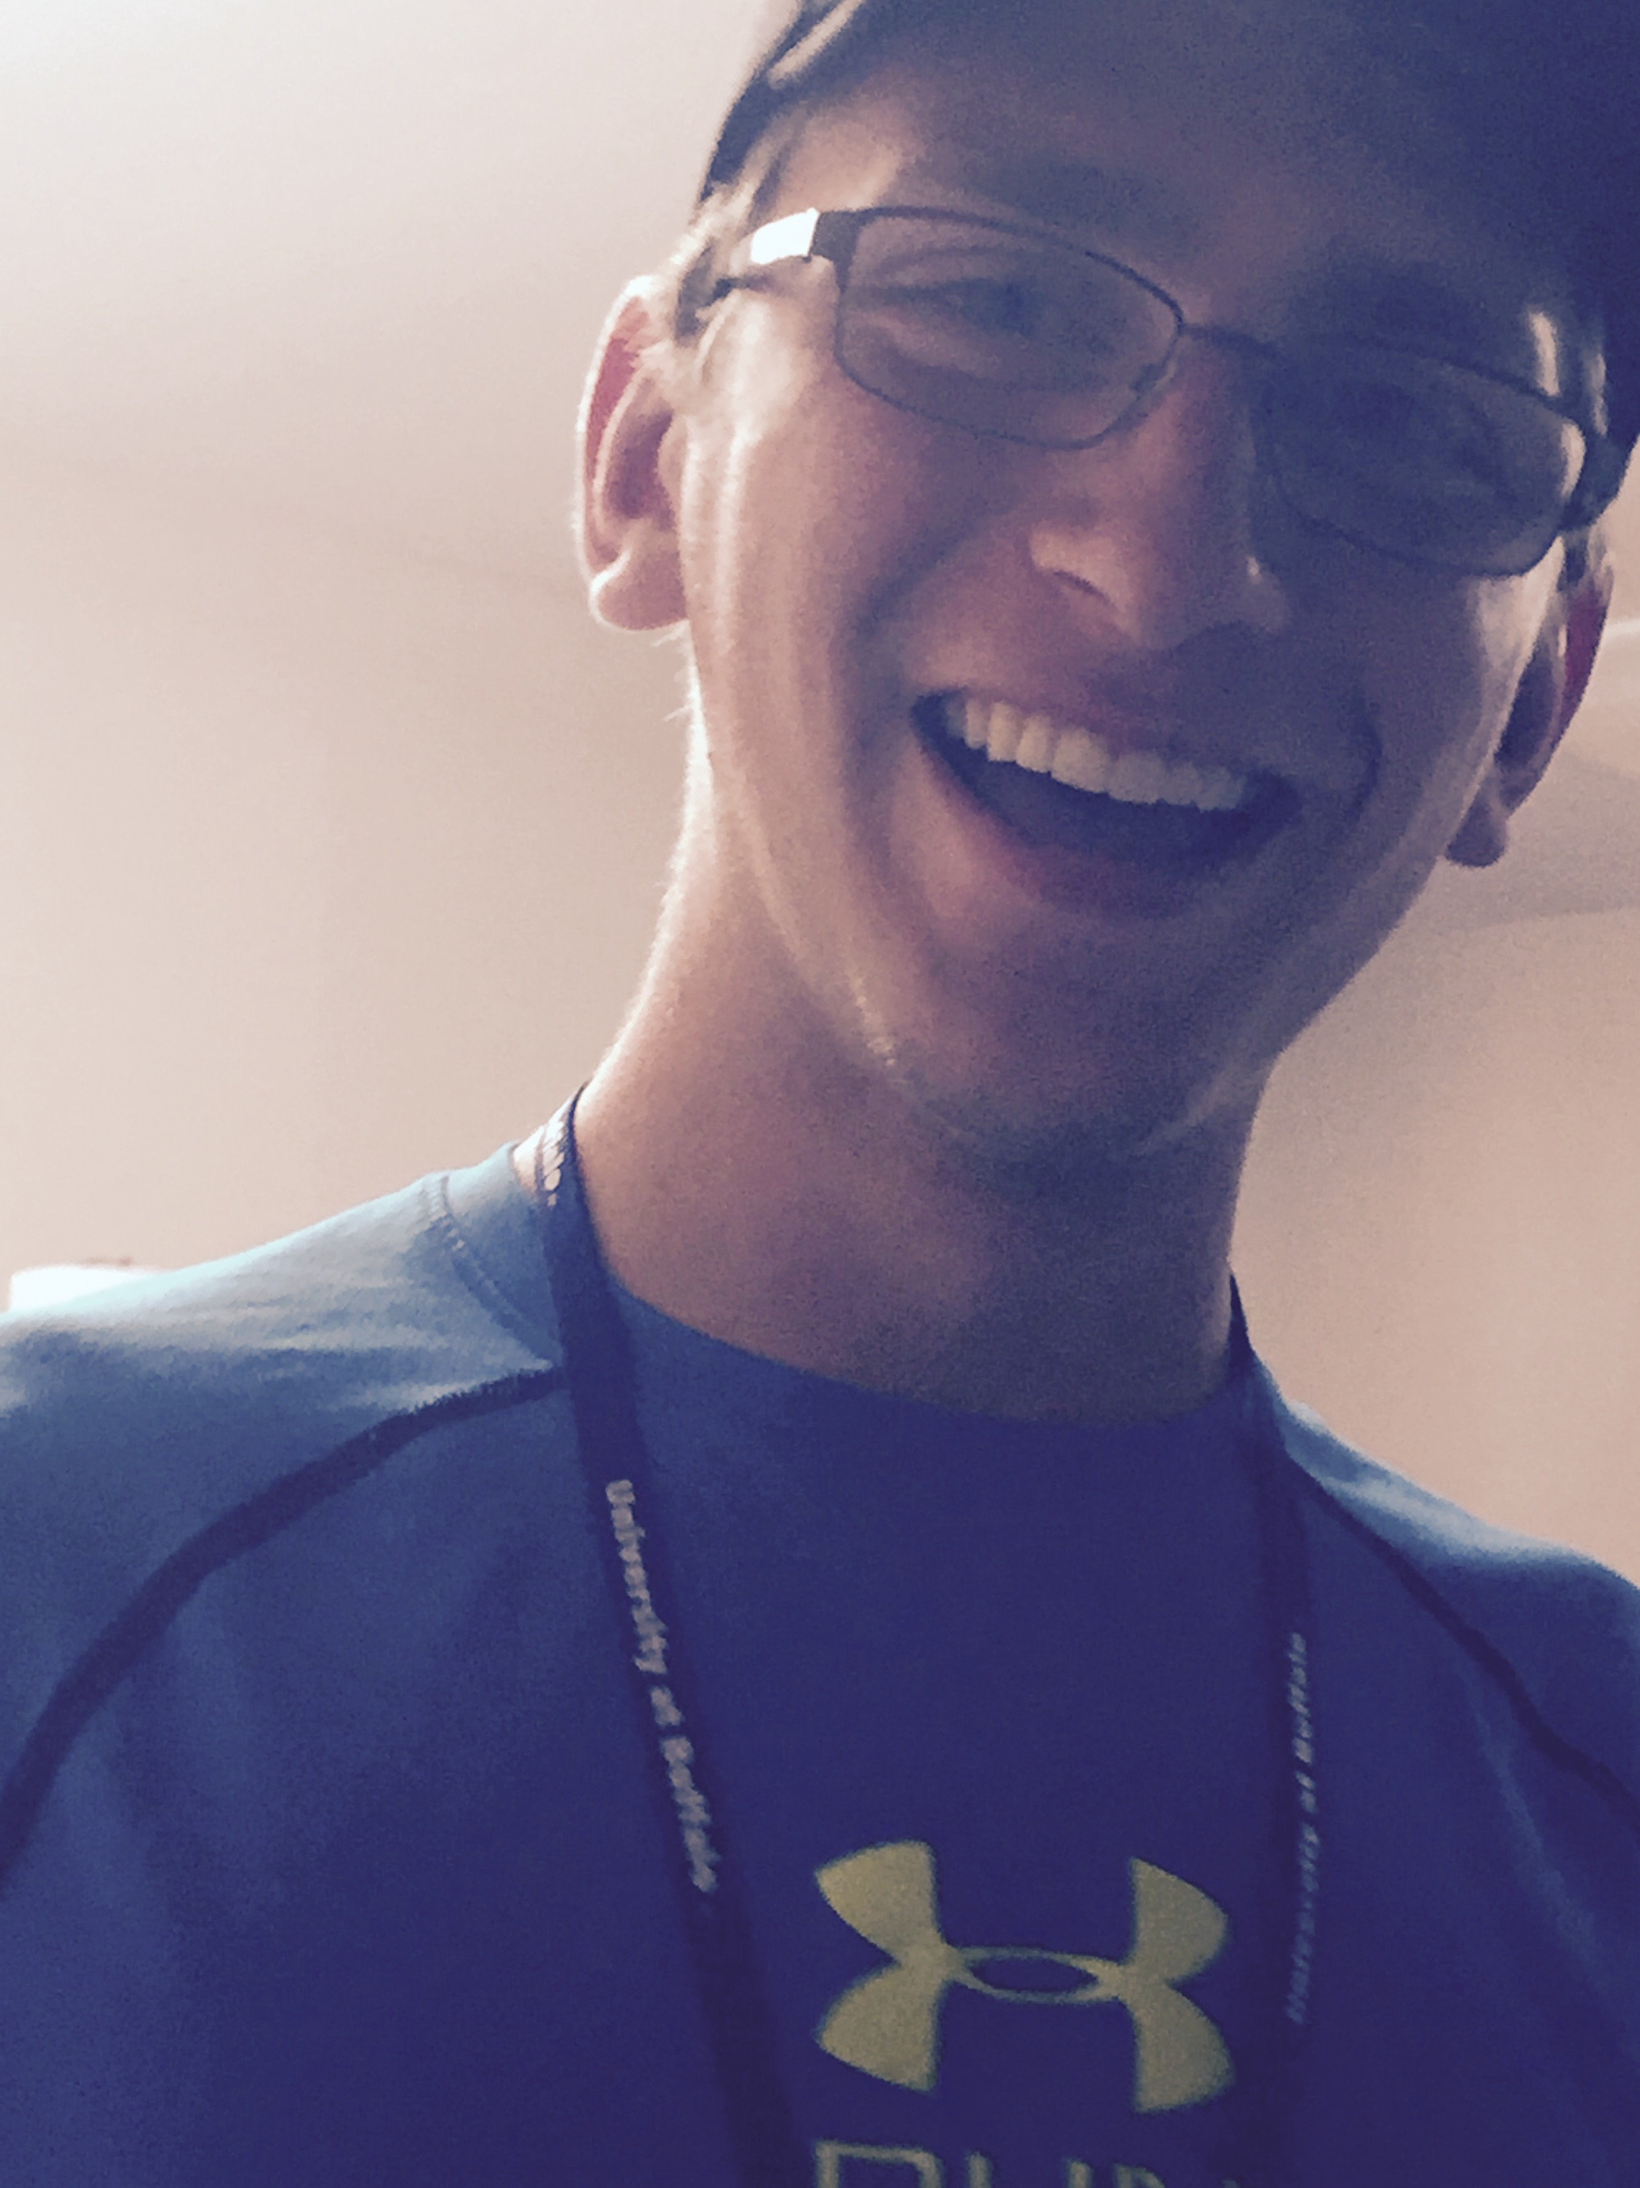
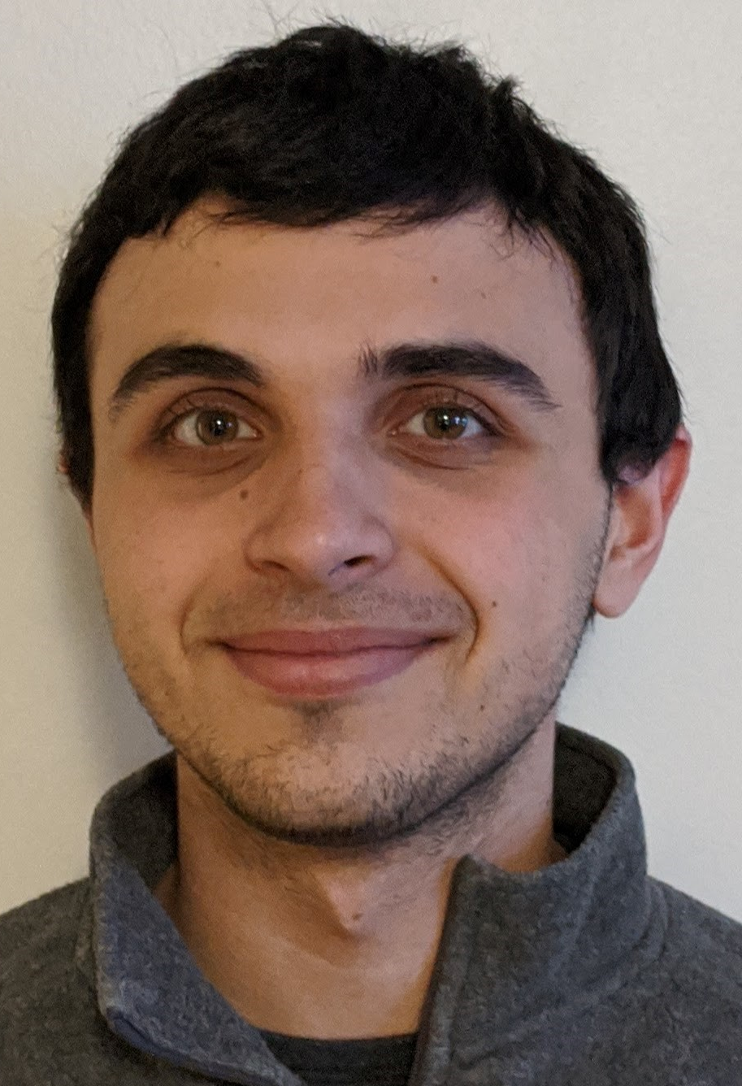
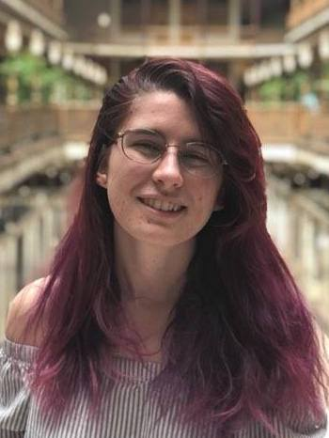
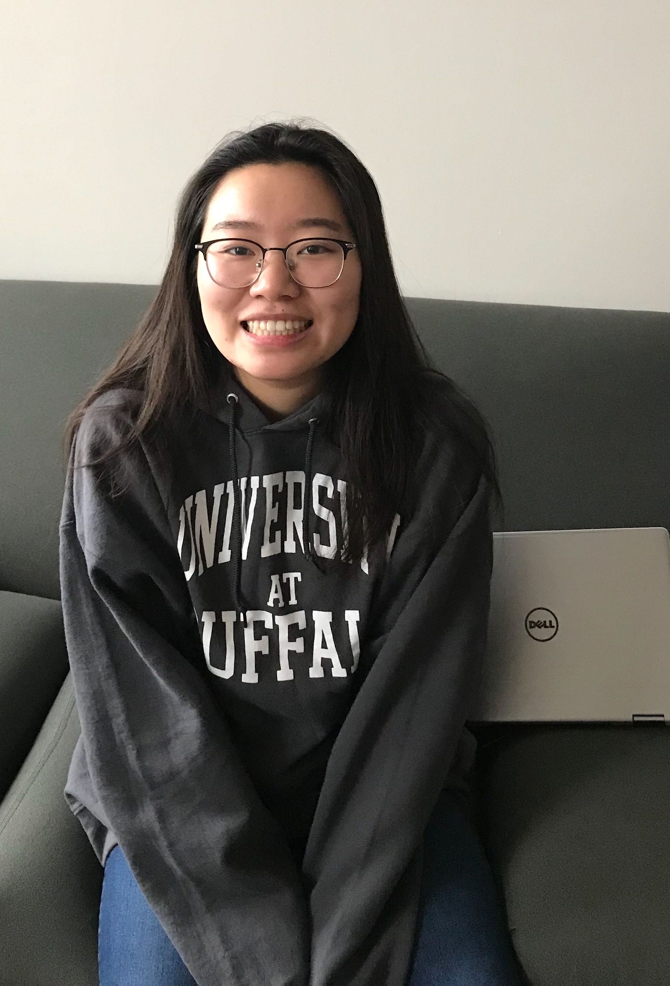
TAs first
Hans
Elijah
Jessica
Johnny
Nick
Rishi
Liam
Jacob
Veronica
Xuanhua
Winnie

Slide 4
Lectures will be videotaped
http://www.imdb.com/title/tt0363510/mediaviewer/rm2499681792

Slide 5
About Me
A. Erdem Sariyuce
erdem@buffalo.edu
Office: 323 Davis
Office hours: Mon 3:00-3:50pm; Wed, 3:00-3:50pm
OH starts today

Slide 6
Contact us all at
Or use piazza!
cse-331-staff@buffalo.edu
TAs will not respond to individual emails (except for re-grading requests)

Slide 7
Handouts for today
Syllabus (online)
Homework Policy document (online)
Homework 0 (online)

Slide 8
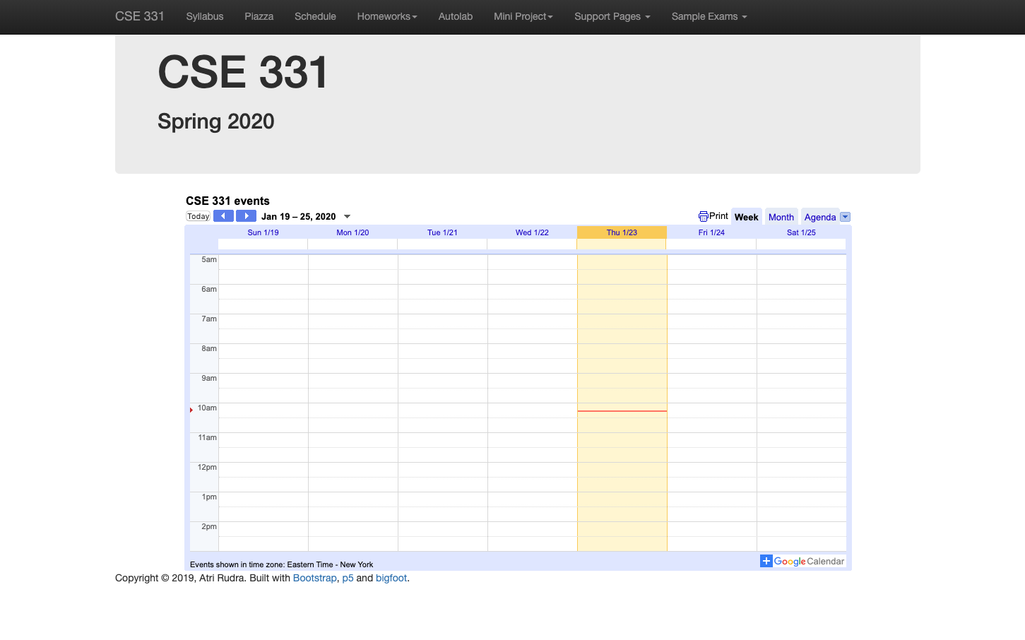
One Stop Shop for the Course
https://cse.buffalo.edu/~erdem/cse331/spring20/index.html

Slide 9
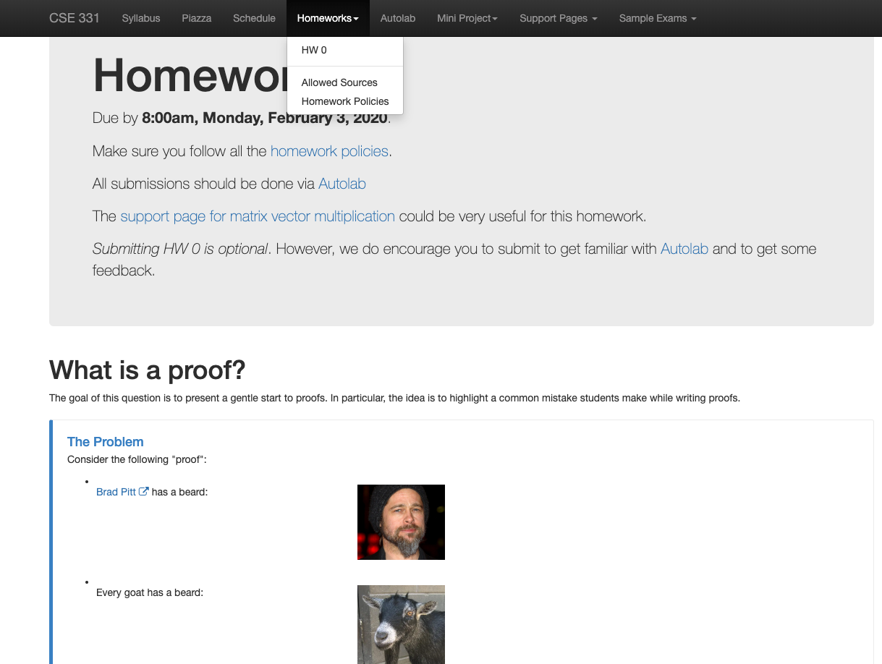
Homework 0 (Optional)
Due: next Monday 8am

Slide 10
Three things to remember
WORK HARD!
DO NOT CHEAT!
READ CAREFULLY!

Slide 11
Wait.. What???
Make sure you follow submission
instructions
Two most common ways of losing points
Make sure you read problem
statements carefully

Slide 12
Academic Dishonesty
All your submissions must be your own work
Penalty:
Minimum: A grade reduction in course
Possible: F (or higher penalty) if warranted
YOUR responsibility to know what is cheating, plagiarism etc.
If not sure, come talk to me
Excuses like “I have a job,” “This was OK earlier/in my country,” “This course is hard,” etc. WON’T WORK
I DO NOT HAVE ANY PATIENCE WITH ANY CHEATING :
YOU WILL GET A GRADE REDUCTION IN THE COURSE
FOR YOUR FIRST MISTAKE

Slide 13
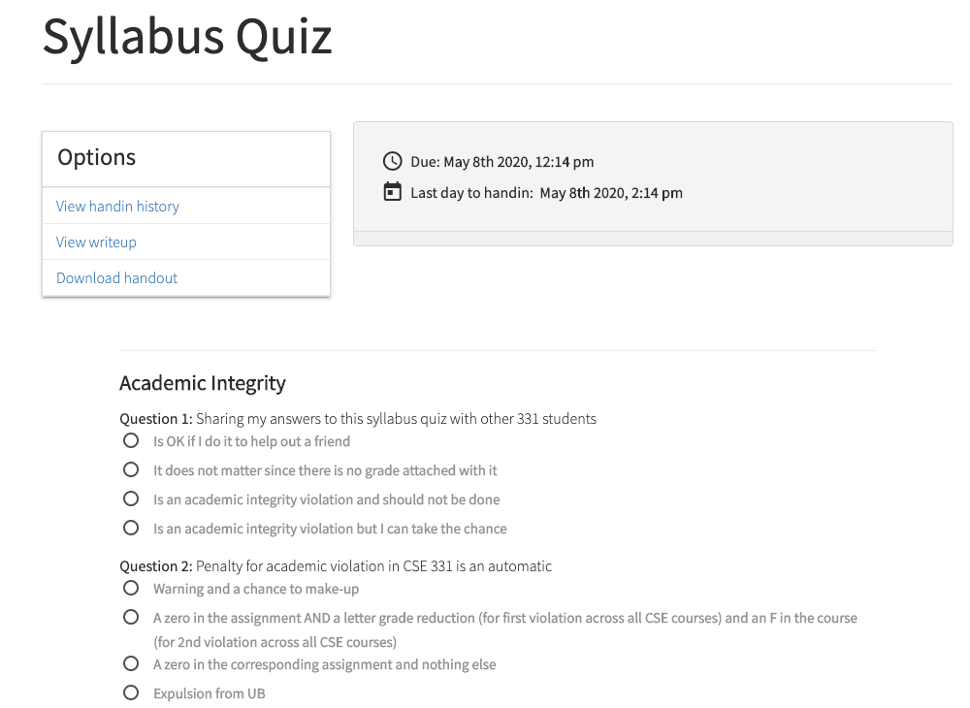
Read the syllabus and hw policy CAREFULLY!
No graded material will be handed back till you pass the syllabus quiz!

Slide 14
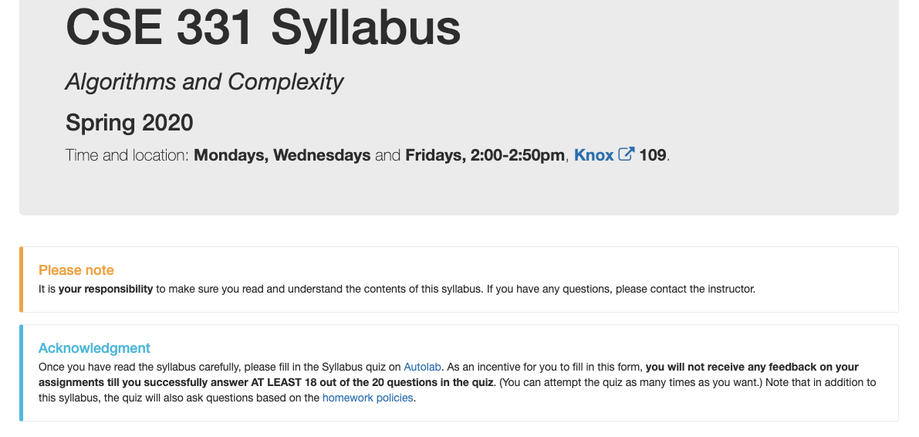
More information on the syllabus quiz

Slide 15
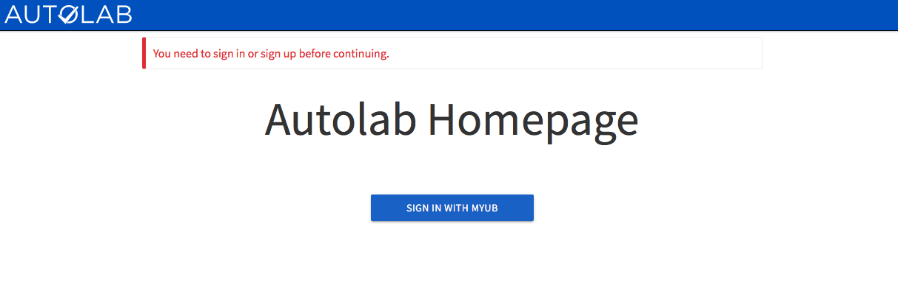
Autolab
https://autograder.cse.buffalo.edu/

Slide 16
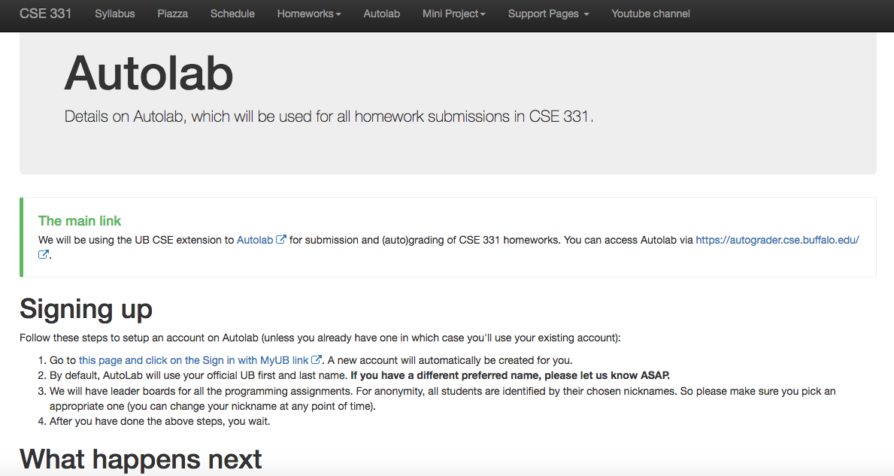
Autolab FAQ

Slide 17
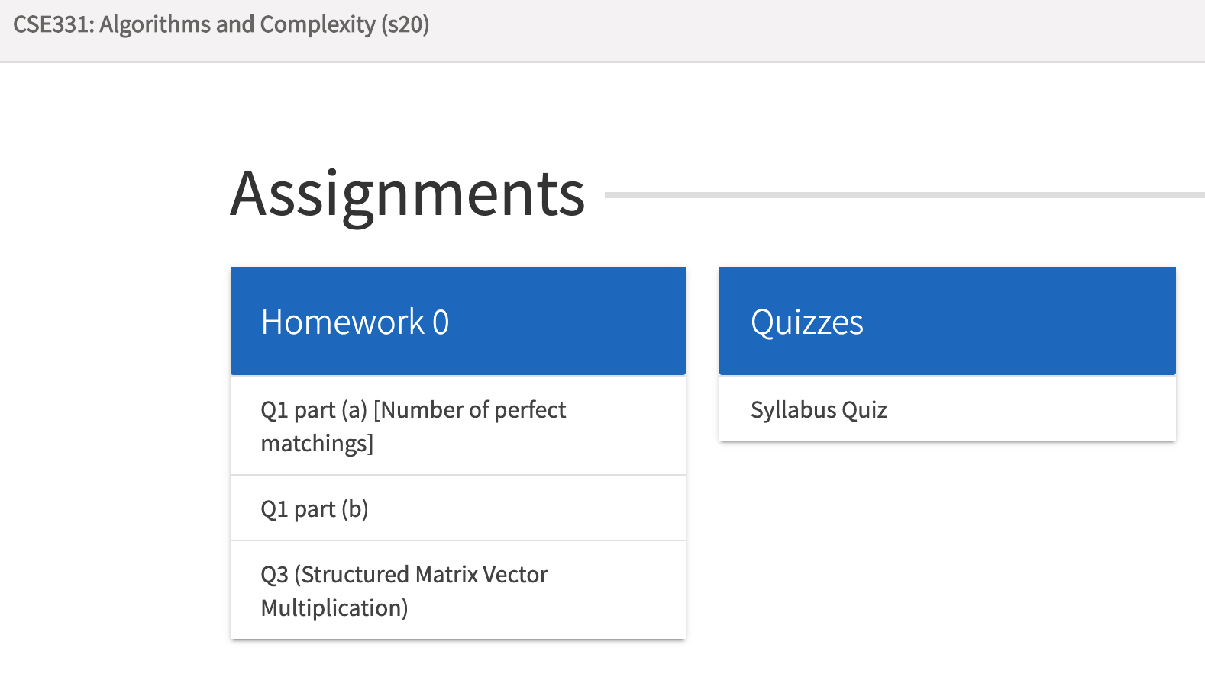
You can submit the following now
If you were registered by 6pm on Saturday, Jan 25 you should be on Autolab

Slide 18
Grading break-down

Slide 19
Pre-requisites
Required (officially)
CSE 250, [CSE 191 or MTH 311] and MTH 142
At least a C-
Required (for practical purposes)
Comfort with proofs
Willingness to work hard!

Slide 20
Accessibility Resources
Information included in the syllabus
In short, let me know and consult with Accessibility Resources

Slide 21
Preferred Name
If you prefer using name diff from UB records
Let me know and we’ll make a note of it.

Slide 22
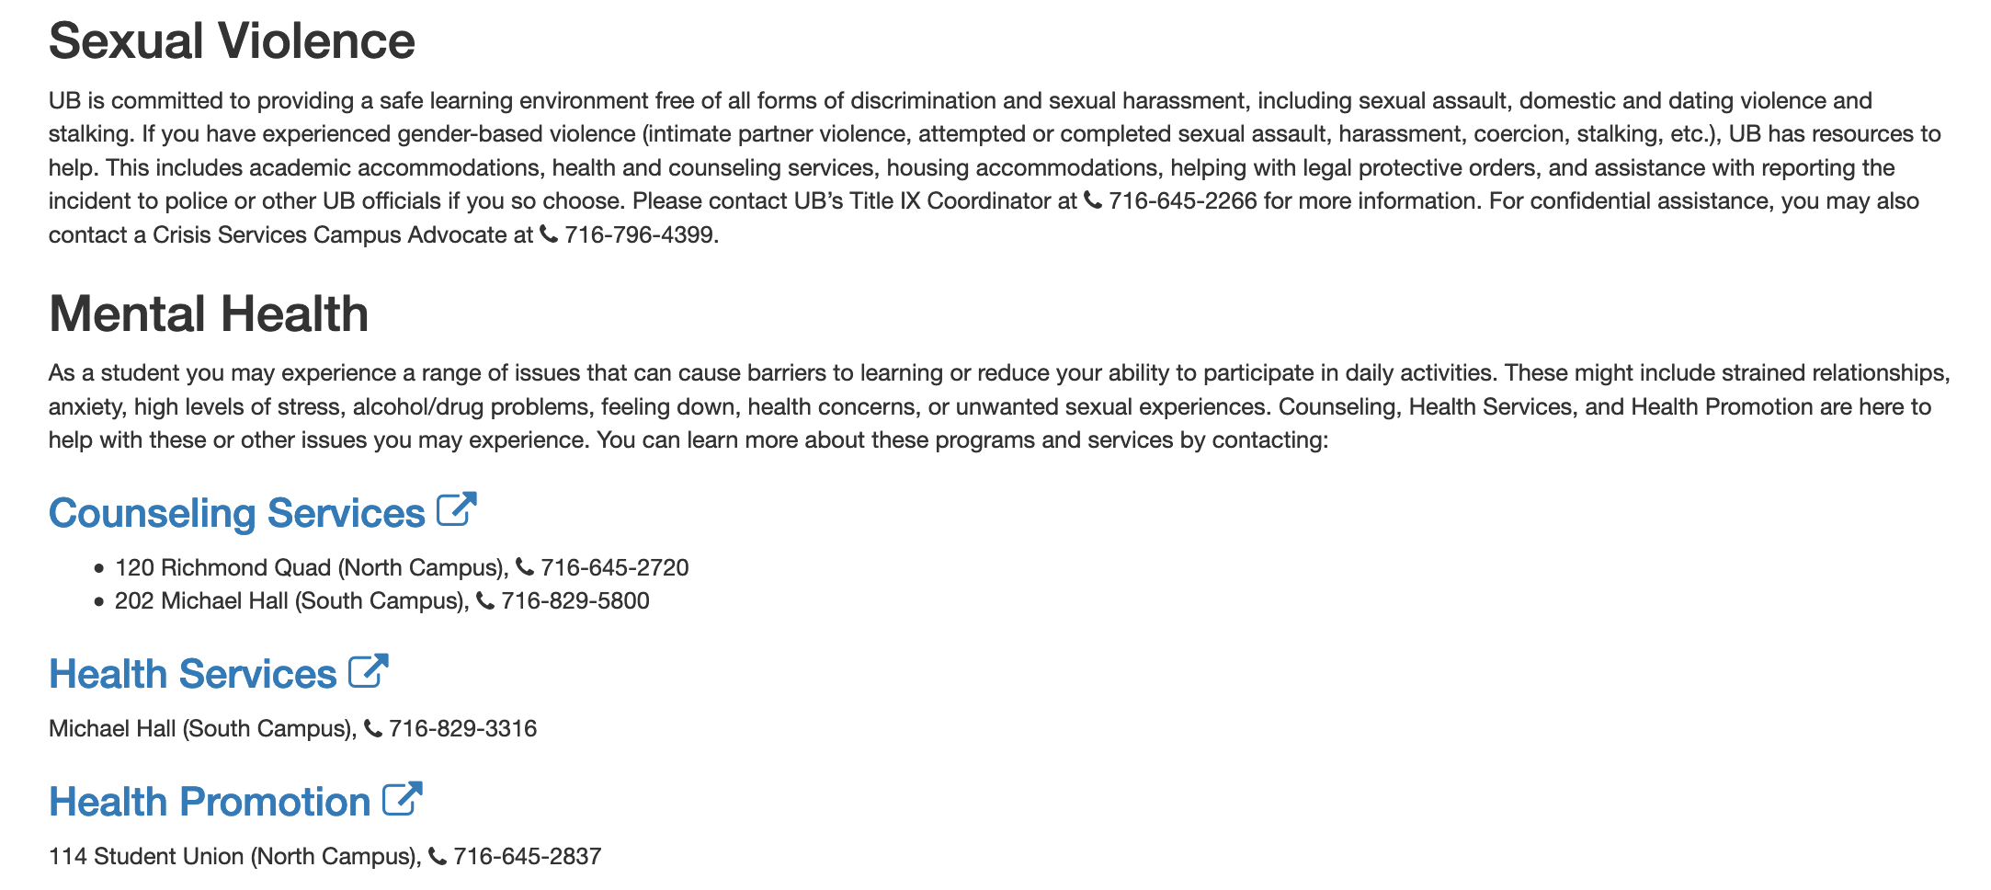
Critical Campus Resources

Slide 23
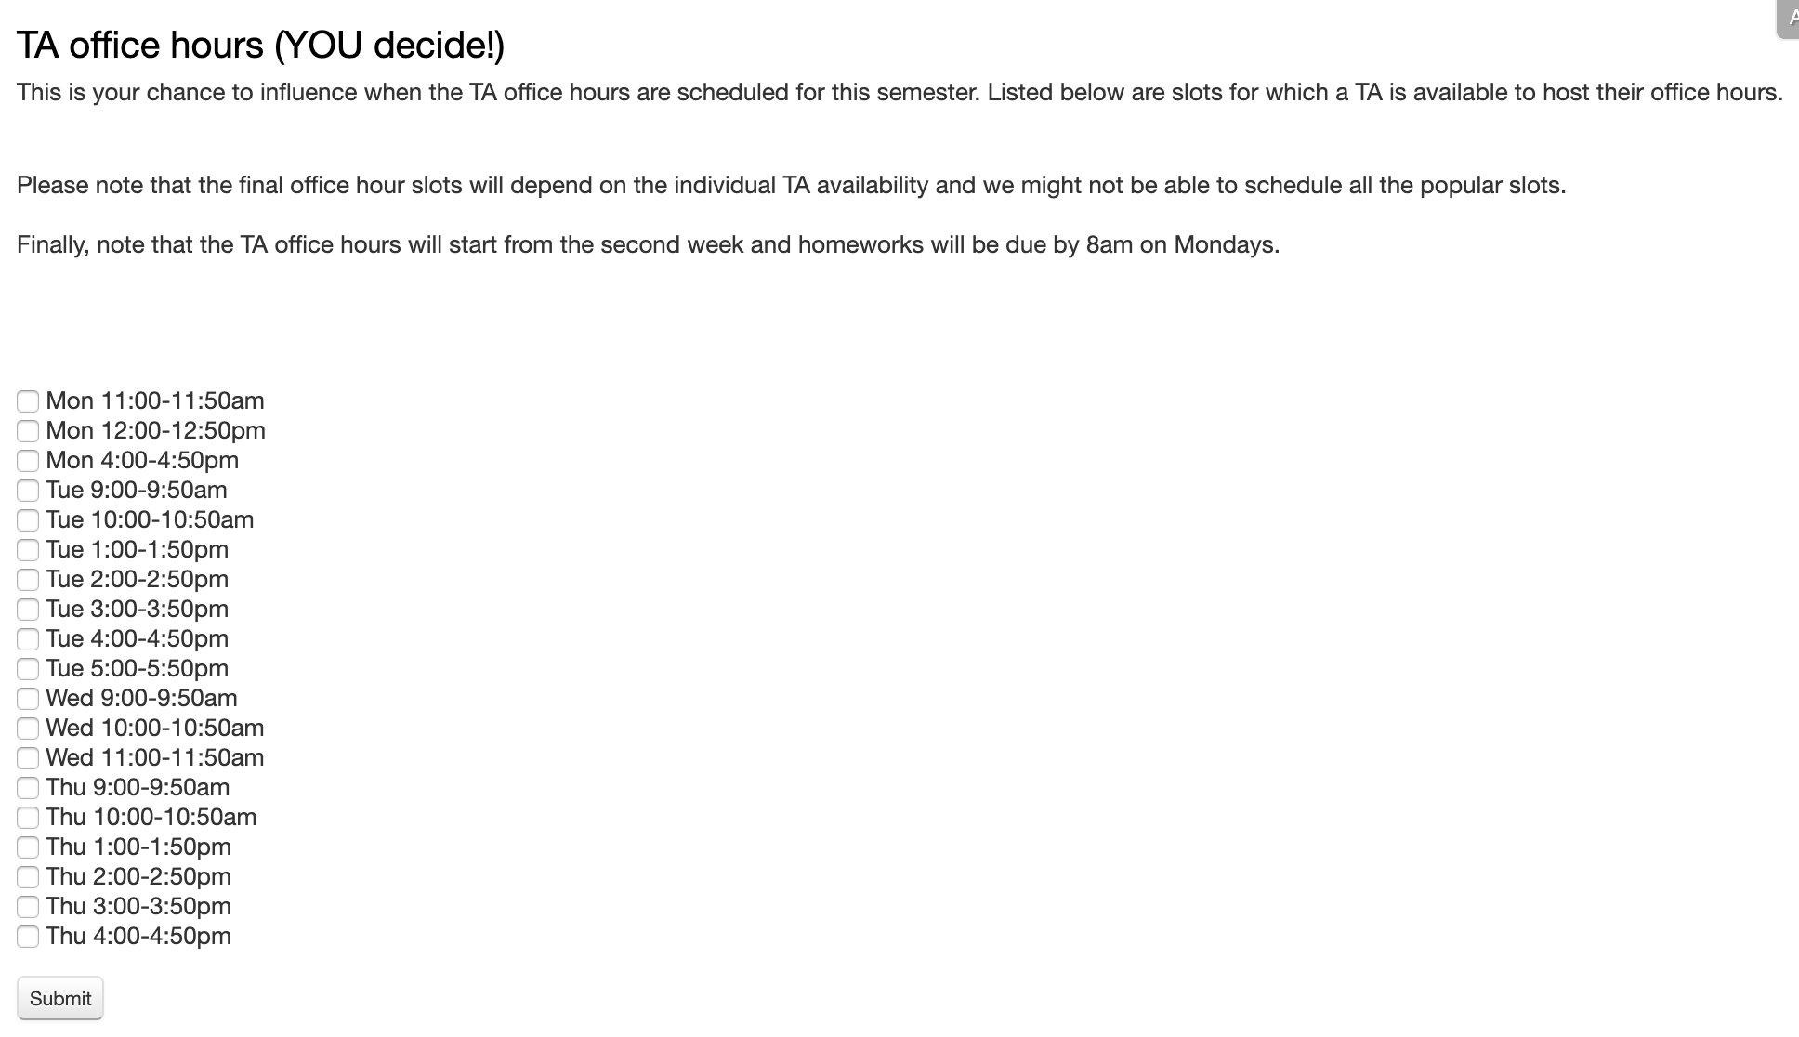
TA Office hours
YOU decide!

Slide 24
Recitations
Are on for this week!
RECITATIONS

Slide 25
Please stick to your recitation section
Seating is limited in each.
You can change (via MyUB) if there is a space.

Slide 26
Exams
Mid term (two parts)
Wed, Mar 11 and Fri, Mar 13, 2020.
(last week before the spring break)
Usual place and time.
Final exam
Mon, May 11, 2020.
Knox 109, 3:30-6:00pm (not 3 hrs)

Slide 27
HWs
[50 pts] Q1 (easier) is a proof-based question; two parts
[25 pts] Q2 (harder) is a proof-based question; two parts
[25 pts] Q3 is a programming question; autograded
HWs due by 8:00am on Mondays
(assigned a week before)

Slide 28
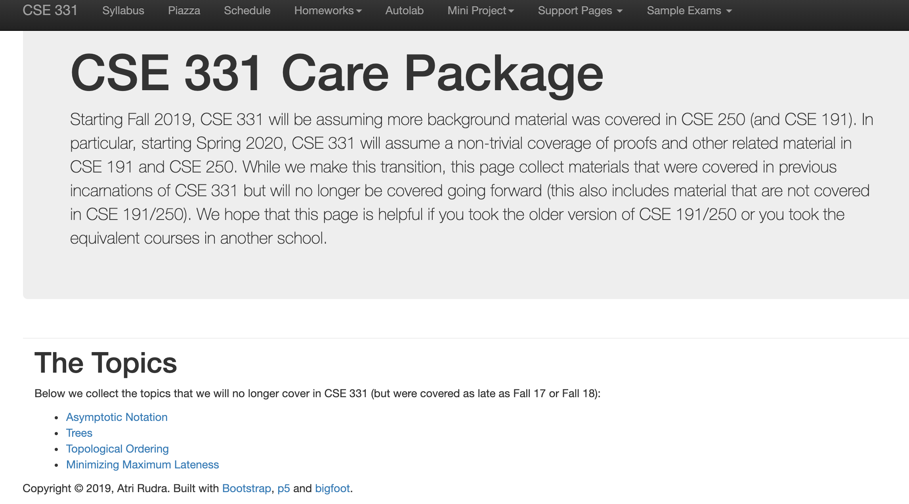
Support page

Slide 29
C++ vs Java/Python
Use Java/Python if as you just as comfortable with as C++

Slide 30
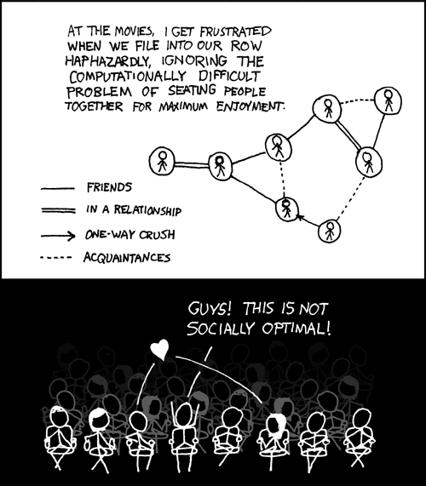
This course: how to solve problems!
http://xkcd.com/173/

Slide 31
331 IS THE MOST IMPORTANT CLASS IN YOUR COMPUTER SCIENCE DEGREE

