Slide 1
Welcome
to
CSE 331

Slide 2
Let’s do some introductions
http://www.zazzle.com/warning_teaching_assistant_bag-149882665435161818

Slide 3
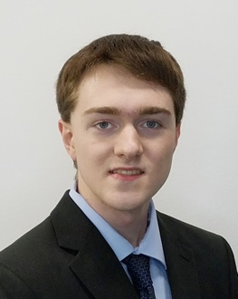
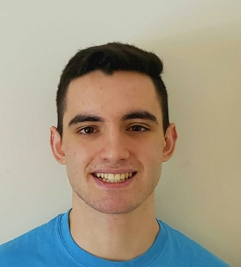
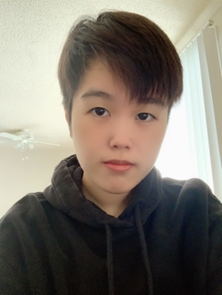
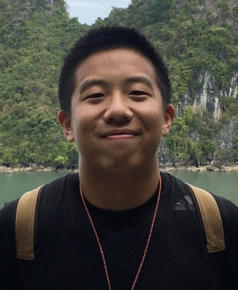
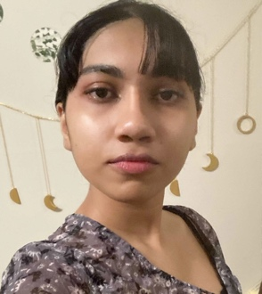
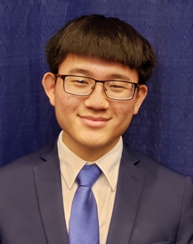
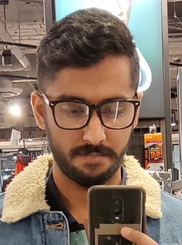
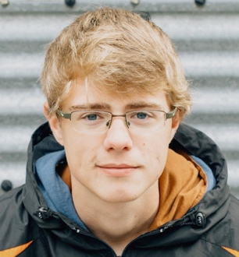
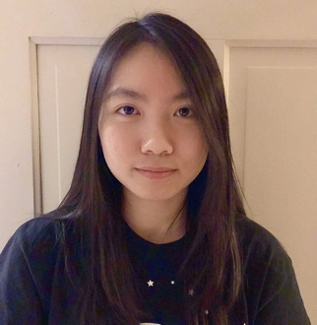
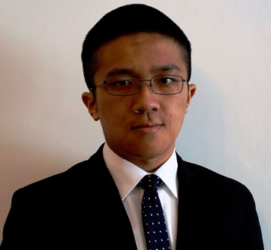
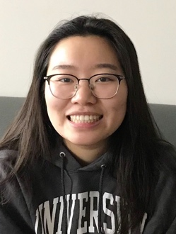
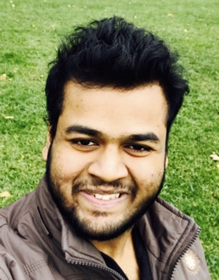
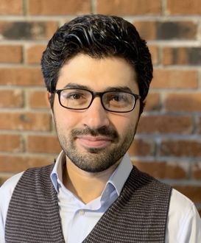
TAs first
Robert
Nitya
Jessica
Justin
Monica
Alex
Snigdha
Michael
Harishvar
Connor
Megan
Joseph
Winnie
Mihir
Elijah
Jakir
Bekir
Yang

Slide 4
Lectures will be recorded
http://www.imdb.com/title/tt0363510/mediaviewer/rm2499681792

Slide 5
About Me
A. Erdem Sariyuce
erdem@buffalo.edu
Office: 323 Davis over Zoom
Office hours: Mon 5:00-6:00pm; Wed, 1:30-2:30pm
OH starts today (Waiting room enabled)

Slide 6
Contact us all at
Or use piazza!
cse-331-staff@buffalo.edu
TAs will not respond to individual emails (except for re-grading requests)

Slide 7
Handouts for today
Syllabus (online)
Homework Policy document (online)
Homework 0 (online)

Slide 8
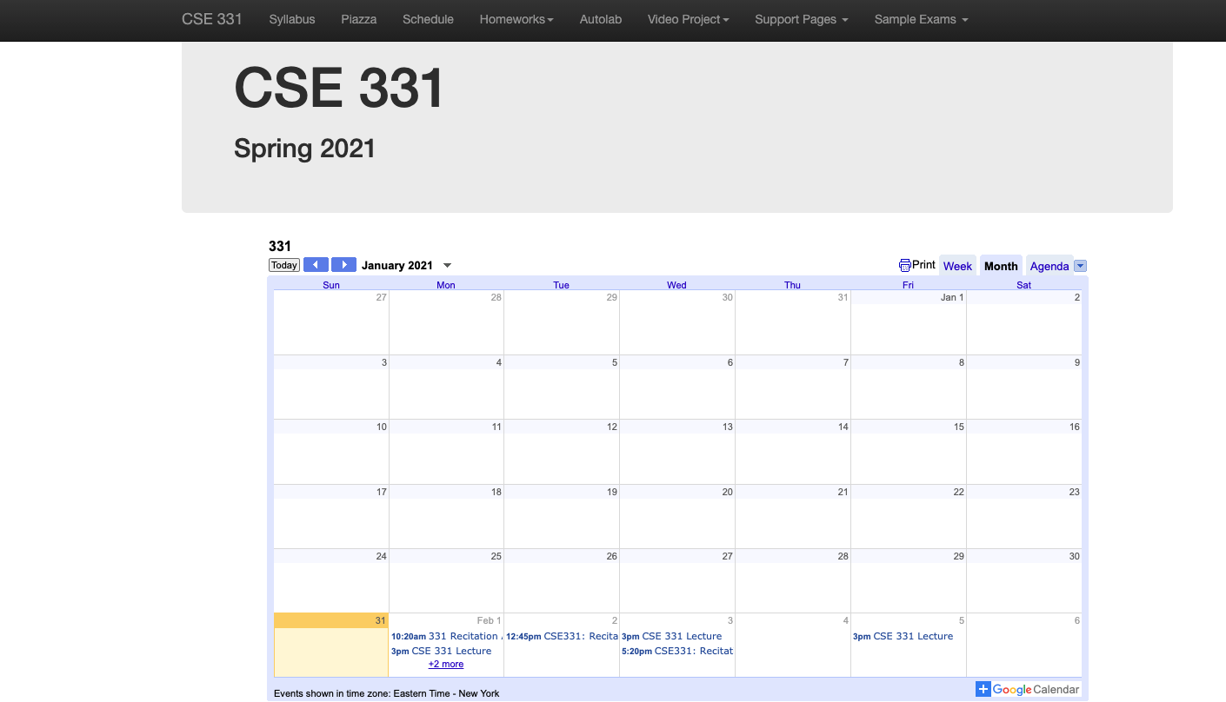
One Stop Shop for the Course
https://cse.buffalo.edu/~erdem/cse331/spring21/index.html

Slide 9
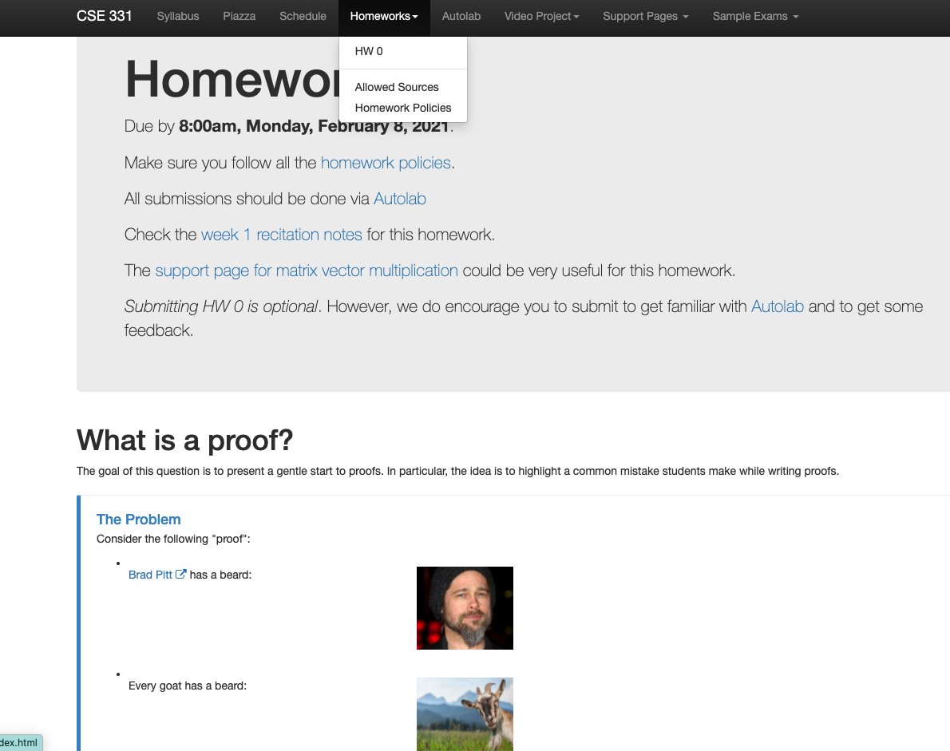
Homework 0 (Optional)
Due: next Monday 8am

Slide 10
Three things to remember
WORK HARD!
DO NOT CHEAT!
READ CAREFULLY!

Slide 11
Wait.. What???
Make sure you follow submission
instructions
Two most common ways of losing points
Make sure you read problem
statements carefully

Slide 12
Academic Dishonesty
All your submissions must be your own work
Penalty:
Minimum: A grade reduction in course
Possible: F (or higher penalty) if warranted
YOUR responsibility to know what is cheating, plagiarism etc.
If not sure, come talk to me
Excuses like “I have a job,” “This was OK earlier/in my country,” “This course is hard,” etc. WON’T WORK
I DO NOT HAVE ANY PATIENCE WITH ANY CHEATING :
YOU WILL GET A GRADE REDUCTION IN THE COURSE
FOR YOUR FIRST MISTAKE

Slide 13
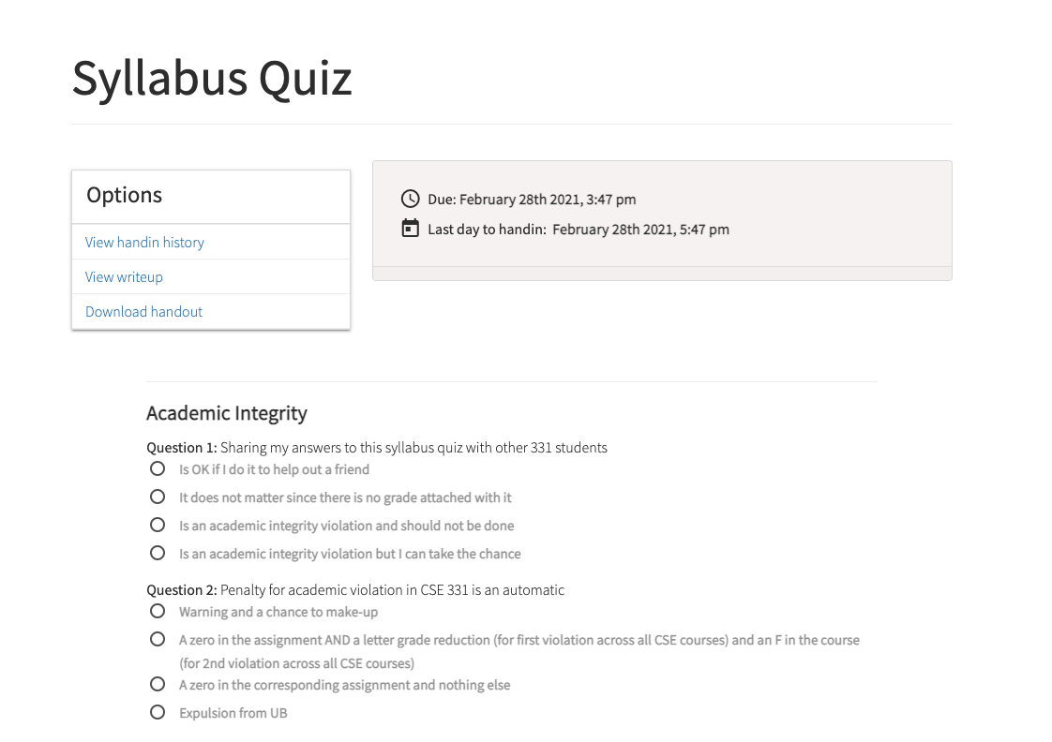
Read the syllabus and hw policy CAREFULLY!
No graded material will be handed back till you pass the syllabus quiz!

Slide 14
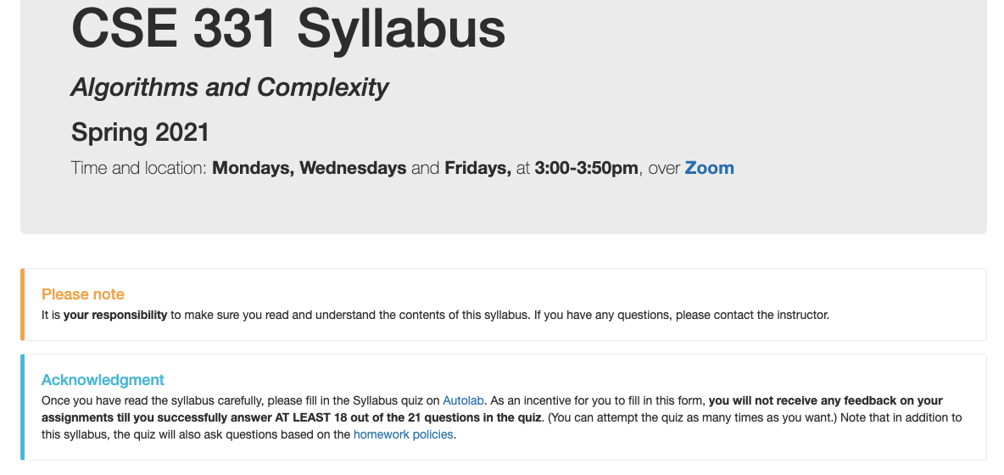
More information on the syllabus quiz

Slide 15
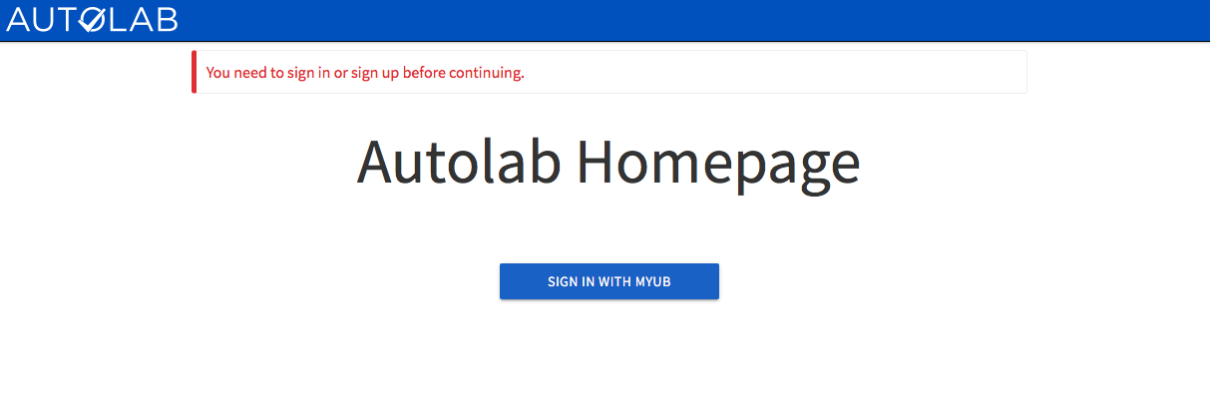
Autolab
https://autograder.cse.buffalo.edu/

Slide 16
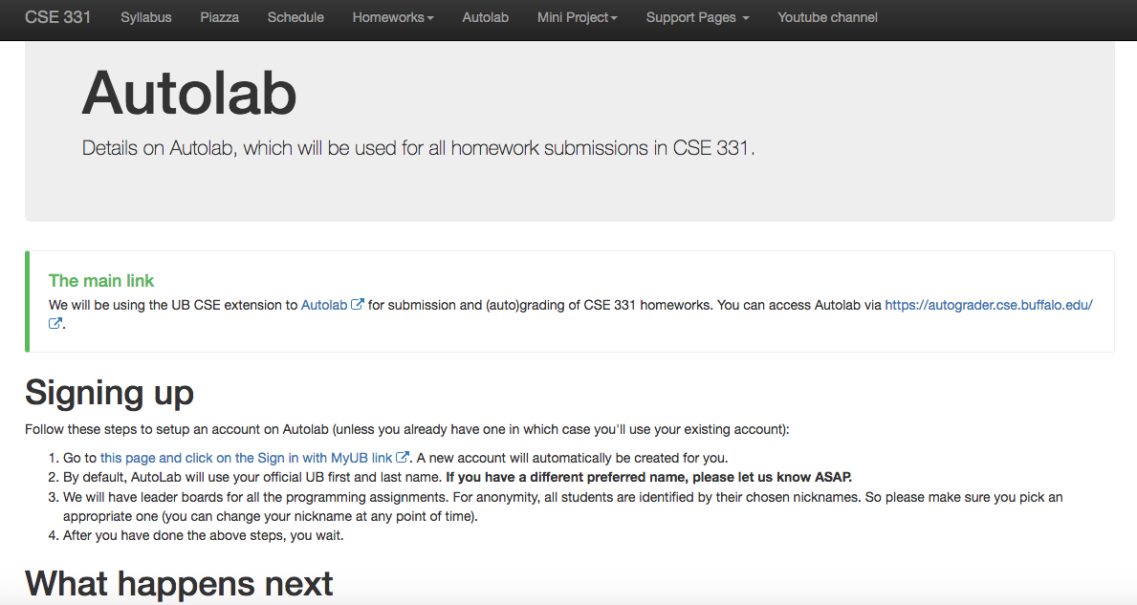
Autolab FAQ

Slide 17
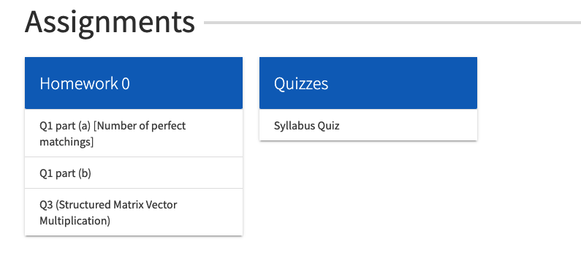
You can submit the following now
If you were registered by 11pm on Friday, Jan 30; you should be on Autolab
(newcomers can let me know by private posts at Piazza)

Slide 18
Grading break-down

Slide 19
Pre-requisites
Required (officially)
CSE 250, [CSE 191 or MTH 311] and MTH 142
At least a C-
Required (for practical purposes)
Comfort with proofs
Willingness to work hard!
Support pages: https://cse.buffalo.edu/~erdem/cse331/support/background.html

Slide 20
Accessibility Resources
Information included in the syllabus
In short, let me know and consult with Accessibility Resources

Slide 21
Preferred Name
If you prefer using name diff from UB records
Let me know and we’ll make a note of it.

Slide 22
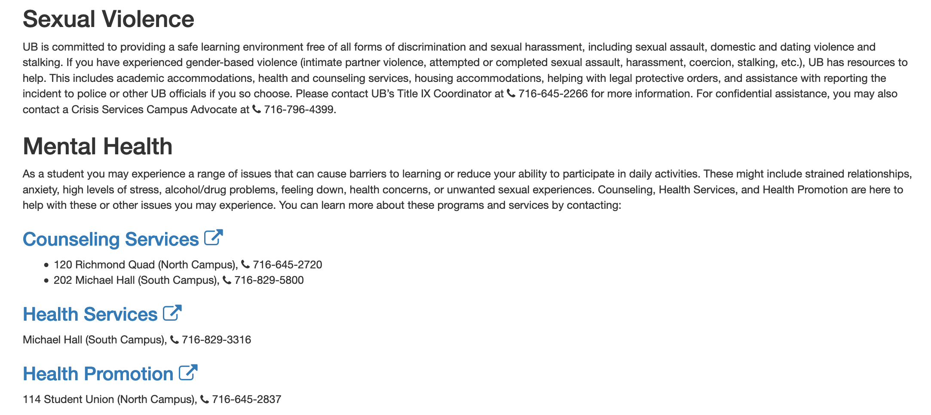
Critical Campus Resources

Slide 23
TA Office hours
Starts next week!
Will cover pretty much all the weekdays!

Slide 24
Recitations
Are on for this week!
RECITATIONS

Slide 25
Please stick to your recitation section
So that Zoom sessions can be more interactive.
You can change (via MyUB) if there is a space.

Slide 26
Exams
Mid term (two parts)
Wed, Mar 17 and Fri, Mar 19, 2021.
Live exams, during the class time.
MARK YOUR CALENDAR!
Final exam
Wed, May 12, 2021.
Live exam, 3:30-6:00pm (not 3 hrs)
MARK YOUR CALENDAR!

Slide 27
HWs
[50 pts] Q1 (easier) is a proof-based question; two parts
[25 pts] Q2 (harder) is a proof-based question; two parts
[25 pts] Q3 is a programming question; autograded
HWs due by 8:00pm on Fridays
(assigned a week before)
NO LATE SUBMISSIONS!!!

Slide 28
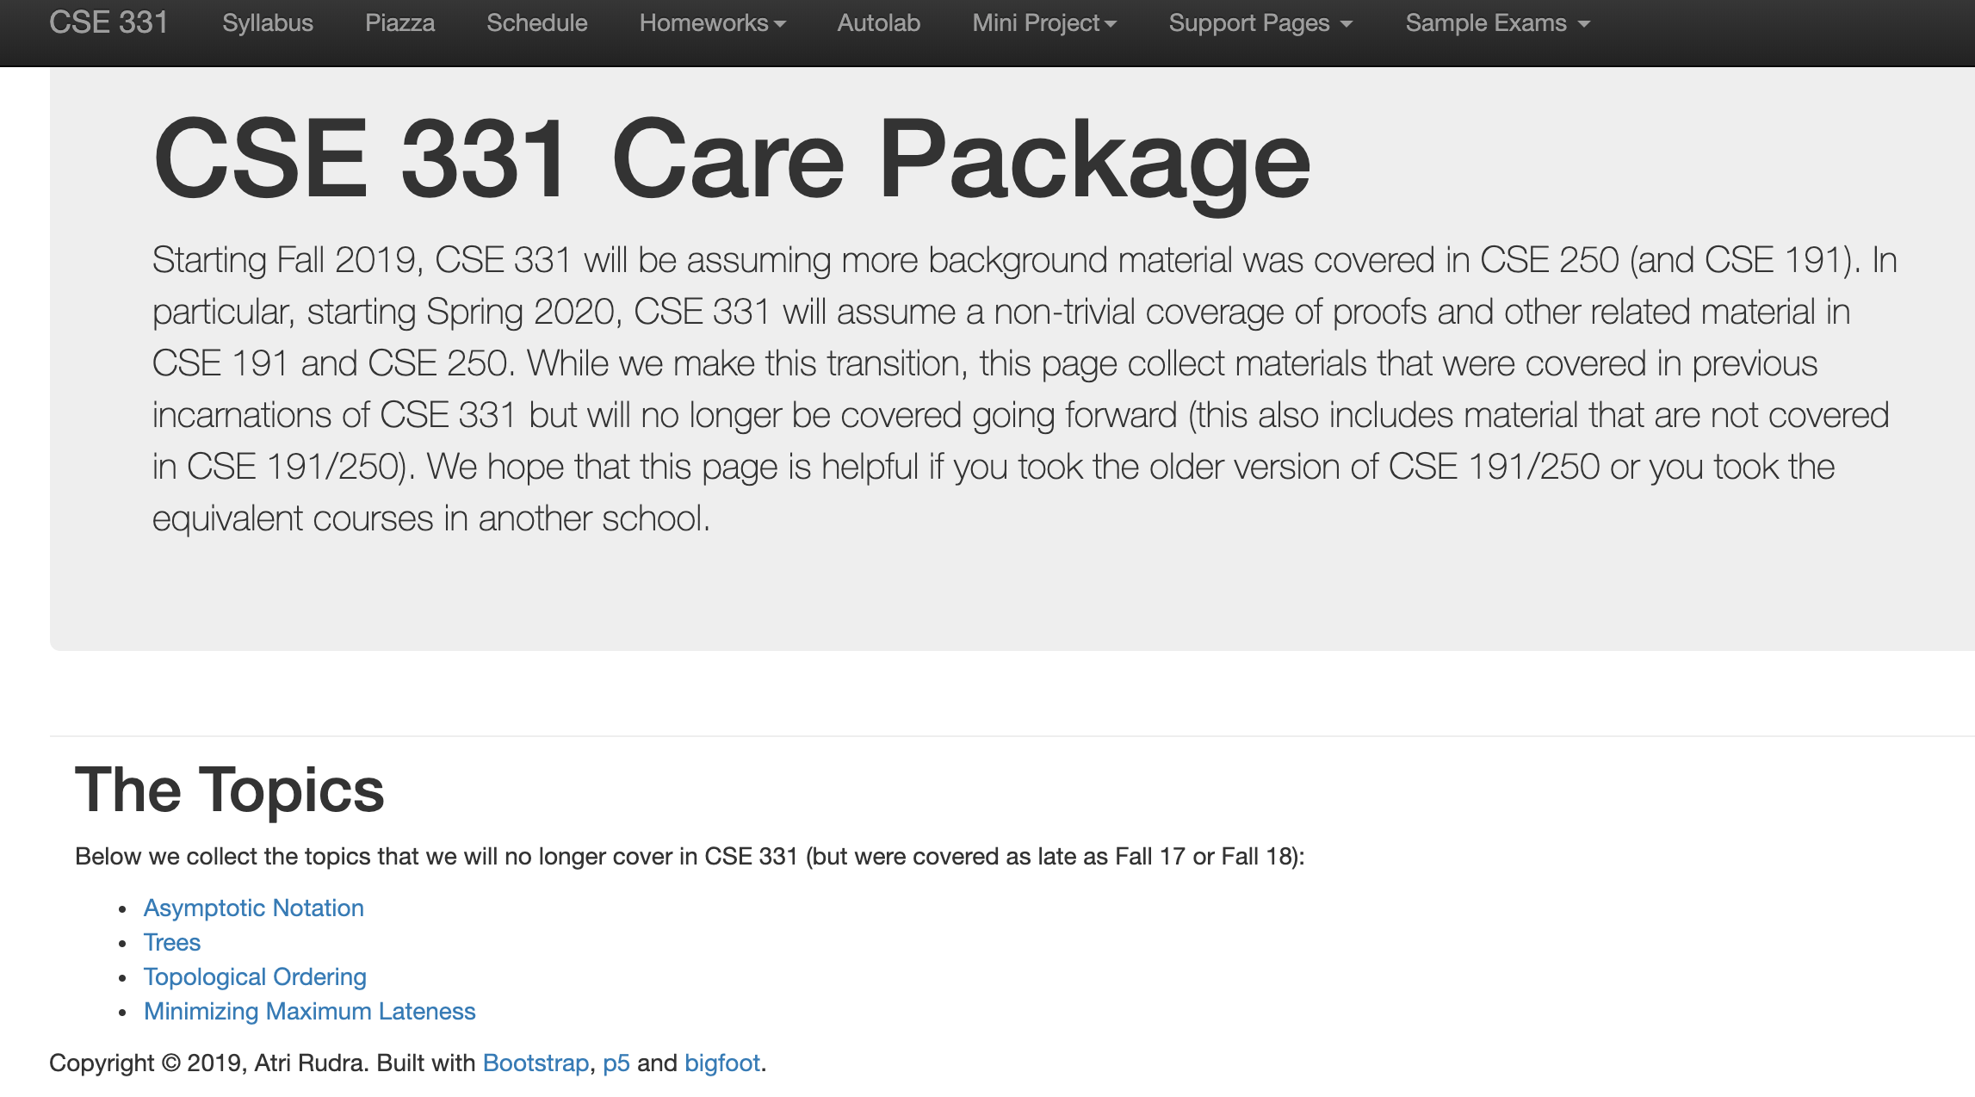
Support page

Slide 29
C++ vs Java/Python
Use Java/Python if you are just as comfortable with as C++

Slide 30
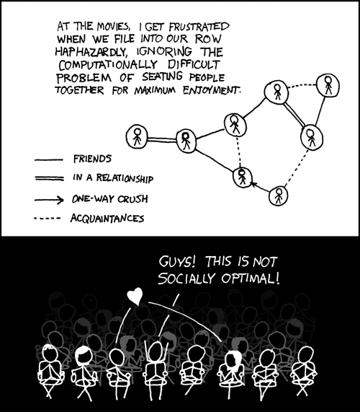
This course: how to solve problems!
http://xkcd.com/173/

