Slide 1
Pointers and Arrays
And C-style strings

Slide 2
Agenda
Memory regions
Pointers
Arrays
Arrays and Pointers

Slide 3
Memory regions
Each C++ variable is stored in a memory region
The size of the region depends on the variable’s type

Slide 4
Each Variable is Stored in a Memory Region
string a = “cse 250”;
int myint = 15;
0x000000
15
4 bytes long
“cse 250”
0xf3c453
0xfa4bc3
Not quite correct, but ok for now
0xffffff

Slide 5
Sizes of Some Basic Data Types
cout << "sizeof(char) = " << sizeof(char) << endl; cout << "sizeof(char&) = " << sizeof(char&) << endl; cout << "sizeof(int) = " << sizeof(int) << endl; cout << "sizeof(int&) = " << sizeof(int&) << endl; cout << "sizeof(long int) = " << sizeof(long int) << endl; cout << "sizeof(bool) = " << sizeof(bool) << endl; cout << "sizeof(float) = " << sizeof(float) << endl; cout << "sizeof(double) = " << sizeof(double) << endl; cout << "sizeof(string) = " << sizeof(string) << endl;

Slide 6
Where in memory? Use “address of” op
#include <iostream>
using namespace std;
int main() {
int a = 12345;
cout << "Address of a is at: " << &a << endl;
// get something like 0x7fff6425d7c4
return 0;
}
32-bit architecture: an address is 4 bytes long
64-bit architecture: an address is 8 bytes long

Slide 7
Pointers
A pointer is a variable that holds a memory address
We often want a pointer to a particular type
Pointers are extremely powerful (java hides it from us!)

Slide 8
Declaring Pointers
int *i_ptr; // i_ptr is a pointer to an integer
char *c_ptr; // c_ptr is a pointer to a character
string *s_ptr; // s_ptr is a pointer to a string
cout << "sizeof(i_ptr) = " << sizeof(char*) << endl;
cout << "sizeof(char*) = " << sizeof(char*) << endl;
cout << "sizeof(int*) = " << sizeof(int*) << endl;
cout << "sizeof(string*) = " << sizeof(string*) << endl;

Slide 9
Assigning and Dereferencing Pointers
int x = 10;
int *i_ptr;
i_ptr = &x; // to the 1st byte of the 4 bytes long x.
cout << "x = " << x << endl; // this prints x = 10
cout << "x = " << *i_ptr << endl; // also prints x = 10
*i_ptr = 20;
cout << "x = " << x << endl; // this prints x = 20
cout << "x = " << *i_ptr << endl; // also prints x = 20
int y = 30;
i_ptr = &y;
cout << "y = " << *i_ptr << endl; // this prints y = 30
*i_ptr = 40
cout << "y = " << y << endl; // this prints y = 40

Slide 10
Visualize
0x000000
int myint = 15
15
0xf3c453
0xf3c453
int* ptr = &myint
0xffffff

Slide 11
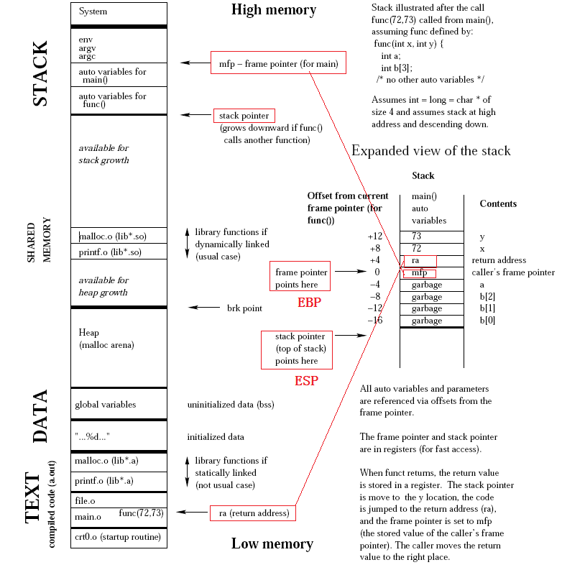

Slide 12
Pointers and References
// pt.cpp: testing pointers #include <iostream> using namespace std; void swap(int *a, int *b) { int temp=*a; *a=*b; *b=temp; } int main() { int x = 1, y=9; swap(&x, &y); cout << "x = " << x << endl; // x = 9 cout << "y = " << y << endl; // y = 1 return 0; }
Note that the pointers a, b are passed by value

Slide 13
Pointers to Objects and the -> operator
void print_reversed_sentence(const string* s_ptr) { int start; int end = s_ptr->length()-1; // or end = (*s_ptr).length() - 1 for (start = s_ptr->length()-1; start>=0; start--) { if ( ( (*s_ptr)[start] == ' ') && (start < end) ) { cout << s_ptr->substr(start+1,end-start) << ' '; end = start-1; } } if (start < end) cout << s_ptr->substr(start+1,end-start+1) << endl; }
(*obj_ptr).member is the same as obj->member

Slide 14
Pointer to Pointer, Ad Infinitum
#include <iostream> using namespace std; void swap(string **a, string **b)
{ string* temp = *a; *a = *b; *b = temp; } int main() { string first("David"); string last("Blaine"); string* p1 = &first; string* p2 = &last; swap(&p1, &p2); cout << "p1 points to " << *p1 << endl; // "Blaine" cout << "p2 points to " << *p2 << endl; // "David" return 0; }

Slide 15
Arrays
Array size must be a constant expression
Some extension allows “dynamic” size, not recommended
Array name can be used as a pointer to the first element of the array
(here we’re talking about pure array, there is also an std::array object in C++11)

Slide 16
Definition and initialization
int main() { const size_t s = 5; int A[s]; int B[5] = {1, 2, 3, 4, 5}; int C[] = {1, 2, 3, 4, 5}; // the same as saying int C[5] for (size_t i=0; i<s; i++) { A[i] = i*i; B[i] += A[i]; C[i] += B[i]; } for (size_t i=0; i<s; i++) cout << C[i] << ' '; cout << endl; return 0; }

Slide 17
Extension – not recommended
int s = 5; int A[s]; // should not be allowed, but OK with g++ 4.x

Slide 18
C-style strings
char name[] = "David”;
// name has 6 elements, the last is implicitly '\0’
cout << sizeof(name) << endl; // prints 6
int i=0;
while (name[i] != '\0’)
cout << name[i++];
cout << endl;
cout << name << endl; // same effect
char name[5] = "David"; // compilation error

Slide 19
Initializing C-style string (char array)
#include <iostream> using namespace std; int main() { char name[] = "David"; char another[] = { 'D', 'a', 'v', 'i', 'd', '\0' }; cout << name << endl; cout << another << endl; return 0; }

Slide 20
String literals
The expression "David" is called a string literal
char name[] = "This is a very long " "name and thus won't fit " "on a line"; cout << name; // get "This is a very long name and thus won't fit in a line"

Slide 21
Character arrays with ‘\0’ in the middle
Perfectly fine to have them; just be careful!
char sa[] = "Only up to here\0The rest can still be printed";
cout << sa << endl; for (i=0; i< sizeof(sa); i++) { if (sa[i] != '\0') cout << sa[i]; else cout << "[NULL CHAR]"; } cout << endl; string str_obj = sa; cout << str_obj; // prints "Only up to here"

Slide 22
Why do we care about C-style strings?
They are very efficient
Necessary in system programming
Some C++ functions take C-style string arguments

Slide 23
Command line arguments
int main() int main(void) int main(int argc, char **argv) int main(int argc, char *argv[])

Slide 24
Multidimensional Arrays
const int m=2; const int n=3; int A[m][n] = { {1, 2, 3}, {4, 5, 6} }; // initialization must have bounds for all dimension, except the first int B[][n] = { {10, 20, 30}, {40, 50, 60} }; int C[m][n]; int i, j; for (i=0; i<m; i++) for (j=0; j<n; j++) C[i][j] = A[i][j] + B[i][j]; for (i=0; i<m; i++) { for (j=0; j<n; j++) { cout << setw(2) << C[i][j] << ' '; } cout << endl; }

Slide 25
Arrays and Pointers
Array name can be used as pointer
We can navigate arrays using pointer arithmetic
Pointers and arrays can be used interchangably in argument passing
An array name can be thought of as a constant pointer

Slide 26
Array name as constant pointer
int a[5] = {1,2,3,4,5}; int* i_ptr = &a[0]; // i_ptr points to a[0] i_ptr = a; // i_ptr points to a[0], equivalent to the above line *i_ptr = 10; // now a[0] == 10
int a[5]; int* i_ptr; i_ptr = a; // perfectly fine! a = i_ptr; // compilation error!

Slide 27
Traversing array using pointer arithmetic
int A[5] = {1, 2, 3, 4, 5}; int i; int* int_ptr; // we can traverse A like this for (i=0; i<5; i++)
cout << A[i] << ' '; // or like this for (int_ptr=A; int_ptr != A+5; int_ptr++)
cout << *int_ptr << ' ';

Slide 28
Pointer arithmetic
int a = 123; int* int_ptr = &a; cout << "+0:" << int_ptr << endl; // +0:0x7fff6a9387c4 cout << "+1:" << int_ptr+1 << endl; // +1:0x7fff6a9387c8 cout << "+2:" << int_ptr+2 << endl; // +2:0x7fff6a9387cc

Slide 29
Pointer & array used interchangably in argument passing
void ps1(char* s) { while (*s != '\0') { cout << *s; s++; } } void ps2(char s[]) { while (*s != '\0') { cout << *s; s++; } } int main() { char* s1 = new char[7]; // allocate an array of 7 chars char s2[] = "abcde\n"; int i=0; while (s2[i] != '\0') { s1[i] = s2[i]; i++; } ps1(s1); ps1(s2); // valid ps2(s1); ps2(s2); // also valid delete [] s1;
}

