Slide 1
Binary Trees & Binary Search Trees
Binary tree
Expression tree, Huffman tree
Tree traversals
Binary search tree
Random binary search tree
Optimal binary search tree

Slide 2
Binary Trees
Extremely useful data structure
Special cases include
Huffman tree
Expression tree
Decision tree (in machine learning)

Slide 3
Binary Trees
5
Root
left
right
4
2
Depth 2
right
3
0
9
Height 3
3, 7, 1, 9 are leaves
8
1
5, 4, 0, 8, 2 are internal nodes
Height 1
7

Slide 4
Ancestors and Descendants
5
4
2
3
0
9
1, 0, 4, 5 are ancestors of 1
8
1
0, 8, 1, 7 are descendants of 0
7

Slide 5
Expression Trees
4*(3+2) – (6-3)*5/3
-
*
/
4
+
*
3
3
2
-
5
6
3

Slide 6
Character Encoding
UTF-8 encoding:
Each character occupies 8 bits
For example, ‘A’ = 0x0041
A text document with 10⁹ characters is 10⁹ bytes long
But characters were not born equal

Slide 7
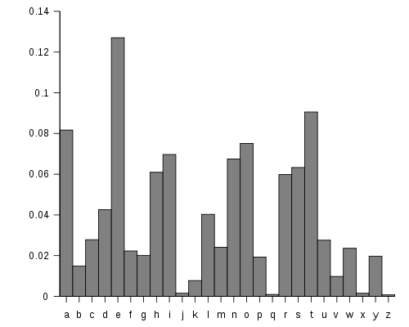
English Character Frequencies

Slide 8
Variable-Length Encoding: Idea
Encode letter E with fewer bits, say b_{E} bits
Letter J with many more bits, say b_{J} bits
We gain space if
where f is the frequency vector
Problem: how to decode?

Slide 9
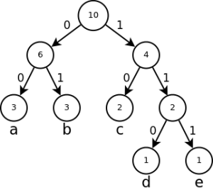
One Solution: Prefix-Free Codes

Slide 10
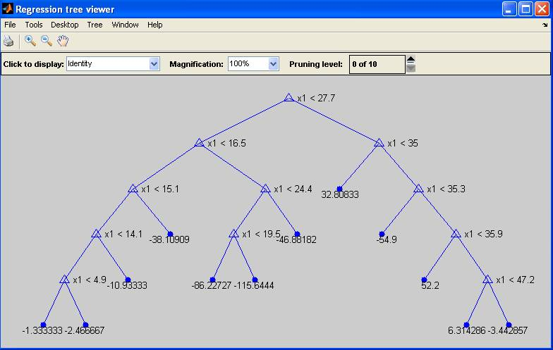
Regression Tree (in Matlab)

Slide 11
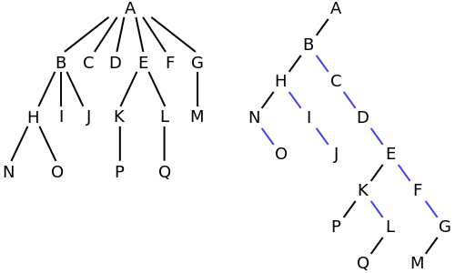
Any Tree can be “Encoded” as a Binary Tree

Slide 12
Tree Walks/Traversals
There are many ways to traverse a binary tree
(reverse) In order
(reverse) Post order
(reverse) Pre order
Level order = breadth first

Slide 13
A BTNode in C++
template <typename Item>
struct BTNode {
Item payload;
BTNode* left;
BTNode* right;
BTNode(const Item& item = Item(),
BTNode* l = NULL,
BTNode* r = NULL)
: payload(item), left(l), right(r) {}
};
Item payload
left
right

Slide 14
Inorder Traversal
Inorder-Traverse(BTNode root)
Inorder-Traverse(root->left)
Visit(root)
Inorder-Traverse(root->right)
Also called the (left, node, right) order

Slide 15
Inorder Printing in C++
template <typename T>
void inorder_print(BTNode<T>* root) {
if (root != NULL) {
inorder_print(root->left);
cout << root->payload << " ";
inorder_print(root->right);
}
}
“Visit” the node

Slide 16
In Picture
5
3
4
4
2
8
7
3
0
9
0
1
8
1
5
9
2
7

Slide 17
Run Time
Suppose “visit” takes O(1)-time, say c seconds
n_{l} = # of nodes on the left sub-tree
n_{r} = # of nodes on the right sub-tree
Note: n - 1 = n_{l} + n_{r}
T(n) = T(n_{l}) + T(n_{r}) + c
Induction: T(n) ≤ cn, i.e. T(n) = O(n)
T(n) ≤ cn_{l} + cn_{r} + c = c(n-1) + c = cn

Slide 18
Reverse Inorder Traversal
RevInorder-Traverse(root->right)
Visit(root)
RevInorrder-Traverse(root->left)
The (right, node, left) order

Slide 19
The other 4 traversal orders
Preorder: (node, left, right)
Reverse preorder: (node, right, left)
Postorder: (left, right, node)
Reverse postorder: (right, left, node)
We’ll talk about level-order later

Slide 20
What is the preorder output for this tree?
5
4
2
3
0
9
8
1
5
4
3
0
8
7
1
2
9
7

Slide 21
What is the postorder output for this tree?
5
4
2
3
0
9
8
1
3
7
8
1
0
4
9
2
5
7

Slide 22
Questions to Ponder
template <typename T>
void inorder_print(BTNode<T>* root) {
if (root != NULL) {
inorder_print(root->left);
cout << root->payload << " ";
inorder_print(root->right);
}
}
Can you write the above routine without the recursive calls?
Use a stack
Don’t use a stack

Slide 23
Exercise
Write iterative versions of all 6 traversal order routines

Slide 24
Reconstruct the tree from inorder+postorder
Inorder
3
4
8
7
0
1
5
9
2
Preorder
5
4
3
0
8
7
1
2
9
5

Slide 25
Questions to Ponder
Can you reconstruct the tree given its postorder and preorder sequences?
How about inorder and reverse postorder?
How about other pairs of orders?
How many trees are there which have the same in/post/pre-order sequence? (suppose payloads are distinct)

Slide 26
Number of trees with given inorder sequence
Catalan numbers

Slide 27
What is a traversal order good for?
Many things
E.g., Evaluate(root) of an expression tree
If root is an INTEGER token, return the integer
Else
A = Evaluate(root->left)
B = Evaluate(root->right)
Return A root->payload B
What traversal order is that?

Slide 28
Level-Order Traversal
5
4
2
3
0
9
8
1
5
4
2
3
0
9
8
1
7
7

Slide 29
How to do level-order traversal?
5
5
2
4
2
4
9
3
9
3
0
0
1
8
1
8
A (FIFO) Queue (try deque in C++)
7
7

Slide 30
Level-Order Print in C++
template <typename T>
void levelorder_print(BTNode<T>* root) {
if (root != NULL) {
deque<BTNode<T>*> node_q;
node_q.push_front(root);
while (!node_q.empty()) {
BTNode<T>* cur = node_q.back();
node_q.pop_back();
if (cur->left != NULL)
node_q.push_front(cur->left);
if (cur->right != NULL)
node_q.push_front(cur->right);
cout << cur->payload << " ";
}
cout << endl;
}
}

Slide 31
Binary Search Trees
Fundamental data structure for
Storing (key, value) pairs
Allowing for efficient insertion, deletion, and search for values given keys

Slide 32
Managing (Key, Value) Pairs
(username, password)
MapReduce framework
Domain Name System
Database indexing
Dictionary lookup
Kademlia DHT
Associative arrays (remember “string”->func*)
Binary Search Trees is a good data structure for maintaining (key, value) pairs

Slide 33
Binary Search Tree & Its Main Property
Key = x Value
BST keys ≤ x
BST keys ≥ x

Slide 34
Example BST
8
3
9
1
6
8
12
4
7
10
6
9
11
Inorder_print lists all keys in non-decreasing order!

Slide 35
Basic Operations
Search(tree, key)
Minimum(tree), Maximum(tree)
Successor(tree, node) Predecessor(tree, node)
Insert(tree, node) – node has (key, value) Delete(tree, node) – node has (key, value)

Slide 36
BSTNode in C++
template <typename Key, typename Value>
struct BSTNode {
Key key;
Value value;
BSTNode* left;
BSTNode* right;
BSTNode* parent;
BSTNode(const Key& k, const Value& v,
BSTNode* p = NULL,
BSTNode* l = NULL,
BSTNode* r = NULL)
: key(k), value(v), parent(p), left(l), right(r) {}
};

Slide 37
Search in a BST
5
7
8
3
9
1
6
8
12
0
4
7
10
6
9
11

Slide 38
Minimum and Maximum
8
3
9
1
6
8
12
0
4
7
10
6
9
11

Slide 39
Successor
9
3
11
1
7
10
15
0
4
8
13
6
12
14
If v has a right branch: successor(v) = minimum(right-branch)
Else, successor(v) = the first ancestor u with another ancestor as a left child

Slide 40
Successor in C++
template <typename Key, typename Value>
BSTNode<Key, Value>* successor(BSTNode<Key, Value>* node) {
if (node == NULL)
return NULL;
if (node->right != NULL)
return minimum(node->right);
BSTNode<Key, Value>* p = node->parent;
while (p != NULL && p->right == node) {
node = p;
p = p->parent;
}
return p; // could be NULL
}

Slide 41
Predecessor
9
3
11
1
7
10
15
0
4
8
13
6
12
14
If v has a left branch: predecessor(v) = maximum(left-branch)
Else, predecessor(v) = the first ancestor u with another ancestor as a right child

Slide 42
Insert
5
9
3
11
1
7
10
15
0
4
8
13
6
12
14

Slide 43
Delete – Node has ≤ 1 Child
9
3
11
1
7
10
15
0
4
8
13
6
12
14

Slide 44
Delete – Node Has 2 Children
9
3
11
1
7
10
15
0
4
8
13
6
12
14

Slide 45
Run Times of Basic Operations
Search(tree, key)
Minimum(tree) Maximum(tree)
Successor(tree, node) Predecessor(tree, node)
Insert(tree, node) – node has (key, value) Delete(tree, node) – node has (key, value)
All run in time O(h)
h is the height of the tree

Slide 46
Range Query
range_query(tree, x, y)
Report all nodes where x ≤ key ≤ y
A very fundamental query in databases
E.g., report all people with x ≤ salary ≤ y
How do we do it?
How much time does it take?

Slide 47
Assume All Keys are Distinct, [x,y] = [4,13]
9
3
11
1
7
10
15
0
5
8
13
4
6
12
14
Run time: O(h + |output size|)

Slide 48
Random and Optimal BSTs
Height of random BST
Optimal BST

Slide 49
Random BST
Consider storing a dictionary using a BST
Randomize the word order
Insert (word, meaning) pairs into the BST
Is this (with high probability) a good data structure for dictionary management?

Slide 50
Generate a Random BST
BSTNode<int, string>* random_bst(size_t base, size_t n,
BSTNode<int, string>* p)
{
if (n <= 0) return NULL;
size_t root_rank = rand() % n;
ostringstream oss;
oss << "Node" << base + root_rank;
BSTNode<int, string>* node =
new BSTNode<int, string>(base+root_rank,
oss.str(), p);
node->left = random_bst(base, root_rank, node);
node->right = random_bst(base+root_rank+1,
n-root_rank-1, node);
return node;
}

Slide 51
Yes
It can be shown that the expected height of a random BST is O(log n)
And the variance is extremely small

Slide 52
Optimal BST
Suppose we know the frequencies (or probabilities) of key searches
E.g., translating English into Vietnamese
Build a BST which yields the minimum expected search time
Keys searched more often should be closer to the root
Dynamic programming solves this problem!

