Slide 1
Linked Lists
Singly & doubly linked list
XOR lists
Skip lists
C++ iterators

Slide 2
Performance of UBVector
The good
Dynamic size
[idx], push_back, pop_back take O(1)
Sorting takes O(n log n)
Allow for binary search
The bad
Insert & delete take O(n)
Waste O(n) space
Requires contiguous memory block
Shouldn’t be used to implement a stack/queue

Slide 3
Linked lists
Overcome the bad of vectors/arrays
Insert & delete in O(1)-time
Does not need contiguous block of memory
Can still grow/shrink dynamically
Can still sort in O(n log n), with care
Core data structure for LISP/SCHEME
However
No random access
Can’t do binary search even if list is sorted
Unless we use more advanced linked lists

Slide 4
Basic Singly Linked List
struct Node {
Node* next;
string payload;
Node(string pl="", Node* n_ptr=NULL) :
payload(pl), next(n_ptr) {};
};
SLL Node Structure
payload | “some string”
next
Node
“another string”

Slide 5
Constructing a SLL
int main() {
Node* head = new Node("deep");
head = new Node("the", head);
head = new Node("in", head);
head = new Node("rolling", head);
print_list(head);
return 0;
}
head
head
head
head
Node
“in”
Node
“the”
Node
“deep”
Node
“rolling”

Slide 6
Traverse a SLL, Iteratively
void print_list(Node* ptr) {
while (ptr != NULL) {
cout << ptr->payload << " ";
ptr = ptr->next;
}
cout << endl;
}
Recursive version?

Slide 7
Traverse a SLL, Recursively
void print_list(Node* ptr) {
if (ptr != NULL) {
cout << ptr->payload << " ";
print_list(ptr->next);
} else {
cout << endl;
}
}

Slide 8
Linear Search
Node* iterative_search(const string& key, Node* ptr) {
while (ptr != NULL && ptr->payload != key)
ptr = ptr->next;
return ptr;
}
Node* recursive_search(const string& key, Node* ptr) {
if (ptr != NULL && ptr->payload != key)
return recursive_search(key, ptr->next);
else
return ptr;
}

Slide 9
Delete: Must Have a Predecessor Pointer
void del_successor(Node* ptr) {
if (ptr == NULL || ptr->next == NULL) return;
Node* temp = ptr->next;
ptr->next = temp->next;
delete temp; // always remember this
}
ptr
temp
temp->next
Node
“b”
Node
“c”
Node
“d”
Node
“a”
11/8/12
CSE 250, Fall 2012, SUNY Buffalo, (C) Hung Q. Ngo
8

Slide 10
Reverse a Linked List
Given a head pointer, return the head pointer to the reversed list
Node* reverse_sll(Node* head) {
Node *prev = NULL, *temp;
while (head != NULL) {
temp = head->next;
head->next = prev;
prev = head;
head = temp;
}
return prev;
}

Slide 11
Insert Into a Sorted List
Node* insert_into_sorted_list(Node* head, Node* node_ptr) {
// insert in the beginning
if (head == NULL || node_ptr->payload < head->payload) {
node_ptr->next = head;
return node_ptr;
}
// insert in the middle, first look for spot
Node *prev = head, *temp = head->next;
while (temp != NULL && temp->payload < node_ptr->payload) {
prev = temp;
temp = temp->next;
}
prev->next = node_ptr;
node_ptr->next = temp;
return head;
}

Slide 12
Properties of Singly Linked Lists
Delete & Insert: O(1)-time if we know where
Especially great if we operate on the two ends
O(1)-time for stack & queue operations
Search: O(n)-time even if list already sorted
Waste O(n)-space for all the pointers
However, this O(n) is only on the pointers!
What about sorting? Assignment 6!
Insertion sort: O(n²)
Merge sort: O(n log n)

Slide 13
Properties of Singly Linked Lists
Many other types of computation can be done iteratively (or recursively sometimes)
Count # of members in the list
Remove duplicate elements
Swap 2 sub-blocks of two lists
Remove elements of a given key
Etc.
Can’t go backward

Slide 14
Doubly Linked Lists
Can go back and forth
Waste one extra pointer per element
DLL Node
“a”
DLL Node
“b”
DLL Node
“c”

Slide 15
XOR Linked List
Can go back and forth
One extra “pointer” per element
Maintain two consecutive pointers to traverse
prev
cur
next
Node
“a”
Node
“b”
prev^next
Node
“c”

Slide 16
Main Problem with Linked List
Operation | Time
Search | O(n)
Insert | Search + O(1)
Delete | Search + O(1)
Insert front/back | O(1)
Delete front/back | O(1)

Slide 17
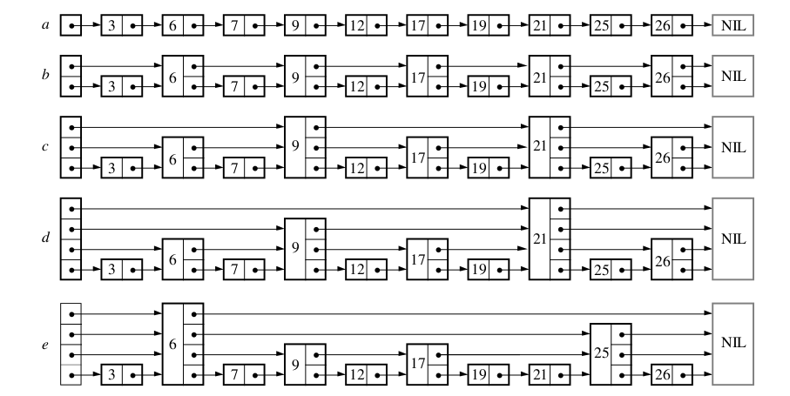
Skip List (William Pugh, 1990)

Slide 18
Properties
Search(key)
Find two consecutive elements at top level where key falls in between
Go down one level and repeat
O(log n) time for a “balanced” skip list
Space wastage

Slide 19
Problem & Solution
Insert/delete will destroy the “balance” of the skip list
Could rebalance once in a while, O(n)-time.
Solution
Randomization!
After insertion, flip a coin and float the new element up one level with probability ½
Works very well on average

