Slide 1
Binary Trees & Binary Search Trees
Binary tree
Expression tree, Huffman tree
Tree traversals
Binary search tree
Random binary search tree
Optimal binary search tree

Slide 2
Binary Trees
Extremely useful data structure
Special cases include
Huffman tree
Expression tree
Decision tree (in machine learning)

Slide 3
Binary Trees
5
Root
left
right
4
2
Depth 2
right
3
0
9
Height 3
3, 7, 1, 9 are leaves
8
1
5, 4, 0, 8, 2 are internal nodes
Height 1
7

Slide 4
Ancestors and Descendants
5
4
2
1, 0, 4, 5 are ancestors of 1
0, 8, 1, 7 are descendants of 0
3
0
9
8
1
7

Slide 5
Expression Trees
4*(3+2) – (6-3)*5/3
-
*
/
4
+
*
3
3
2
-
5
6
3

Slide 6
Character Encoding
UTF-8 encoding:
  Each character occupies 8 bits
  For example, ‘A’ = 0x0041
A text document with 10⁹ characters is 10⁹ bytes long
But characters were not born equal

Slide 7
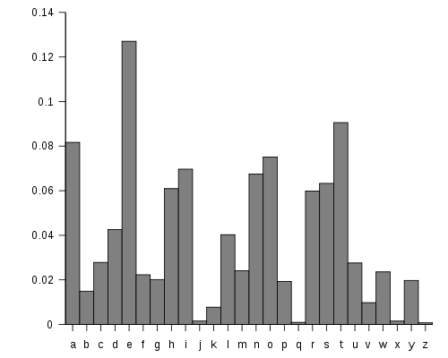
English Character Frequencies

Slide 8
Variable-Length Encoding
Encode letter E with fewer bits, say b_{E} bits
Letter J with many more bits, say b_{J} bits
We gain space if
b_{E}*f_{E} + b_{J}*f_{J} < 8f_{E} + 8f_{J}
Where f is the frequency vector
Problem: how to decode?

Slide 9
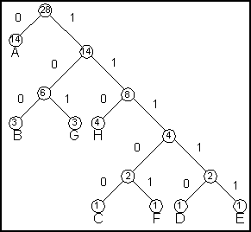
One Solution: Prefix-Free Codes

Slide 10
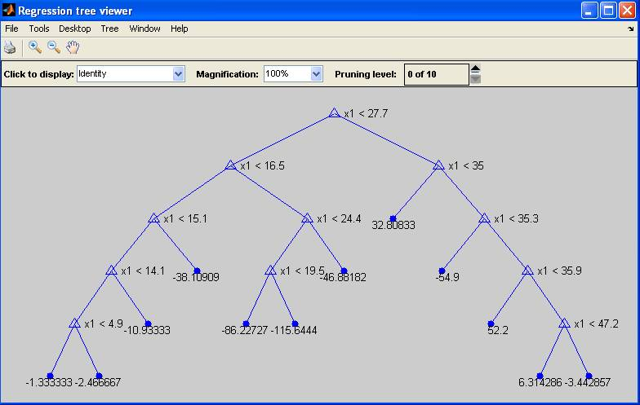
Regression Tree (in Matlab)

Slide 11
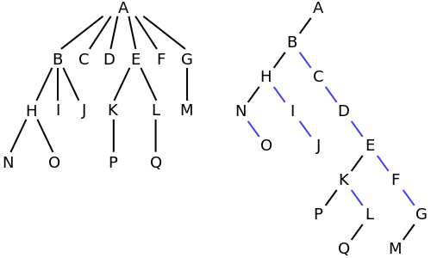
Any Tree can be “Encoded” as a Binary Tree

Slide 12
Tree Walks/Traversals
There are many ways to traverse a binary tree
(reverse) In order
(reverse) Post order
(reverse) Pre order
Level order = breadth first

Slide 13
A BTNode in C++
template <typename Item>
struct BTNode {
Item payload;
BTNode* left;
BTNode* right;
BTNode(const Item& item = Item(),
BTNode* l = NULL,
BTNode* r = NULL)
: payload(item), left(l), right(r) {}
};
Item payload
Left
Right

Slide 14
Inorder Traversal
Function: Inorder-Traverse(BTNode root)
Inorder-Traverse(root->left)
Visit(root)
Inorder-Traverse(root->right)
Also called the (left, node, right) order

Slide 15
Inorder Printing in C++
template <typename T>
void inorder_print(BTNode<T>* root) {
if (root != NULL) {
inorder_print(root->left);
cout << root->payload << " ";
inorder_print(root->right);
}
}

Slide 16
In Picture
5
3
4
4
2
8
7
3
0
9
0
1
8
1
5
9
2
7

Slide 17
Reverse Inorder Traversal
RevInorder-Traverse(root->right)
Visit(root)
RevInorrder-Traverse(root->left)
The (right, node, left) order

Slide 18
The other 4 traversal orders
Preorder: (node, left, right)
Reverse preorder: (node, right, left)
Postorder: (left, right, node)
Reverse postorder: (right, left, node)
We’ll talk about level-order later

Slide 19
What is the preorder output for this tree?
5
4
2
3
0
9
8
1
5
4
3
0
8
7
1
2
9
7

Slide 20
What is the postorder output for this tree?
5
4
2
3
0
9
8
1
3
7
8
1
0
4
9
2
5
7

Slide 21
Reconstruct the tree from inorder+postorder
Inorder
3
4
8
7
0
1
5
9
2
Preorder
5
4
3
0
8
7
1
2
9
5

Slide 22
Questions to Ponder
Can you reconstruct the tree given its postorder and preorder sequences?
How about inorder and reverse postorder?
How about other pairs of orders?
How many trees are there which have the same in/post/pre-order sequence? (suppose payloads are distinct)

Slide 23
Number of trees with given inorder sequence
Catalan numbers

Slide 24
What is it good for?
Many things
For example, Evaluate(root) of an expression tree
  If root is an INTEGER token, return the integer
  Else
    A = Evaluate(root->left)
    B = Evaluate(root->right)
    Return A root->payload B
What traversal order is that?

Slide 25
Questions to Ponder
template <typename T>
void inorder_print(BTNode<T>* root) {
if (root != NULL) {
inorder_print(root->left);
cout << root->payload << " ";
inorder_print(root->right);
}
}
Can you write the above routine without the recursive calls?
Use a stack
Don’t use a stack

Slide 26
Level-Order Traversal
5
4
2
3
0
9
8
1
5
4
2
3
0
9
8
1
7
7

Slide 27
How to do level-order traversal?
5
5
2
4
2
4
9
3
9
3
0
0
1
8
1
8
A (FIFO) Queue
(try deque in C++)
7
7

Slide 28
Binary Search Trees
Fundamental data structure for
Storing (key, value) pairs
Allowing for efficient insertion, deletion, and search for values given keys

Slide 29
Managing (Key, Value) Pairs
(username, password)
MapReduce framework
Domain Name System
Database indexing
Dictionary lookup
Kademlia DHT
Associative arrays (remember “string”->func*)
Binary Search Trees is a good data structure for maintaining (key, value) pairs

Slide 30
Binary Search Tree & Its Main Property
Key = x
Value
BST
keys ≤ x
BST
keys ≥ x

Slide 31
Example BST
8
3
9
1
6
8
12
4
7
10
6
9
11
Inorder print keys gives all keys in non-decreasing order

Slide 32
Main Operations
Search(tree, key)
Minimum(tree), Maximum(tree)
Successor(tree, node), Predecessor(tree, node)
Insert(tree, node) – node has (key, value)
Delete(tree, node) – node has (key, value)

Slide 33
BSTNode in C++
template <typename Key, typename Value>
struct BSTNode {
Key key;
Value value;
BSTNode* left;
BSTNode* right;
BSTNode* parent;
BSTNode(const Key& k, const Value& v,
BSTNode* p = NULL,
BSTNode* l = NULL,
BSTNode* r = NULL)
: key(k), value(v), parent(p), left(l), right(r) {}
};

Slide 34
Search in a BST
5
7
8
3
9
1
6
8
12
0
4
7
10
6
9
11

Slide 35
Minimum and Maximum
8
3
9
1
6
8
12
0
4
7
10
6
9
11

Slide 36
Successor
9
3
11
1
7
10
15
0
4
8
13
6
12
14
If v has a right branch:
successor(v) = minimum(right-branch)
Else,
successor(v) = the first ancestor u with another ancestor as a left child

Slide 37
Successor in C++
template <typename Key, typename Value>
BSTNode<Key, Value>* successor(BSTNode<Key, Value>* node) {
if (node == NULL)
return NULL;
if (node->right != NULL)
return minimum(node->right);
BSTNode<Key, Value>* p = node->parent;
while (p != NULL && p->right == node) {
node = p;
p = p->parent;
}
return p; // could be NULL
}

Slide 38
Predecessor
9
3
11
1
7
10
15
0
4
8
13
6
12
14
If v has a left branch:
predecessor(v) = maximum(left-branch)
Else,
predecessor(v) = the first ancestor u with another ancestor as a right child

Slide 39
Insert
5
9
3
11
1
7
10
15
0
4
8
13
6
12
14

Slide 40
Delete – Node has ≤ 1 Child
9
3
11
1
7
10
15
0
4
8
13
6
12
14

Slide 41
Delete – Node Has 2 Children
9
3
11
1
7
10
15
0
4
8
13
6
12
14

Slide 42
Run Times of Main Operations
Search(tree, key)
Minimum(tree), Maximum(tree)
Successor(tree, node), Predecessor(tree, node)
Insert(tree, node) – node has (key, value)
Delete(tree, node) – node has (key, value)
All run in time O(h)
  h is the height of the tree

Slide 43
Random and Optimal BSTs
Height of random BST
Optimal bst

Slide 44
Random BST
Consider storing a dictionary using a BST
Randomize the words
Insert (word, meaning) pairs into the BST
Is this (with high probability) a good data structure for dictionary management?

Slide 45
Generate a Random BST
BSTNode<int, string>* random_bst(size_t base, size_t n,
BSTNode<int, string>* p)
{
if (n <= 0) return NULL;
size_t root_rank = rand() % n;
ostringstream oss;
oss << "Node" << base + root_rank;
BSTNode<int, string>* node =
new BSTNode<int, string>(base+root_rank,
oss.str(), p);
node->left = random_bst(base, root_rank, node);
node->right = random_bst(base+root_rank+1,
n-root_rank-1, node);
return node;
}

Slide 46
Yes
It can be shown that the expected height of a random BST is O(log n)
And the variance is extremely small

Slide 47
Optimal BST
Suppose we know the frequencies (or probabilities) of key searches
  E.g., translating English into Vietnamese
Build a BST which yields the minimum expected search time
  Keys searched more often should be closer to the root
Dynamic programming solves this problem!

