Slide 1
AIS 220
Foundational Mathematics for AI
Lecture 1
Hi!
Kenneth (Kenny) Joseph

Slide 2
Welcome!
Plan:
  Introduce ourselves
  Tell you a little about what the course is and is not
  Logistics
  Break
  Bit more about the course

Slide 3
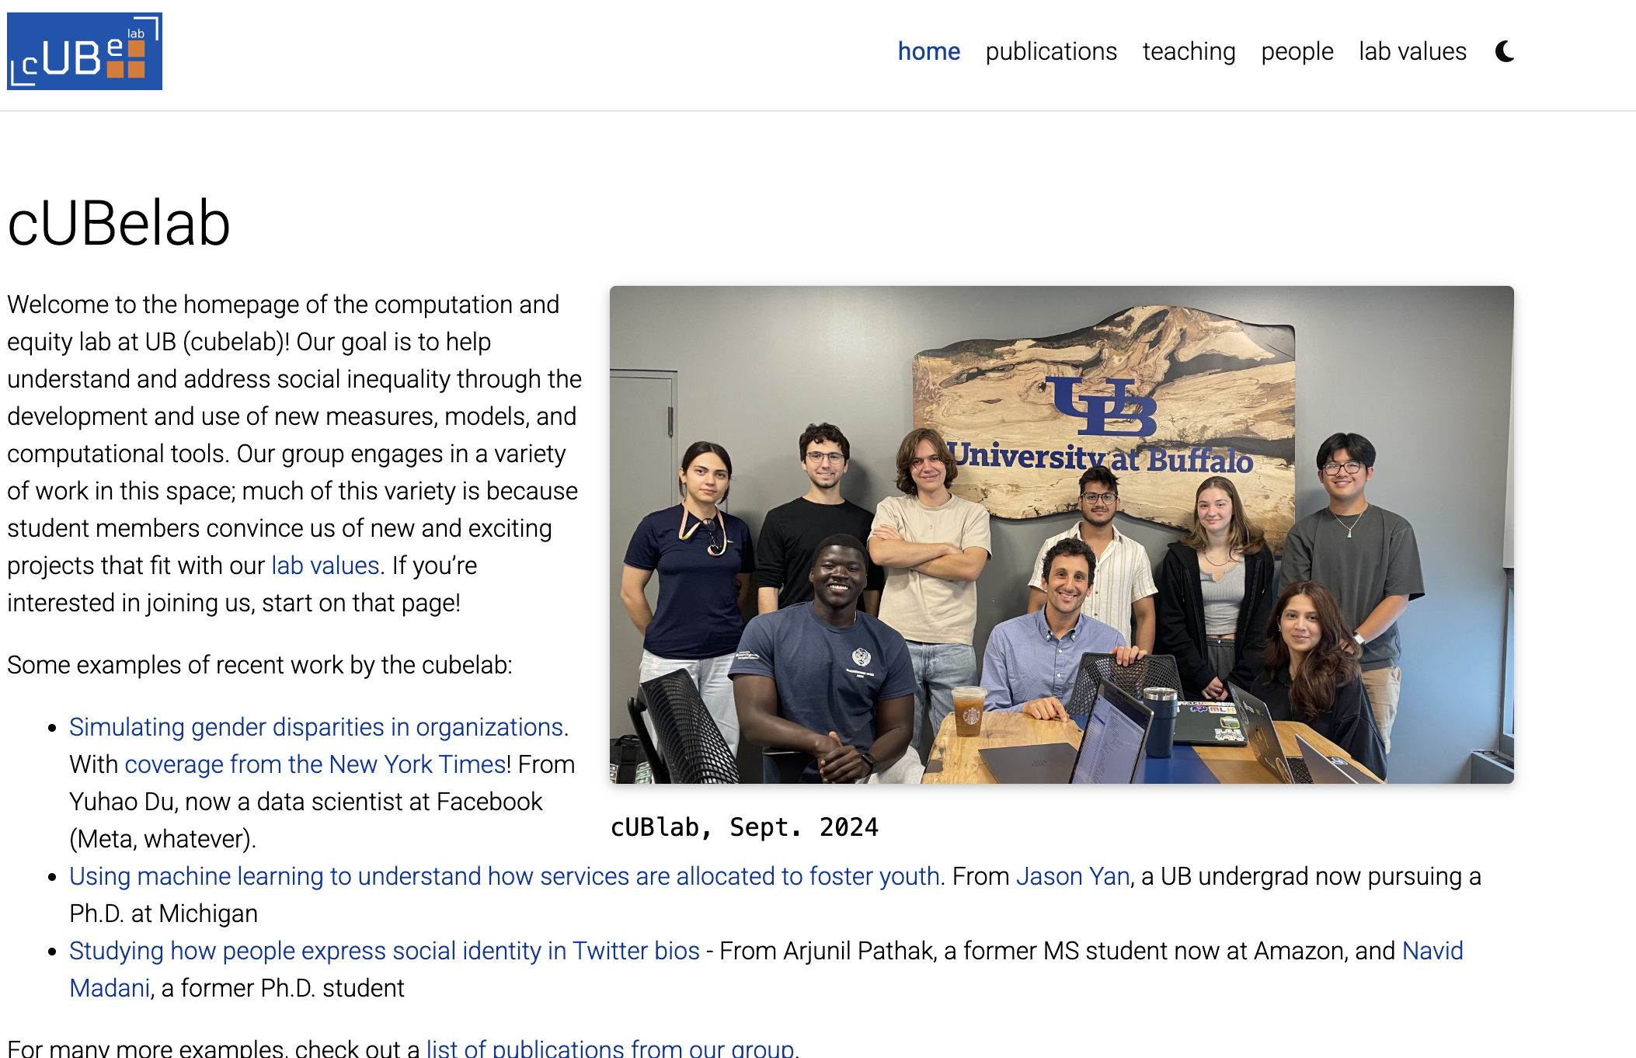

Slide 4
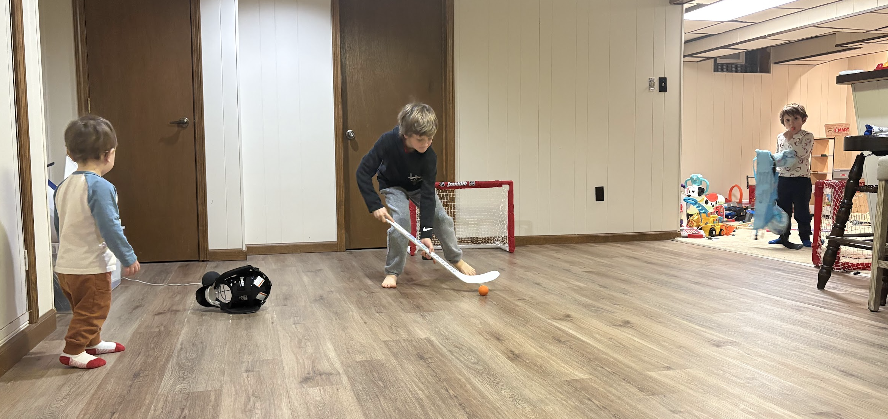
Owen, Micah, and Teddy

Slide 5
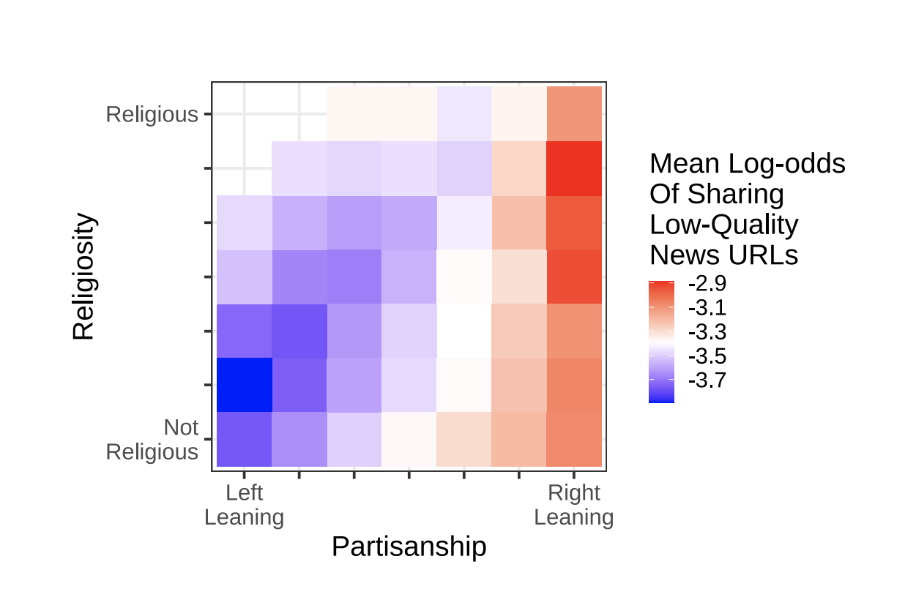
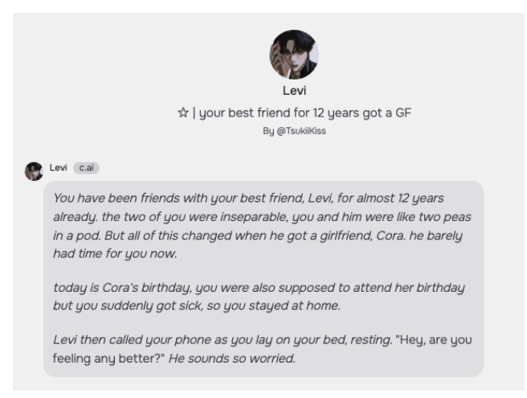

Slide 6
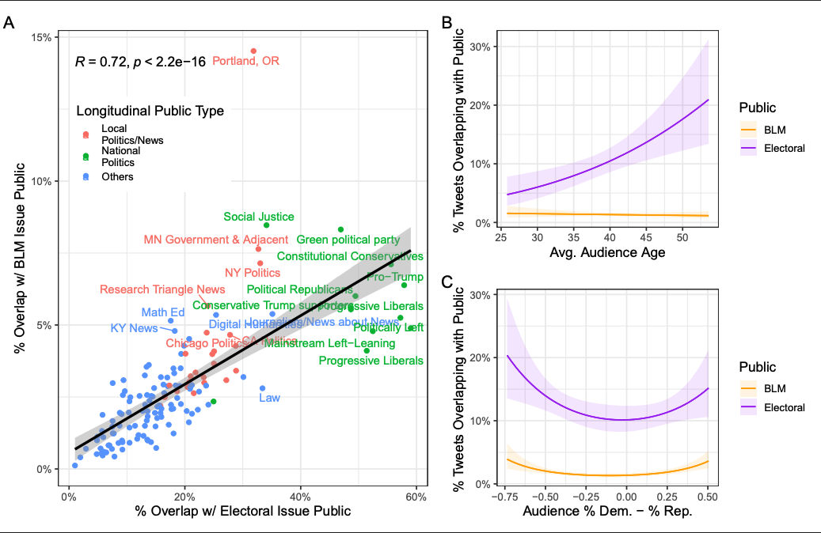

Slide 7
Track record with linear algebra and probability
Undergrad
  Never took linear, wasn’t required and I wanted to be a journalist until very late ☺
  Almost failed several classes focused on probability
Grad
  At some point realized everyone assumed I understood linear
  Realized that I actually really liked probability & stats. Like, really liked
Prof
  Finally learned linear
  Forgot most of what I know about linear and probability
  Excited to re-learn with you ☺

Slide 8
This course
This course is about
  Giving you a solid foundation in Probability and Linear Algebra
  Introducing you to how to write python code to do some probability and linear algebra
  Working and learning together through some difficult concepts and
This course is not about
  Building ML models (although you’ll do a little bit of that at the end)
  Generative AI

Slide 9
And you are?
Name
Last thing you binged
Something boring about yourself
One thing that would keep you interested in a math class such as, say, this one
…
What is your background with probability, and with linear?
What do you hope to get out of the course?

Slide 10
Office Hours
Davis Hall, 335 (for most of the semester)
Fridays, 12:30-1:30

Slide 11
Things to remember
ATTEND, SUBMIT ALL THINGS ON TIME!
DO NOT CHEAT!
READ CAREFULLY!
Take care of yourself!
Be respectful of your classmates!

Slide 12
Academic Dishonesty
All your submissions must be your own work
Penalty:
  Minimum: An grade reduction in course
  Possible: F (or higher penalty) if warranted
YOUR responsibility to know what is cheating, plagiarism etc.
  If not sure, come talk to me
Excuses like “I have a job,” “This was OK earlier/in my country,” “This course is hard,” etc. WON’T WORK
WE DO NOT HAVE ANY PATIENCE WITH ANY CHEATING :
YOU WILL GET A GRADE REDUCTION IN THE COURSE
FOR YOUR FIRST MISTAKE

Slide 13
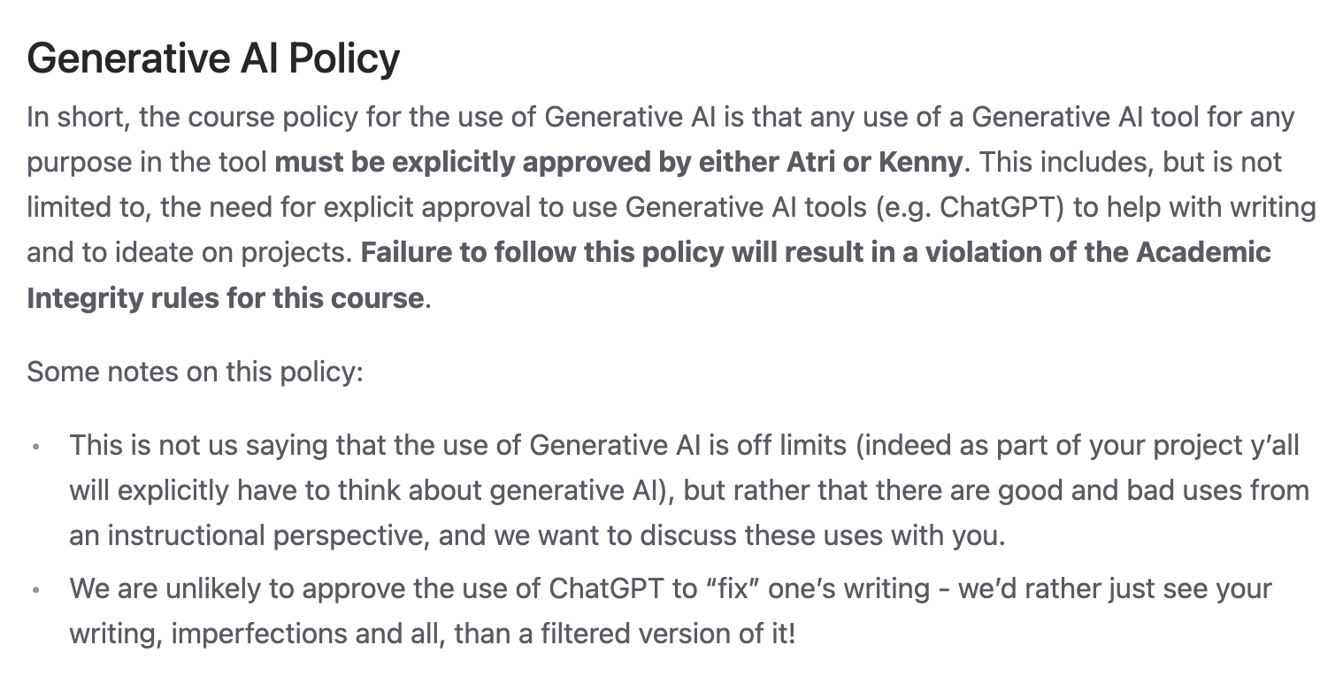
Don’t use it unless we ask you to.

Slide 14
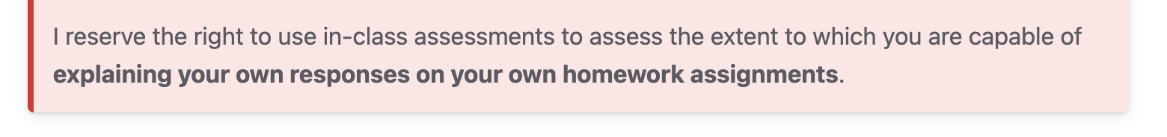
Note the following…

Slide 15
Accessibility Resources
Information included in the syllabus
In short, let us know and consult with Accessibility Resources

Slide 16
Preferred Name
If you prefer using name diff from UB records
Let us know and we’ll make a note of it.

Slide 17

Critical Campus Resources

Slide 18
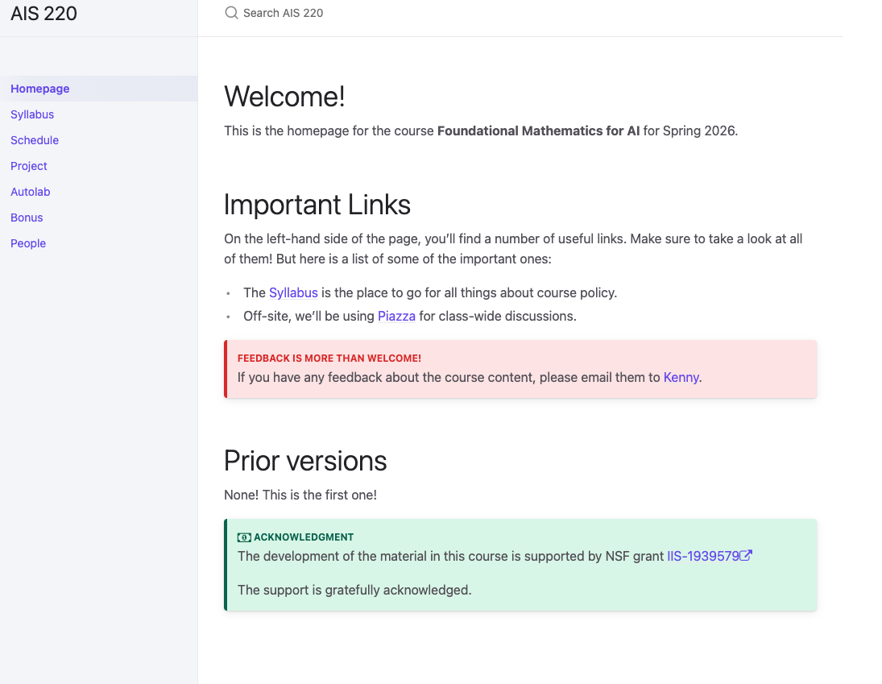
Mostly One Stop-shop for the course
cse.buffalo.edu/~kjoseph/ais220

Slide 19
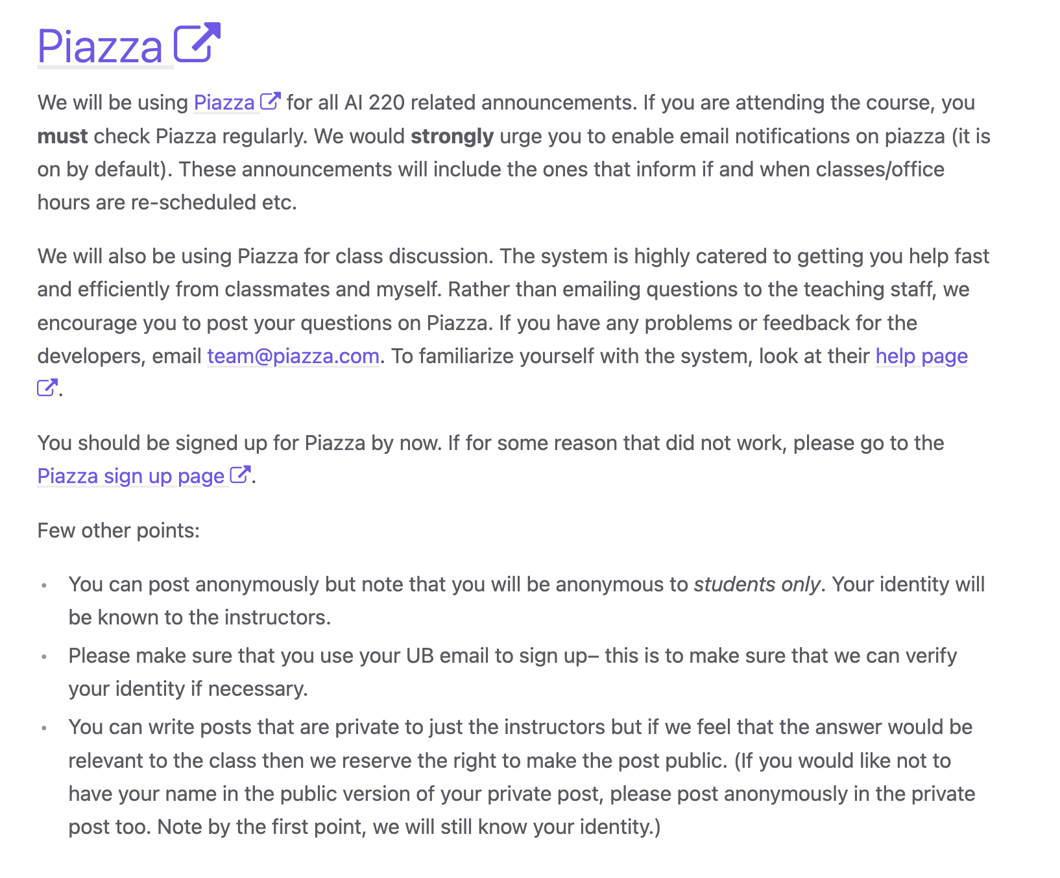
The other stop shop…

Slide 20
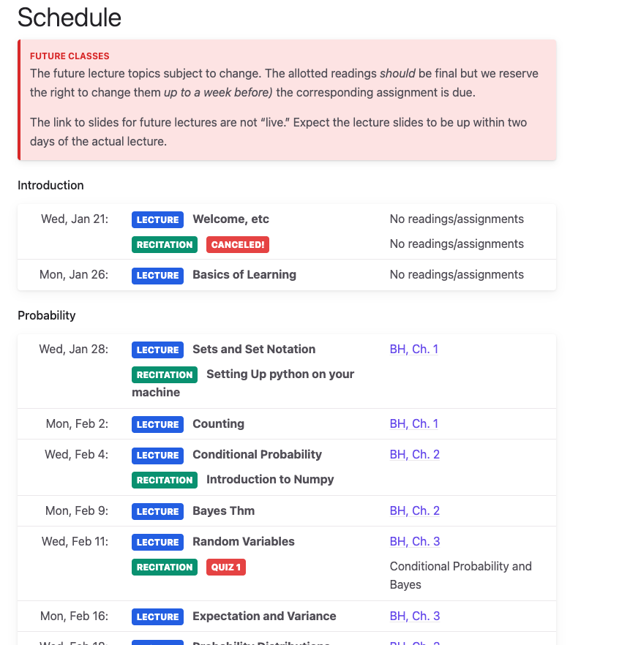

Slide 21
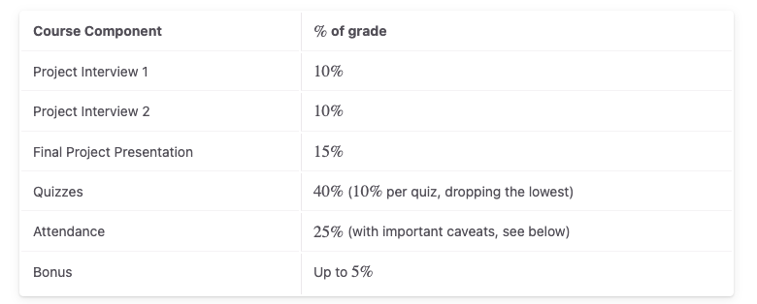
Class outline

Slide 22
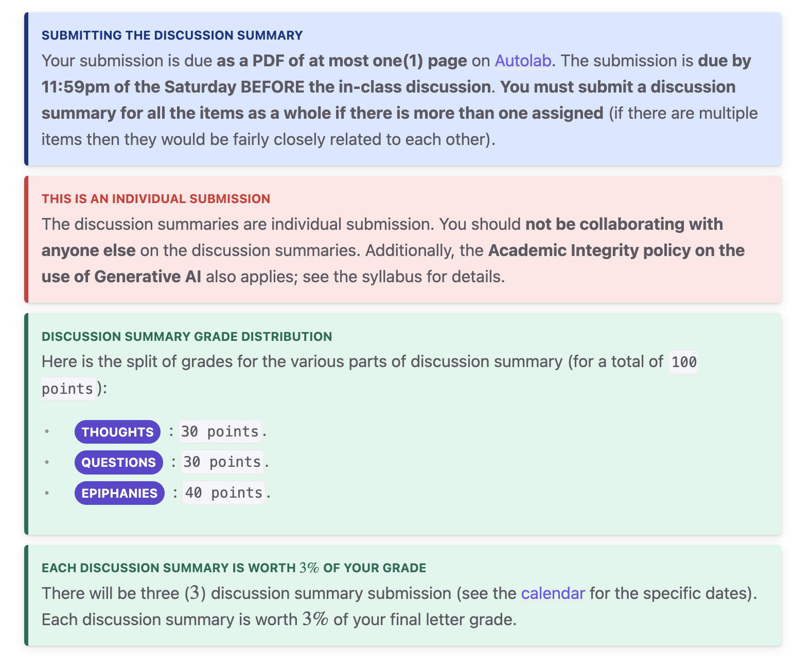
Instructions are not suggestions

Slide 23
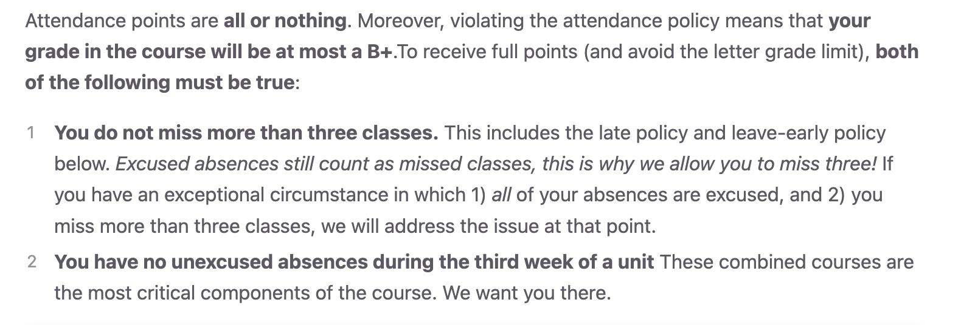
Attendance is critical

Slide 24
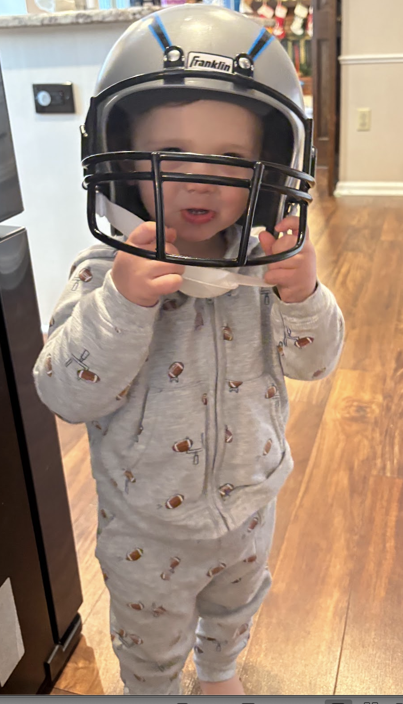
…why?
The workload for this course should be relatively light. There isn’t even homework!
Consequently, you need to be in class, because that is where we will put in the work.
There are no exceptions to the attendance policy.

Slide 25
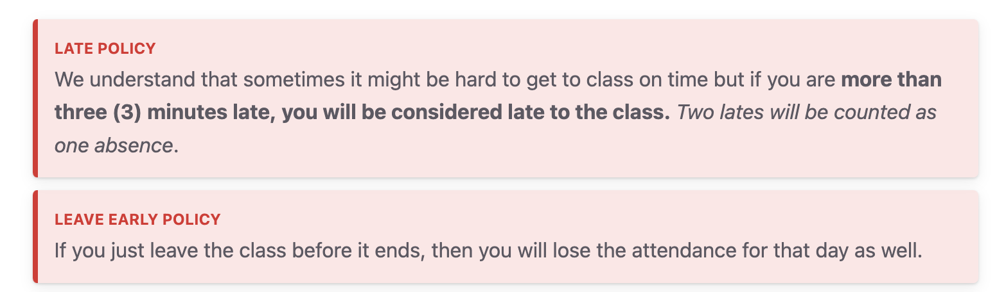
Attendance, additional notes

Slide 26
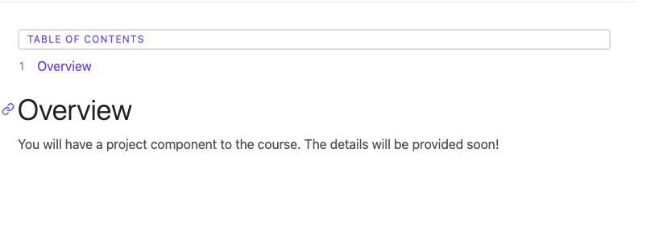
Semester-long Project

Slide 27
Semester-long project
In recitation, you will learn some programming basics
This is not a programming course!
But… we want to show you how to do some things with programming that will help you understand probability and linear algebra!
You will be assessed based on your understanding of your own code!
  This means you will not (only) be assessed on correctness of your code!

Slide 28
Quizzes
Designed to test your understanding
There will be no tricks
The hope is that you will all, with adequate preparation, get 100% on every quiz
I will test you on:
  The material we cover in lecture
  Specific sections of the book, but only if I explicitly assign those sections as readings!
  I.e. I’m not going to pull something super obscure out of the book

Slide 29
More generally, we’re going to go w/ the flow more than I usually would…
…a bit
First time this course has ever been taught (anywhere at the 200 level, as far as I’m aware!)
We’ll have to be a little bit adaptable
Don’t stress about your grades
  In general
  In this class. If you put in the work, it will be obvious to both of us, and it’ll be taken into consideration.

Slide 30
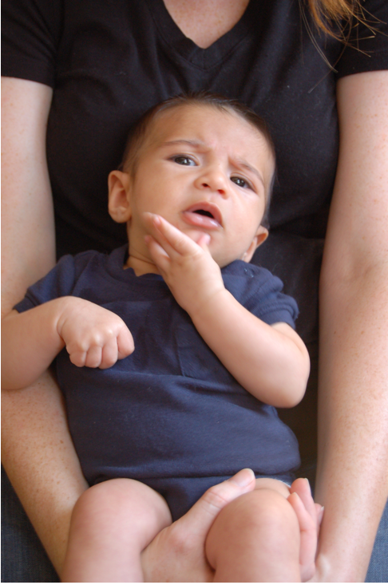
Questions/Comments?

Slide 31

Why this course?

Slide 32
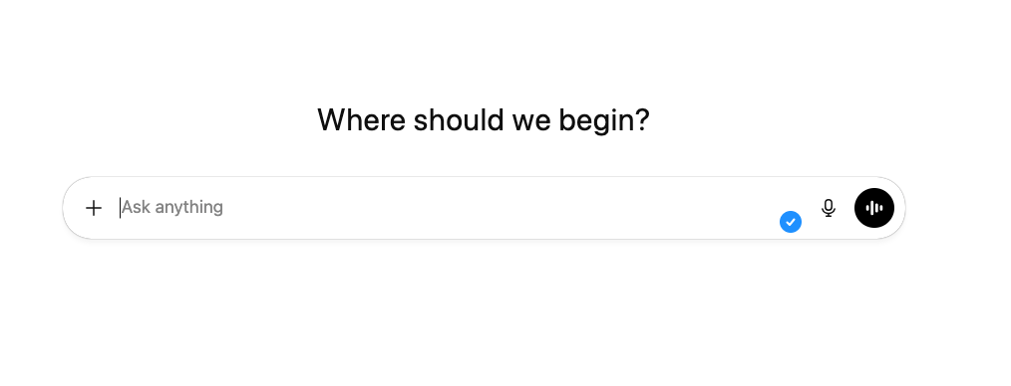

Slide 33
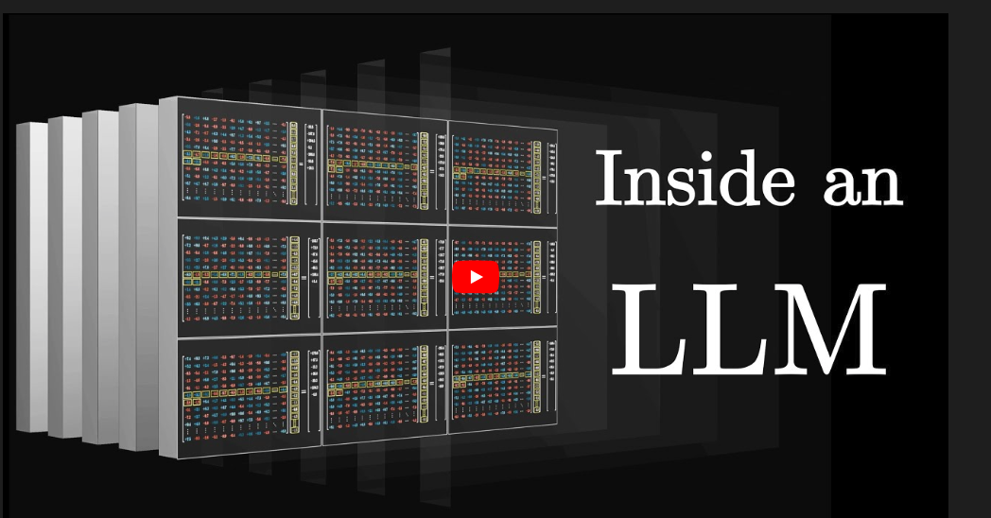

Slide 34
https://www.youtube.com/watch?v=LPZh9BOjkQs&vl=en

Slide 35
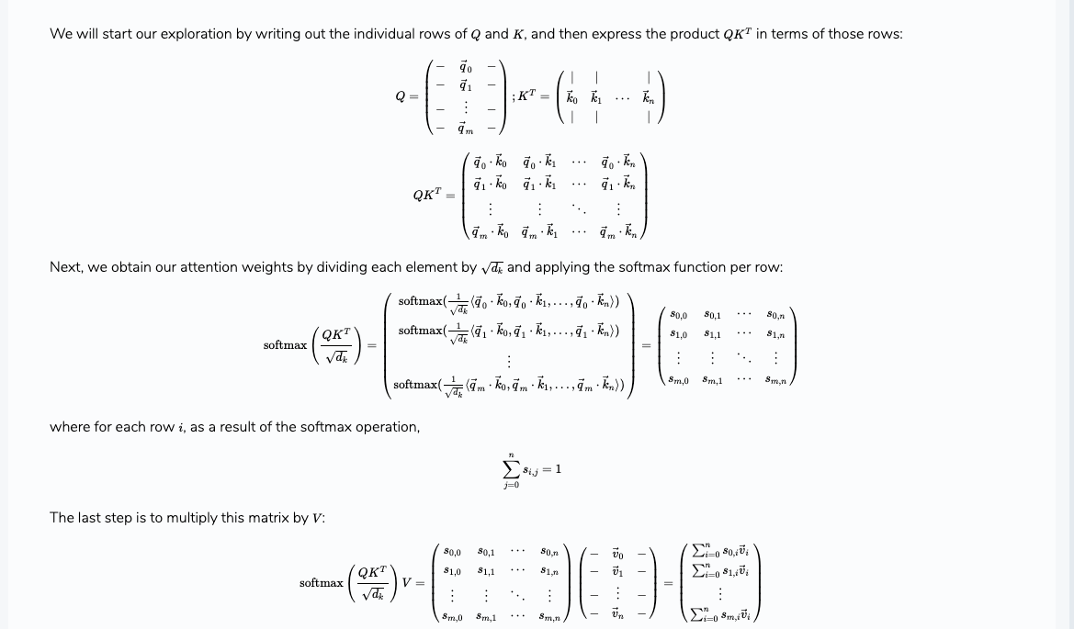

Slide 36
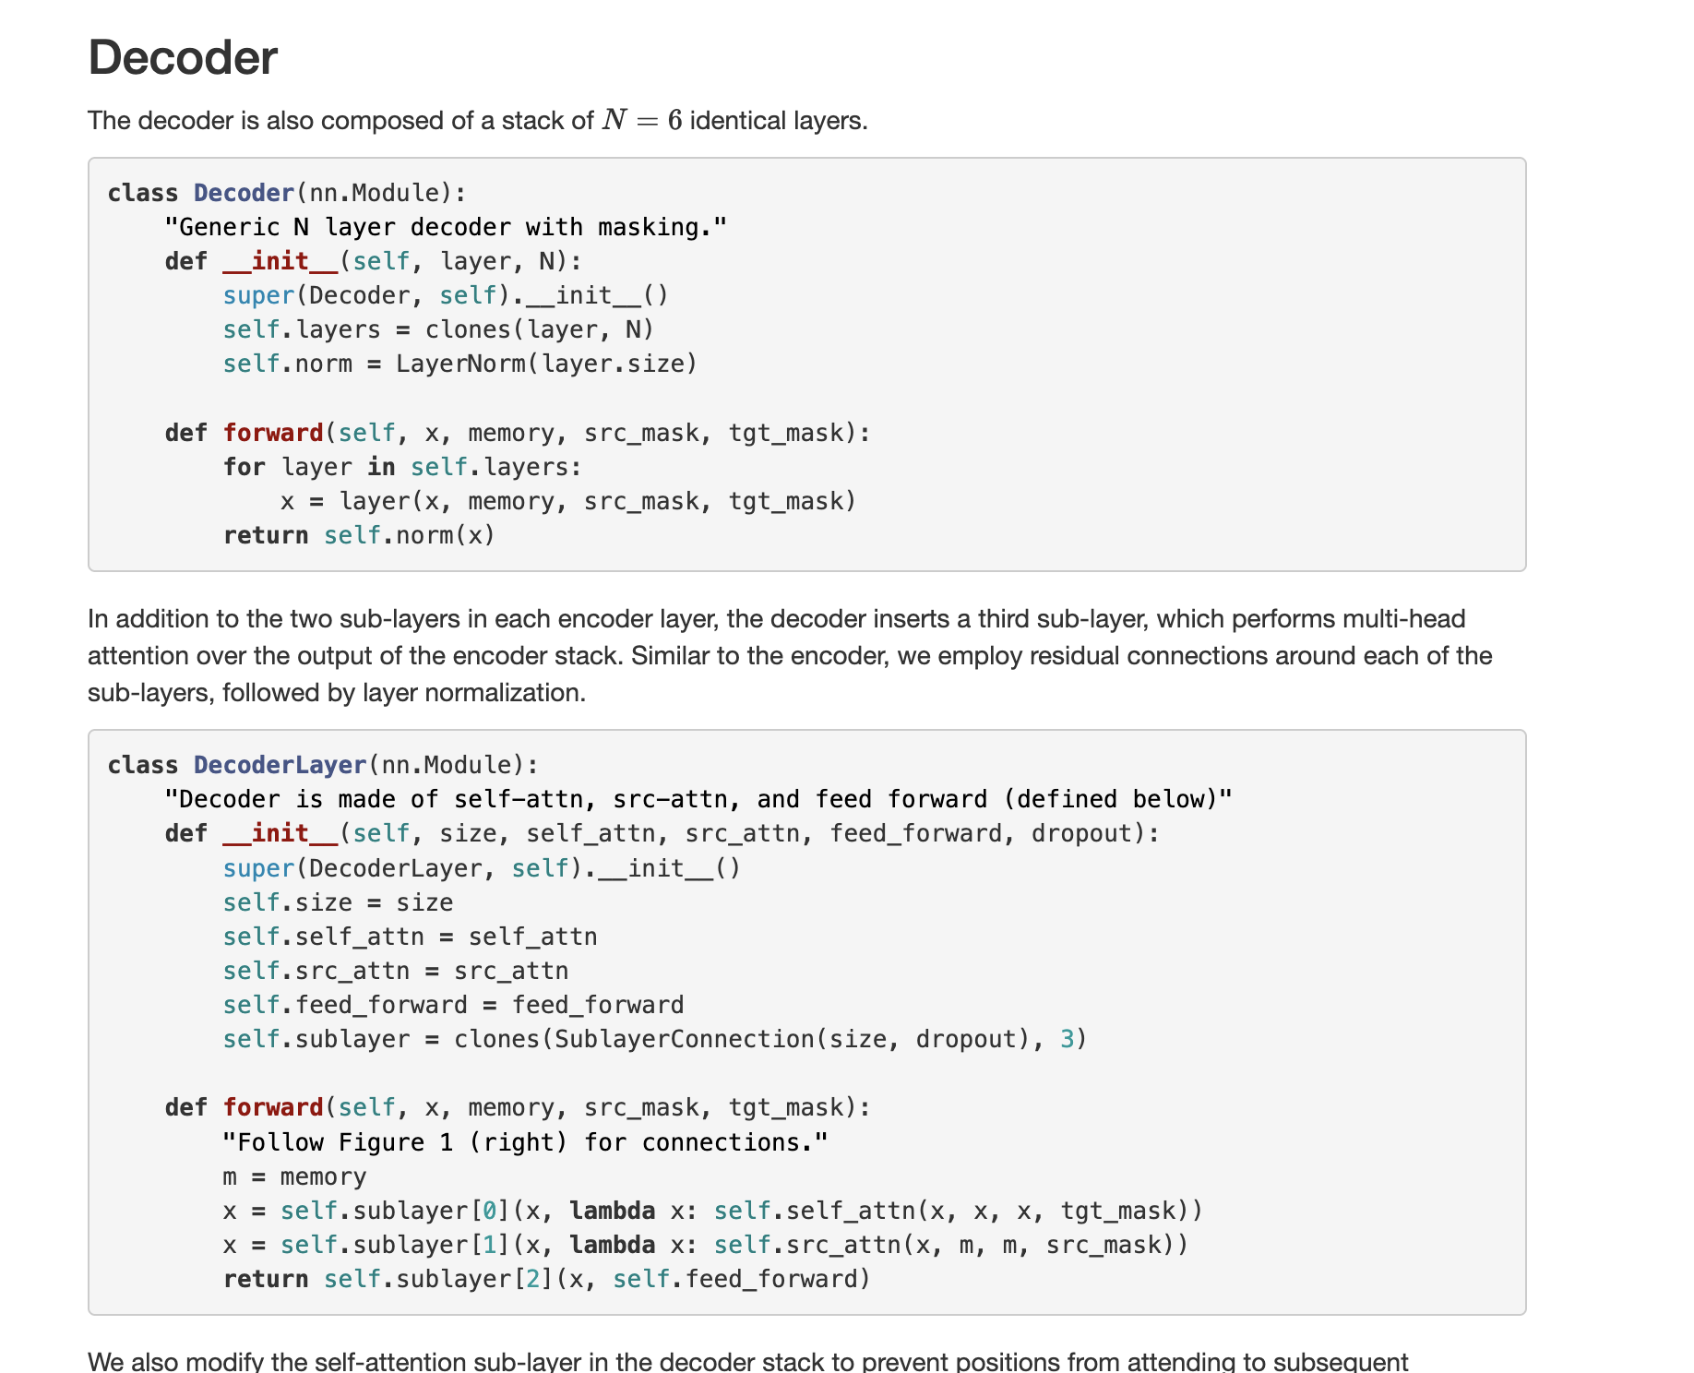

Slide 37
ML today is Programming, Probability, Linear
If you want to understand why these models do what you do, you need fundamental knowledge in linear & probability
You also need to be able to formulate these thoughts in code (perhaps with the help of code assist, yes! But you still need to understand what’s going on)
This course is designed to give you that fundamental knowledge

