Slide 1
AIS 220
Foundational Mathematics for AI
Lecture 10
Vector Operations
Kenneth (Kenny) Joseph

Slide 2
Announcements
Quiz 2 hand back and review
On to linear!
We will use Boyd and Vandenberghe
  https://web.stanford.edu/~boyd/vmls/
  And I’ll largely follow the slides!
  As with the previous section, I expect to cover basically everything you need to know in lecture
We’ll also get some help from 3blue1brown

Slide 3
Today
What is a vector?
Adding and Subtracting Vectors
Multiplying vectors by scalars
Dot products

Slide 4
3Blue1Brown
https://www.youtube.com/watch?v=fNk_zzaMoSs&list=PLZHQObOWTQDPD3MizzM2xVFitgF8hE_ab&index=1

Slide 5
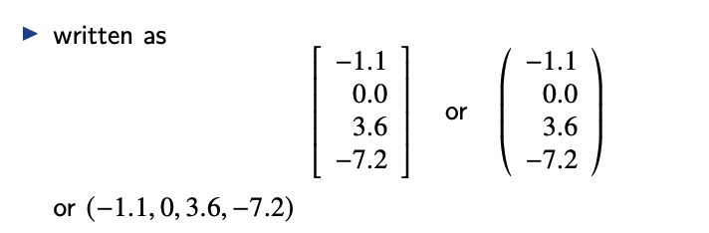
Vectors
Vectors
A vector is an ordered list of numbers
Elements are also called entries, coefficients, or components
The number of elements is the size (dimension, length)
A vector of size n is called an n-vector
Numbers are called scalars

Slide 6
Notation/Terms
We’ll see a variety of symbols to define vectors. For the most part, I’ll use lower-case letters, like x
Then
  x_{i} refers to the ith entity in x, i is called an index
  What is x₃ ?
  The dimension of a vector is its length
Two vectors are equal if …

Slide 7
Special names for kinds/properties of vectors
Zero vector
Ones vector
Unit vectors
Sparse vectors

Slide 8
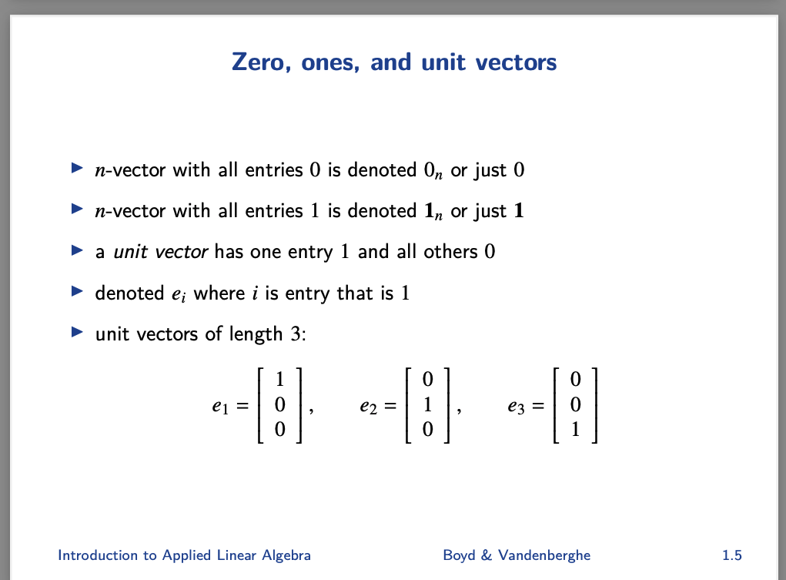

Slide 9
Examples of vectors
Color
Customer purchases
Movie viewings
What posts you’ve watched
“Bag of words” from last lecture!

Slide 10
Bag of words demo (on board, in book)
Adding two vectors together
Must be the same shape!
Subtraction is the same

Slide 11
AIS 220
Foundational Mathematics for AI
Lecture 11
Vector Operations
Kenneth (Kenny) Joseph

Slide 12
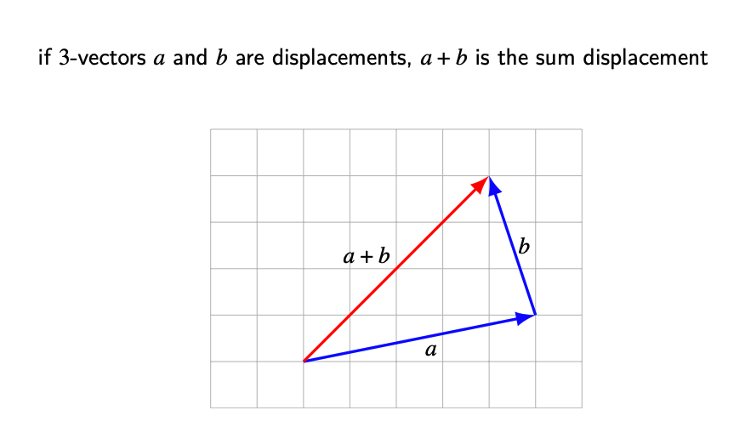
Visual (better in the 3blue1brown video)

Slide 13
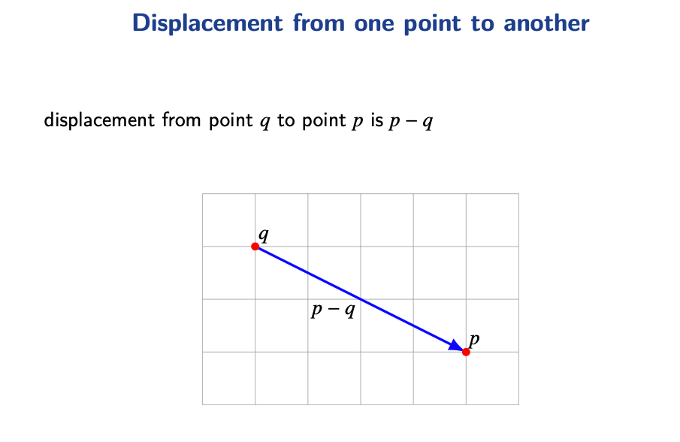
Visual (better in the 3blue1brown video)

Slide 14
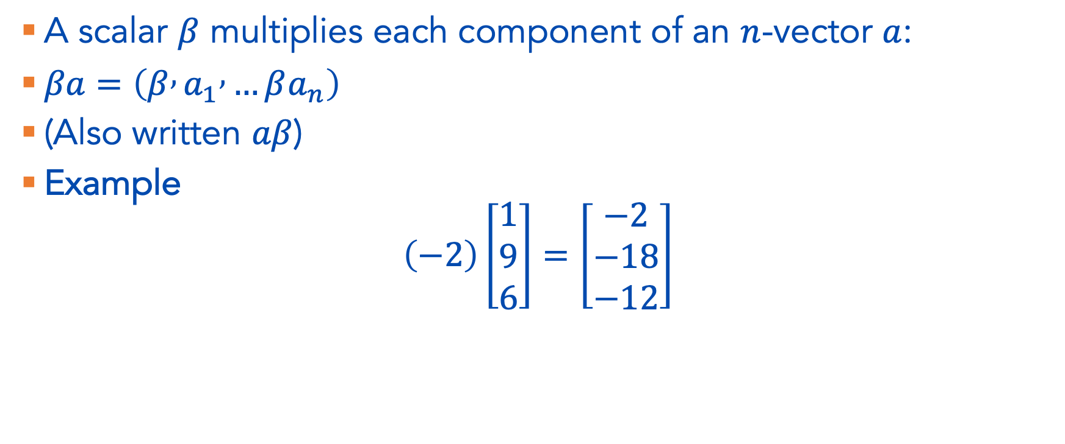
Multiplying a vector by a scalar
A scalar $β$ multiplies each component of an $n$-vector $a$:
$βa=\left(β , a_{1} , …βa_{n}\right)$
(Also written $aβ$)
Example
$$\left(−2\right)\left[\begin{matrix}1 \\ 9 \\ 6\end{matrix}\right]=\left[\begin{matrix}−2 \\ −18 \\ −12\end{matrix}\right]$$

Slide 15
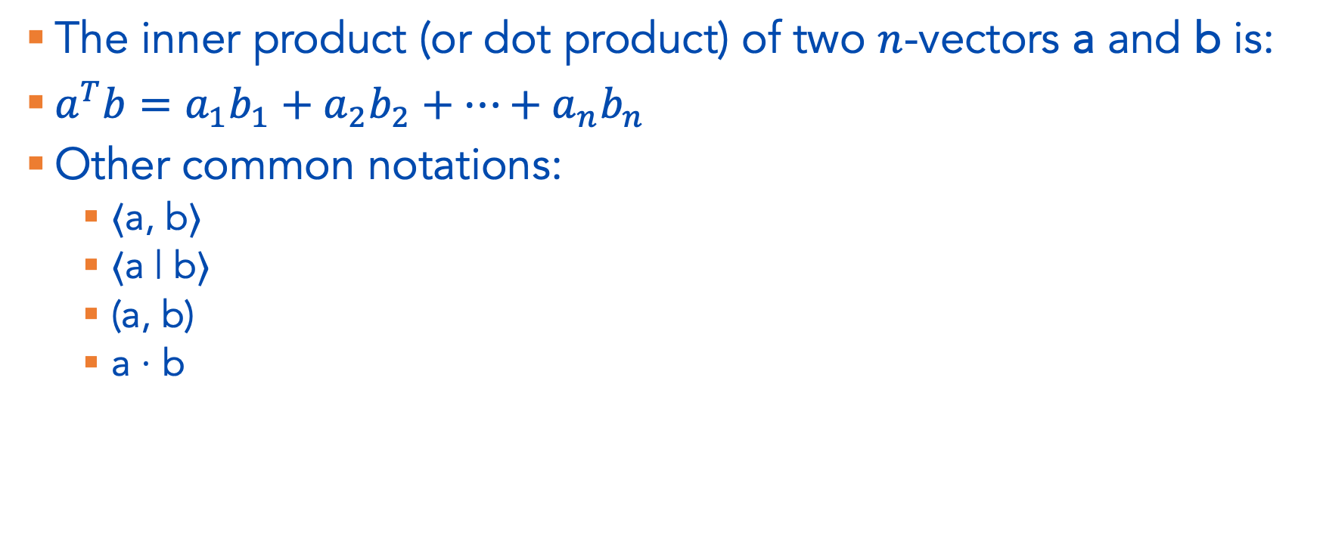
Inner products (the “dot product”)
The inner product (or dot product) of two $n$-vectors a and b is:
$a^{T}b=a_{1}b_{1}+a_{2}b_{2}+⋯+a_{n}b_{n}$
Other common notations:
  ⟨a, b⟩
  ⟨a | b⟩
  (a, b)
  a · b

Slide 16

Example
Let
$a=\left[\begin{matrix}−1 \\ 2 \\ 2\end{matrix}\right] b=\left[\begin{matrix}1 \\ 0 \\ −3\end{matrix}\right]$
Then
$$a^{T}b=\left(−1\right)\left(1\right)+\left(2\right)\left(0\right)+\left(2\right)\left(−3\right)=−1+0−6=−7$$

Slide 17
We’ll come back to this!
3Blue1Brown makes this much more interesting. But we’re not there yet

Slide 18
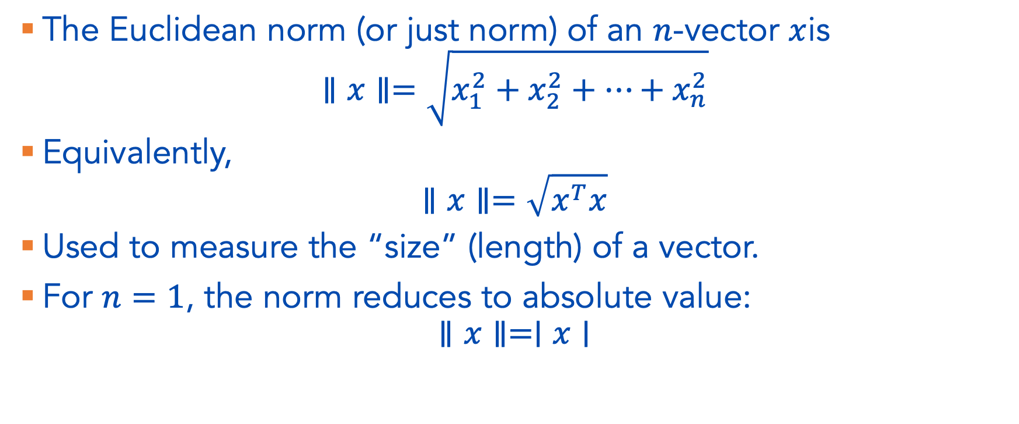
Vector Norm
The Euclidean norm (or just norm) of an $n$-vector $x$is
$$∥x∥=\sqrt{x_{1}^{2}+x_{2}^{2}+⋯+x_{n}^{2}}$$
Equivalently,
$$∥x∥=\sqrt{x^{T}x}$$
Used to measure the “size” (length) of a vector.
For $n=1$, the norm reduces to absolute value:
$$∥x∥=∣x∣$$

Slide 19
Vector Distance
(Euclidean) distance between n-vectors a and b is
dist(a, b) = ∥a − b∥

Slide 20
Distance and Vector Similarity (3.11 of the book)
Example of computing distances between vectors, formalizing the notion of similarity

Slide 21
OK! Where are we?
Vectors
Vector operations
  Adding and Subtracting
  Multiplying by scalars (numbers)
  Dot product / multiplying vectors (more here in a few classes)
  Norms (length)
  Distance / Similarity
Now:
  Linear (in)dependence
  Basis
  Spans

Slide 22
3Blue1Brown
https://www.youtube.com/watch?v=k7RM-ot2NWY&list=PLZHQObOWTQDPD3MizzM2xVFitgF8hE_ab&index=3

