Slide 1
AIS 220
Foundational Mathematics for AI
Lecture 12
Vector Operations and Linear Combinations
Kenneth (Kenny) Joseph

Slide 2
3Blue1Brown
https://www.youtube.com/watch?v=k7RM-ot2NWY&list=PLZHQObOWTQDPD3MizzM2xVFitgF8hE_ab&index=3

Slide 3
Defining a linear combination
What was a linear combination in the video?
Draw two 2n vectors with a span of 2
Draw two 2n vectors with a span of 1
Can you write two vectors where one is linearly dependent on the other?

Slide 4
To B&V, Ch. 5!

Slide 5
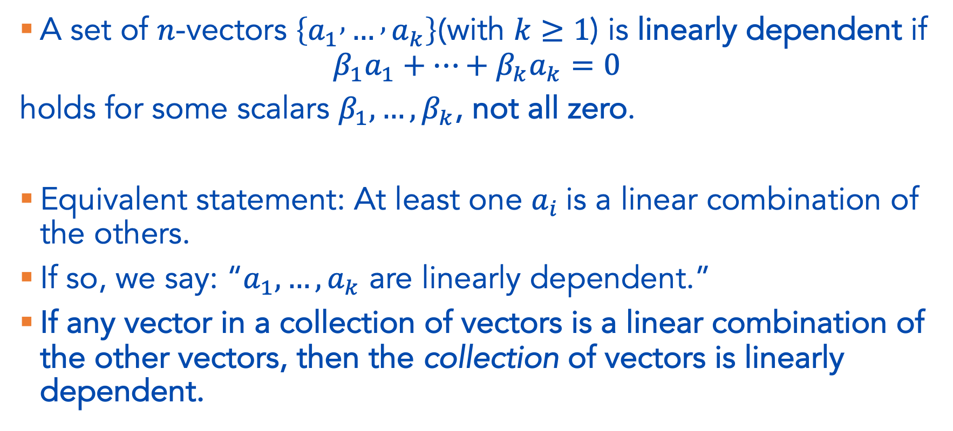
Linear Dependence, formally
A set of $n$-vectors $\left\{a_{1} , … , a_{k}\right\}$(with $k≥1$) is linearly dependent if
$$β_{1}a_{1}+⋯+β_{k}a_{k}=0$$
holds for some scalars $β_{1},…,β_{k}$, not all zero.
Equivalent statement: At least one $a_{i}$is a linear combination of the others.
If so, we say: “$a_{1},…,a_{k}$ are linearly dependent.”
If any vector in a collection of vectors is a linear combination of the other vectors, then the collection of vectors is linearly dependent.

Slide 6

Linear Dependence, cont.
Special Cases
  $\left\{a_{1}\right\}$is linearly dependent only if $a_{1}=0$.
  $\left\{a_{1} , a_{2}\right\}$is linearly dependent only if one vector is a multiple of the other.
  For more than two vectors, there is no simple geometric condition.

Slide 7
Example (B&V, 5.1)

Slide 9
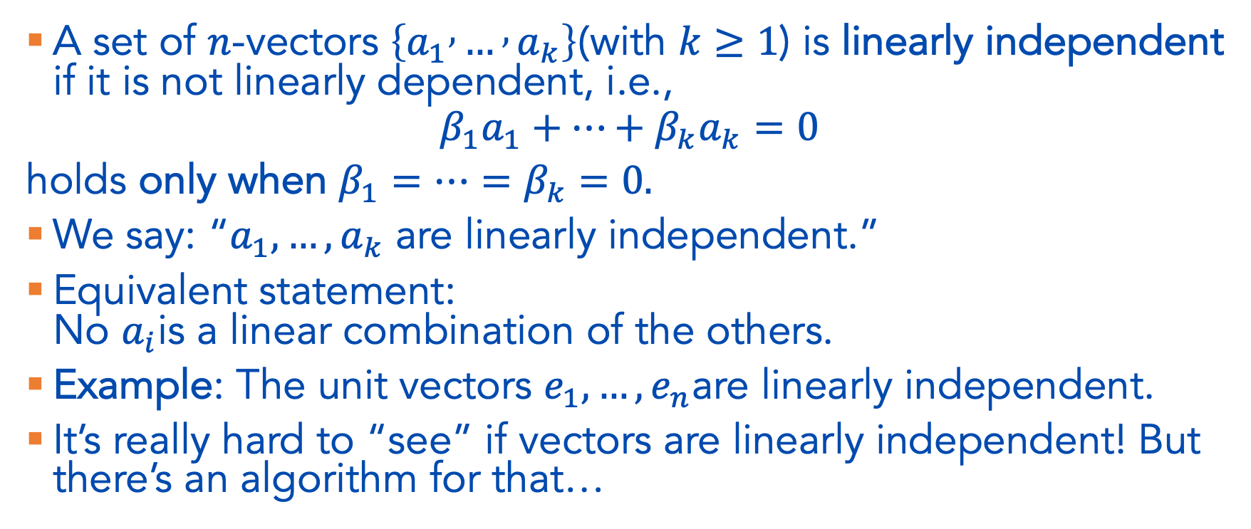
Linear Independence
A set of $n$-vectors $\left\{a_{1} , … , a_{k}\right\}$(with $k≥1$) is linearly independent if it is not linearly dependent, i.e.,
$$β_{1}a_{1}+⋯+β_{k}a_{k}=0$$
holds only when $β_{1}=⋯=β_{k}=0.$
We say: “$a_{1},…,a_{k}$ are linearly independent.”
Equivalent statement:
No $a_{i}$is a linear combination of the others.
Example: The unit vectors $e_{1},…,e_{n}$are linearly independent.
It’s really hard to “see” if vectors are linearly independent! But there’s an algorithm for that…

Slide 10
Linear Independence example

Slide 11
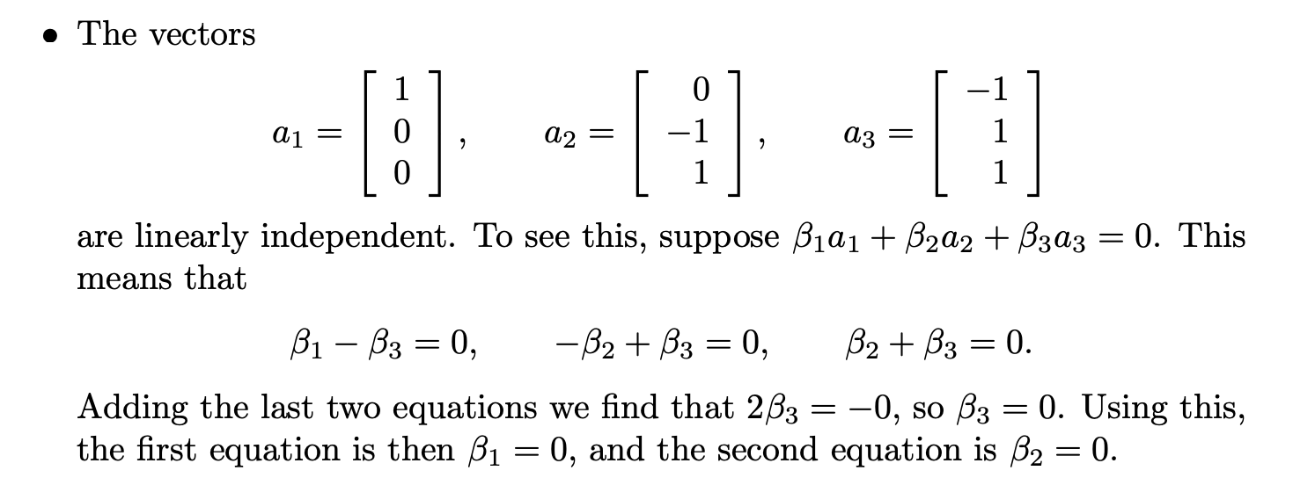

Slide 12
Independence-dimension inequaliy
A linearly independent set of n-vectors can have at most n elements
Put another way: any set of n + 1 or more n-vectors is linearly dependent
Remember the 3blue1brown video on this as a ”proof by intuition”

Slide 13
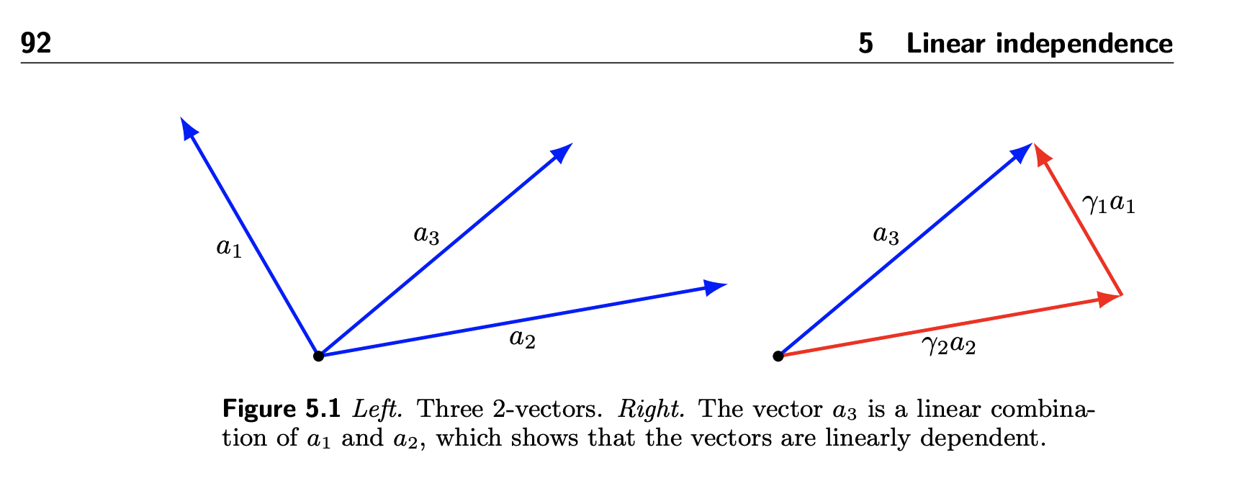

Slide 14
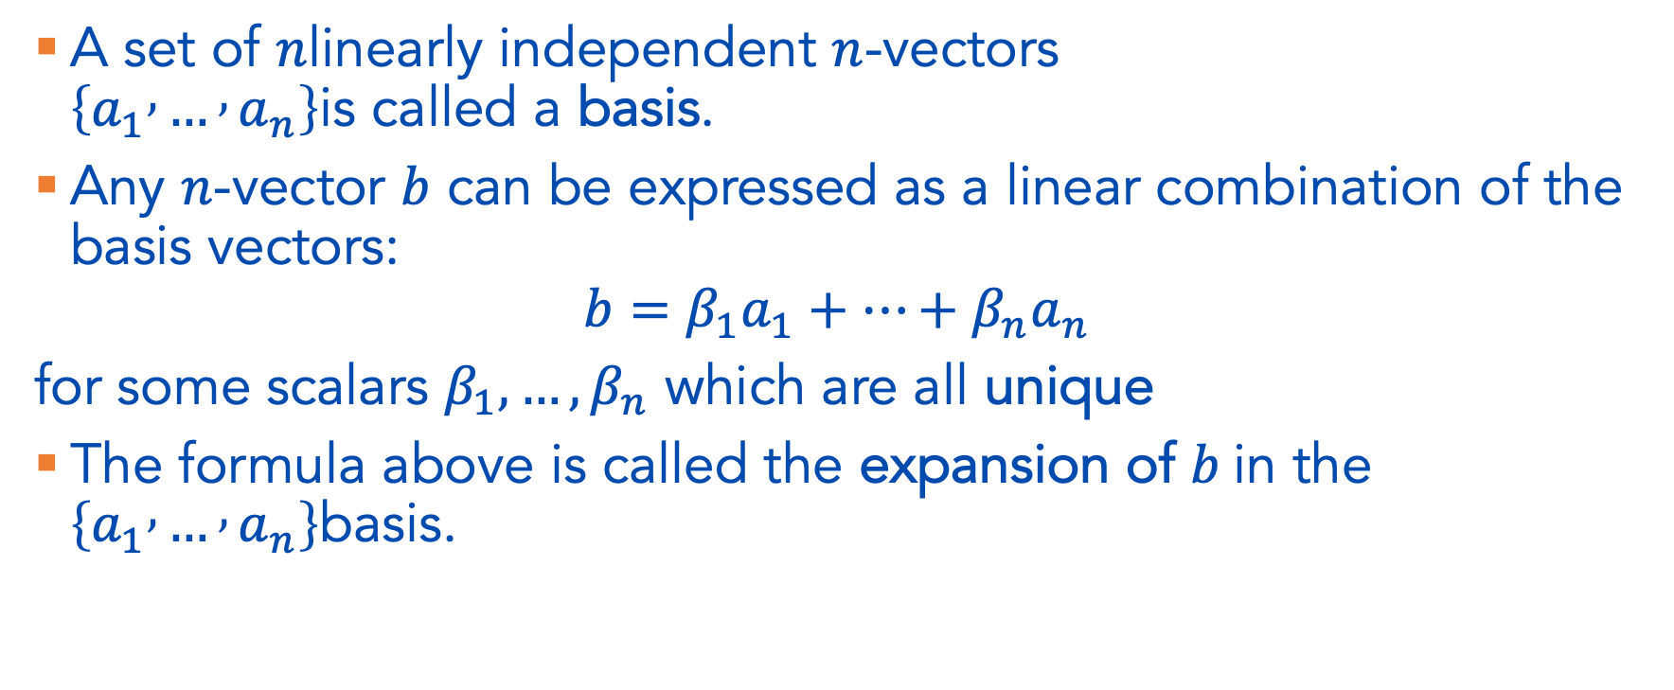
Basis (formally)
A set of $n$linearly independent $n$-vectors
$\left\{a_{1} , … , a_{n}\right\}$is called a basis.
Any $n$-vector $b$ can be expressed as a linear combination of the basis vectors:
$$b=β_{1}a_{1}+⋯+β_{n}a_{n}$$
for some scalars $β_{1},…,β_{n}$ which are all unique
The formula above is called the expansion of $b$in the
$\left\{a_{1} , … , a_{n}\right\}$basis.

Slide 15
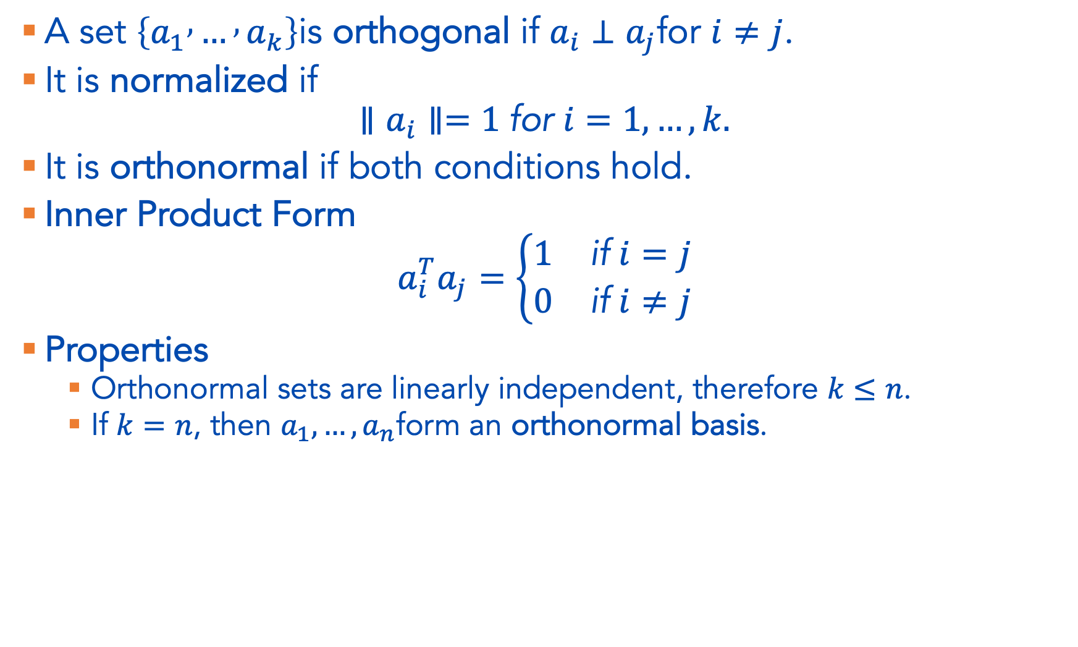
Orthogonal/Orthonormal Vectors
A set $\left\{a_{1} , … , a_{k}\right\}$is orthogonal if $a_{i}⊥a_{j}$for $i≠j$.
It is normalized if
$$∥a_{i}∥=1 \text{for} i=1,…,k.$$
It is orthonormal if both conditions hold.
Inner Product Form
$$a_{i}^{T}a_{j}=\left\{\begin{matrix}1 & \text{if} i=j \\ 0 & \text{if} i≠j\end{matrix}\right.$$
Properties
  Orthonormal sets are linearly independent, therefore $k≤n$.
  If $k=n$, then $a_{1},…,a_{n}$form an orthonormal basis.

Slide 16
Examples

Slide 17
