Slide 1
AIS 220
Foundational Mathematics for AI
Lecture 13
On to Matrices! Content and slides adapted from B&V, Ch. 6!

Slide 2
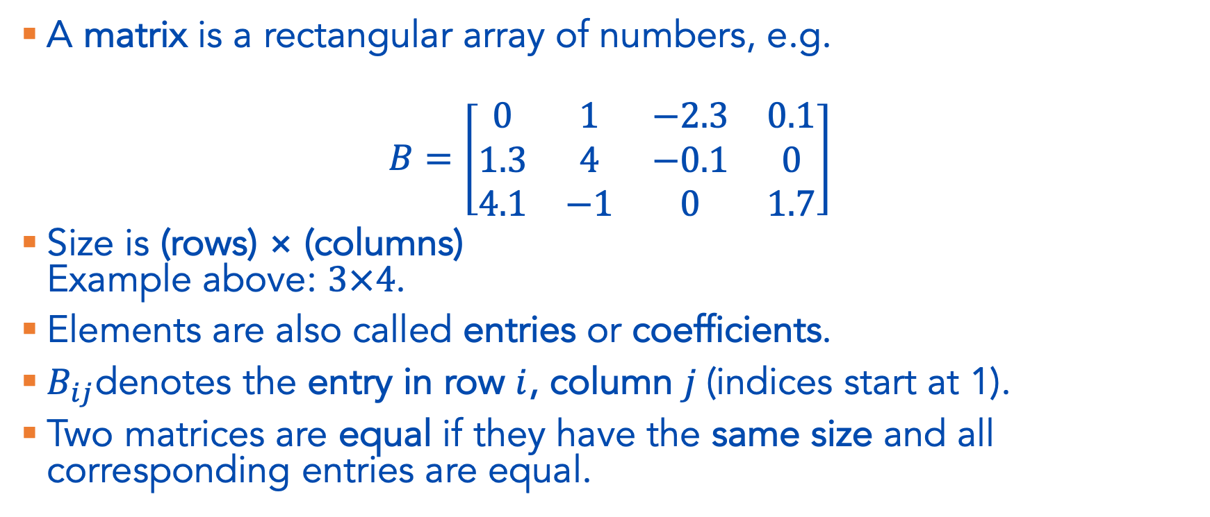
Matrix Definition
A matrix is a rectangular array of numbers, e.g.
$$B=\left[\begin{matrix}0 & 1 & −2.3 & 0.1 \\ 1.3 & 4 & −0.1 & 0 \\ 4.1 & −1 & 0 & 1.7\end{matrix}\right]$$
Size is (rows) × (columns)
Example above: $3×4$.
Elements are also called entries or coefficients.
$B_{ij}$denotes the entry in row $i$, column $j$(indices start at 1).
Two matrices are equal if they have the same size and all corresponding entries are equal.

Slide 3

Matrix Sizes
For an $m×n$ matrix $A$:
We call it Tall if $m>n$
Wide if $m<n$
Square if $m=n$

Slide 4
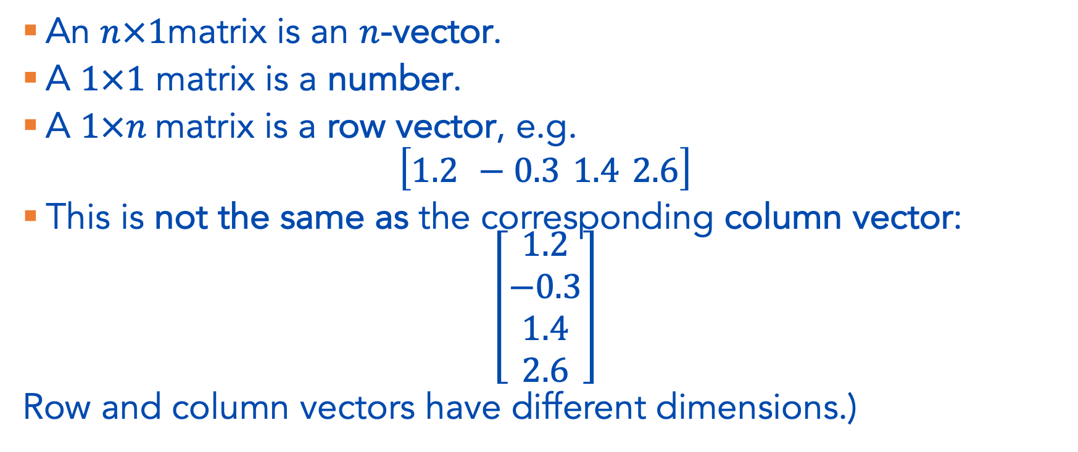
Columns and Rows
An $n×1$matrix is an $n$-vector.
A $1×1$ matrix is a number.
A $1×n$matrix is a row vector, e.g.
$$\left[\begin{matrix}1.2 −0.3 1.4 2.6\end{matrix}\right]$$
This is not the same as the corresponding column vector:
$$\left[\begin{matrix}1.2 \\ −0.3 \\ 1.4 \\ 2.6\end{matrix}\right]$$
Row and column vectors have different dimensions.)

Slide 5
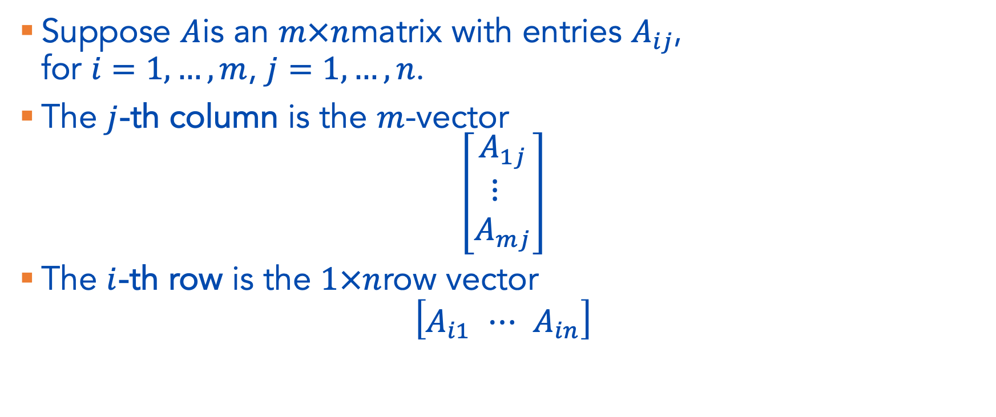
Columns and Rows, cont.
Suppose $A$is an $m×n$matrix with entries $A_{ij}$,
for $i=1,…,m$, $j=1,…,n$.
The $j$-th column is the $m$-vector
$$\left[\begin{matrix}A_{1j} \\ ⋮ \\ A_{mj}\end{matrix}\right]$$
The $i$-th row is the $1×n$row vector
$$\left[\begin{matrix}A_{i1} ⋯ A_{in}\end{matrix}\right]$$

Slide 6
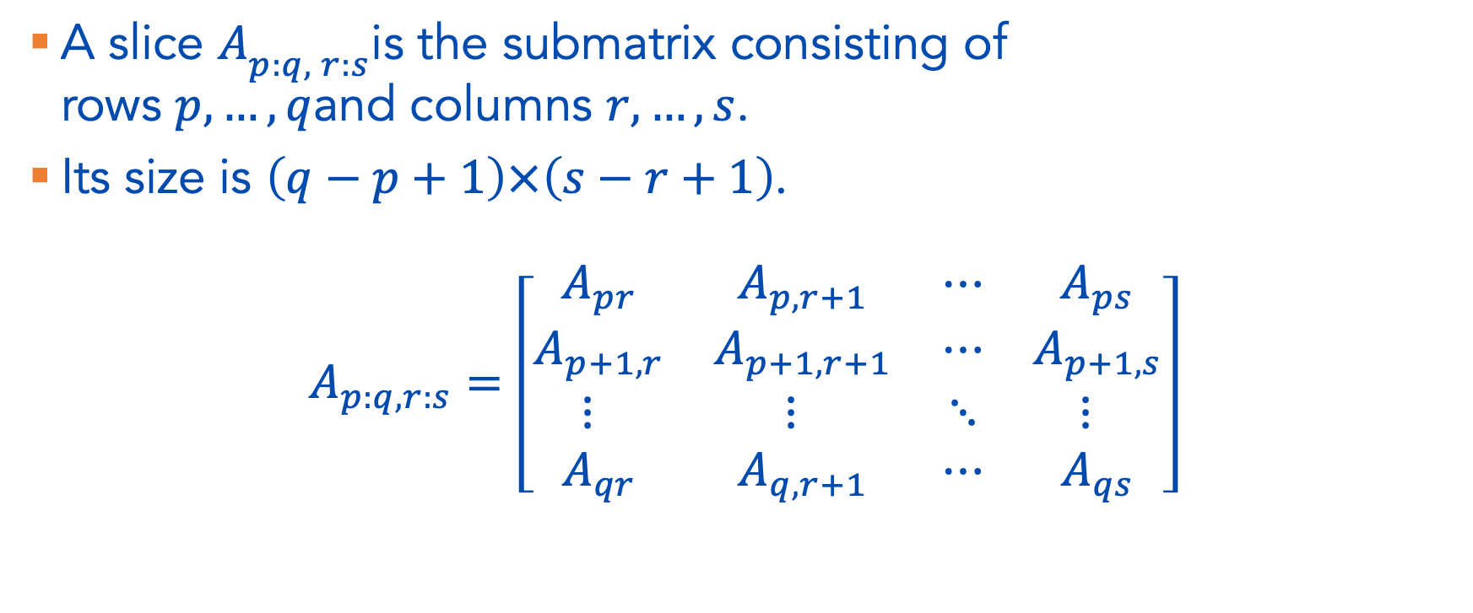
Matrix Slice
A slice $A_{p:q, r:s}$is the submatrix consisting of
rows $p,…,q$and columns $r,…,s$.
Its size is $\left(q−p+1\right)×\left(s−r+1\right)$.
$$A_{p:q,r:s}=\left[\begin{matrix}A_{pr} & A_{p,r+1} & ⋯ & A_{ps} \\ A_{p+1,r} & A_{p+1,r+1} & ⋯ & A_{p+1,s} \\ ⋮ & ⋮ & ⋱ & ⋮ \\ A_{qr} & A_{q,r+1} & ⋯ & A_{qs}\end{matrix}\right]$$

Slide 7
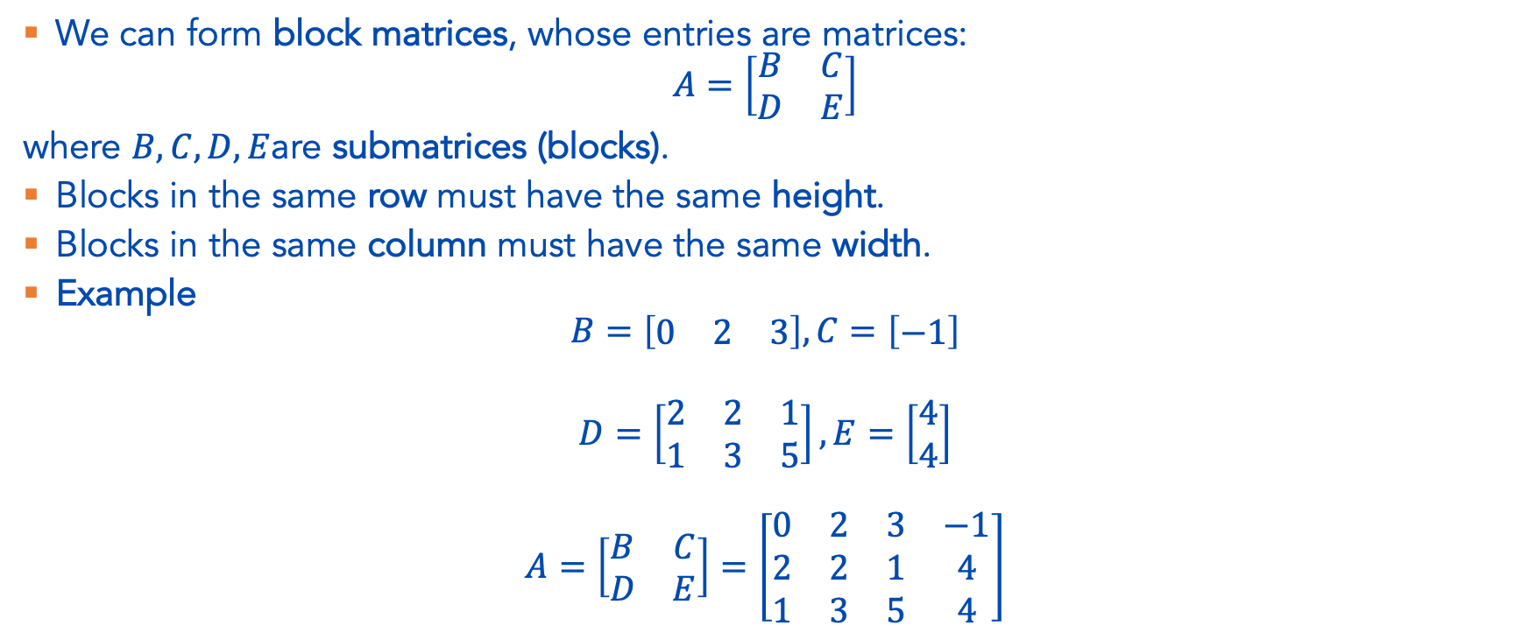
Constructing Matrices from Blocks
We can form block matrices, whose entries are matrices:
$$A=\left[\begin{matrix}B & C \\ D & E\end{matrix}\right]$$
where $B,C,D,E$are submatrices (blocks).
Blocks in the same row must have the same height.
Blocks in the same column must have the same width.
Example
$$B=\left[\begin{matrix}0 & 2 & 3\end{matrix}\right], C=\left[\begin{matrix}−1\end{matrix}\right]$$
$$D=\left[\begin{matrix}2 & 2 & 1 \\ 1 & 3 & 5\end{matrix}\right], E=\left[\begin{matrix}4 \\ 4\end{matrix}\right]$$
$$A=\left[\begin{matrix}B & C \\ D & E\end{matrix}\right]=\left[\begin{matrix}0 & 2 & 3 & −1 \\ 2 & 2 & 1 & 4 \\ 1 & 3 & 5 & 4\end{matrix}\right]$$

Slide 8
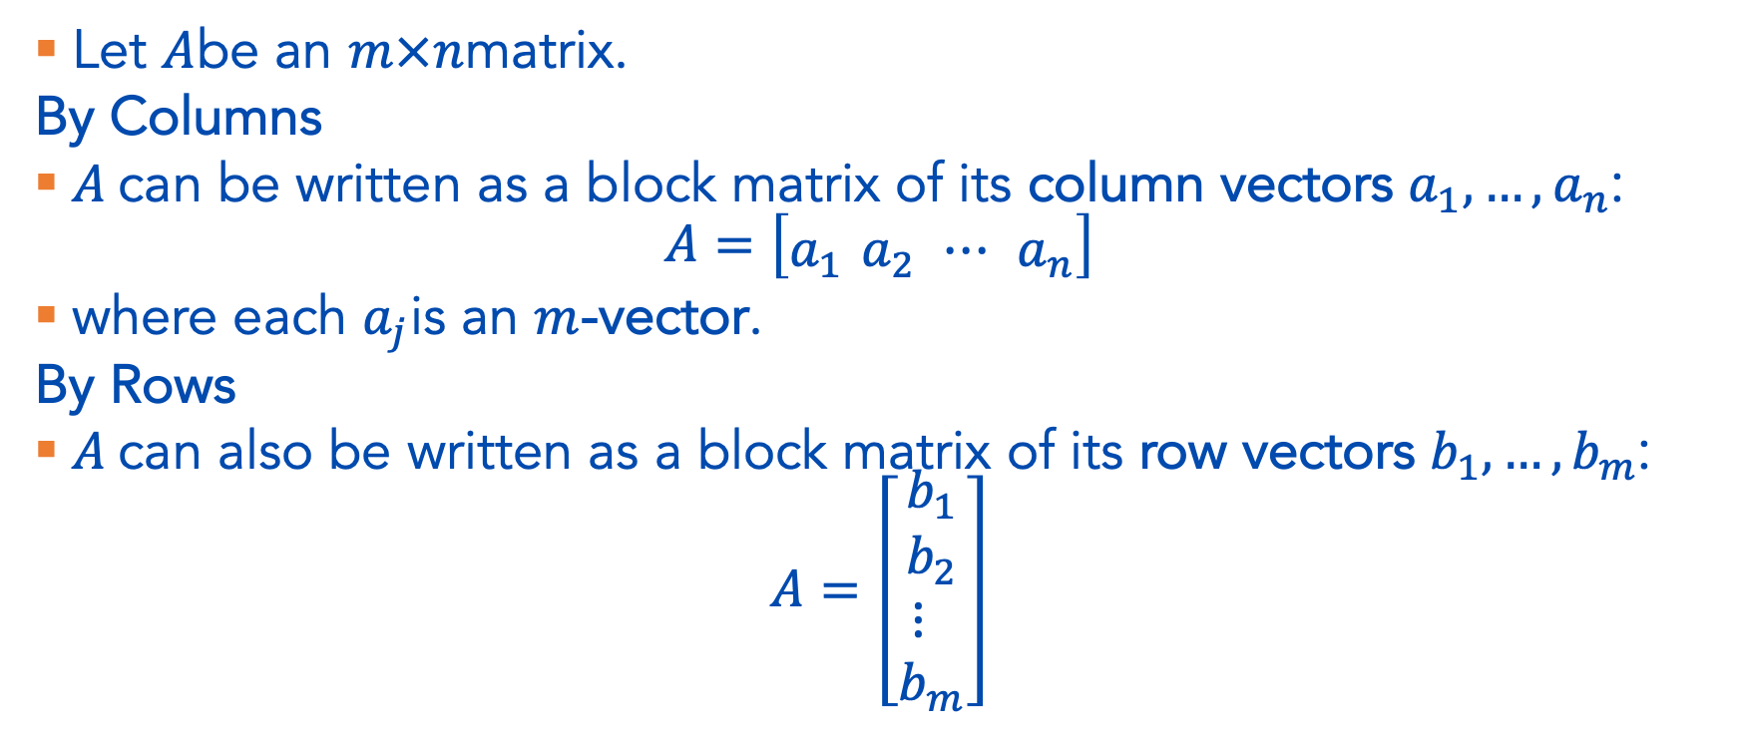
Matrix as columns or rows
Let $A$be an $m×n$matrix.
By Columns
$A$can be written as a block matrix of its column vectors $a_{1},…,a_{n}$:
$$A=\left[\begin{matrix}a_{1} a_{2} ⋯ a_{n}\end{matrix}\right]$$
where each $a_{j}$is an $m$-vector.
By Rows
$A$can also be written as a block matrix of its row vectors $b_{1},…,b_{m}$:
$$A=\left[\begin{matrix}b_{1} \\ b_{2} \\ ⋮ \\ b_{m}\end{matrix}\right]$$

Slide 9
Some examples
Images
Spatial Data
Graphs
Documents
Word embeddings!
Text corpora
…

Slide 10
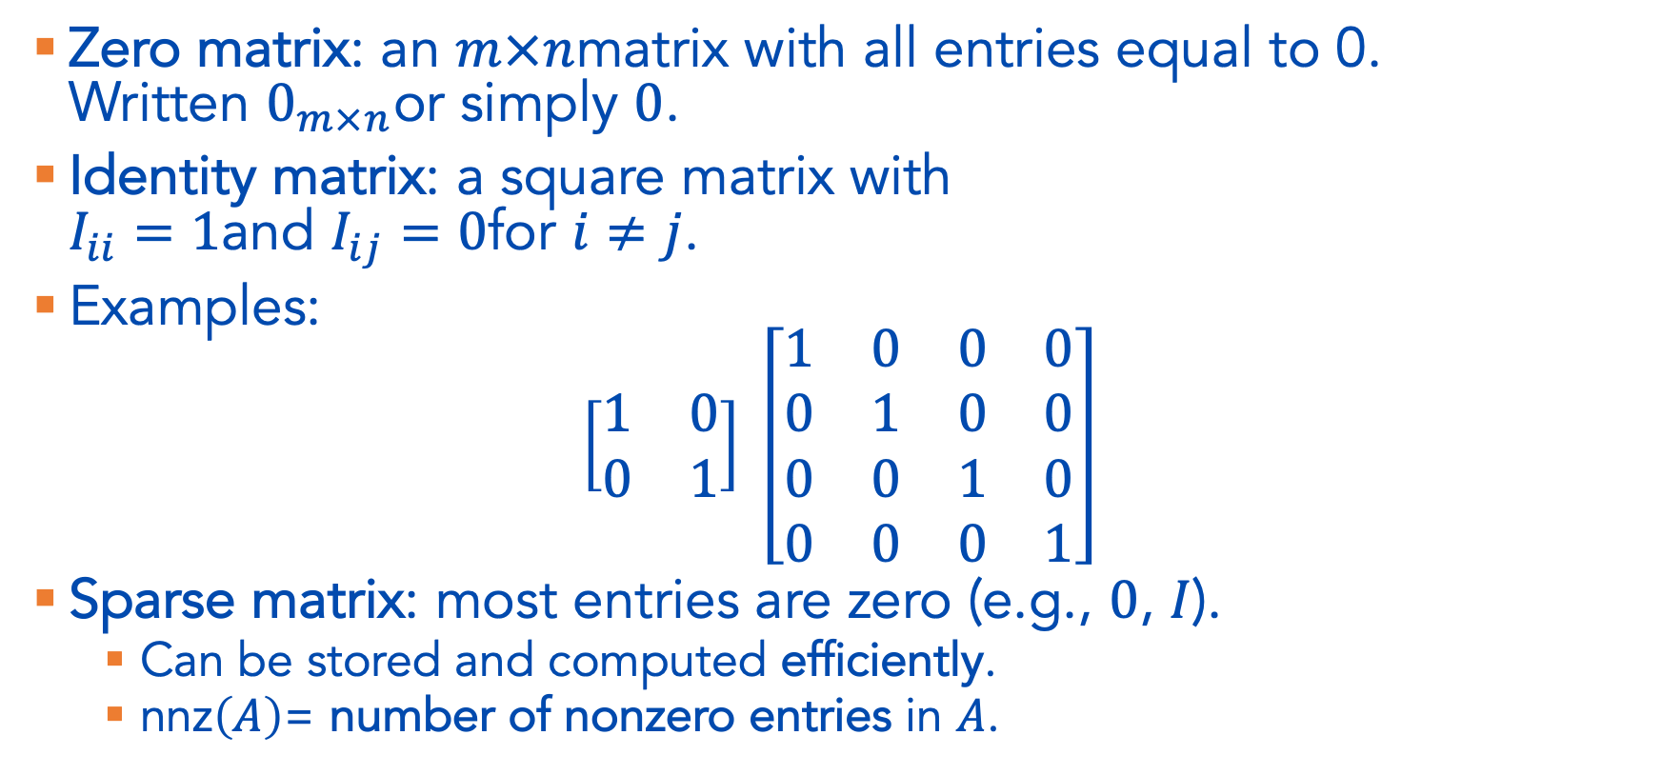
Special Matrices
Zero matrix: an $m×n$matrix with all entries equal to 0.
Written $0_{m×n}$or simply $0$.
Identity matrix: a square matrix with
$I_{ii}=1$and $I_{ij}=0$for $i≠j$.
Examples:
$$\left[\begin{matrix}1 & 0 \\ 0 & 1\end{matrix}\right] \left[\begin{matrix}1 & 0 & 0 & 0 \\ 0 & 1 & 0 & 0 \\ 0 & 0 & 1 & 0 \\ 0 & 0 & 0 & 1\end{matrix}\right]$$
Sparse matrix: most entries are zero (e.g., $0$, $I$).
  Can be stored and computed efficiently.
  $\text{nnz}\left(A\right)$= number of nonzero entries in $A$.

Slide 11
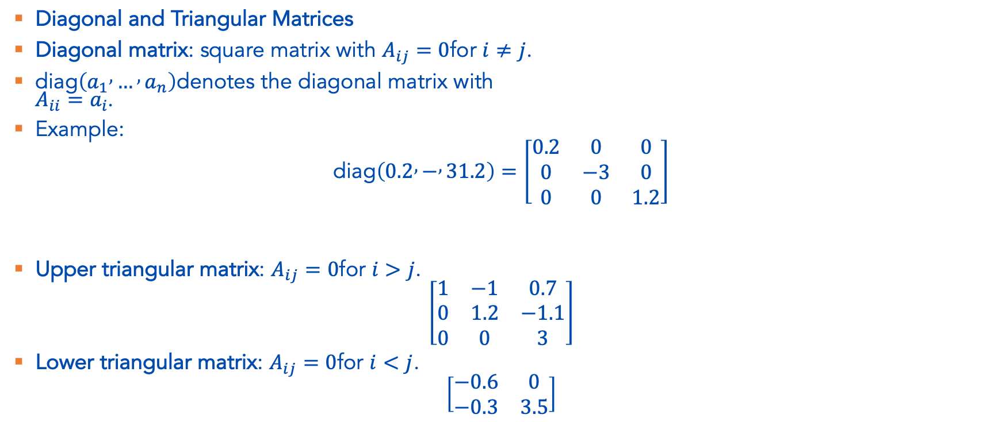
Special Matrices, cont.
Diagonal and Triangular Matrices
Diagonal matrix: square matrix with $A_{ij}=0$for $i≠j$.
$\text{diag}\left(a_{1} , … , a_{n}\right)$denotes the diagonal matrix with
$A_{ii}=a_{i}$.
Example:
$$\text{diag}\left(0.2 , − , 31.2\right)=\left[\begin{matrix}0.2 & 0 & 0 \\ 0 & −3 & 0 \\ 0 & 0 & 1.2\end{matrix}\right]$$
Upper triangular matrix: $A_{ij}=0$for $i>j$.
$$\left[\begin{matrix}1 & −1 & 0.7 \\ 0 & 1.2 & −1.1 \\ 0 & 0 & 3\end{matrix}\right]$$
Lower triangular matrix: $A_{ij}=0$for $i<j$.
$$\left[\begin{matrix}−0.6 & 0 \\ −0.3 & 3.5\end{matrix}\right]$$

Slide 12

Matrix Operations – Addition/Subtraction
We can add or subtract matrices of the same size.
$$(A , + , B , {\left.)\right.}_{ij} , = , A_{ij}+B_{ij} i=1…m j=1…n,$$
Subtraction is defined similarly

Slide 13
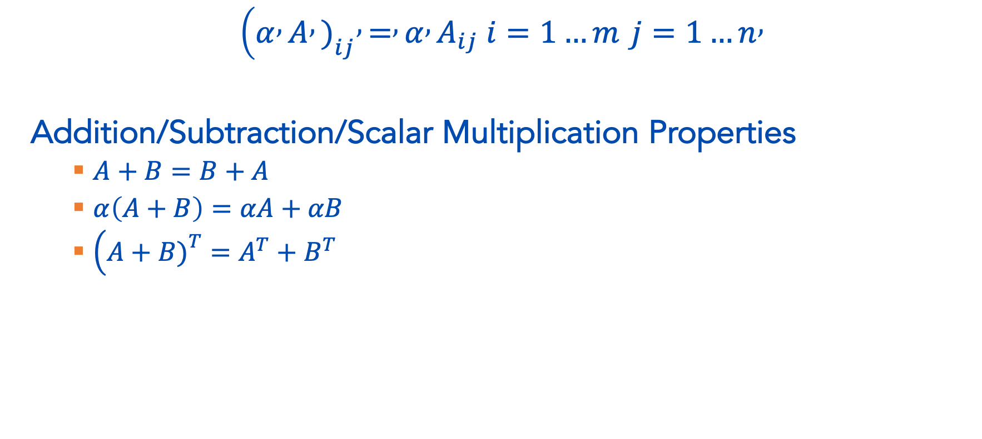
Matrix Operations Scalar Multiplication
$$(α , A , {\left.)\right.}_{ij} , = , α , A_{ij} i=1…m j=1…n,$$
Addition/Subtraction/Scalar Multiplication Properties
  $A+B=B+A$
  $α\left(A+B\right)=αA+αB$
  $\left(A+B{\left.)\right.}^{T}=A^{T}+B^{T}\right.$

Slide 14
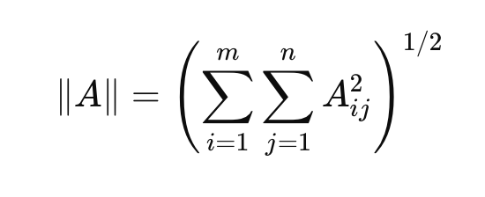
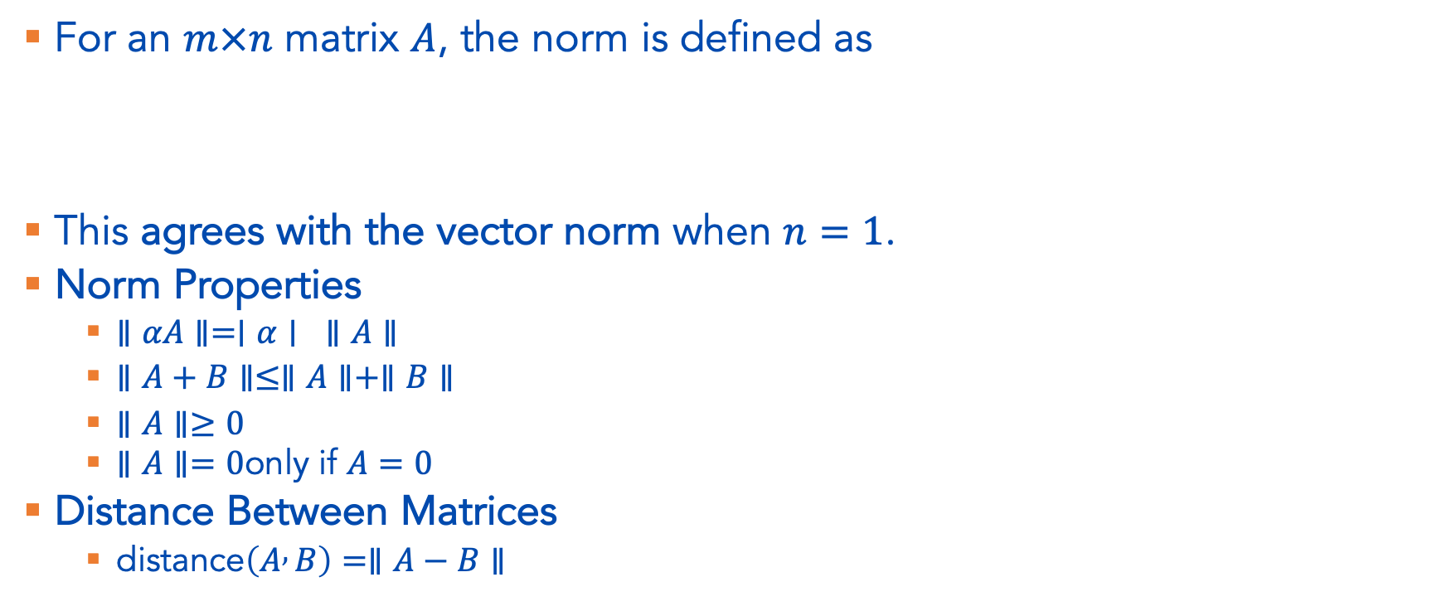
Matrix Operations – Matrix Norm
For an $m×n$ matrix $A$, the norm is defined as
This agrees with the vector norm when $n=1$.
Norm Properties
  $∥αA∥=∣α∣ ∥A∥$
  $∥A+B∥≤∥A∥+∥B∥$
  $∥A∥≥0$
  $∥A∥=0$only if $A=0$
Distance Between Matrices
  $\text{distance}\left(A , B\right)=∥A−B∥$

Slide 15
Matrix-Vector Multiplication(!)
https://www.youtube.com/watch?v=kYB8IZa5AuE&list=PLZHQObOWTQDPD3MizzM2xVFitgF8hE_ab&index=3
[The book provides a different intuition, I like the above better but both may be useful for you!]

Slide 16
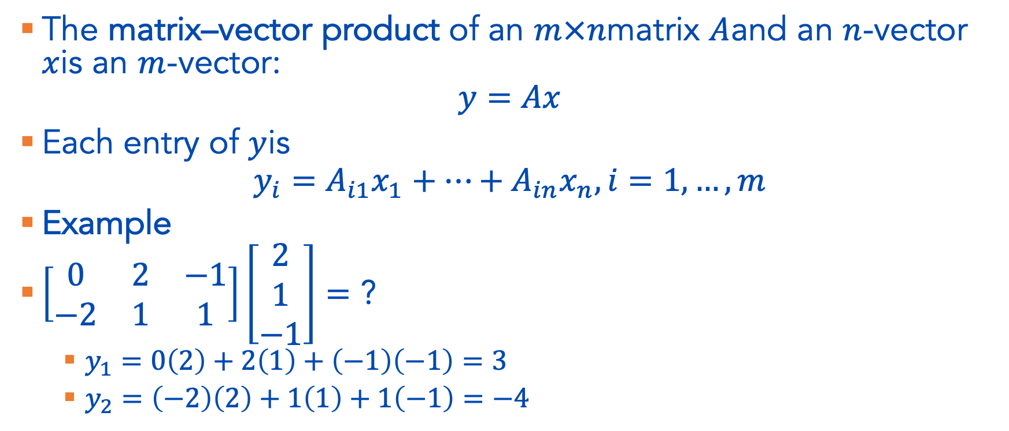
Matrix-Vector Multiplication
The matrix–vector product of an $m×n$matrix $A$and an $n$-vector $x$is an $m$-vector:
$$y=Ax$$
Each entry of $y$is
$$y_{i}=A_{i1}x_{1}+⋯+A_{in}x_{n}, i=1,…,m$$
Example
$\left[\begin{matrix}0 & 2 & −1 \\ −2 & 1 & 1\end{matrix}\right]\left[\begin{matrix}2 \\ 1 \\ −1\end{matrix}\right]=$ ?
  $y_{1}=0\left(2\right)+2\left(1\right)+\left(−1\right)\left(−1\right)=3$
  $y_{2}=\left(−2\right)\left(2\right)+1\left(1\right)+1\left(−1\right)=−4$

