Slide 1
AIS 220
Foundational Mathematics for AI
Lecture 14
Quiz Review and Matrix Multiplication

Slide 2
Quiz Review

Slide 3
Matrix Multiplication
https://www.3blue1brown.com/?v=matrix-multiplication
Practice on the board
More intuition
  https://www.3blue1brown.com/?v=3d-transformations
  https://www.3blue1brown.com/lessons/nonsquare-matrices#title
Even more (but not in class)
  Matrix multiplication is a change of basis
    https://www.3blue1brown.com/lessons/change-of-basis

Slide 4
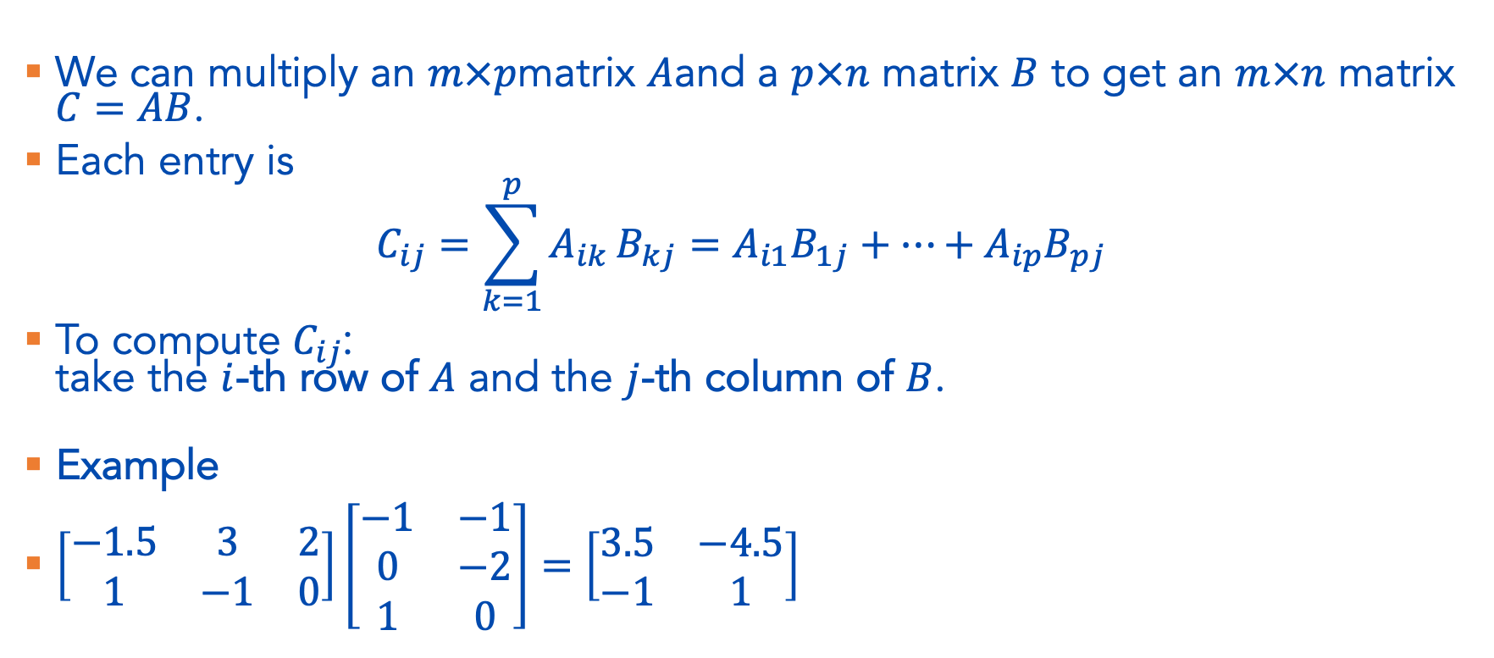
Matrix Multiplication – The lame way
We can multiply an $m×p$matrix $A$and a $p×n$ matrix $B$ to get an $m×n$ matrix $C=AB$.
Each entry is
$$C_{ij}=\sum_{k=1}^{p}{A_{ik}}B_{kj}=A_{i1}B_{1j}+⋯+A_{ip}B_{pj}$$
To compute $C_{ij}$:
take the $i$-th row of $A$ and the $j$-th column of $B$.
Example
$\left[\begin{matrix}−1.5 & 3 & 2 \\ 1 & −1 & 0\end{matrix}\right]\left[\begin{matrix}−1 & −1 \\ 0 & −2 \\ 1 & 0\end{matrix}\right]=\left[\begin{matrix}3.5 & −4.5 \\ −1 & 1\end{matrix}\right]$

Slide 5
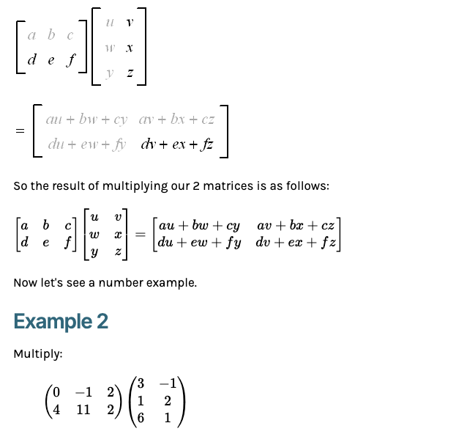
Other potential explanations
https://www.intmath.com/matrices-determinants/4-multiplying-matrices.php

Slide 6
Interpretation Questions
Say we have two matrices A and B, what has to be true about their dimensions in order to multiply them in the form
  AB ?
  BA ?

