Slide 1
AIS 220
Foundational Mathematics for AI
Lecture 15
Matrix Transpose and Motivating Eigen-thingys

Slide 2
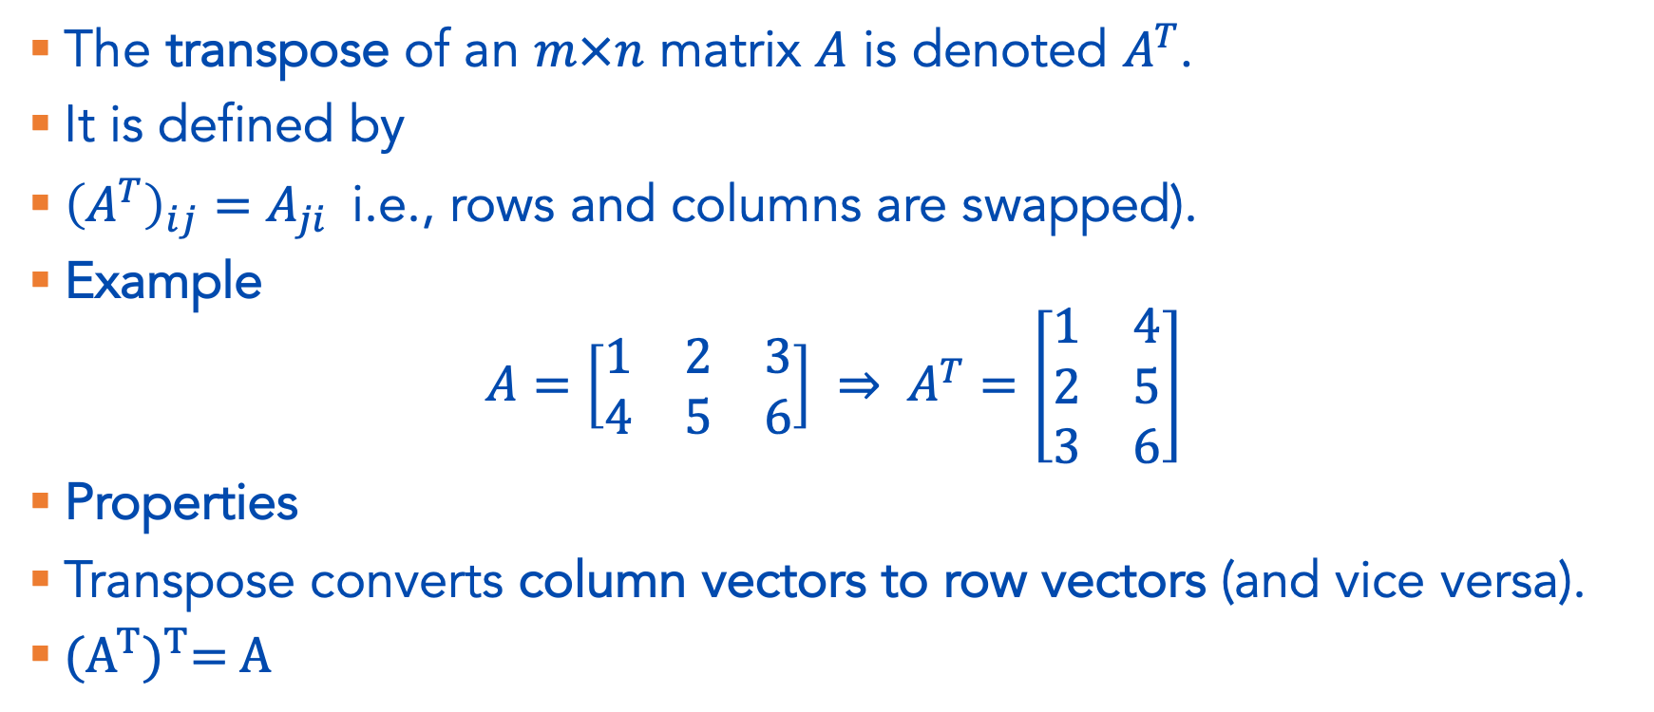
Matrix Operations – the Transpose
The transpose of an $m×n$ matrix $A$ is denoted $A^{T}$.
It is defined by
${\left(A^{T}\right)}_{ij}=A_{ji}$i.e., rows and columns are swapped).
Example
$$A=\left[\begin{matrix}1 & 2 & 3 \\ 4 & 5 & 6\end{matrix}\right] ⇒ A^{T}=\left[\begin{matrix}1 & 4 \\ 2 & 5 \\ 3 & 6\end{matrix}\right]$$
Properties
Transpose converts column vectors to row vectors (and vice versa).
${\text{(}A^{T}\text{)}}^{T}\text{= }\text{A}$

Slide 3
Interpretation Questions
Why do we write the dot product of two vectors a^{T}b?

Slide 4
Where are we at?
Save for a few functions, we now have all the linear algebra we need to understand what transformers do
But! There’s more linear algebra that’s useful in ML more broadly.
And, we probably should talk about the fundamental goal of linear algebra – to solve linear equations ☺

Slide 5
Roadmap I showed you Monday
Other matrix operations
  Determinant (Not covered, but you’re responsible for it)
  Inverse
  Null space
  Column Space
Eigenvectors / Eigenvalues
Systems of equations
… leads us into the ideas of
  Modeling
  Minimizing error
  Optimization
Which take us to the end of the term!

Slide 6
Roadmap
Why is an idea like Eigenvectors useful?
Eigenvectors / Eigenvalues
Why is the ability to solve systems of equations useful?
Systems of equations
  Inverse
  Null space
  Column Space
… leads us into the ideas of
  Modeling
  Minimizing error
  Optimization
Which take us to the end of the term!

Slide 7
https://explosion.ai/demos/sense2vec

Slide 8
Generating Word embeddings

Slide 9
Step 1: Select a corpus

Slide 10
Typical Corpora
Main requirement: corpus is large.
Some common corpora
  News articles
  Common Crawl
  Twitter
  Wikipedia

Slide 11
2. Create co-occurence matrix is to represent entire corpora

Slide 13
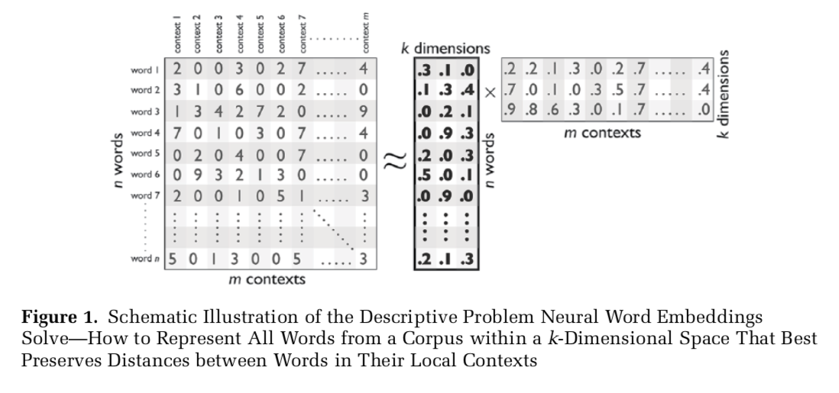

Slide 14
3. Run algorithm (e.g. SGNS, GloVe) to embed words in co-occurance matrix into low dimensional space

Slide 16
Mikolov, T., Yih, W., & Zweig, G. (2013). Linguistic Regularities in Continuous Space Word Representations. HLT-NAACL, 746–751. Citeseer.

Slide 17
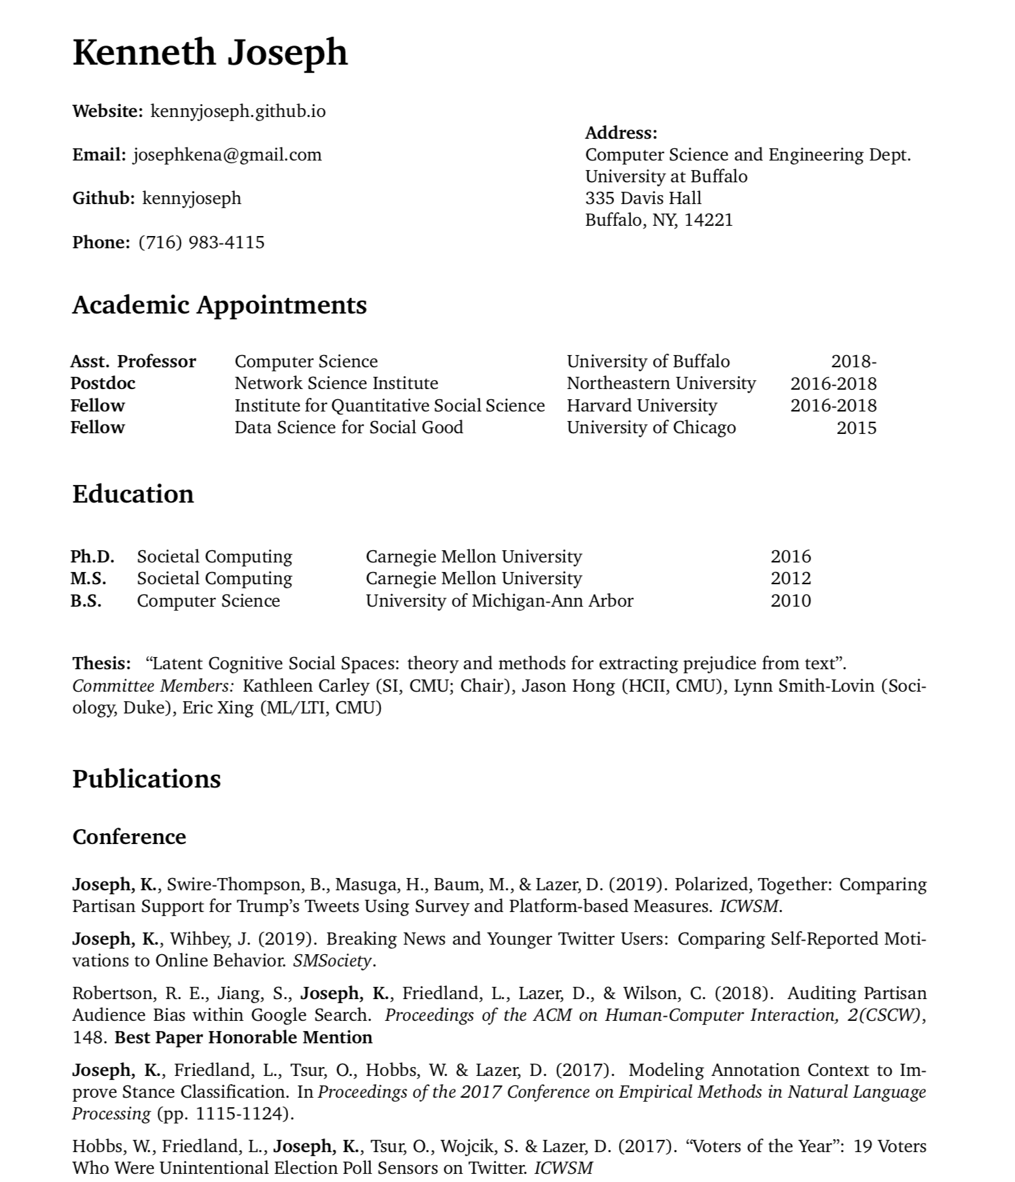

Slide 18
Checking in
We learn word embeddings from large text corpora we find on the internet
We then use them to do a lot of things, like coreference resolution and document classification
Anyone see a potential problem w/ this?

Slide 19
http://wordbias.umiacs.umd.edu/

Slide 20
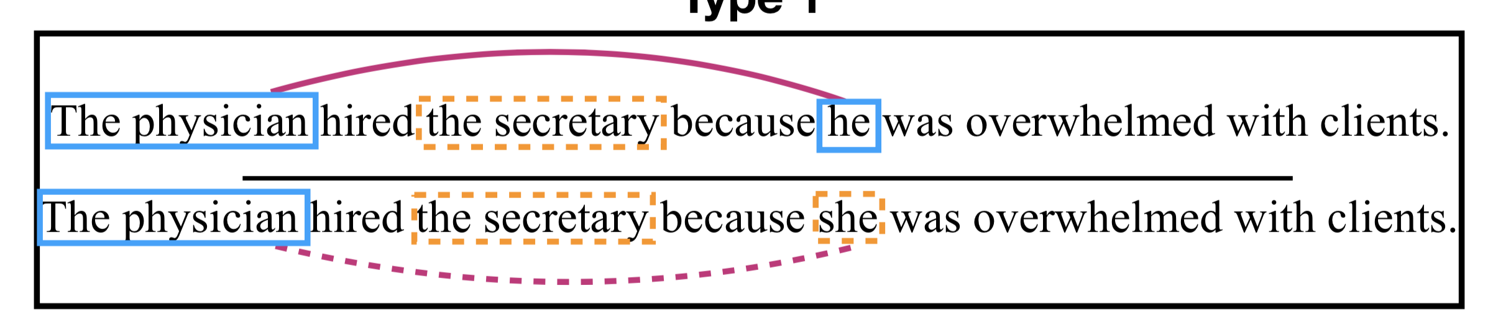
https://huggingface.co/coref

Slide 21
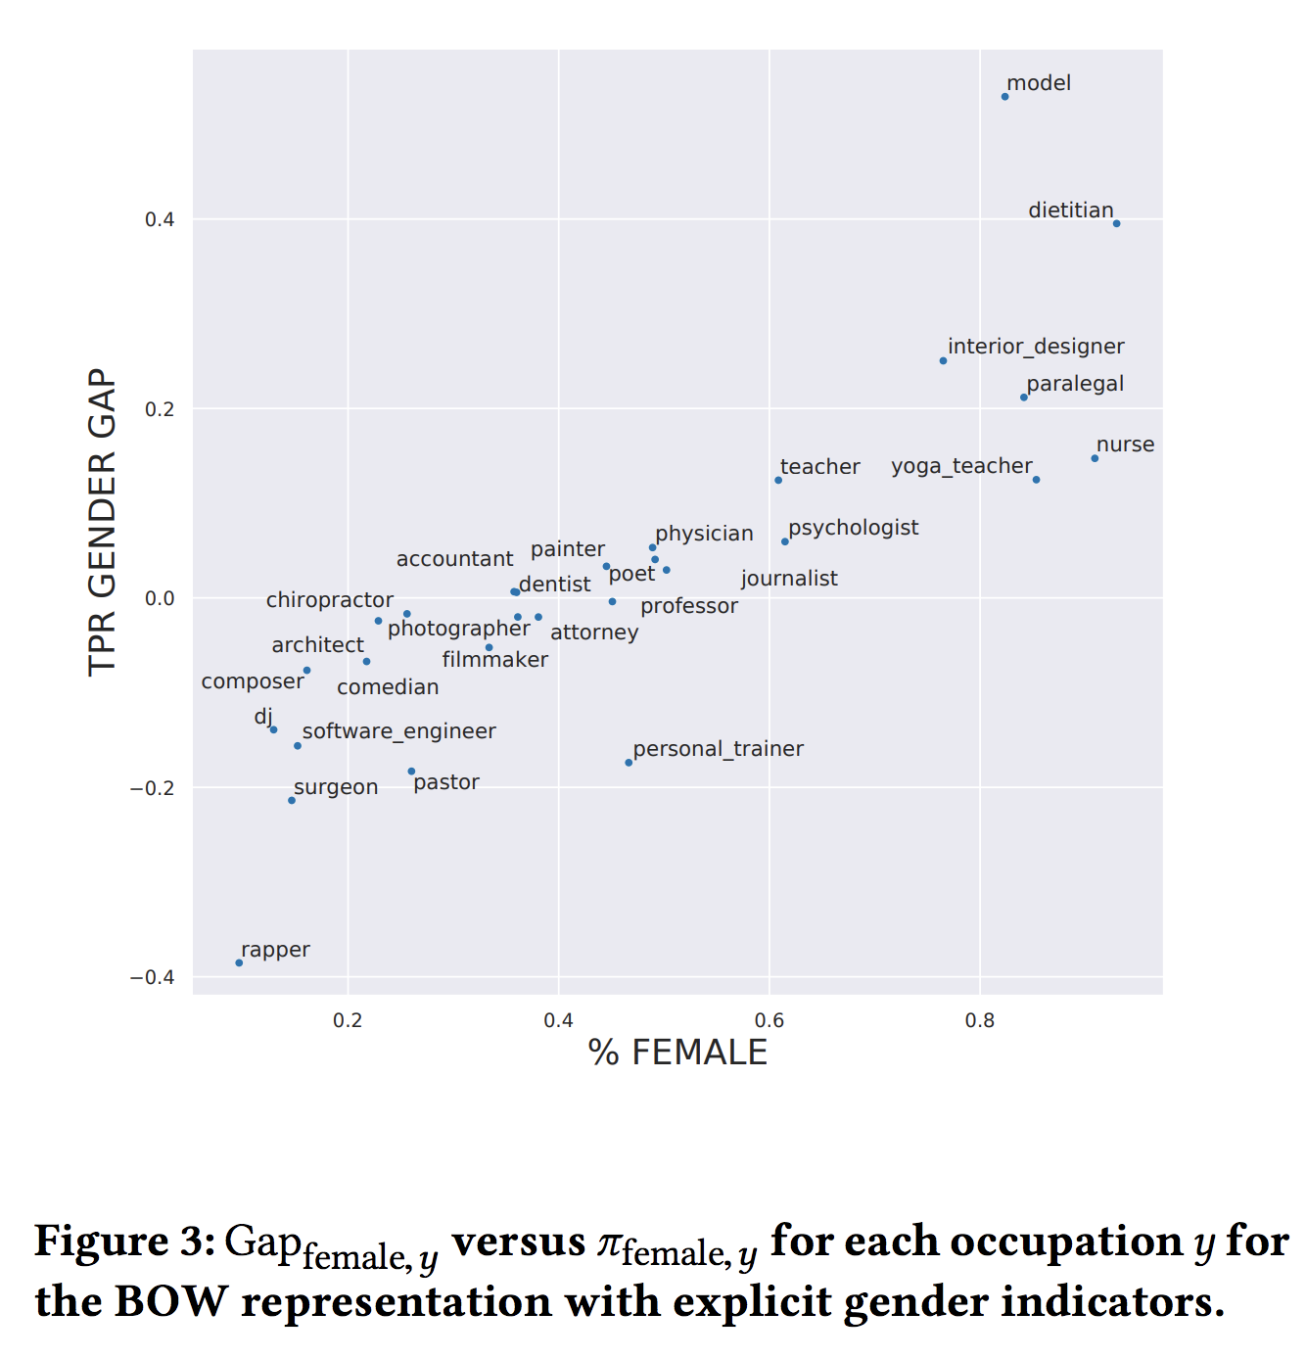
De-Arteaga, M., Romanov, A., Wallach, H., Chayes, J., Borgs, C., Chouldechova, A., ... & Kalai, A. T. (2019, January). Bias in bios: A case study of semantic representation bias in a high-stakes setting. In Proceedings of the Conference on Fairness, Accountability, and Transparency (pp. 120-128). ACM.

Slide 22
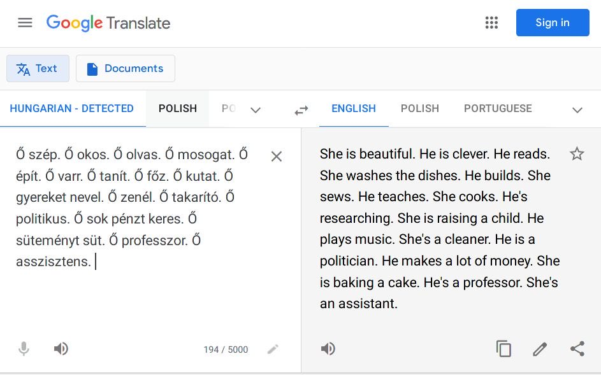

Slide 23
Erg
Now what?
One thought early on – what if we “debias” the embeddings?
But … much more complicated
Take CSE 440 or, soon, some of the AIS classes to learn more ☺

Slide 24
In the context of this class
The word to context matrix contains a lot of redundant information
[What concept do we already have that kind of gets at this?!]
It would be nice if we had a way to shrink the matrix while still maintaining most of the important information
That’s what word embeddings are really doing!
Enter matrix decomposition
  A starting point for decomposition are eigenthing-ys ☺

Slide 25
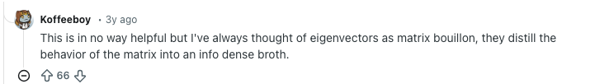
Eigenthingys – Intuition

Slide 26
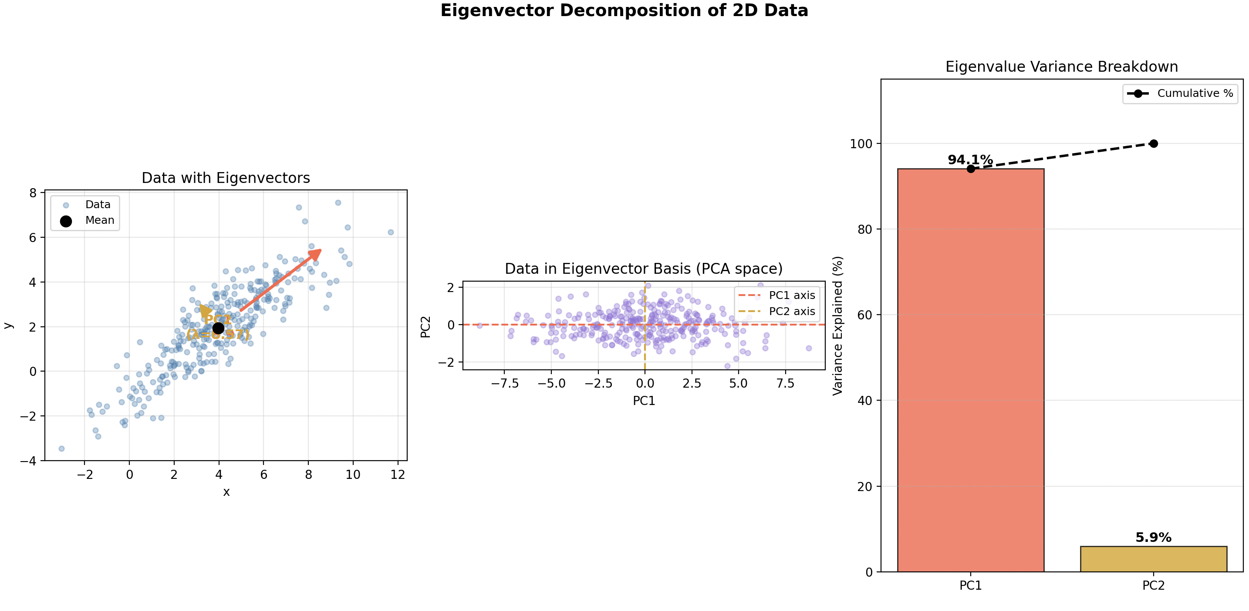
Eigenthingys – Intuition from an ML perspective
https://setosa.io/ev/principal-component-analysis/

Slide 27
[We’re actually doing SVD, not EVD]
… just a reminder, for next class!

